Slide 1

Comparative Security Analysis of Telnet and SSH
Using Network Traffic Capture (Wireshark)
By Vikrant

Slide 2

Introduction
Telnet and SSH are remote login protocols.
Telnet transmits data in plain text, while SSH encrypts all communication.
This project demonstrates why Telnet is insecure and SSH is secure.

Slide 3

Tools & Environment
- Kali Linux
- Telnet
- OpenSSH
- Wireshark
- Virtualized Lab Environment

Slide 4

Telnet Service Configuration
Telnet service enabled using inetd for demonstration purposes.

Slide 5
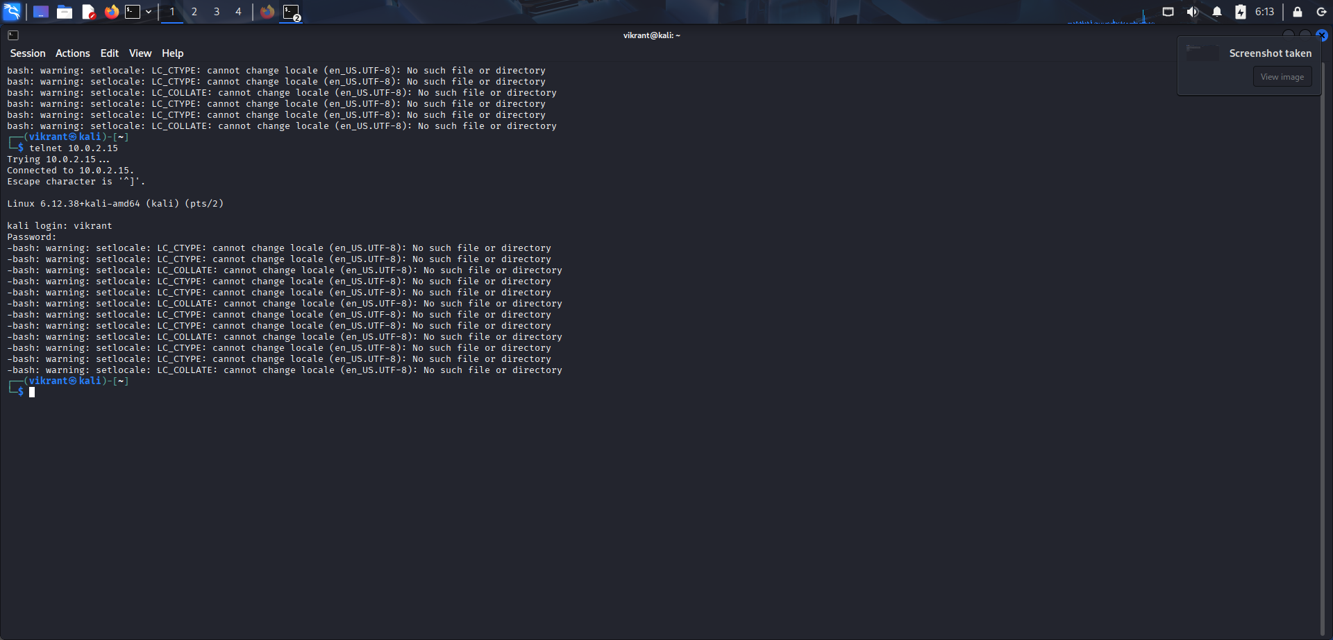
Telnet Login Demonstration
User successfully logged in using Telnet (insecure remote access).

Slide 6
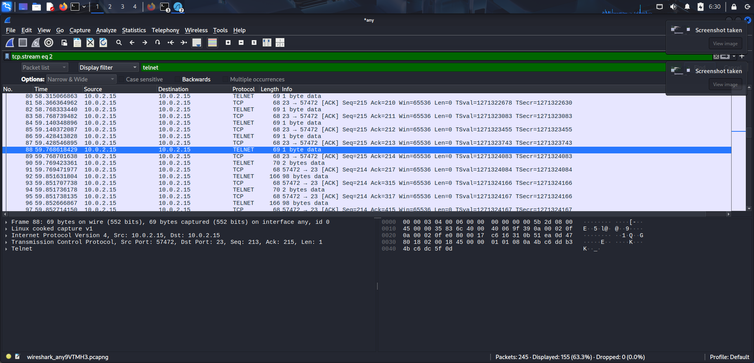
Telnet Traffic Capture in Wireshark
Wireshark capturing Telnet packets on port 23.

Slide 7
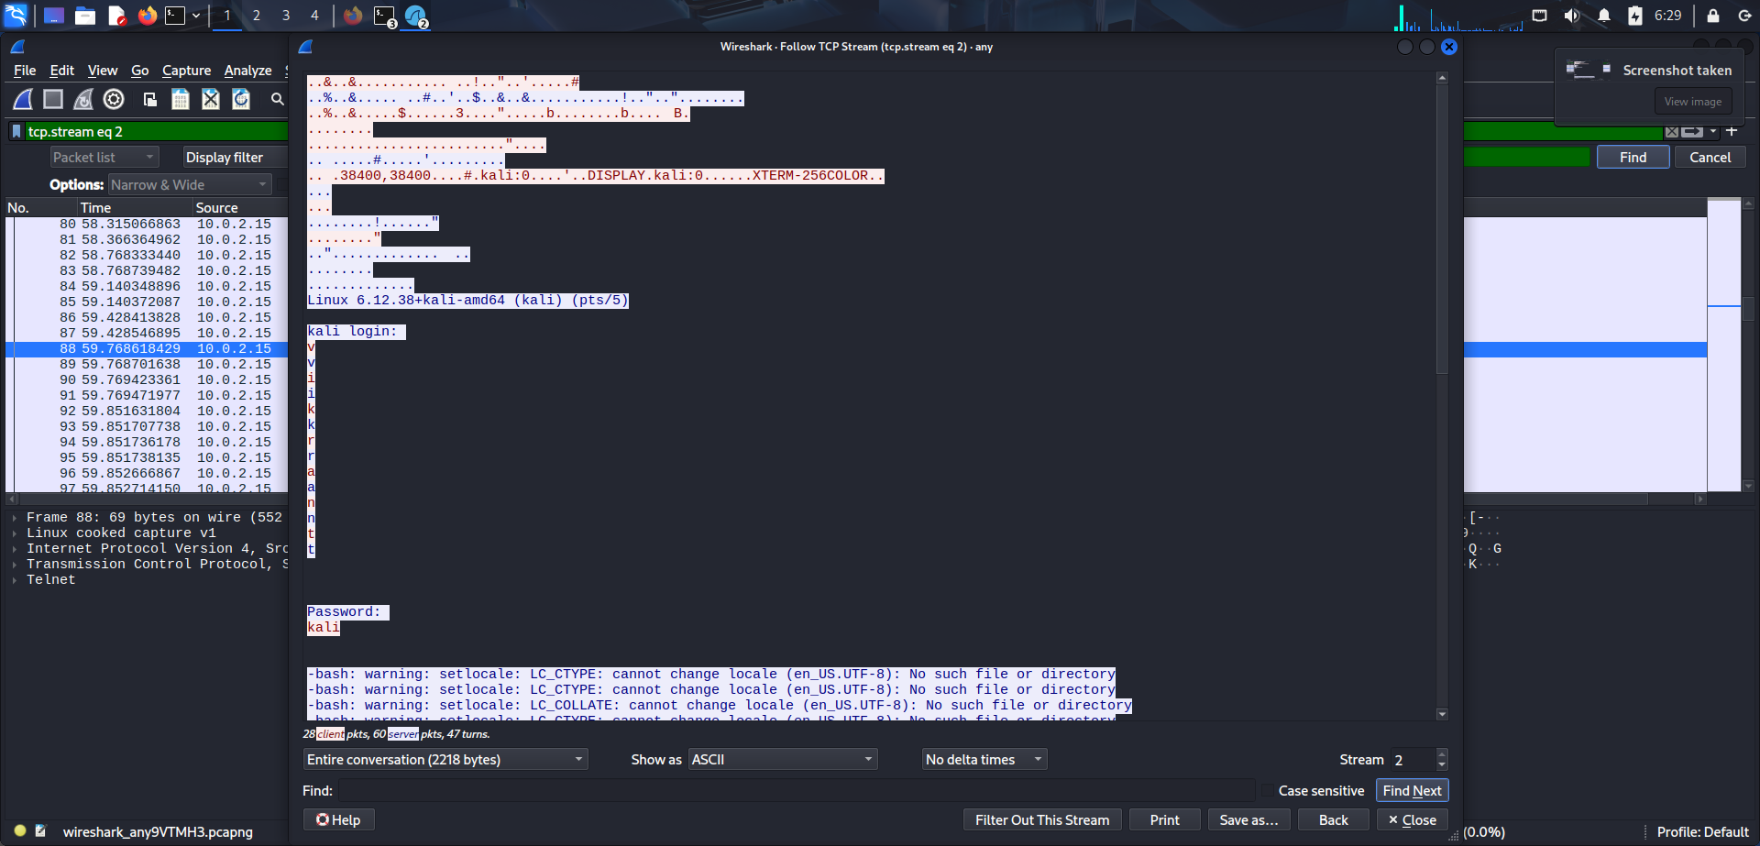
Telnet Credentials Visible in Plain Text
Username and password are clearly visible in Wireshark (Follow TCP Stream).

Slide 8
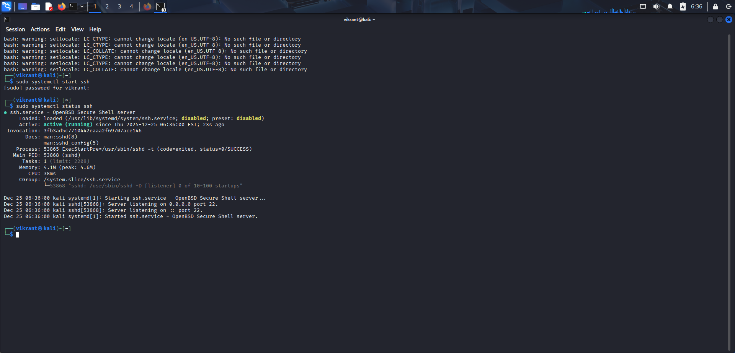
SSH Service Configuration
SSH service started and running securely on port 22.

Slide 9
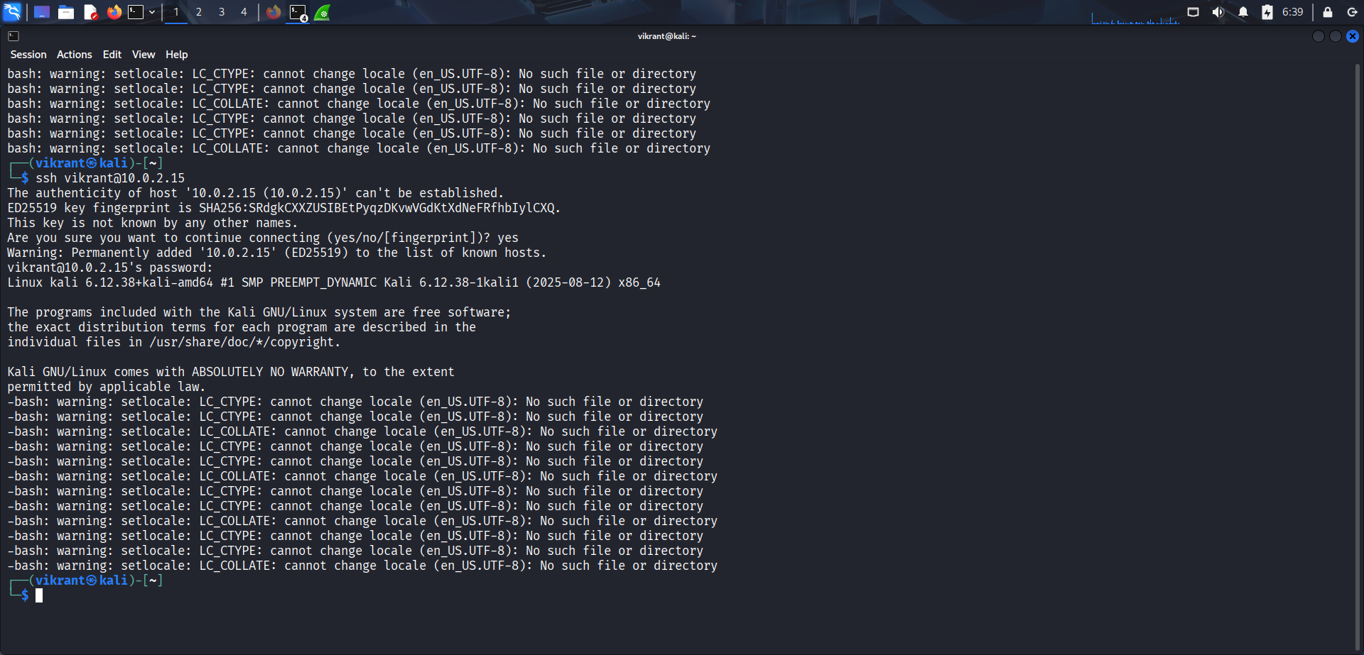
SSH Login Demonstration
User successfully logged in using SSH (secure remote access).

Slide 10
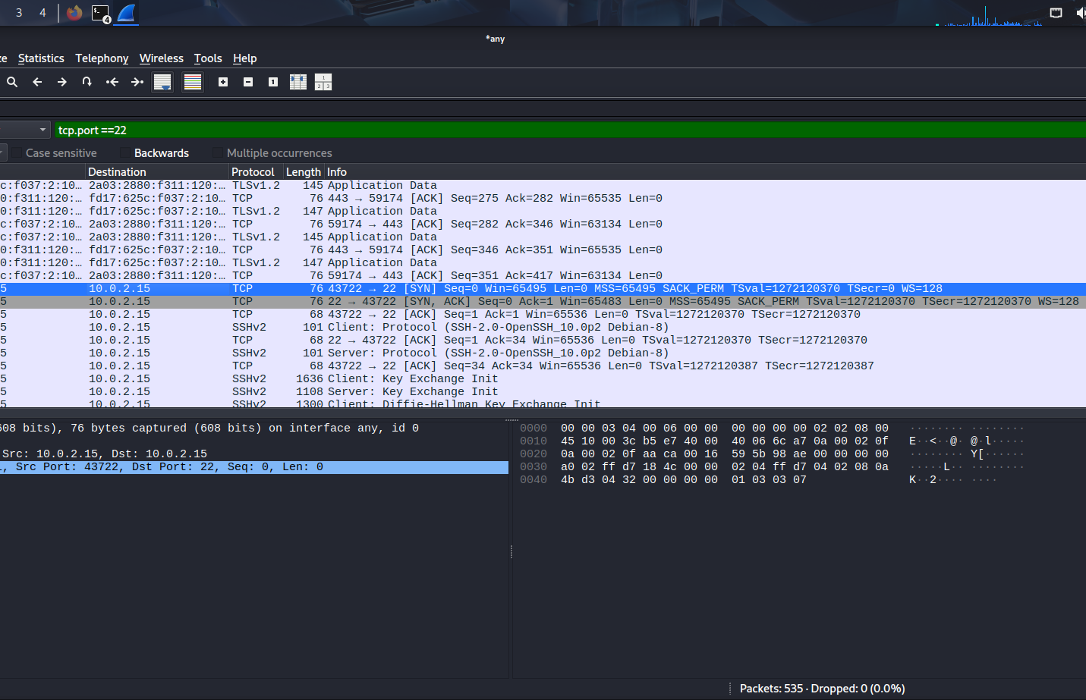
SSH Traffic Capture in Wireshark
Wireshark capturing SSH encrypted packets.

Slide 11
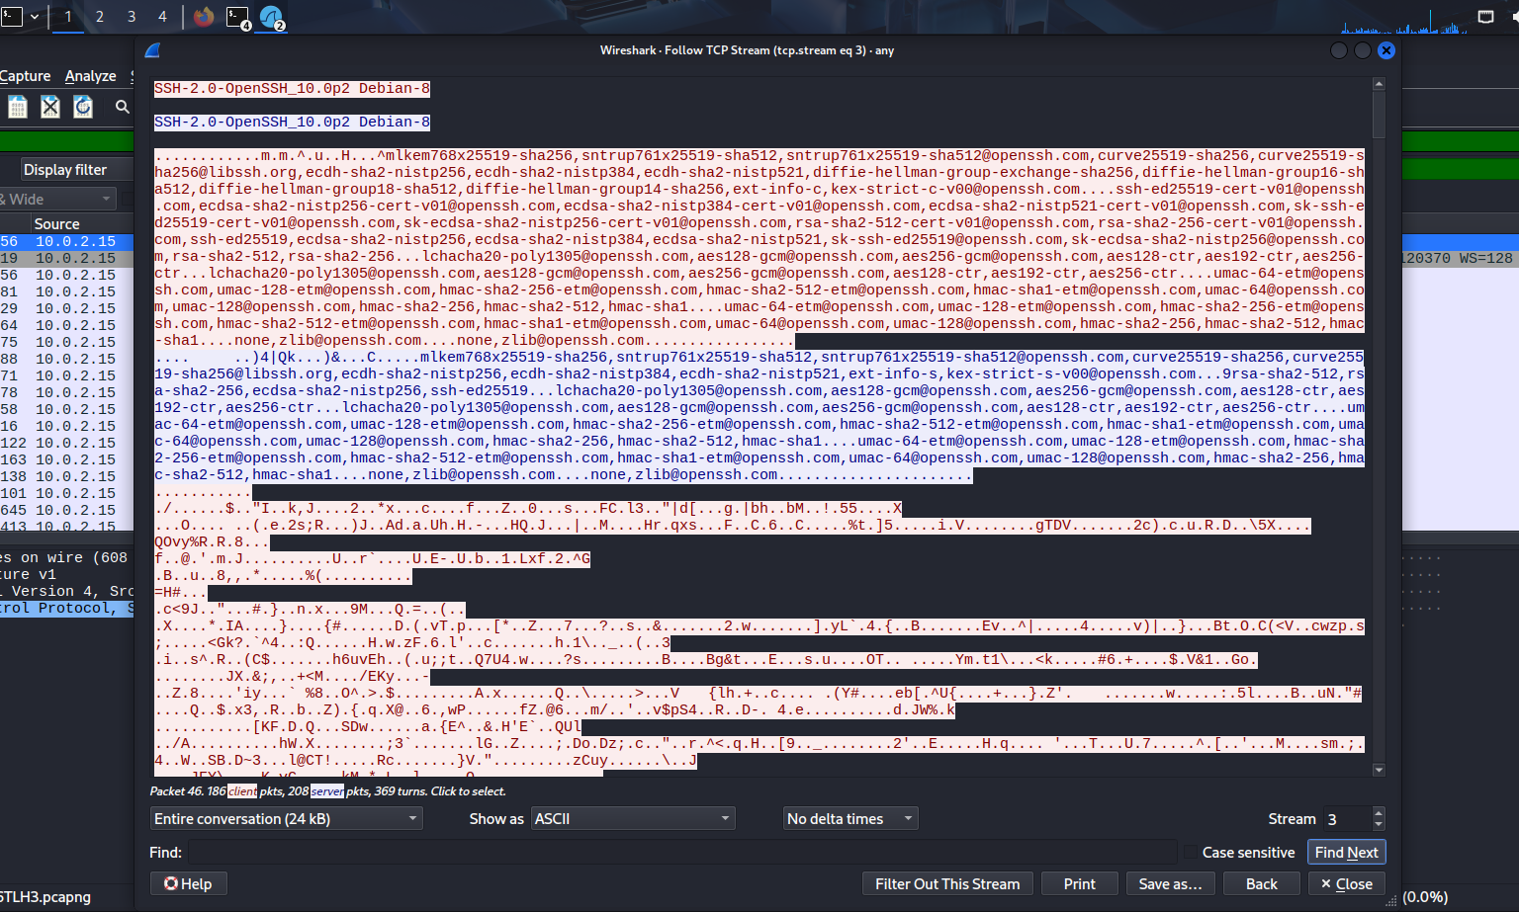
SSH Data is Encrypted
No readable credentials visible – SSH traffic is encrypted.

Slide 12

Comparison: Telnet vs SSH
Telnet:
- No encryption
- Credentials visible
- Insecure
SSH:
- Encrypted communication
- Credentials hidden
- Secure & recommended

Slide 13
Conclusion
This experiment proves that Telnet is insecure because it transmits data in plain text.
SSH encrypts all communication and is the industry-standard secure remote access protocol.

