Slide 1
Privacy Preserving ML
Federated Learning
Differential Privacy
Homomorphic Encryption
Trusted Exection Environments
Romeo Kienzler
IBM CODAIT
IBM Center for Open Source Data and AI Technologies

Slide 2






state of the art
query
data

Slide 3
Problem #1
data privacy

Slide 4
Problem #2
competitive advantage / information cartels

Slide 5

homomorphic encryption
fhe(query)
fhe(data)

Slide 6
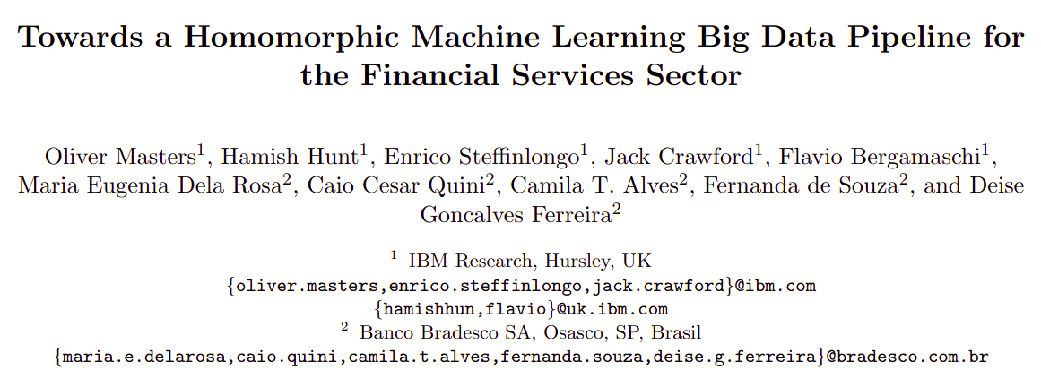

Slide 7
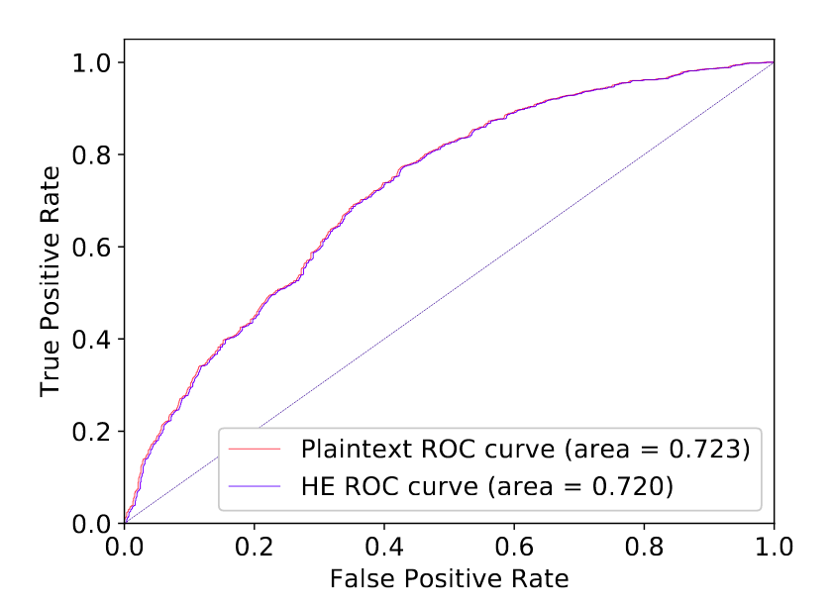

Slide 8
https://github.com/homenc/HElib

Slide 9
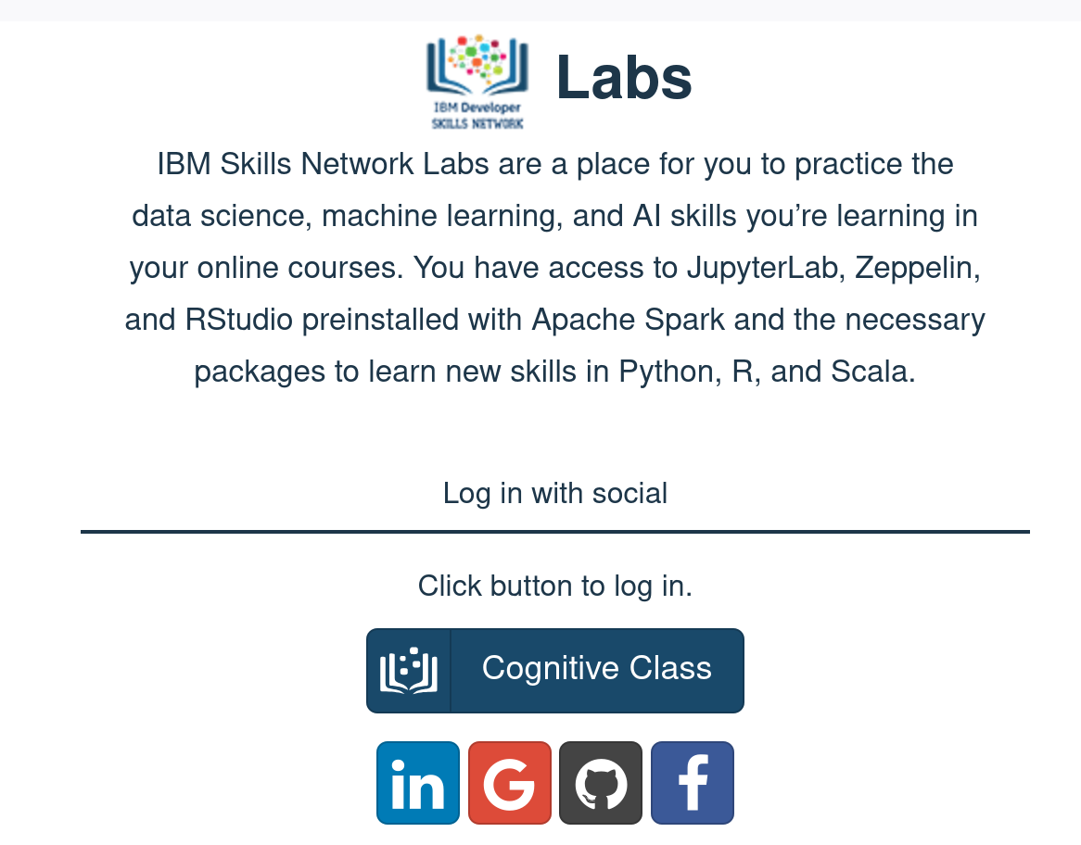
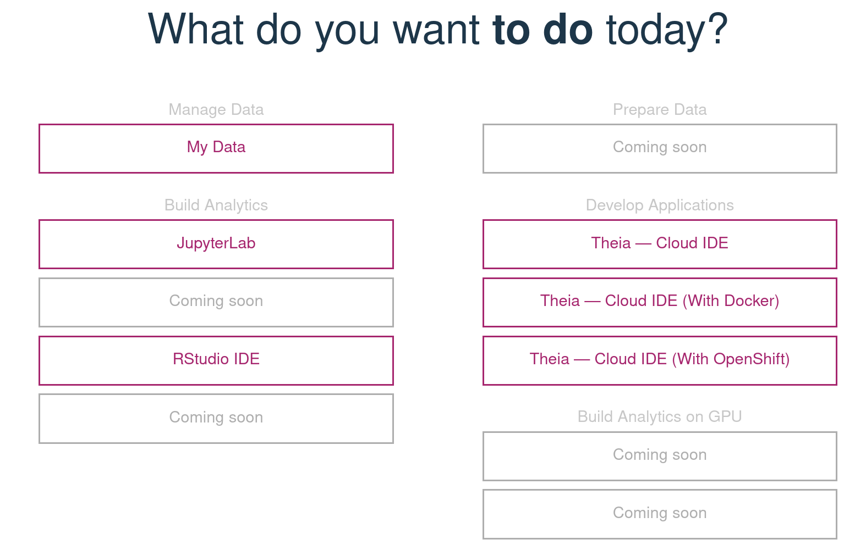
Lab 1: Homomorphic Encrytion
https://github.com/romeokienzler/ppml
he_1.ipynb
labs.cognitiveclass.ai

Slide 10
federated learning
query
data

Slide 11

Device 1
Device 2
Device 3
1
3
5
2
4
6

Slide 12
Device 1
Device 2
Device 3
1
3
5
2
4
6
1.5
3.5
5.5

Slide 13
Device 1
Device 2
Device 3
1
3
5
2
4
6
1.5
3.5
5.5
10.5
/3
3.5

Slide 14
Device 1
Device 2
Device 3
1
3
5
2
4
6
1.5
1.5+3.5
5+5.5
10.5
/3
3.5

Slide 15
data parallelism
aka. “Jeff Dean style” parameter averaging
Parameter Server
Model A
Model A
Model A
Node 1
Node 2
Node 3
P1
P2
P3

Slide 16
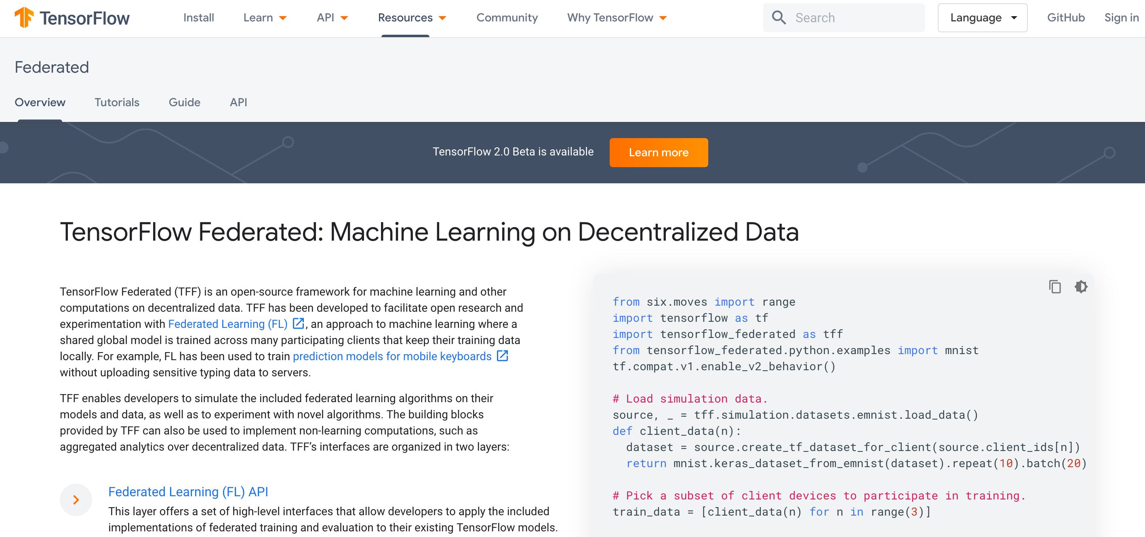

Slide 17
Lab 1: Homomorphic Encrytion
https://github.com/romeokienzler/ppml
fl_1.ipynb

Slide 18
differential privacy
Federated Learning Idea:
Share aggregates only

Slide 19
differential privacy
Problem:
https://en.wikipedia.org/wiki/Reconstruction_attack

Slide 20
differential privacy
Example:
Sales by County + Sales by LOB + Total Sales
May reveal sales of entities which are alone in a LOB/county combination

Slide 21
differential privacy
Conclusion:
No privacy without noise

Slide 22
ε-differential privacy
Summary:
Calibrating noise to sensitivity in private data analysis.

Slide 23
ε-differential privacy
In other words:
The more individuals are involved in an aggregate, the less noise needs to be added

Slide 24
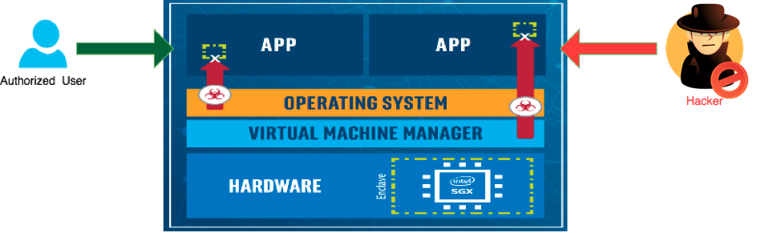
Intel SGX
(Software Guard Extensions)

Slide 25
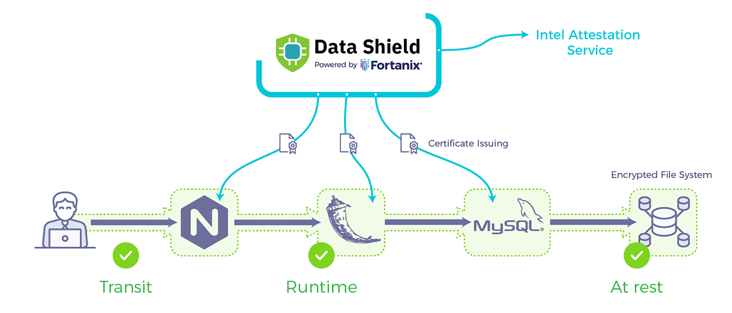
IBM Data Shield

Slide 26
Problem #1
data privacy

Slide 27

Problem #1
data privacy

Slide 28
Problem #2
competitive advantage / information cartels

Slide 29
Problem #2
competitive advantage / information cartels

Slide 30
…discussion…
(questions, comments, additions, complaints, suggestions, feedback, ...)

