Slide 1
The open source serverless data lakehouse - the next evolution in big data
romeo kienzler
19th of Oct 2022, for Baselone.ch

Slide 2
CREDITS
Torsten Steinbach (torsten@de.ibm.com) – CTO Big Data in Cloud, IBM
July 2022
https://community.ibm.com/community/user/cloud/viewdocument/modernize-your-big-data-analytics-w https://ibm.co/3ySkeTI

Slide 3
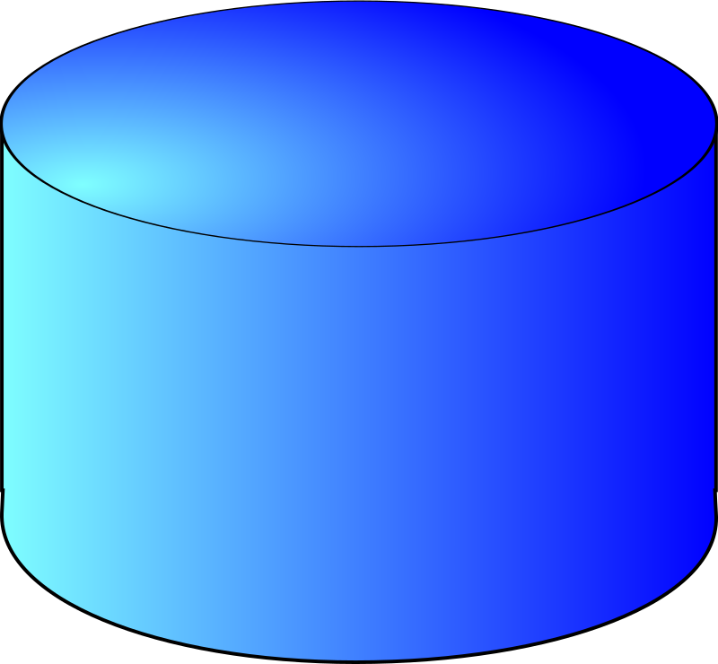
Enterprise Data Warehouses (Level 1)
RDBMS
ETL
RDBMS
RDBMS
RDBMS

Slide 4

Hadoop Data Lakes (Level 2)
Map Reduce
PIG
HIVE
HDFS
HBASE

Slide 5
Cloud Data Lakes (Level 3)
SPARK
PRESTO
Cloud Object Store (S3)
IMPALA

Slide 6
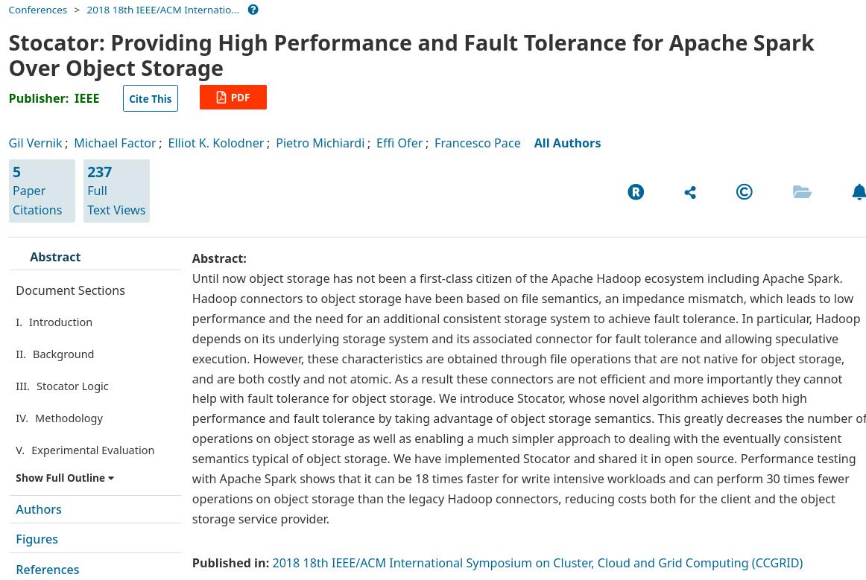

Slide 7
Evolution of Big Data Systems
Data Lakehouses
Cloud Data Lakes
Hadoop Data Lakes
Enterprise Data Warehouses
The 90-ies
2000
2015
Today

Slide 8
Data Lakehouses (Level 4)
ACID
RDBMS
SPARK
ETL
PRESTO
RDBMS
Cloud Object Store (S3)
Apache Iceberg
Deltalake
RDBMS

Slide 9

From Data Lake to Data Lakehouse
Analytics
Explore
Prep
Enrich
Optimize
Batch Query
Interactive Query
Transactional Consistency
ML
Telemetry Data
Streaming
Cloud Data Lakehouse
Cloud Data Lake
DWH
ETL
???
ETL or CDC Replication
Seamless Elasticity
Seamless Scalability
Highly Cost Effective
Long Term Retention
Any data formats
Response Time SLAs
Warm High-quality Data
Databases

Slide 10
Technology support
Storage
Cloud Object Store
IBM Cloud Object Storage, Amazon S3, Azure Blob Store, Google Cloud Storage
On-prem
CEPH, MINIO
HDFS, IBM GPFS
Catalog
HIVE Metastore
Nessie
Table Container
Hive, ORC, Deltalake, Apache Iceberg

Slide 11


IBM Cloud Data Engine (Level 3)
Data Processing
New
Table Catalog
+
=
Data Engine
Aka: SparkSQL + Hive Metastore aaS (Serverless)

Slide 12
Data Engineers
Data Analysts
Data Scientists
IBM Data Fabric
100% Self service, No Setup
100% API enabled
IBM Cloud Data Engine
100% Pay-as-you-go (5$/TB)
Supports ad-hoc inference of unknown data structures
Data Ingestion
(Stream Landing)
New
Data Transformation
(SQL ELT)
Batch Analytics
(SQL Queries)
Table Catalog
(Hive Metastore)
+
+
+
Stream Ingestion
Flexible ELT for data prep
Data Skipping Indexing
Cloud Data
Built-In Table Catalog
Object Storage
RDBMS
Serverless Big Data Scale-Out with Spark

Slide 13




Connect Spark with IBM Data Engine
1. Ingest & Prepare Data
2. Define Data Model
3. Spark Jobs
on the Data Model
Cloud Pak for Data
Custom
Read Table Metadata
Analytics Engine
Watson Studio
Data Engine
Write Data
Read Data
Cloud Object Storage

Slide 14
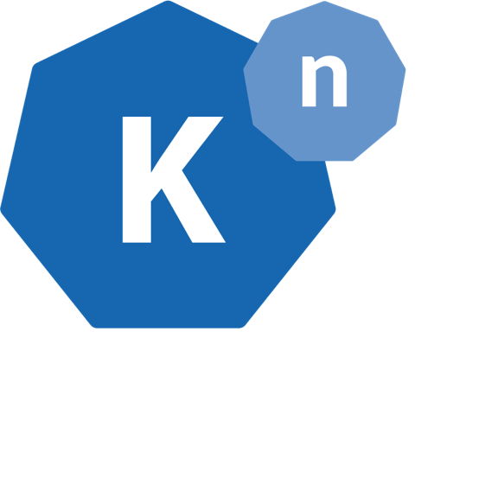
Serverless Engine Stack for Analytics
Degree of Developer Abstraction
SQL & Catalog
Custom Spark
Runs On
SQL+Catalog Service
(Data Engine)
Custom Code
Custom Code
Runs On
Spark aaS (Analytics Engine)
Custom App
(Cloud Native)
Runs On
FaaS / Knative (Code Engine)
Runs On
Kubernetes Service (Redhat OpenShift / IBM IKS)
Custom App
Virtual / Bare Metal machines

Slide 15






IBM Cloud Real-Time Data Architecture
Spark
PrestoDB
Dremio Sonar
Trino
…
Real-Time Queries
Batch Queries
Interactive Queries
ICD
Event Streams
Data Engine
Object Storage
Stream Xform & Joins
Real-Time Enrichment
ETL & Data Preparation
CDC / Debezium
Stream data landing
Metadata
Kafka Schema Registry
Iceberg
Deltalake
Hudi
Hive Metastore
Indexes
Key Mapping

Slide 16
Future work:
Level 3 + ACID + real-time queries = Level 4

Slide 17
Thank YOU!
https://github.com/IBM/claimed https://github.com/IBM/claimed/blob/master/component-library/transform/spark-sql-interactive.ipynb

