Slide 1
Deep Learning in Genomics
The case for domain – agnostic modeling
romeo kienzler
IBM
Center for Open Source Data and AI Technologies
https://www.ibm.com/opensource/centers/codait/
https://github.com/romeokienzler/me

Slide 2
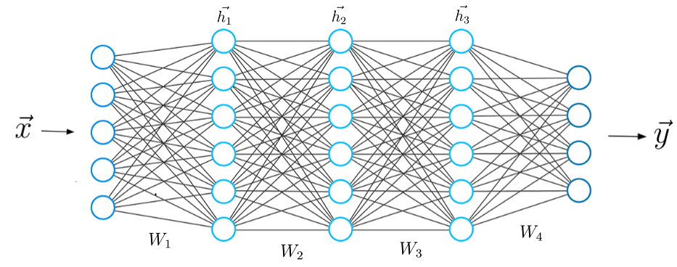
Friendly Reminder
Image Source: https://towardsdatascience.com/what-is-deep-learning-and-how-does-it-work-2ce44bb692ac

Slide 3
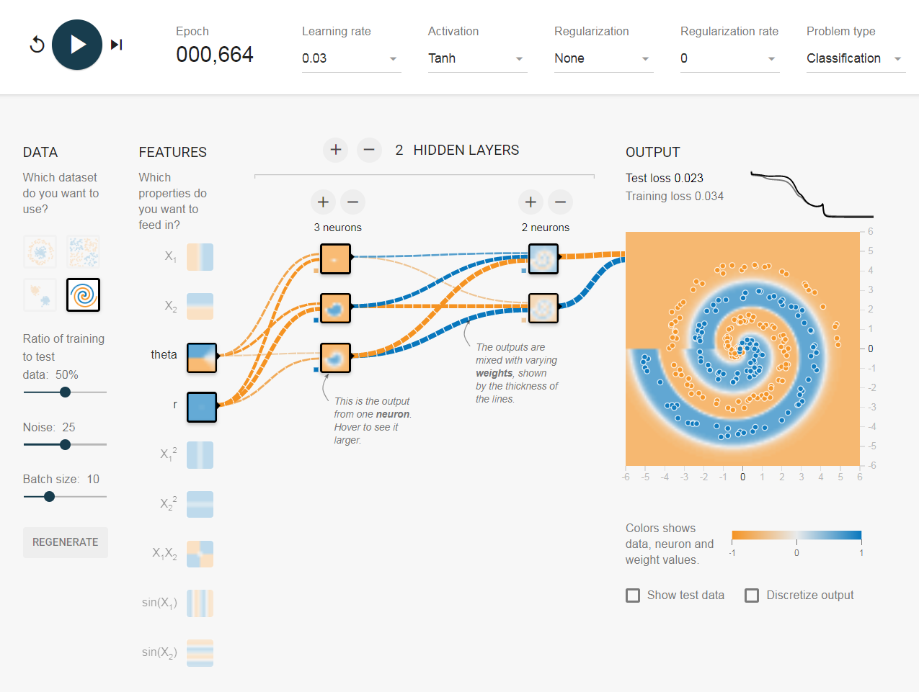
Friendly Reminder (Universal Function Approximator Theorem)
Image Source: https://playground.tensorflow.org

Slide 4

Friendly Reminder (CNN)
Image Source: https://playground.tensorflow.org

Slide 5
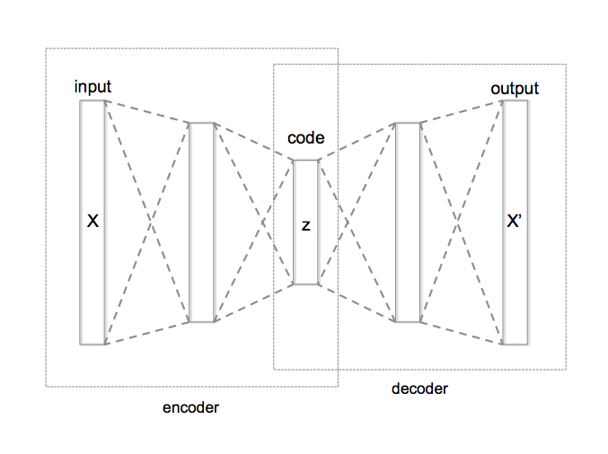
Friendly Reminder (Autoencoder)
By Chervinskii (Own work) [CC BY-SA 4.0 (https://creativecommons.org/licenses/by-sa/4.0)], via Wikimedia Commons

Slide 6
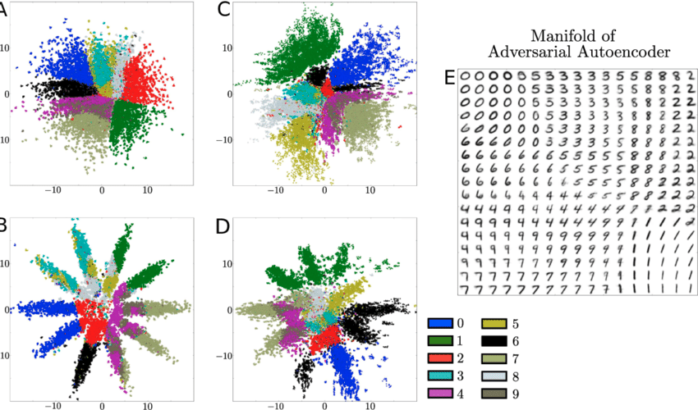
Friendly Reminder (Autoencoder)
https://www.researchgate.net/figure/Comparison-of-adversarial-and-variational-autoencoder-on-MNIST-The-hidden-code-z-of-the_fig3_284219537

Slide 7
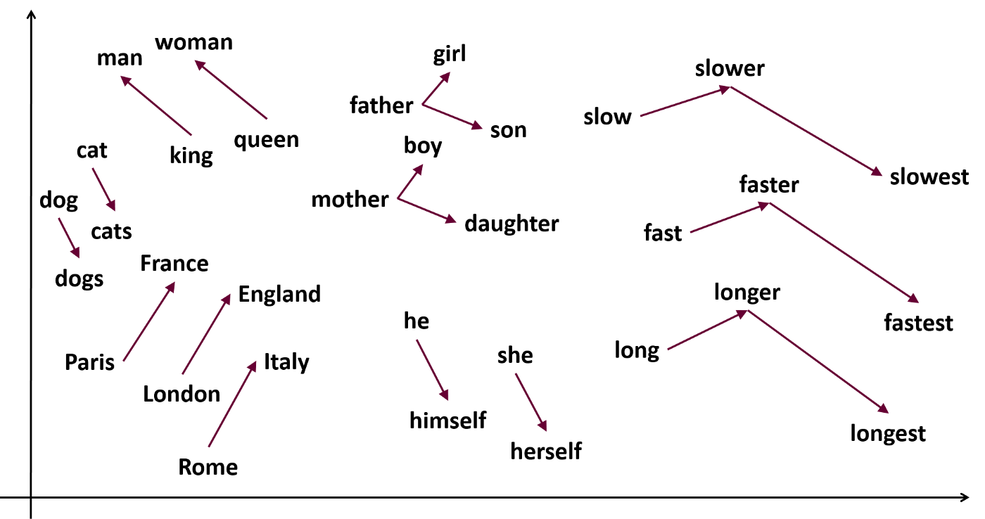
Friendly Reminder
(Word Embeddings, Word2Vec)
https://medium.com/analytics-vidhya/implementing-word2vec-in-tensorflow-44f93cf2665f

Slide 8
Friendly Reminder
(Word Embeddings, Word2Vec)

Slide 9
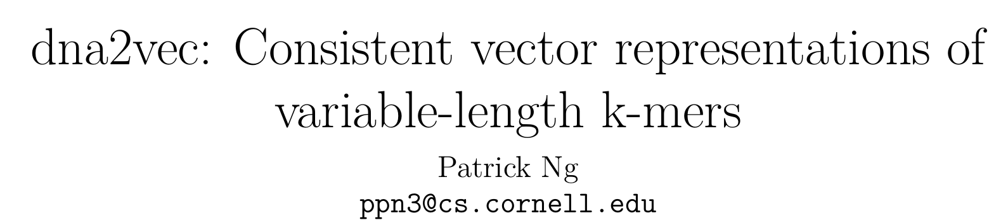

Slide 10
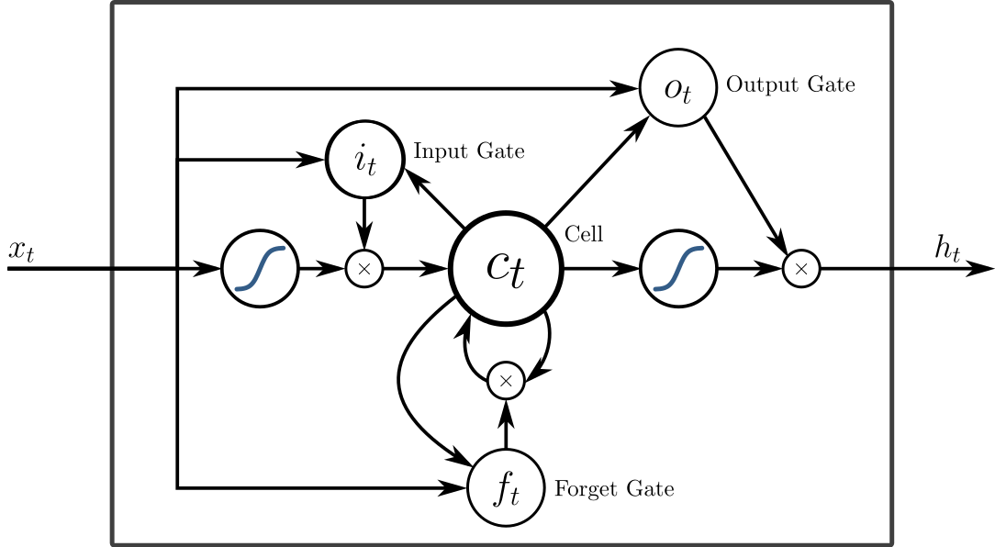
Friendly Reminder (LSTM)
By https://commons.wikimedia.org/wiki/User:BiObserve (Raster version previously uploaded to Wikimedia) Alex Graves, Abdel-rahman Mohamed,
and Geoffrey Hinton (original)
Eddie Antonio Santos (SVG version with TeX math) [CC BY-SA 4.0 (https://creativecommons.org/licenses/by-sa/4.0)], via Wikimedia Commons

Slide 11
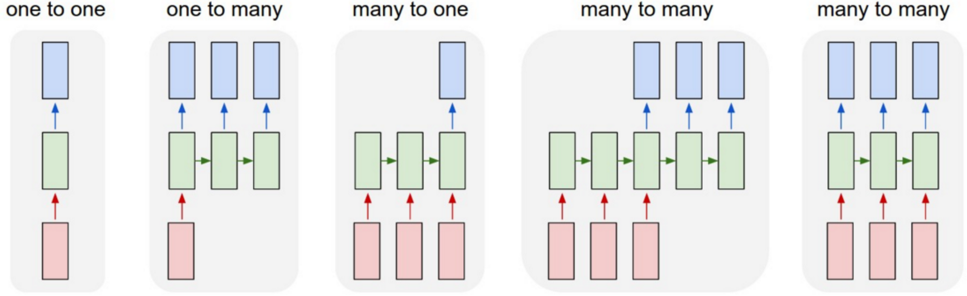
Friendly Reminder (LSTM)
Image Source: http://karpathy.github.io/2015/05/21/rnn-effectiveness/

Slide 12
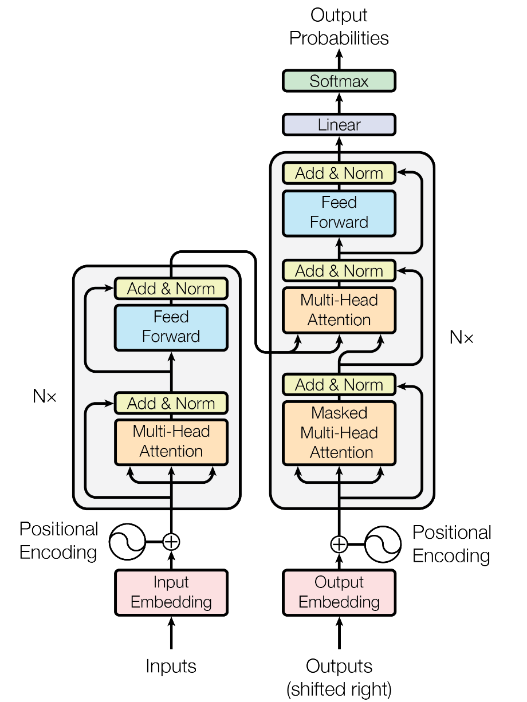
Friendly Reminder (Transformer)
Problem in state-of-the-art:
Complexity to relate distant signals grows linearly or logarithmically
https://arxiv.org/abs/1706.03762

Slide 13
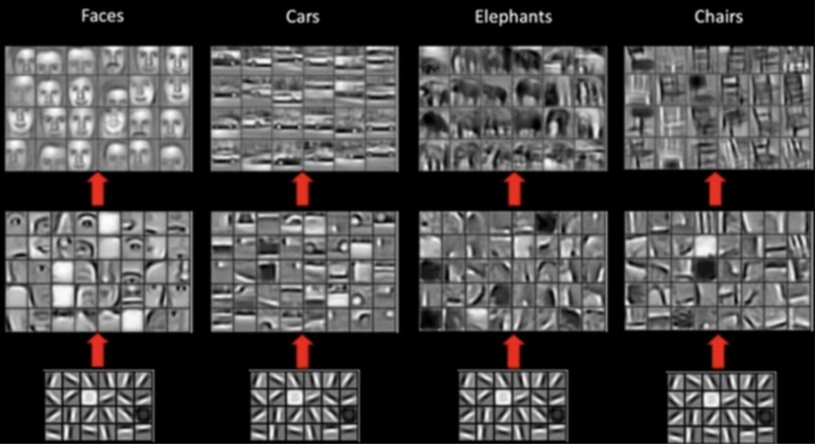
Friendly Reminder
Image Source: https://www.topbots.com/advanced-topics-deep-convolutional-neural-networks/

Slide 14
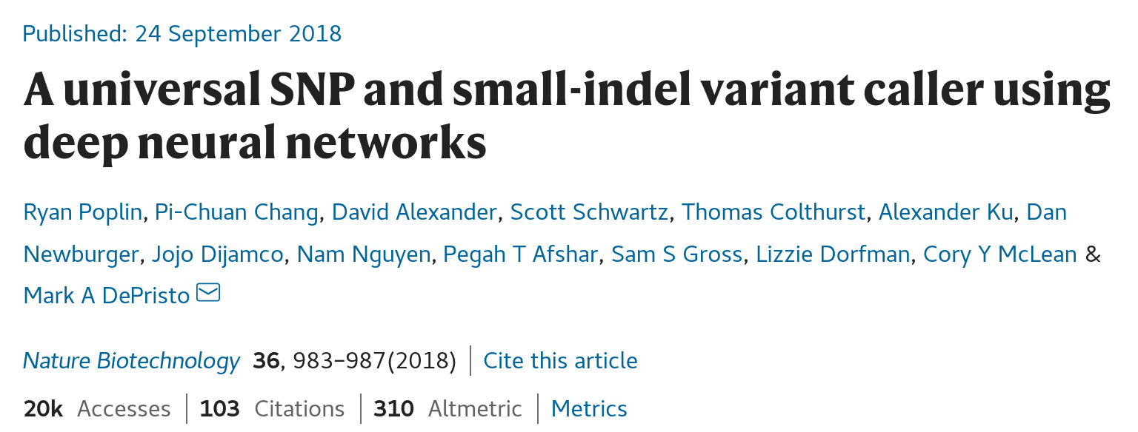
Deep Variant
Image Source: https://www.nature.com/articles/nbt.4235

Slide 15
Deep Variant
Problem 1: Up to 10% of error in DNA sequencing reads
Problem 2: Complex systemic errors
State of the art: GATK
- base error modeling with Logistic Regression
- read likelihood estimation with HMM
- variant identification with Naive Bayes classification
- false positive identification with Gaussian Mixture Models and hand-crafted features
Problem 3: Lot’s of manual tuning necessary for target platform (e.g. Illumina)

Slide 16
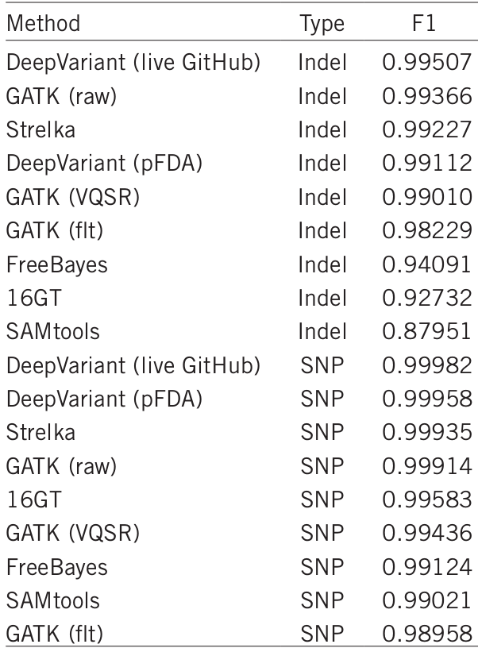
Deep Variant
Solution:
- Create pileup images (6d tensors)
- Train classifier with known variants
- Predict variant based on reads
- Generalizes beyond training data
(e.g. female training, male scoring genomes)
Image Source: https://www.nature.com/articles/nbt.4235
Image Source:https://google.github.io/deepvariant/posts/2020-02-20-looking-through-deepvariants-eyes/

Slide 17
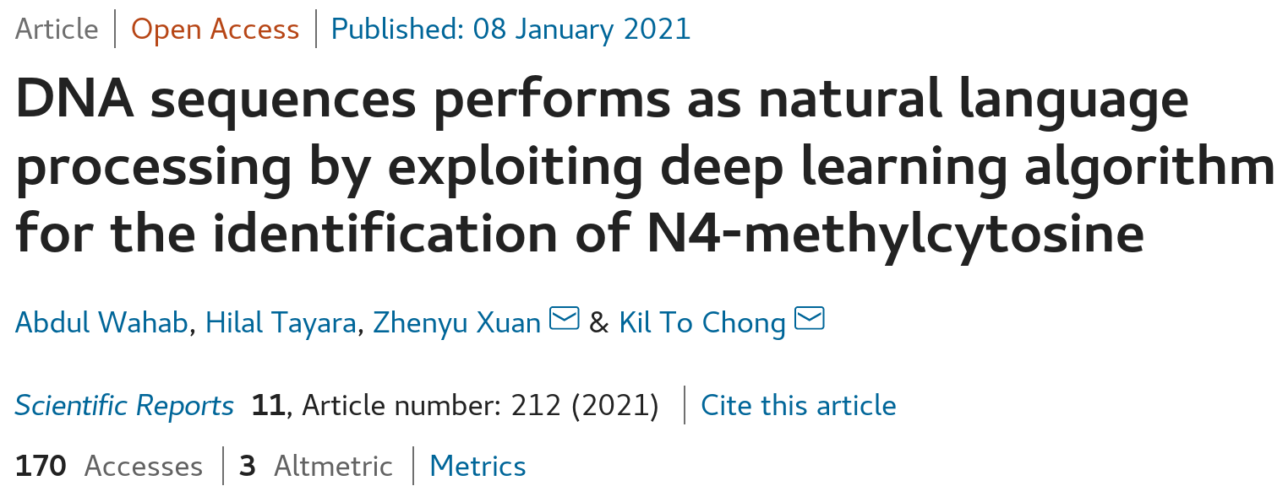
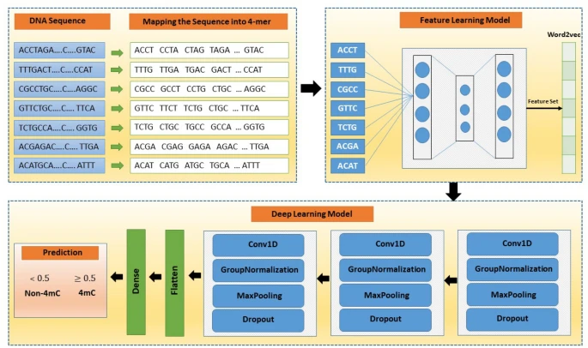
4mCNLP-Deep
https://www.nature.com/articles/s41598-020-80430-x

Slide 18
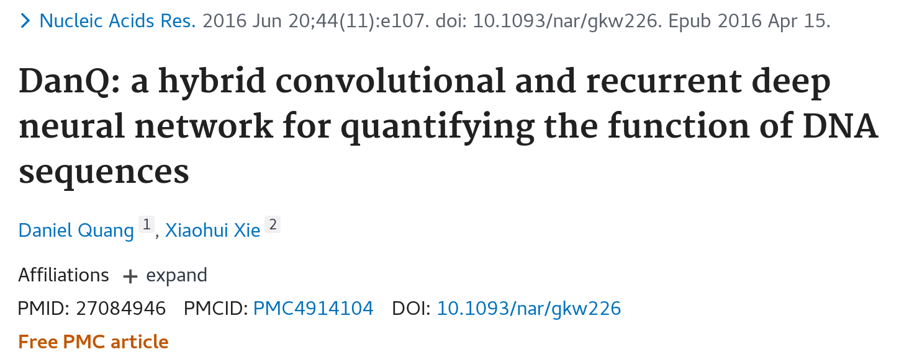
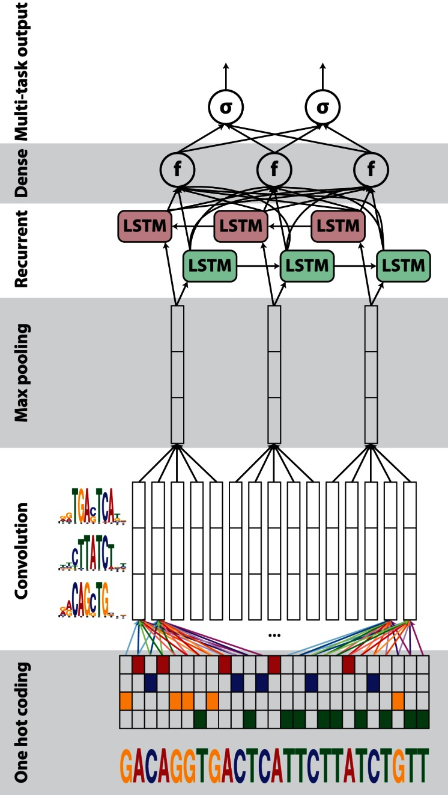
https://www.ncbi.nlm.nih.gov/pmc/articles/PMC4914104/

Slide 19
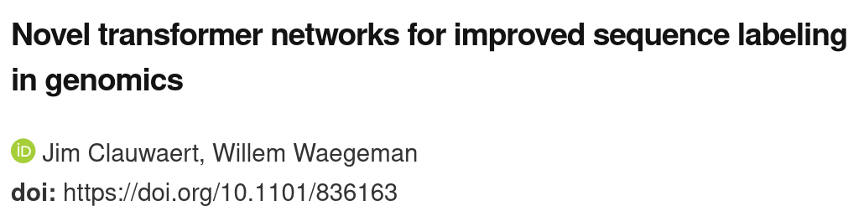
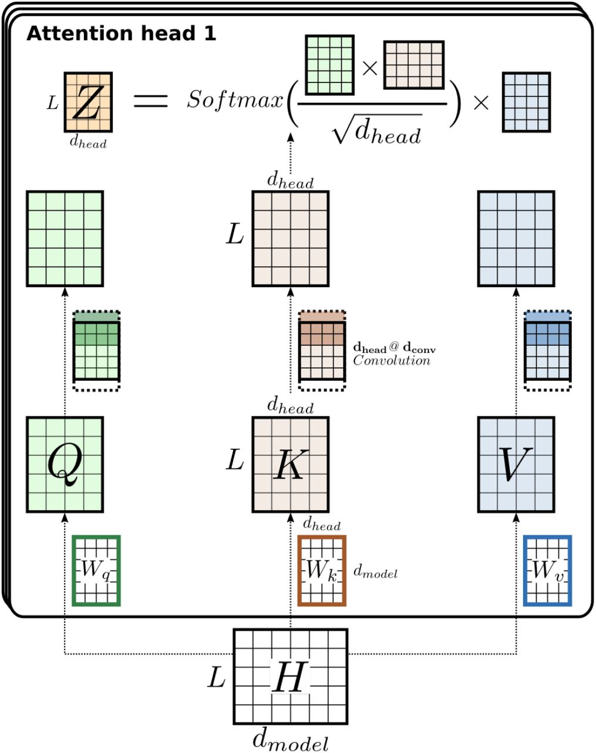
https://www.biorxiv.org/content/10.1101/836163v1.full

Slide 20
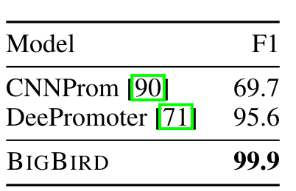
Promoter Region Prediction with BIGBIRD
https://arxiv.org/pdf/2007.14062

