Slide 1
Privacy Preserving AI
Federated Learning and
Homomorphic Encryption
Romeo Kienzler - IBM CODAIT
IBM Center for Open Source Data and AI Technologies

Slide 2






state of the art
query
data

Slide 3
Problem #1
data privacy

Slide 4
Problem #2
competitive advantage / information cartels

Slide 5
federated learning
query
data

Slide 6

Device 1
Device 2
Device 3
1
3
5
2
4
6

Slide 7
Device 1
Device 2
Device 3
1
3
5
2
4
6
1.5
3.5
5.5

Slide 8
Device 1
Device 2
Device 3
1
3
5
2
4
6
1.5
3.5
5.5
10.5
/3
3.5

Slide 9
Device 1
Device 2
Device 3
1
3
5
2
4
6
1.5
1.5+3.5
5+5.5
10.5
/3
3.5

Slide 10
data parallelism
aka. “Jeff Dean style” parameter averaging
Parameter Server
Model A
Model A
Model A
Node 1
Node 2
Node 3
P1
P2
P3

Slide 11
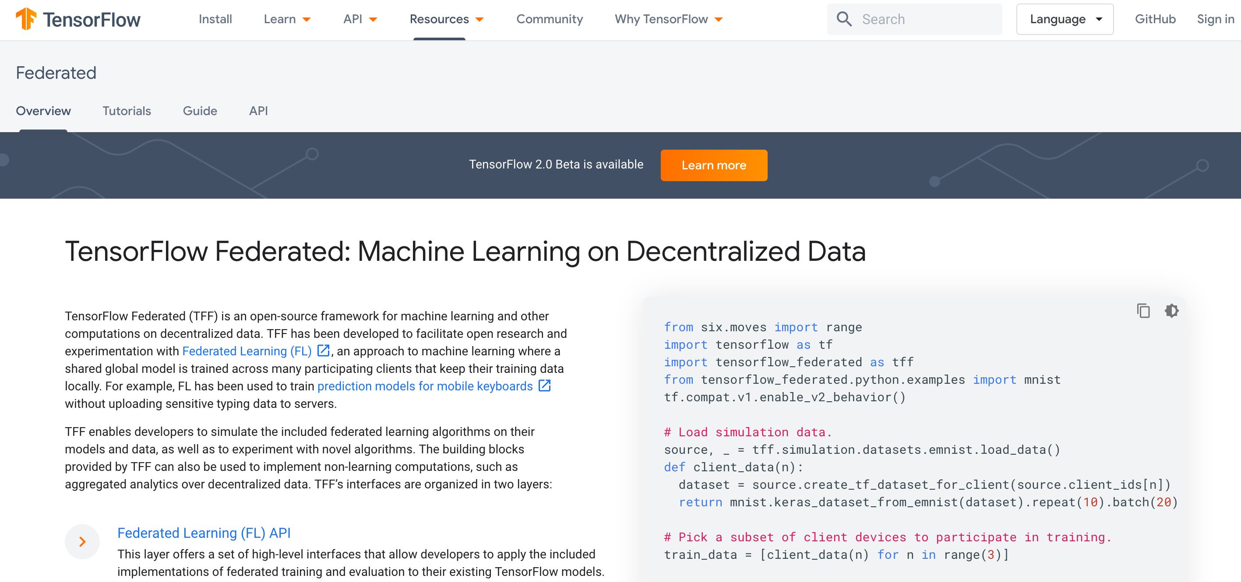

Slide 12
homomorphic encryption
Device 1
1
2

Slide 13

homomorphic encryption
Device 1
1
$
2
£

Slide 14
homomorphic encryption
Device 1
Device 2
1
$
$
%
+
2
£
£

Slide 15
homomorphic encryption
Device 1
Device 2
Device 1
1
$
$
%
%
3
+
2
£
£

Slide 16
homomorphic encryption
fhe(query)
fhe(data)

Slide 17
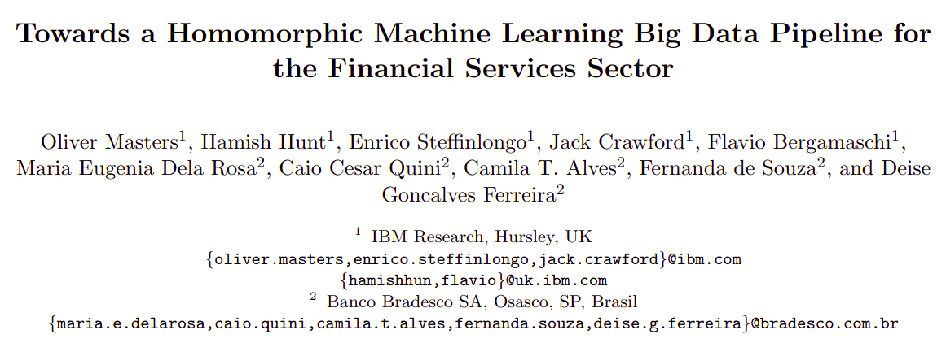

Slide 18
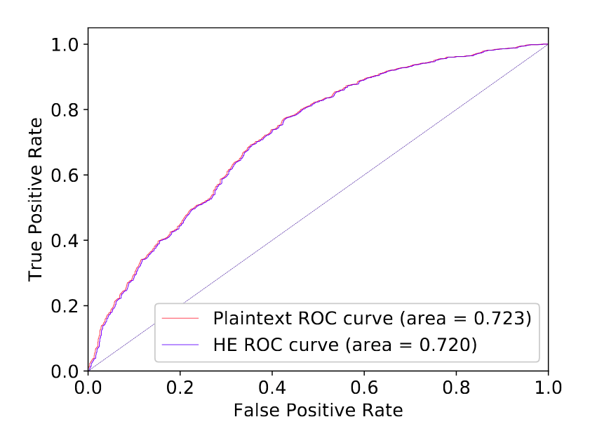

Slide 19
https://github.com/homenc/HElib

Slide 20
Problem #1
data privacy

Slide 21

Problem #1
data privacy

Slide 22
Problem #2
competitive advantage / information cartels

Slide 23
Problem #2
competitive advantage / information cartels

Slide 24
…discussion…
(questions, comments, additions, complaints, suggestions, feedback, ...)

