Slide 1
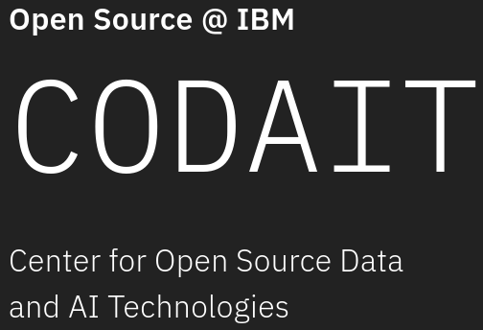

Open Source MLOps with
Kubeflow and ElyraAI
Romeo Kienzler
CTO and Chief Data Scientist, STSM
IBM Center for Open Source Data and AI Technologies (CODAIT)
Credits, thanks and kudos to
Animesh Singh, STSM and Chief Architect, Data and AI OpenSource Platform
Luciano Resende, Open Source AI Platform Architect

Slide 2

What is Docker?
Provides...
...on top of Linux
Product using OS-level virtualization to deliver software in packages called containers
Lightweight virtualization
Security and isolation
Super-fast startup/teardown

Slide 3

What is Kubernetes?
Provides...
...on top of Linux Cluster Hosts
Container Orchestration
Deployment, scaling and management
High availability
Used by (among others):
Adidas, Booking.com, Box, Google, Huawei, IBM, The New York Times, ING, ricardo.ch, Spotify, Wikimedia, Zalando

Slide 4
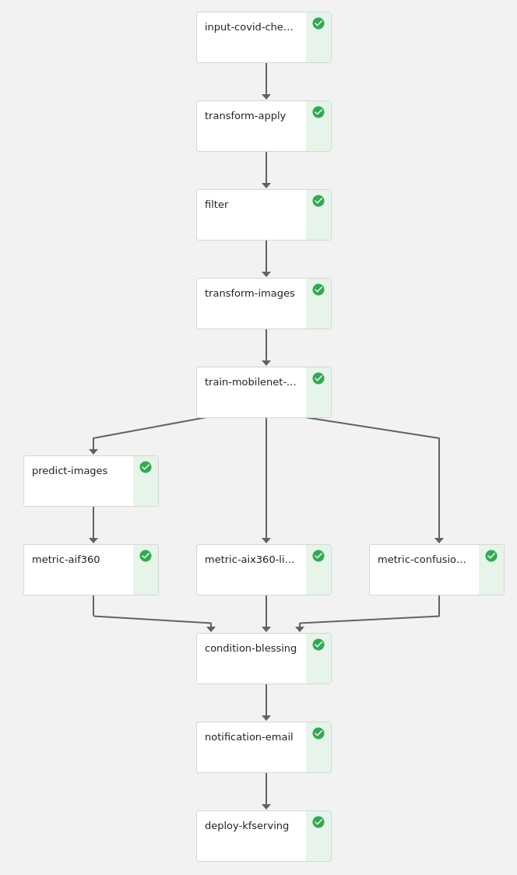
What is Kubeflow?
Provides...
...on top of
Kubernetes
AutoML
Deployment
Reproducibility
Notebooks
Pipelines
Serving
Training
Scale

Slide 5
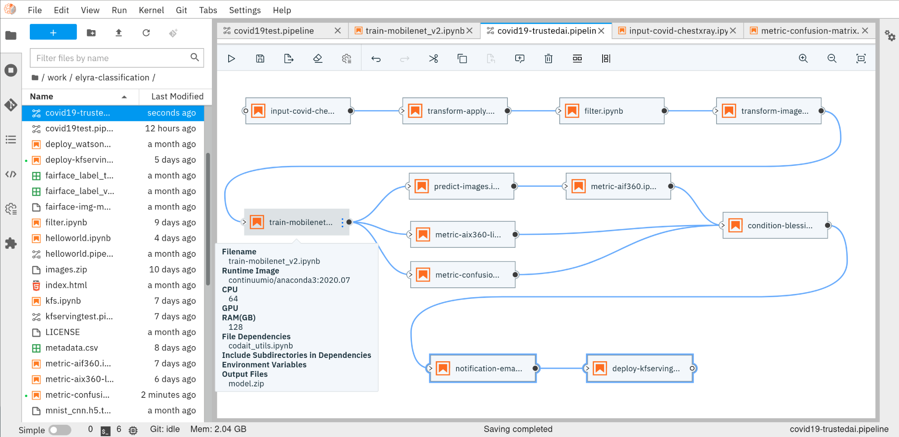
What is ElyraAI?
Provides...
...on top of JupyerLab, VSCode, ...
No Code / Low Code ML Pipeline Design
Re-usable pipeline components
Interchangeability of Engines (Kubeflow, Airfow, ...)

Slide 6
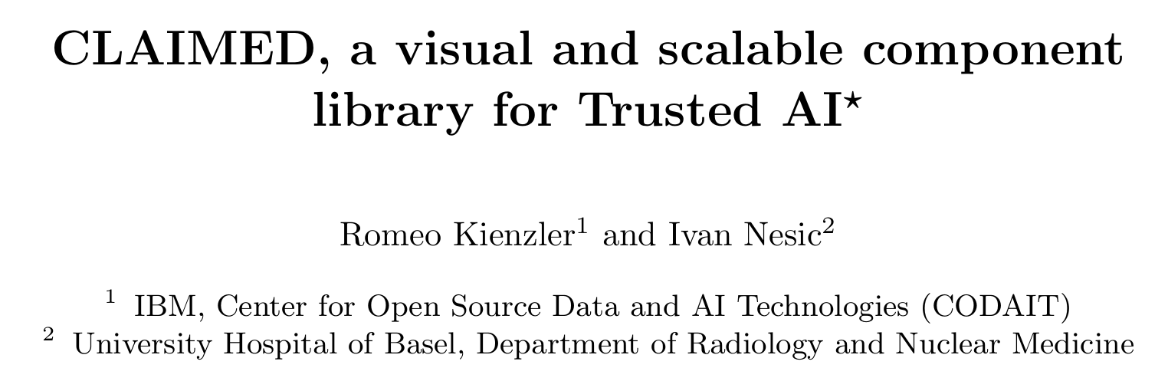
What is CLAIMED?
Provides...
...on top of ElyraAI and Kubeflow
Component Library for AI, Machine Learning, ETL and Data Science
Portable No Code / Low Code Pipeline Components
Jupyter Notebooks
Sample Pipelines

Slide 7
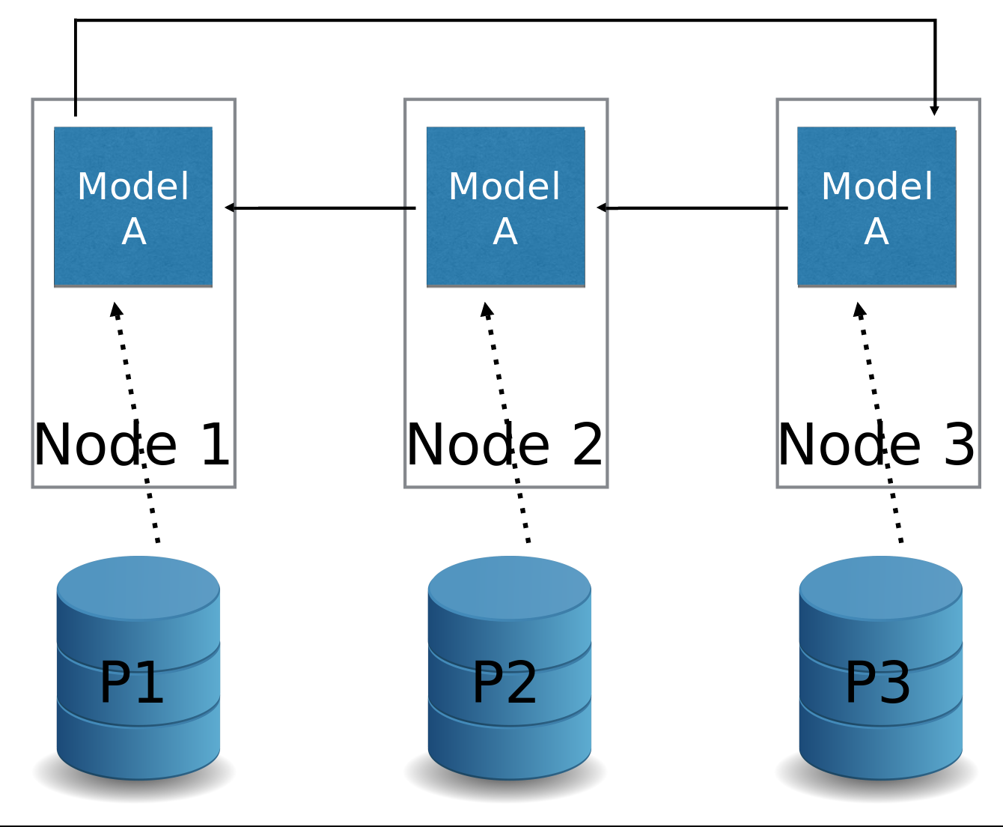
Example Pipeline Components
Category: Training Group: Distributed Name: TFJob
The TFJob operator supports parallel training on multiple nodes and GPUs

Slide 8
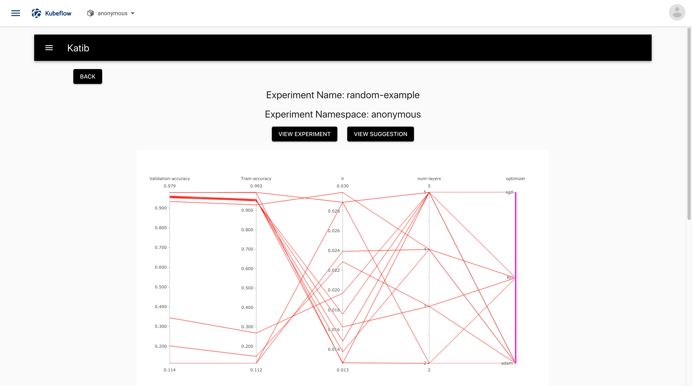
Example Pipeline Components
Category: Tunig Group: Hyperopt Name: Katib
Visualization of a hyper parameter optimization result

Slide 9
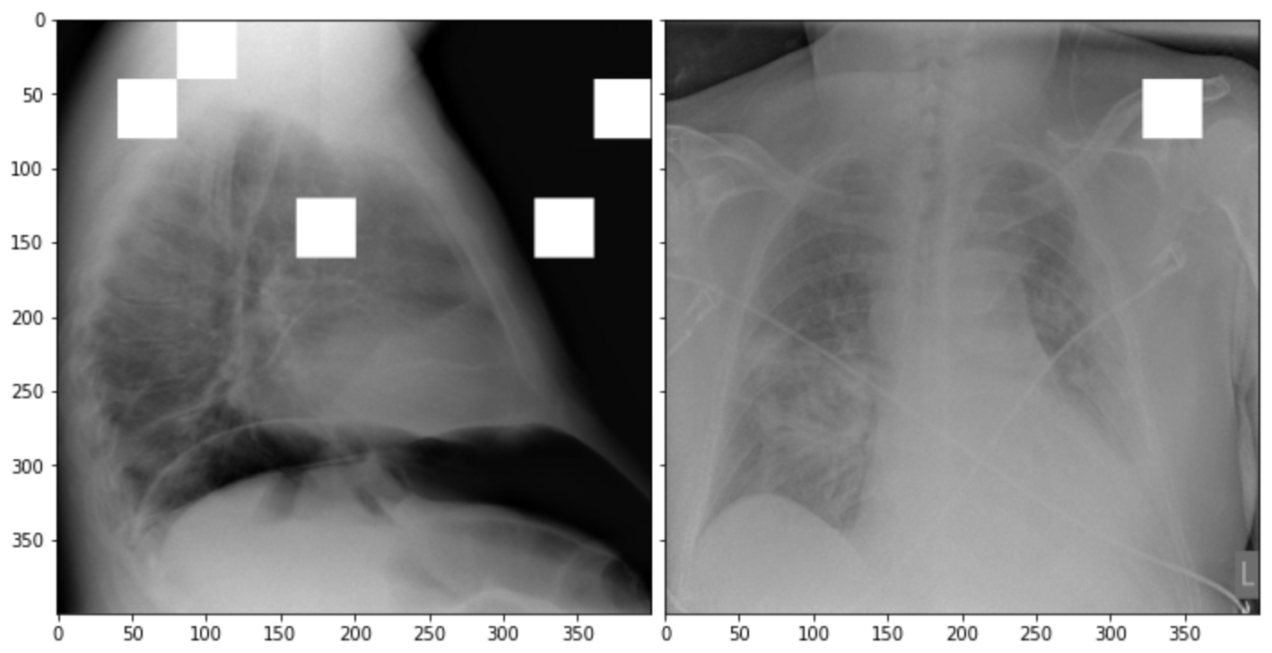
Example Pipeline Components
Category: Metric Group: Explainability Name: AIX360/LIME
Example on how LIME helps to identify classification relevant areas of an image

Slide 10
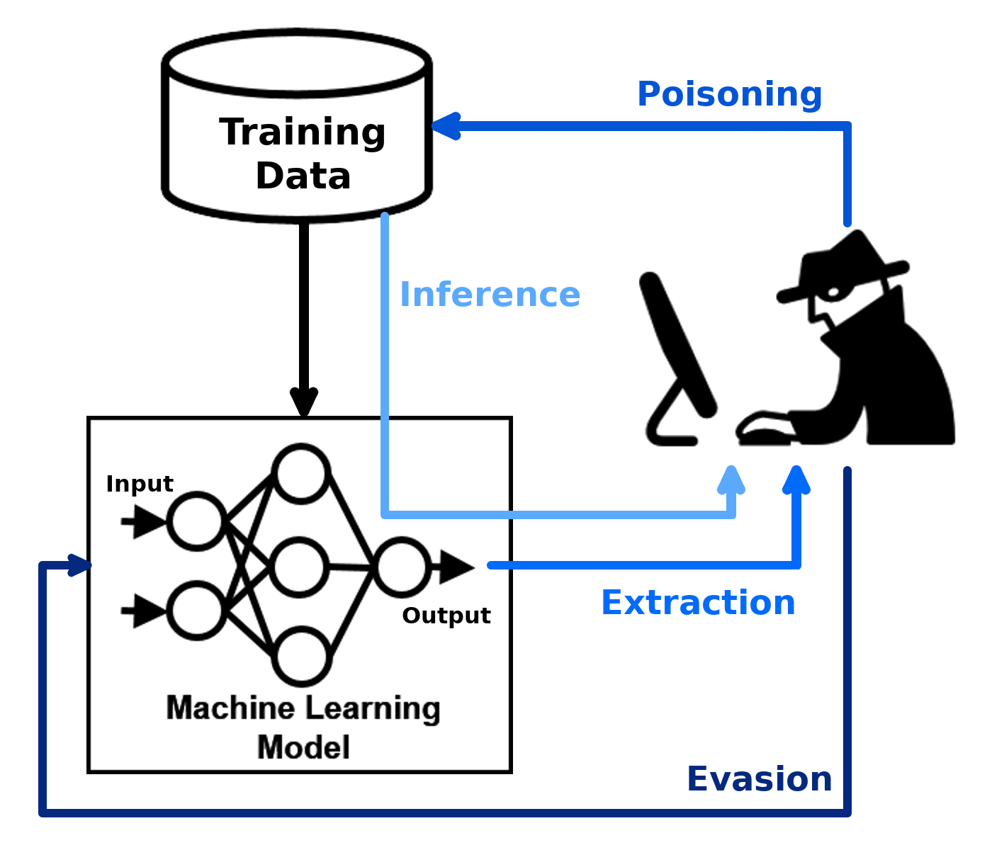
Example Pipeline Components
Category: Metric Group: Adversarial Robustness Name: ART
Example on how Adversarial Attacks happen

Slide 11
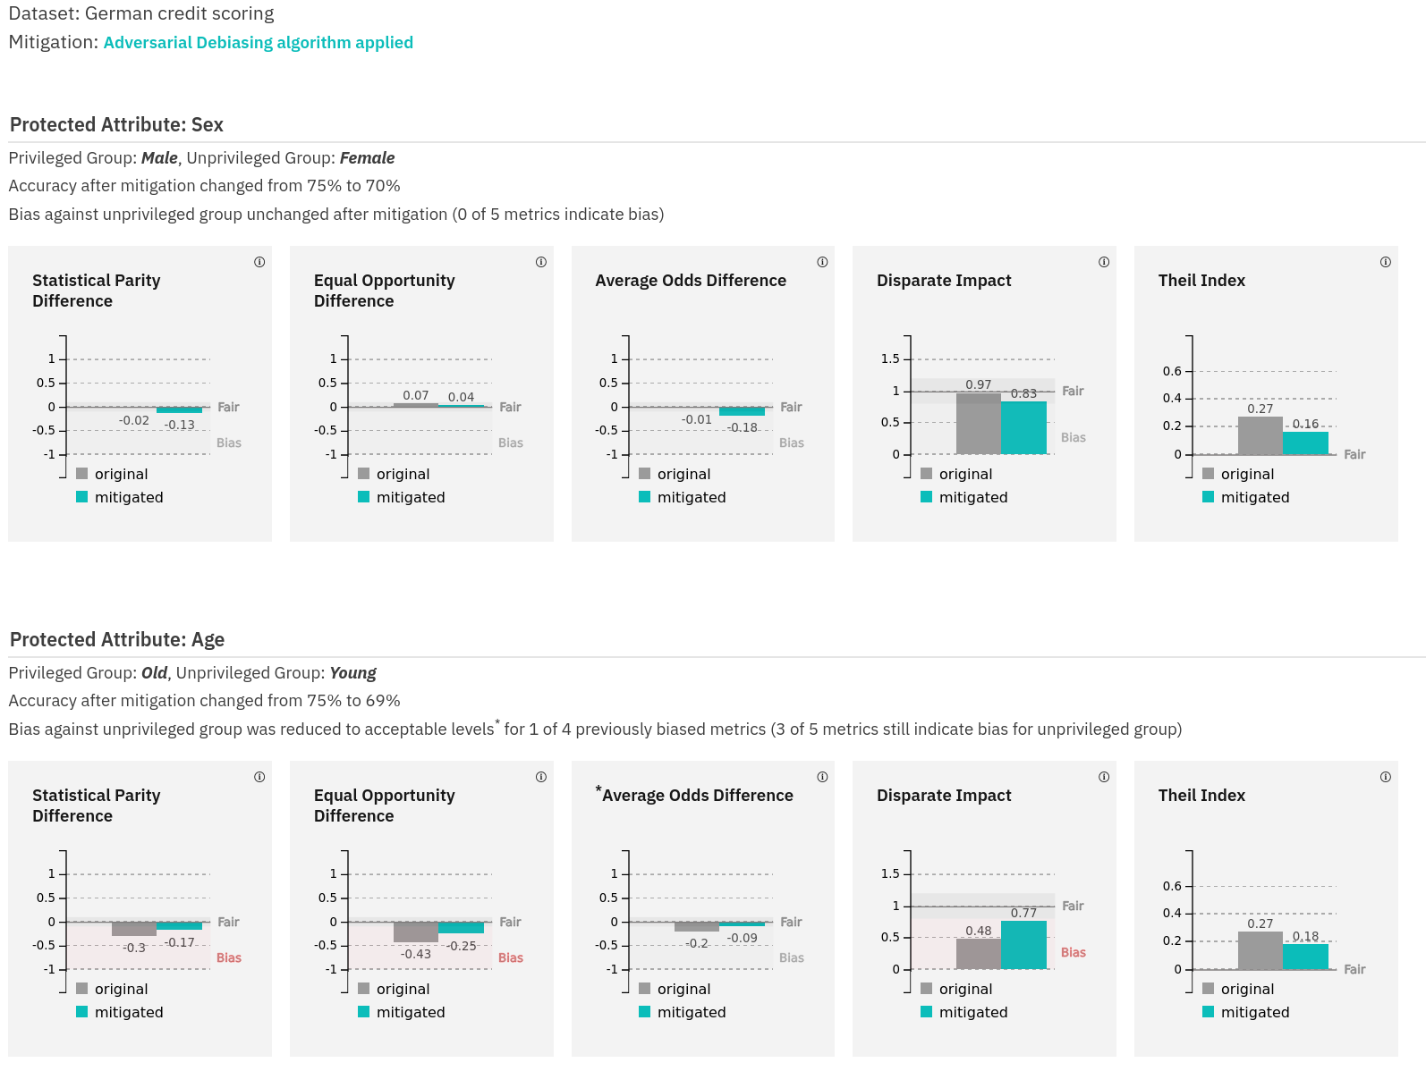
Example Pipeline Components
Category: Metric Group: AI Fairness Name: AIF360
Example on how the AIF360 toolkit computes fairness metrics and mitigates bias

Slide 12
Links
https://github.com/Trusted-AI/adversarial-robustness-toolbox
https://github.com/Trusted-AI/AIF360
https://github.com/Trusted-AI/AIX360
https://github.com/kubeflow/kubeflow
https://www.slideshare.net/AnimeshSingh/kfserving-serverless-model-inferencing-236725227
https://www.tensorflow.org/api_docs/python/tf/keras/applications
https://www.docker.com/
https://github.com/kubernetes/kubernetes
https://elyra.readthedocs.io/en/latest/

