Slide 1
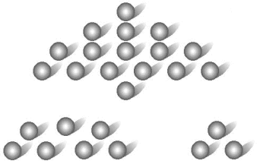
Progressively Finite Games
With Emphasis on the Game of Nim
By Michael Duquette

Slide 2
Progressively Finite Games have the following characteristics
_____________________________________
There are only two players
There is a finite set of possible positions in every game
The rules of the game specify for both players and each position which moves to other positions are legal moves
Players alternate moving
The game ends when a position is reached, called a terminal position, from which no other moves from the other player can be made
The game ends in a finite number of moves no matter how it is played

Slide 3
Example 1: A Simple Take-Away Game
Scenario:
A set of thirteen objects are placed on a table. Two players must take turns removing 1, 2 or 3 objects from the pile. The winner is the player who removes the last object from the table.
In order to visualize the set of possible moves to determine a winning strategy we can model the game using a directed graph. Let each vertex represent a possible position in the game and a directed edge connecting possible moves in the game.
13
11
10
9
7
6
5
3
2
1
12
8
4
0

Slide 4
Example 1: A Simple Take-Away Game
Backward induction is a useful tool for determining the winning strategy and the various positions can be labeled using this technique.
First we must define the positions to be labeled:
P-positions: Are winning positions for the previous player
N-Positions: Are losing positions for the next player

Slide 5
Example 1: A Simple Take-Away Game
Label every terminal position a P-position.
Label every position that can reach a labeled P-position in one move as an N-position.
Find those positions whose only moves are to labeled N-positions and label them as P-positions.
If you found no new P-positions the process is complete, otherwise return to step 2.
Terminal Position
P
0
N
1
2
N
3
N
4
P
5
6
7

Slide 6
Kernel:
By labeling all the winning positions as P-positions we
were forming a subset of vertices known as a kernel. The
kernel of any progressively finite game has the following
properties:
There is no edge joining any two vertices in the kernel.
There is an edge from every non-kernel vertex to some kernel vertex.
Ex.
Non-Kernel Vertices
Kernel Vertices

Slide 7
Theorem 1:
If the graph of a progressively finite game has a kernel k, then a winning strategy for the first player is to move to a kernel vertex on every turn. However, if the starting vertex is in the kernel, then the second player can utilize this winning strategy.
Theorem 2:
Every progressively finite game has a unique winning strategy. That is, the graph of every progressively finite game has a unique kernel.

Slide 8
The Game of Nim
_______________________________________________
A slightly more complex take-away game involving several piles of objects. Two players take turns removing any amount of objects from one of the piles. The winner is the person who removes the last object from the last remaining pile.

Slide 9

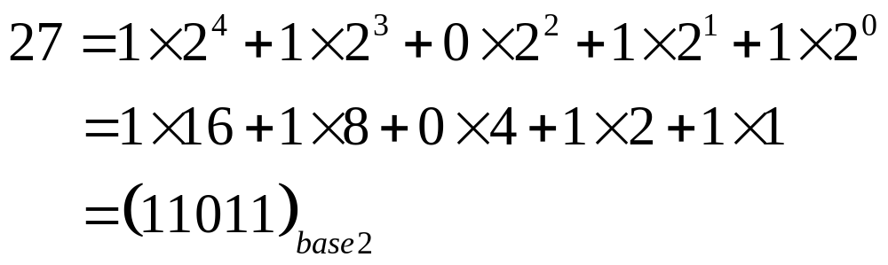
To construct a winning strategy for the game of Nim we will use a technique called
Nim-Sum:
The Nim-Sum of two non-negative integers is their addition in base 2.
Base 2:
Every integer can be written in a series of 1’s and 0’s in the form:
Ex.

Slide 10
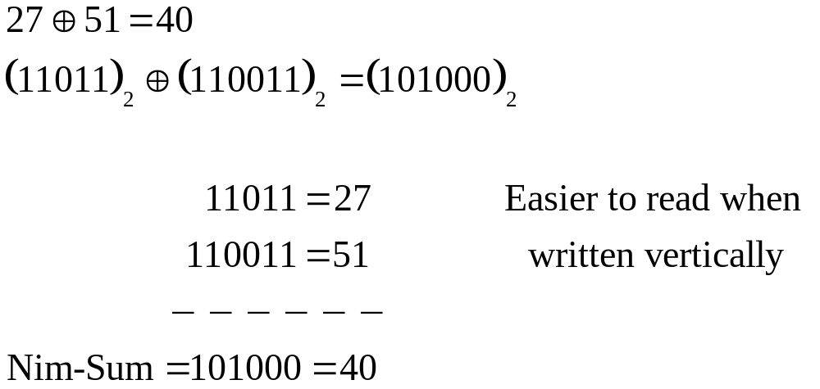
To take the Nim-Sum of two integers
Convert them to base 2
Take their direct sum mod 2
Ex.

Slide 11


Nim-Sum is the only possible technique for winning at Nim
Theorem 3:
A position in Nim is a P-position or winning position if and only if the Nim-Sum of its components is zero;
Note: Nim-Sum is associative and commutative so the order in which we take the Nim-Sum doesn’t matter.

Slide 12
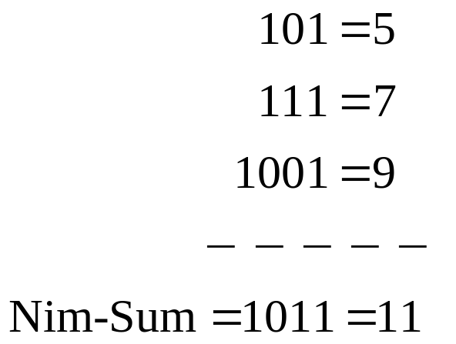
Example 3: The Game of Nim
There are 3 piles of objects with 5, 7 and 9 objects respectively.
Part I:
Compute the Nim-Sum to determine if the first or second player has the winning strategy.
Answer:
Since the Nim-Sum is not equal to 0, position (5,7,9) is not a winning position. Therefore, the first player can move to a winning position and formulate a winning strategy.

Slide 13
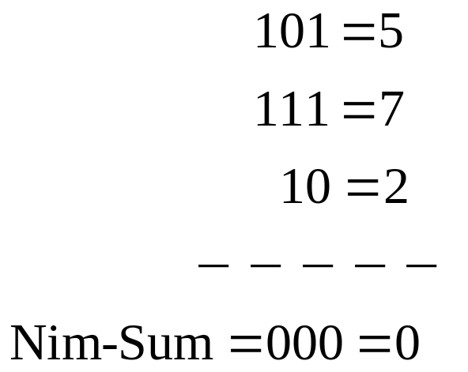
Example 3: The Game of Nim
Part II:
What is the initial move to ensure that the first player moves to a winning position?
Answer:
There is only one possible move. You must take away 7 objects from the 9 pile so that you will be left with 2.

Slide 14
Homework
Question: For the following Nim game with four piles consisting of 2, 4, 4, and 6 objects find the moves that yield the positions with Nim-Sum equal to:
(a) 1
(b) 2
(c) What is your initial move if you want to win the game?

Slide 15
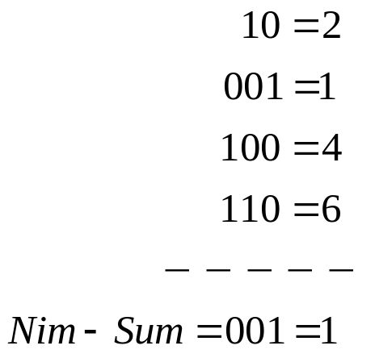
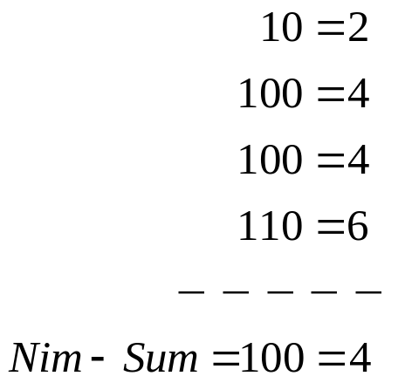
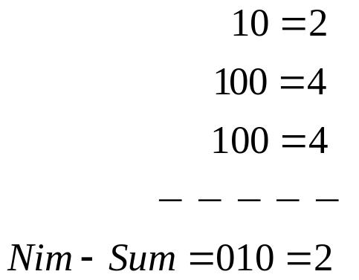
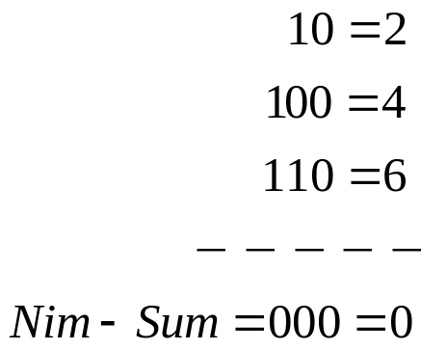
Homework Answers
Take 3 objects away from either 4 object pile.
Take all of the objects from the six object pile
Original Nim-Sum
(c) Take away all four objects from one of the 4 object piles

