Slide 1
Mechanisms of Action (MoA) Prediction
(Kaggle competition)
Romet Aidla, Kadri Onemar, Linda Katariina Grents, Marge Maidla
Team name on Kaggle: Drugdealers
15.12.2020

Slide 2

Goal of the competition
To advance drug development through improvements to MoA prediction algorithms*
Our team’s goal: not the top place on leaderboard but learn as much as possible
* MoA - Mechanism of Action refers to the specific biochemical interaction through which a drug substance produces its pharmacological effect.
Source: https://attract-eu.com/wp-content/uploads/2020/06/ATTRACT_drugdevelopment.png

Slide 3
Details of the project
Duration: 3 Sept - 30 Nov 2020
Unique dataset combining gene expression and cell viability data
Develop an algorithm that labels each case in the test set as one or more MoA classes -> multi-label classification problem
Evaluation: log loss function
Team with best score on private test set wins the competition

Slide 4
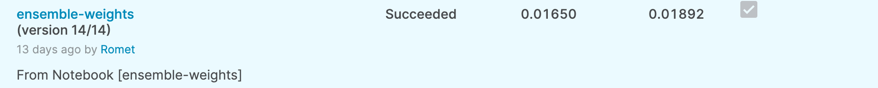
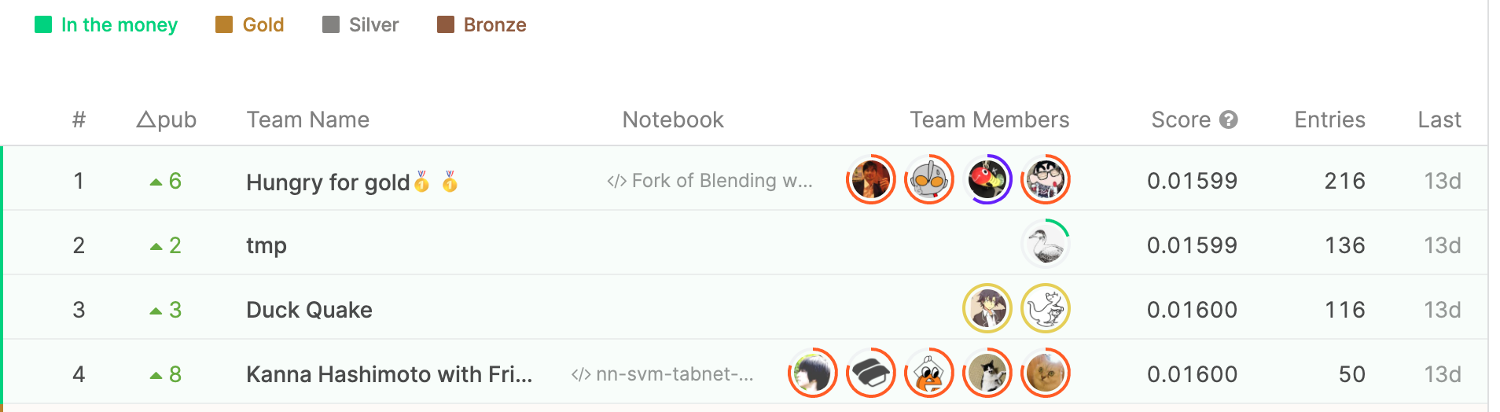
Approach and results
Each team member develops a model, afterwards perform blending
Two Keras NN-s (0.01892 and 0.01911), XGBoost(0.01998), Logistic Regression (0.02688)
Detailed results:
Notes:
Models used
Baseline and better models (Baseline: 0.02398)
Which ones we didn’t use and why? -- > CatBoost (it had public score (on public test data) of 0.03605 and the baseline to select models were 0.02398) and ?
Romet: ma panin kirja järgmisele slaidile mudelid, mis kaalude pärast välja jäid. Kadri-l võiks Catboosti osas täpsustada (Tegin)
Romet: vbl on mõistlik siin slaidil ära näidata erinevate mudelite täpsuse. Või siis vähemalt rääkida üldiselt, et NN töötasid antud andmestikul kõige paremini. Kadri: olen nõus, et näiteks siin slaidil võiks sulgudes olla kirjas nende täpsus public test setile. (XGBoostil oli see 0.01998, Marge NN oli 0.01892? Ja Rometi NN oli 0.01911?, Linda log reg 0.02688?)
Romet: ilmselt mõistlik ära märkida see 449 kohaline tõus, mis on hea märk, et me ei lahendasime asjus õigesti ja mudel üldistus privaatsele andmesetile

Slide 5
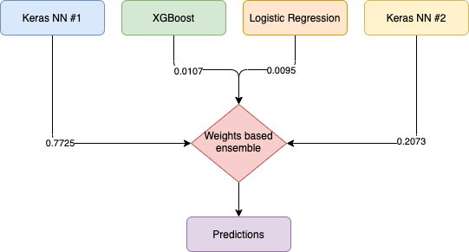
Ensemble
Weights calculated by minimizing OOF losses
Models not used (0 weight from optimizer):
Random Forest (Rapids)
KNN (Rapids)
Support Vector Machines (Rapids)
Models not used (loss above baseline):
Catboost
Notes:
Catboost was not used because it had public score (public test data) of 0.03605 and the baseline to select models were 0.02398. (It also took 1h and 40 min to train the model)

Slide 6
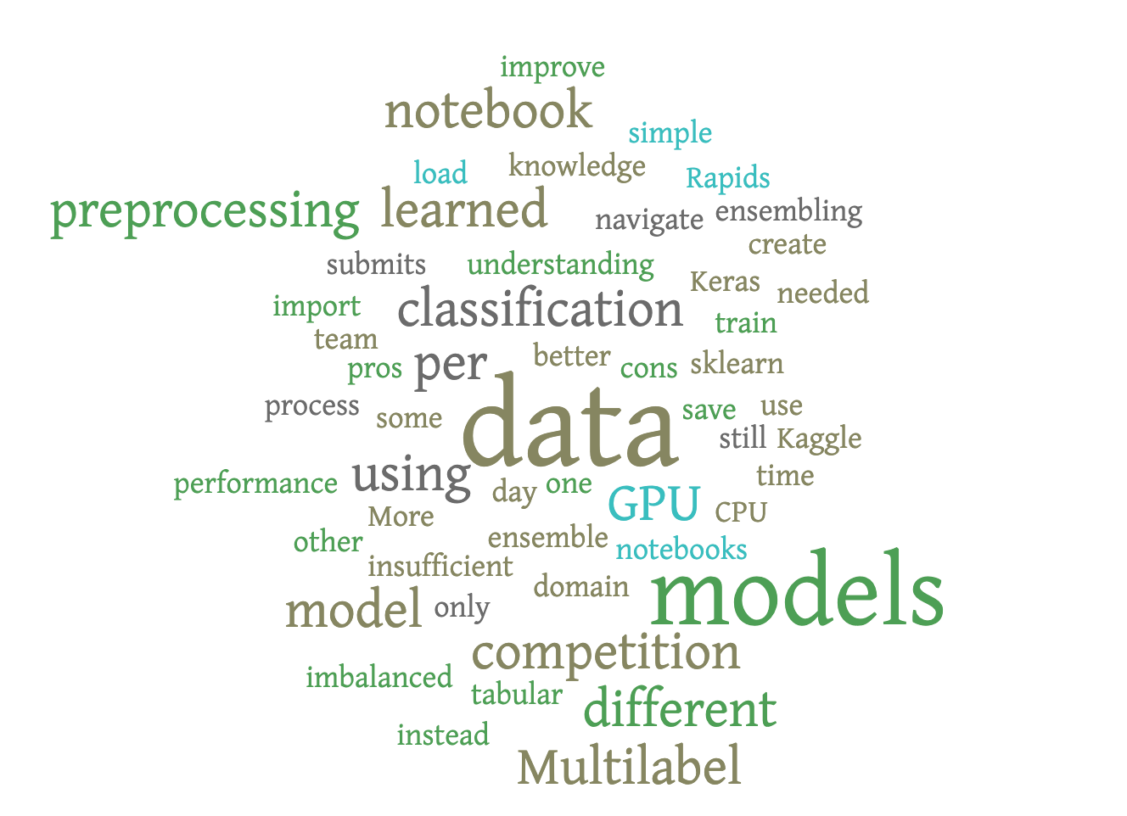
Lessons learned
We all learned about:
Kaggle competition process
how to work with notebooks
new models
RAPIDS
multilabel classification
data preprocessing
basics on drug development
Notes:
Pange siia individual learnings:
Lessons learned:
Kaggle: learned how to ...
... create notebooks,
... import data to notebook,
... save model in one notebook and load in other
Machine learning:
learned which models use CPU, which GPU
pros and cons of some models for this competition data (e.g. tabular, imbalanced and insufficient data)
Marge: Kaggle competition process, data preprocessing, understanding Keras better, how to approach multilabel classification.
Romet: Multilabel classification peculiarities, using Rapids to train models on GPU (instead of using sklearn), simple, but different model can still improve ensemble performance
More time needed for ensembling (only 3 submits per team per day)
Kadri: Kaggle: learned how to 1) create notebooks, 2) import data to notebook, 3) save model in one notebook and load in other ML: 1) learned which models use CPU, which GPU; 2) pros and cons of some models for this competition data (e.g. tabular, imbalanced and insufficient data)
Linda: How to navigate in Kaggle, different models, domain knowledge,
data preprocessing

Slide 7
References
Code repository:
https://github.com/rometaidla/mechanism-of-action
Competition:
https://www.kaggle.com/c/lish-moa/overview
Notes:
Pange siia individual learnings:
Lessons learned:
Kaggle: learned how to ...
... create notebooks,
... import data to notebook,
... save model in one notebook and load in other
Machine learning:
learned which models use CPU, which GPU
pros and cons of some models for this competition data (e.g. tabular, imbalanced and insufficient data)
Marge: Kaggle competition process, data preprocessing, understanding Keras better, how to approach multilabel classification.
Romet: Multilabel classification peculiarities, using Rapids to train models on GPU (instead of using sklearn), simple, but different model can still improve ensemble performance
More time needed for ensembling (only 3 submits per team per day)
Kadri: Kaggle: learned how to 1) create notebooks, 2) import data to notebook, 3) save model in one notebook and load in other ML: 1) learned which models use CPU, which GPU; 2) pros and cons of some models for this competition data (e.g. tabular, imbalanced and insufficient data)
Linda: How to navigate in Kaggle, different models, domain knowledge,
data preprocessing

Slide 8
Thank you!

