Slide 1
Colour Spaces
RGB . HSV . YCbCR . LAB
Mia | Romey | Kyra | Rebecca | Julia

Slide 2
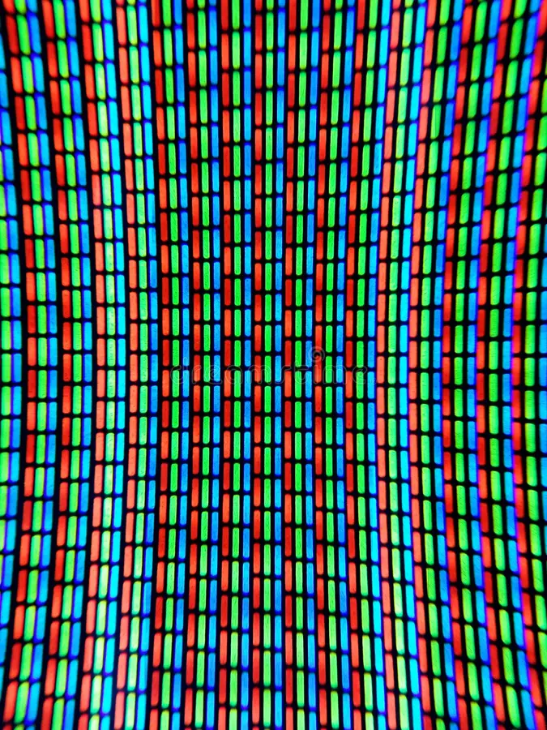
01
RGB

Slide 3
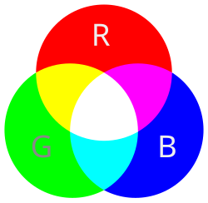
RGB Fundamentals
Represents colors as a combination of Red, Green and Blue
Works well in image editing
provides almost the true color of the image

Slide 4
RGB Applications
Applications | Alternatives
Digital Archiving and Conservation Web design Professional Image Editing | Video/streaming → YCbCr Colour detection → HSV Print/colour accuracy → LAB

Slide 5
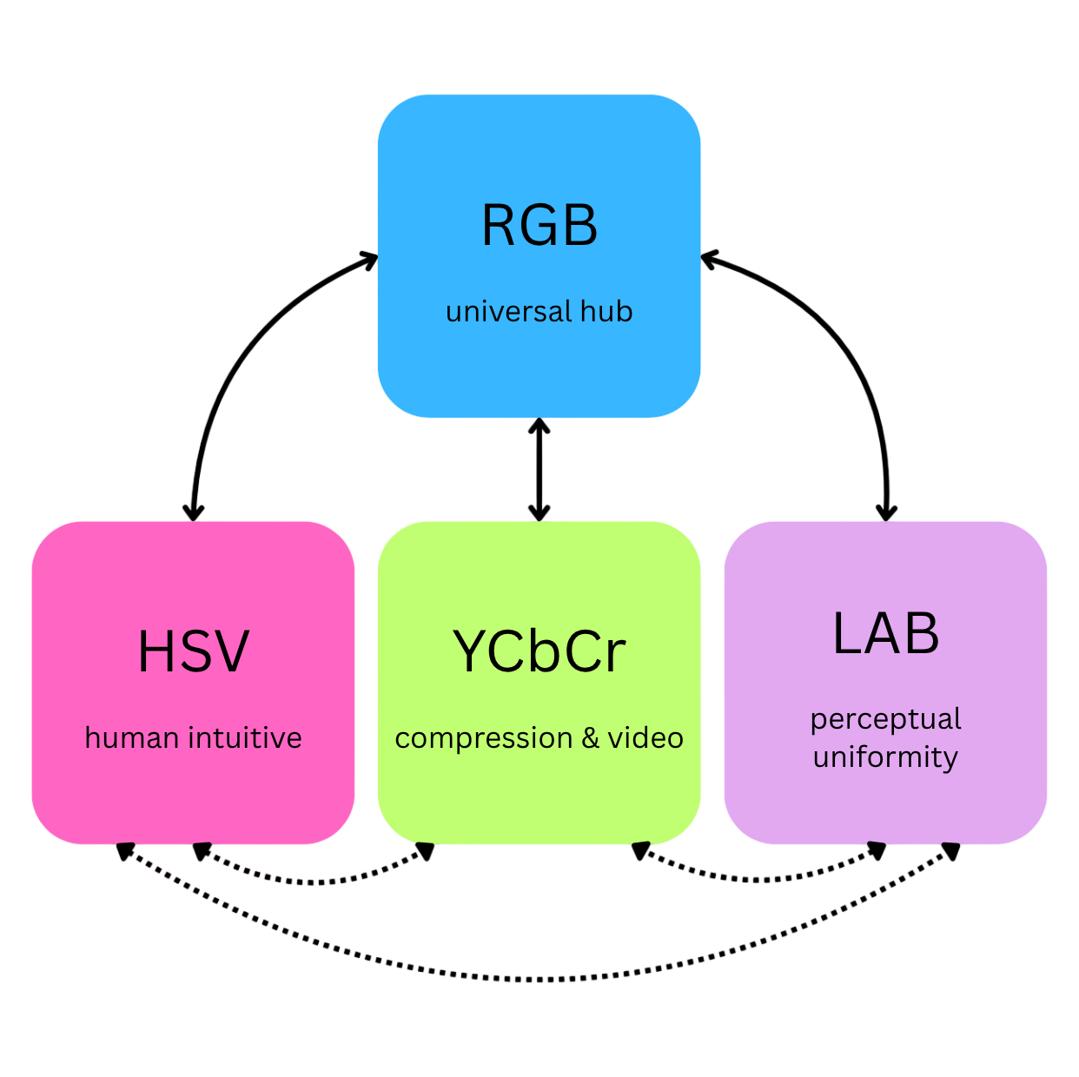
RGB in Conversions

Slide 6
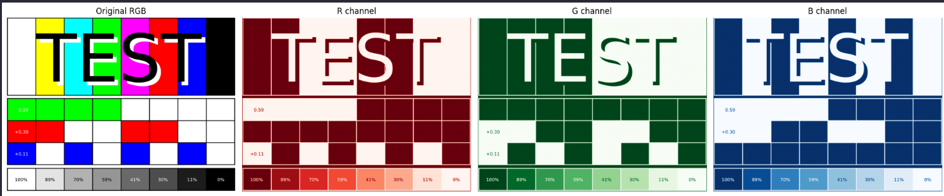
Failure cases & limitations
Red, Green and Blue channels are highly dependant on each other
Inefficient for data compression
The channels contain redundant information that wastes bandwidth

Slide 7
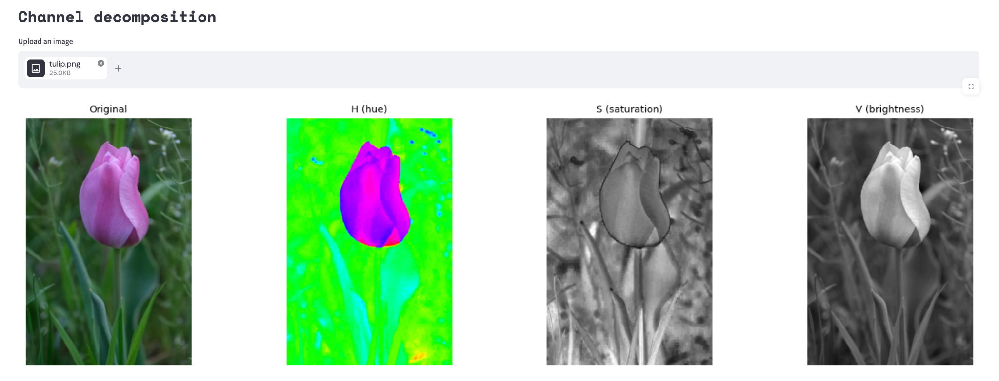
02
HSV

Slide 8
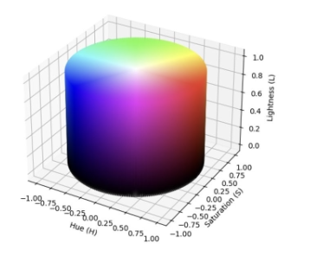
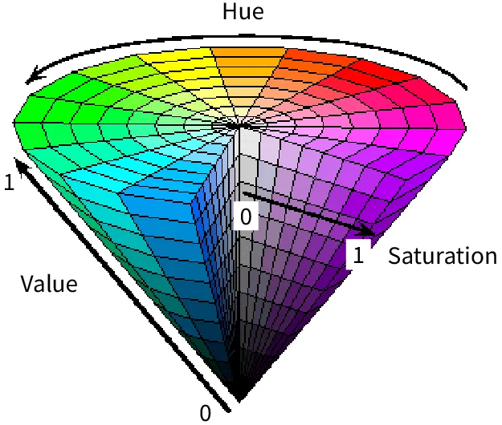
HSV Fundamentals
3 human-intuitive axes: Hue (what colour), Saturation (how vivid), and Value (how bright)
Designed by Alvy Ray Smith in 1978 so artists could think "bright saturated blue" instead of hunting through RGB numbers
Changing brightness only affects V, leaving the colour itself untouched
Notes:
HSV describes any colour using 3 values: Hue, Saturation and Value. Hue is the angle around the colour wheel - it answers ‘what colour is this?’
Saturation controls how vivid versus washed-out the colour is. 1 is a pure, vivid colour while 0 means you’ve drained all the colour out (grey)
Value controls brightness. 1 is max brightness while 0 is pure black regardless of the other two values.
This space was invented to allow artists struggling with RGB to have a space that mimicked painting in real life with real paints.
The pictures on the right show the geometric representation of the space. Hue = the angle around the colour wheel. Value = vertical axis. Saturation = distance from the central axis.A cone is sometimes used because it is a more accurate representation since at V=0 all colours collapse to a single point. However the cylinder is standard for its computational simplicity. (used in OpenCV)

Slide 9
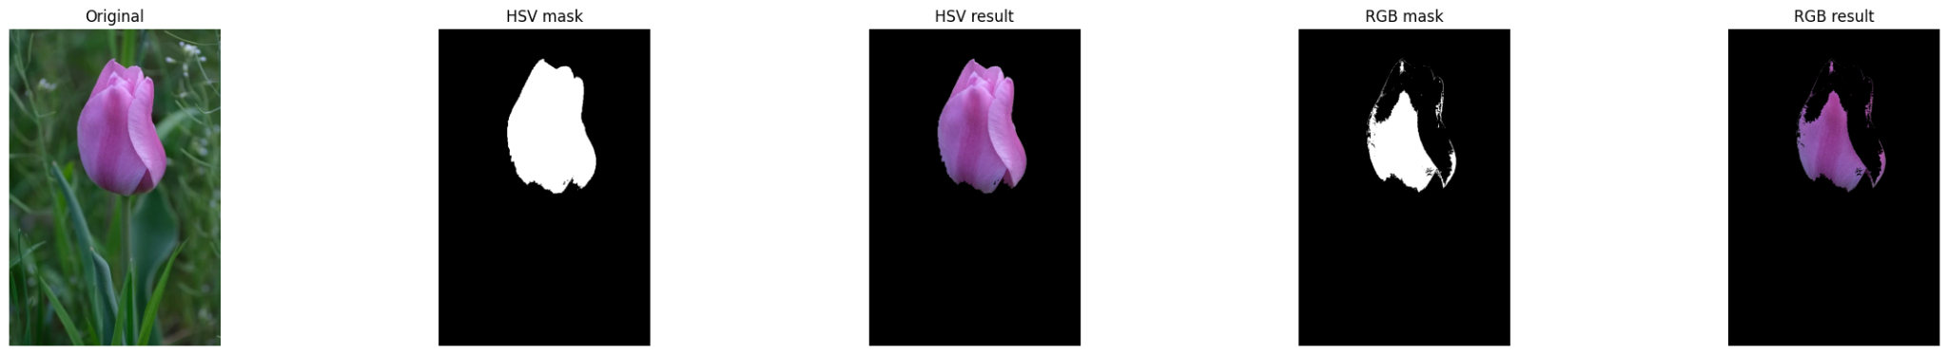
Real World Application:
Colour Masking
HSV is the standard colour space for object detection by colour in computer vision
A hue range threshold isolates a specific colour regardless of lighting. This is something RGB cannot do reliably
Used in traffic light detection, fire detection, and medical imaging
Same tulip, same threshold. HSV isolates cleanly, RGB fragments under shadow.
Notes:
This is where HSV earns its place in computer vision.
The image shows how HSV cleanly isolates the flower, while RGB fragments it.
Why? Because in RGB, brightness and colour are tangled together so when you threshold RGB, you’re trying to separate colours that share similar numerical ranges.
In HSV, you threshold the Hue channel alone (260-340 for the tulip).
This is why HSV is the standard colour space for object detection by colour in computer vision — traffic light detection, fire detection, medical imaging. Anywhere you need to isolate a colour robustly under real-world lighting conditions.

Slide 10
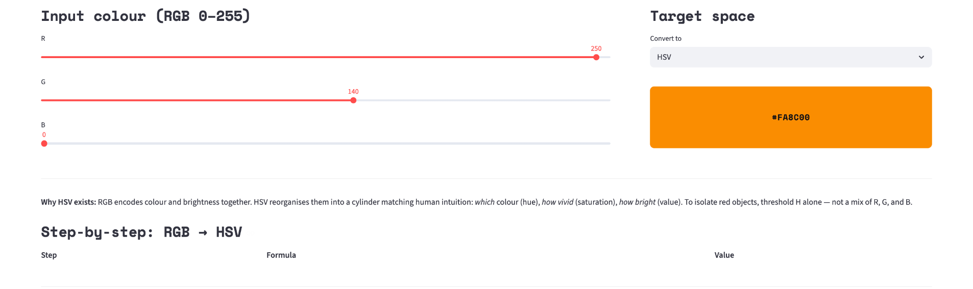
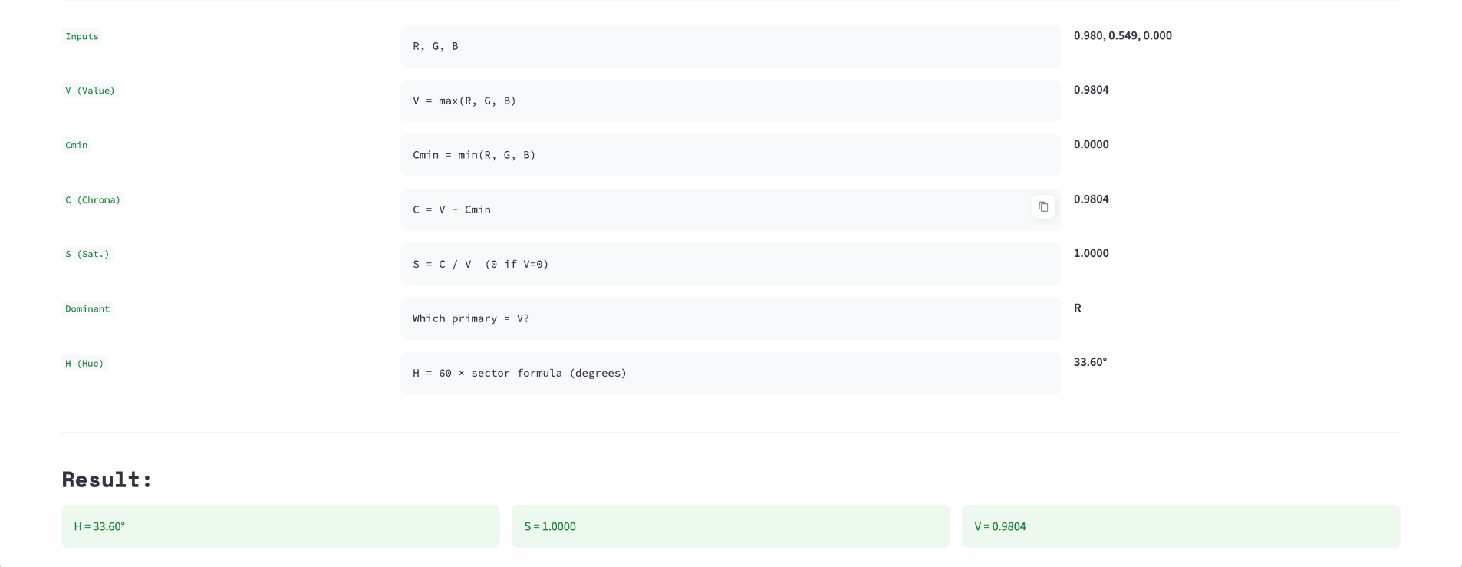
RGB → HSV
Step 1: Normalise R, G, B to [0, 1]
Step 2: V = max(R, G, B)
Step 3: S = δ / V
where δ = max − min (S = 0 if V = 0)
Step 4: H = 60° × formula based on which channel is dominant
Refer to the worked out example:

Slide 11
HSV Limitations
Situation | Problem | Use instead
Measuring how different two colours look | HSV distance ≠ perceptual difference | LAB
Compression and video transmission | HSV not designed for subsampling | YCbCr
Objects that are grey, white, or pastel | Hue is unreliable at low saturation | OpenCV fix - S min threshold
Notes:
HSV is powerful but knowing when not to use it is just as important as knowing when to use it.
First: if you're measuring how perceptually different two colours are. The numerical distance between two points in HSV space does not correspond to how different they look to a human eye. Use LAB
Second: for compression and video transmission. HSV was never designed for chroma subsampling. This limitation led to the creation of the space YCbCr, use that.
Third: near-grey, white, or pastel objects. When saturation is very low, the hue value becomes mathematically unreliable (you're essentially dividing by a very small number and the hue assigned to a near-grey pixel is noisy). OpenCV's fix for this is to always pair your hue threshold with a minimum saturation of around 30, to exclude those unreliable pixels.
So to summarise HSV in one sentence: use it when you want to detect a specific colour under moderate lighting changes, and switch to something else when lighting gets extreme or you need perceptual accuracy.

Slide 12
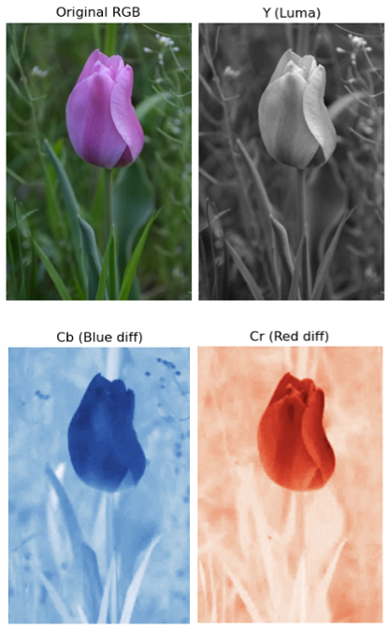
03
YCbCR

Slide 13
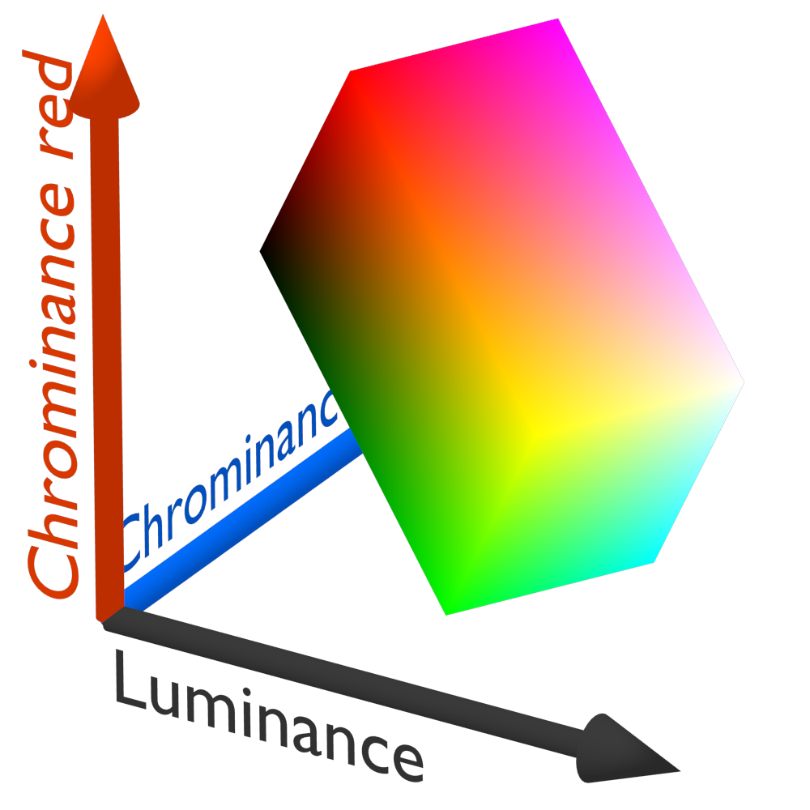
YCbCR
Fundamentals
Colour space used in digital image and video compression
Separates luminance (Y′) from chrominance (Cb, Cr)
Y′ stores image detail, Cb and Cr store colour information
Enables efficient compression with minimal visible quality loss

Slide 14
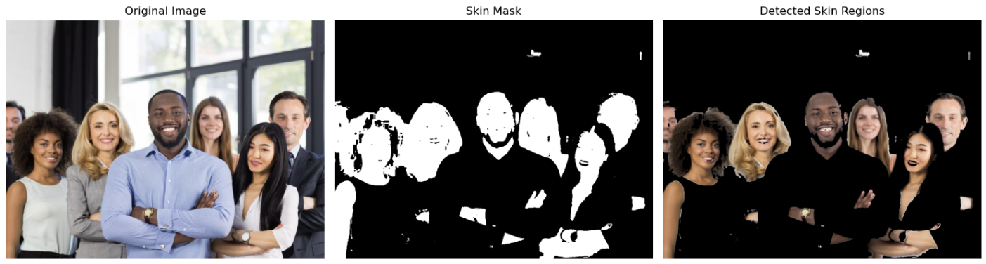
Skin Detection
Skin tones cluster in a narrow range of Cb and Cr values
Y (brightness) is ignored → reduces lighting effects
Enables simple threshold-based segmentation
Works across different skin tones and lighting conditions

Slide 15
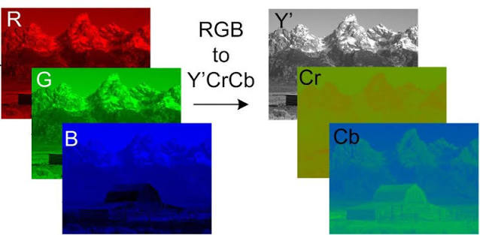
RGB ↔ YCbCR Conversion
Images are usually stored in RGB and then converted to YCbCr before compression
Conversion separates luminance (Y) from chrominance (Cb, Cr)
Based on weighted combinations of RGB values (BT.601 standard)
Y = 0.299R + 0.587G + 0.114B + 16
Cb = -0.1687R - 0.3313G + 0.500B + 128
Cr = 0.500R - 0.4187G - 0.0813B + 128
Enables efficient chroma subsampling and compression

Slide 16
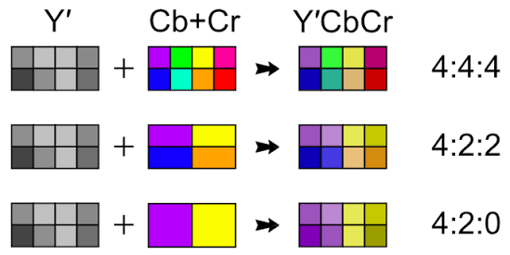
Chroma Subsampling
Chroma Subsampling
Reduces colour resolution to save storage and bandwidth
Human vision is less sensitive to colour details
than brightness detail
Formats:
4:4:4 - No subsampling
4:2:2 - Half horizontal colour resolution
4:2:0 - Half horizontal and vertical colour resolution

Slide 17
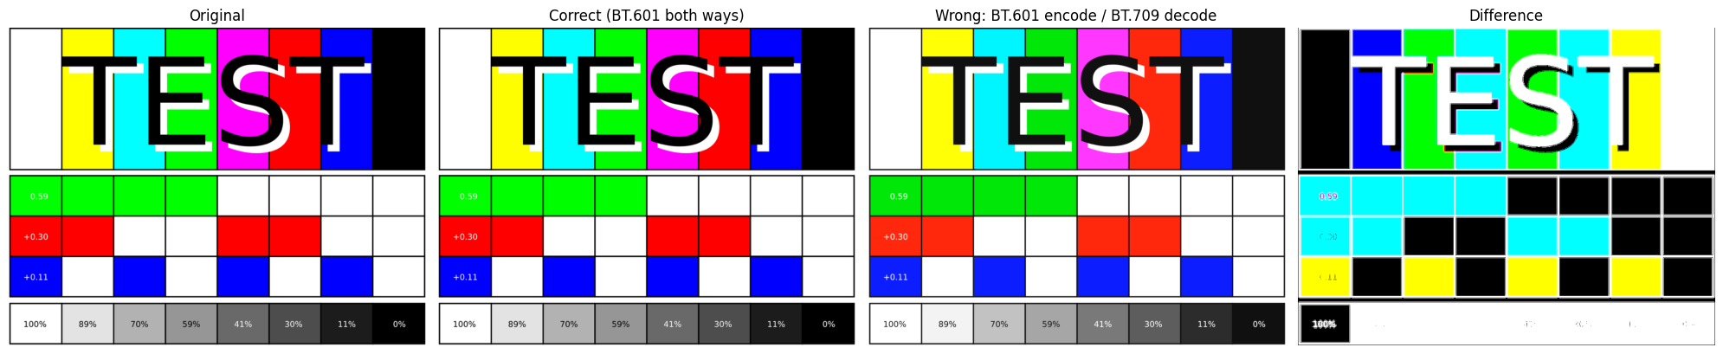
Failure cases & limitations
Chroma subsampling may cause colour bleeding and compression artifacts
Fine details such as text and UI elements can appear blurred
Not ideal for professional graphics or colour-critical editing
RGB is preferred for colour-critical applications
Excessive compression reduces image quality visibly

Slide 18
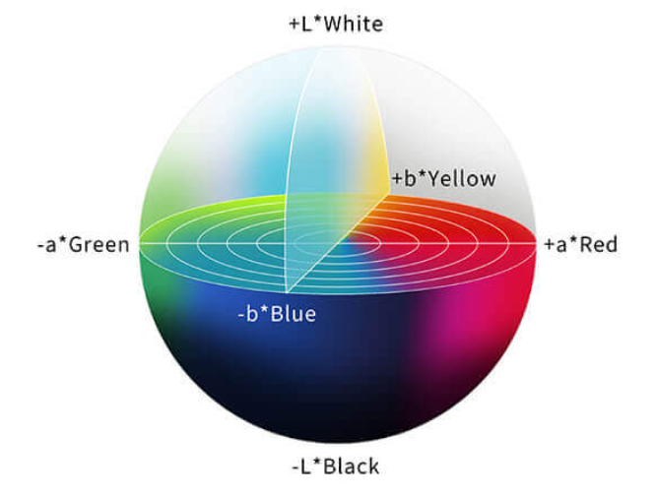
04
LAB

Slide 19
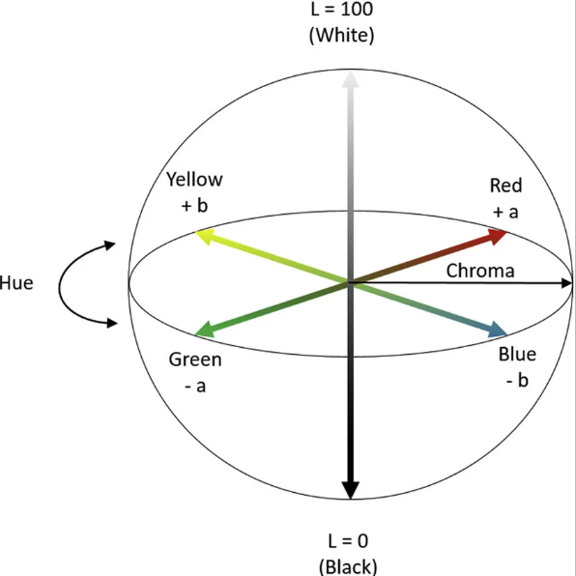
LAB
fundamentals
We have 3 LAB axes:
L* - lightness
a*- green-red
b*- blue-yellow
Designed to model human colour perception, separated brightness from colour information.
The separation makes LAB useful in image processing because lighting and colour can be analyzed independently

Slide 20
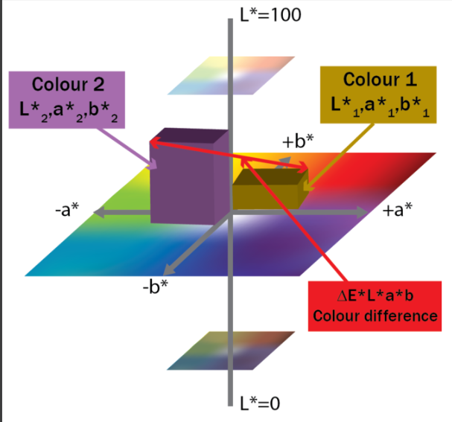
ΔE* - Measuring Colour Difference in LAB
ΔE* = √[(ΔL*)² + (Δa*)² + (Δb*)²]
Perceptually uniform
ΔE* = 1 - approx the smallest difference eyes can detect
ΔE = 0 Colours are identical
Small ΔE Colours are very similar
Large ΔE Colours are noticeably different
< 1 Not visible to the human eye
1 – 2 Only noticeable by a trained expert 2 – 3.5 Acceptable in most industries
> 5 Obvious mismatch (rejected)

Slide 21
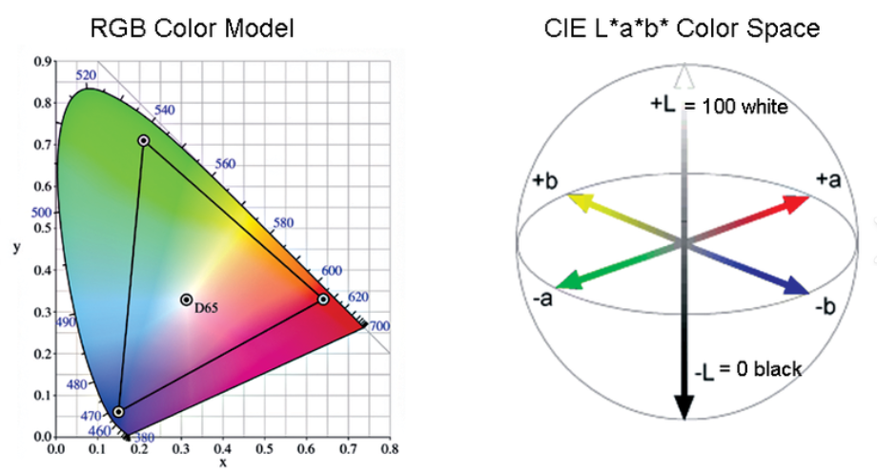
RGB → LAB conversion
Images are stored in RGB and must be converted to LAB before perceptual processing
Conversion separates lightness (L*) from colour information (a*, b*)
Requires passing through XYZ -a device-independent intermediate space
Step 1: RGB → XYZ (via linear matrix)
Step 2: XYZ → LAB
Equations:
L* = 116 · f(Y/Yn) − 16
a* = 500 · [f(X/Xn) − f(Y/Yn)]
b* = 200 · [f(Y/Yn) − f(Z/Zn)]
Enables perceptually uniform colour comparison using ΔE*

Slide 22
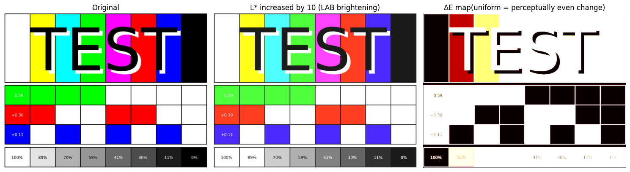
Failure cases & limitations
- Not perfectly perceptually uniform, highly saturated colours can still produce inaccurate ΔE* values
- Depends on accurate RGB calibration- poor lighting or camera calibration makes LAB values unreliable
- Computationally expensive, the 5-step pipeline is significantly slower than working directly in RGB or HSV
- Noise amplification ,dark regions become noisier after conversion
- Hue instability near neutral when a* and b* are close to 0, small rounding errors cause large hue shifts
These limitations led to improved formulas -CIE94 and CIEDE2000, developed to better model human perception

Slide 23
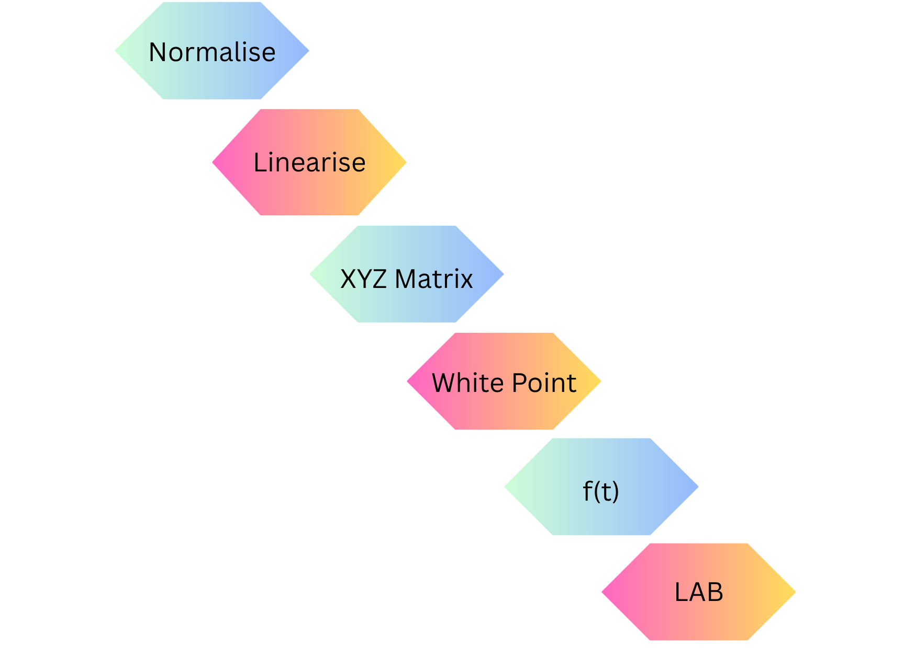
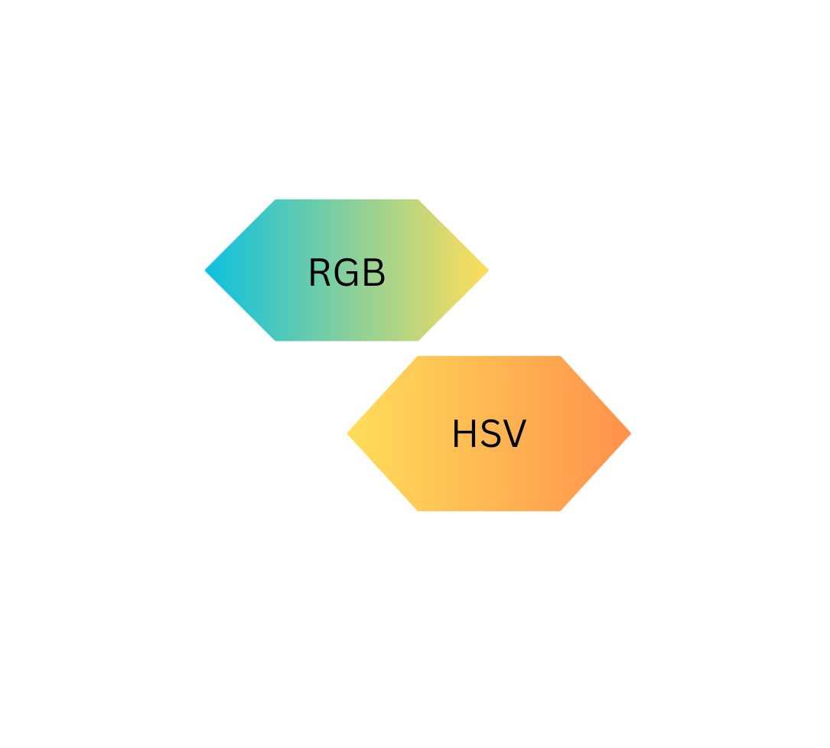
Example of Conversion Flow
RGB -> HSV
RGB -> LAB
More complex, 5 step pipeline

Slide 24
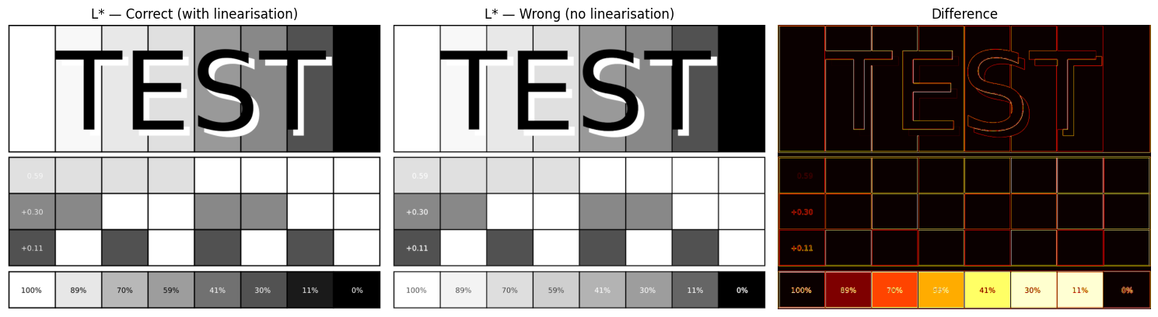
Failure Case: Skipping Linearisation for LAB

Slide 25

Conversion Limitations
When speed is critical
Working within entirely one space
When OpenCV already handles it

Slide 26
Thank you for your attention !

