Slide 1
COMP741 – Term Project
Library Management System
Presented by:
Rodrigo Adati
Romeric Heredia

Slide 2
Project Definition
Scope of the project
Technologies used
Project Demo

Slide 3
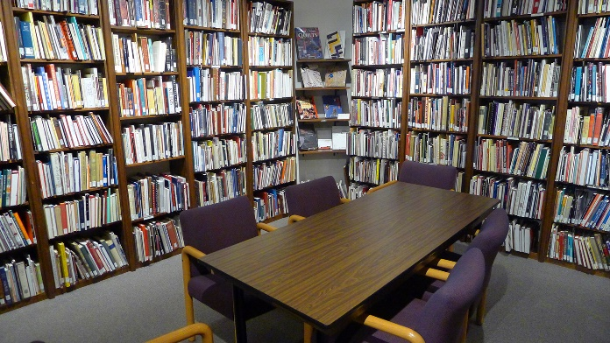

Project Definition
Library system management
3 tier architecture (View Layer – Business Layer – Data Layer)
Object Oriented Programming
9 weeks
Documentation
Development
Testing

Slide 4




Scope of the project
Development of a library system for institutes.
Management of books and DVDs inventory
Borrow/Return books and DVDs
User authentication
Management of member information

Slide 5


Technologies Used
Java (3 tier architecture, Polymorphism, Java GUI)
MySql (Store Procedures)

Slide 6
Project Demo

Slide 7

Questions

