Slide 1

Gamification of the Vehicle
By- Maserati Maniacs
This Photo by Unknown author is licensed under CC BY-SA-NC.

Slide 2

Keval Jain
Kyrylo Shyvam Kumar
Vansh Garg
Romica Raisinghani
Vanshika Dhingra
This Photo by Unknown author is licensed under CC BY-NC.

Slide 3

GAMIFICATION
Everyday repetitive driving can become boring. We are trying to gamify the same.
Gamification is a powerful way to engage customers and create loyalty.

Slide 4

OUR IDEA
Imagine there's a company of five people.
All of them go to the same office from their homes daily.
Let's make this more fun promoting safe driving practices and punctuality.

Slide 5
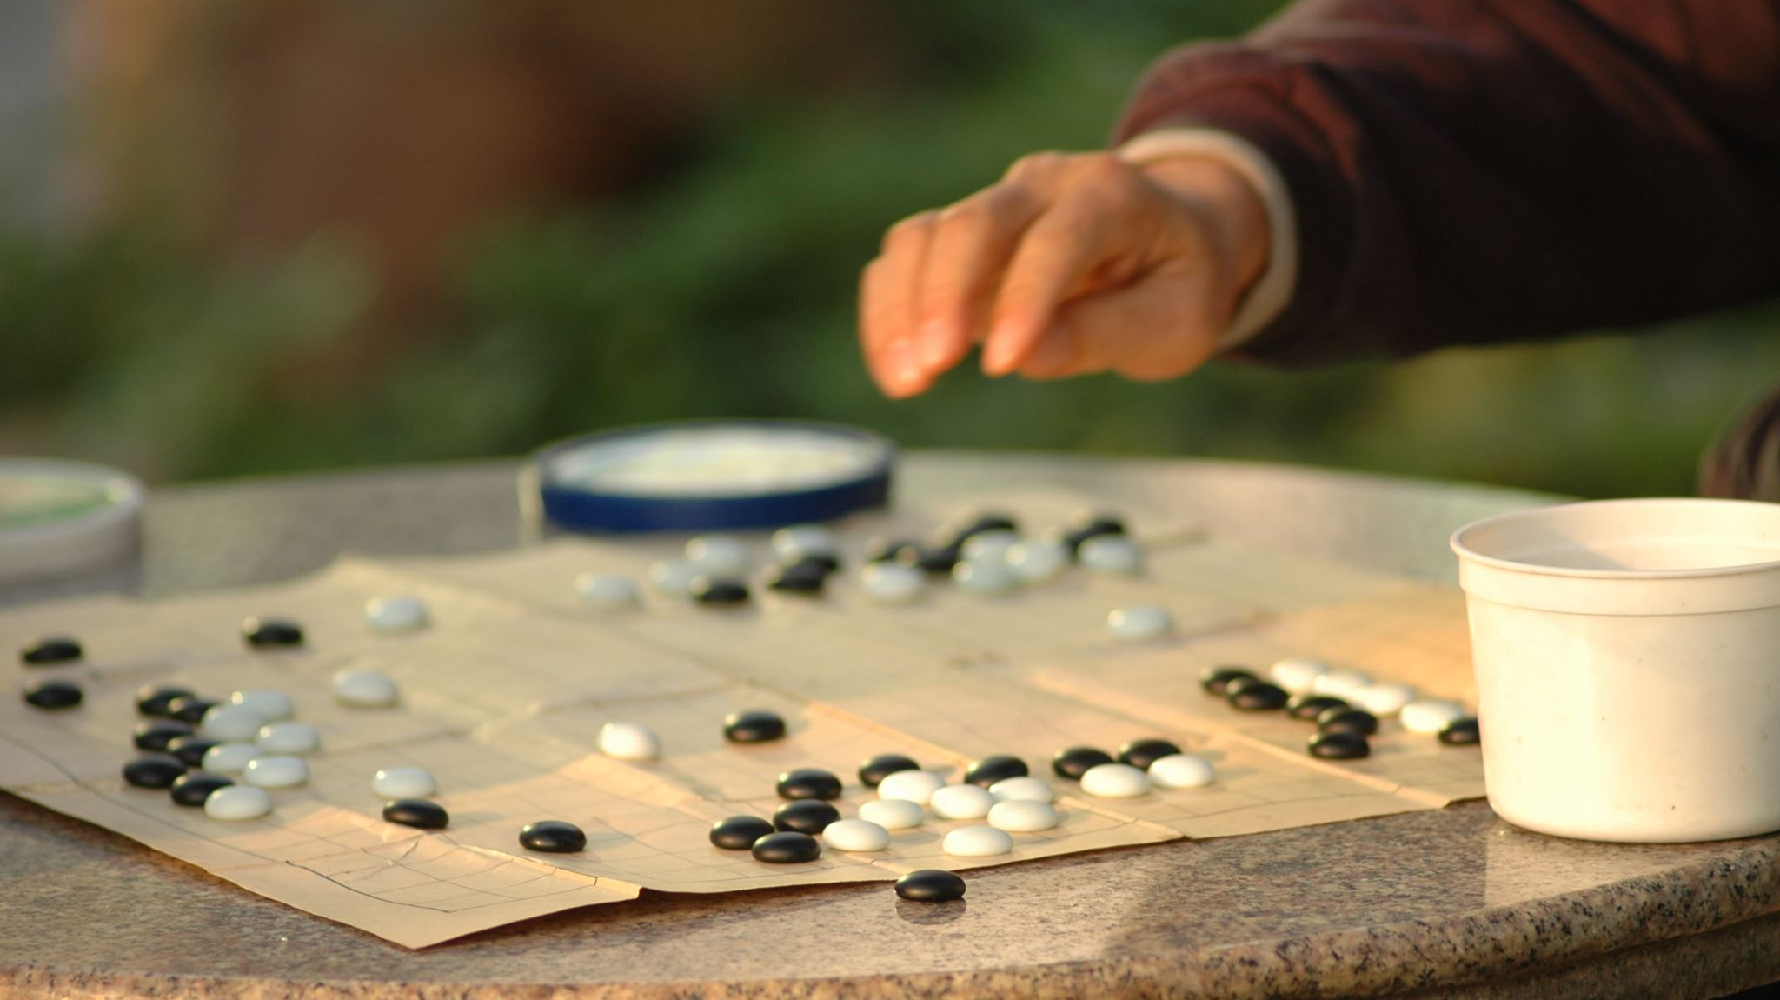
OUR TAKE ON GAMIFICATION
All five people are competing to gain the maximum number of points which would translate to the in game currency Stella Coins.
Through this currency, we base an entire virtual world.

Slide 6
Evaluation of driving efficiency and safety
Collecting data like speed, rpm, position and other various parameters from the vehicle every second.
Designing a set of driving patterns to characterize the driver's behaviour.
Having a KPI (Key Performance Index) for each driving pattern.

Slide 7

Driving Patterns
We classify the patterns according to three main aspects:
The initiation of the movement (referred to as "start driving pattern")
The movement ("in motion driving patterns")
Finalization of the movement ("stop driving patterns")

Slide 8
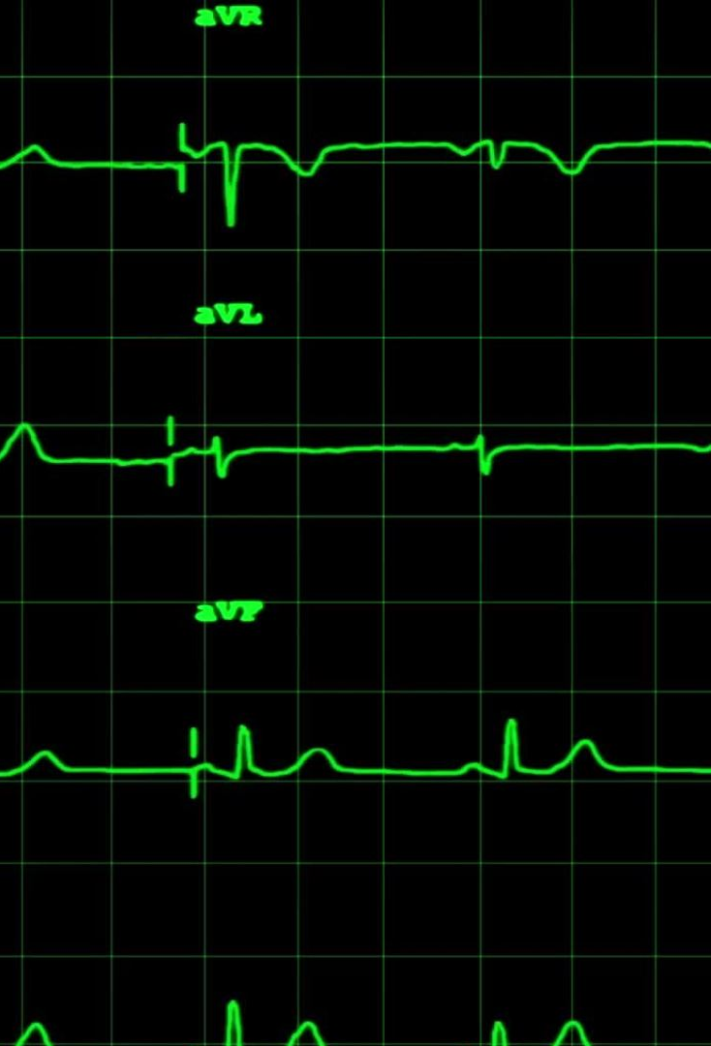
Start Driving Pattern
Measures the effectiveness of acceleration
Optimal acceleration between 0.5 m/s^2 and 1.078 m/s^2
KPI is the standard deviation of the acceleration value and reference value 0.8 m/s^2

Slide 9

In motion driving pattern
Divided into two sub-types of patterns: one related to efficient actions and one related to inefficient and unsafe actions.
Occurence/presence of first type should be maximized, while the second should be minimized

Slide 10
Corrected Inertia without Detention Pattern (CIWoD)
This is an efficient pattern of driving
Driver progressively reduces speed without braking hard.
Driver should regulate the speed by slightly using the brakes and inertia
KPI is defined as the percentage of use of brake regarding the total duration of the pattern

Slide 11
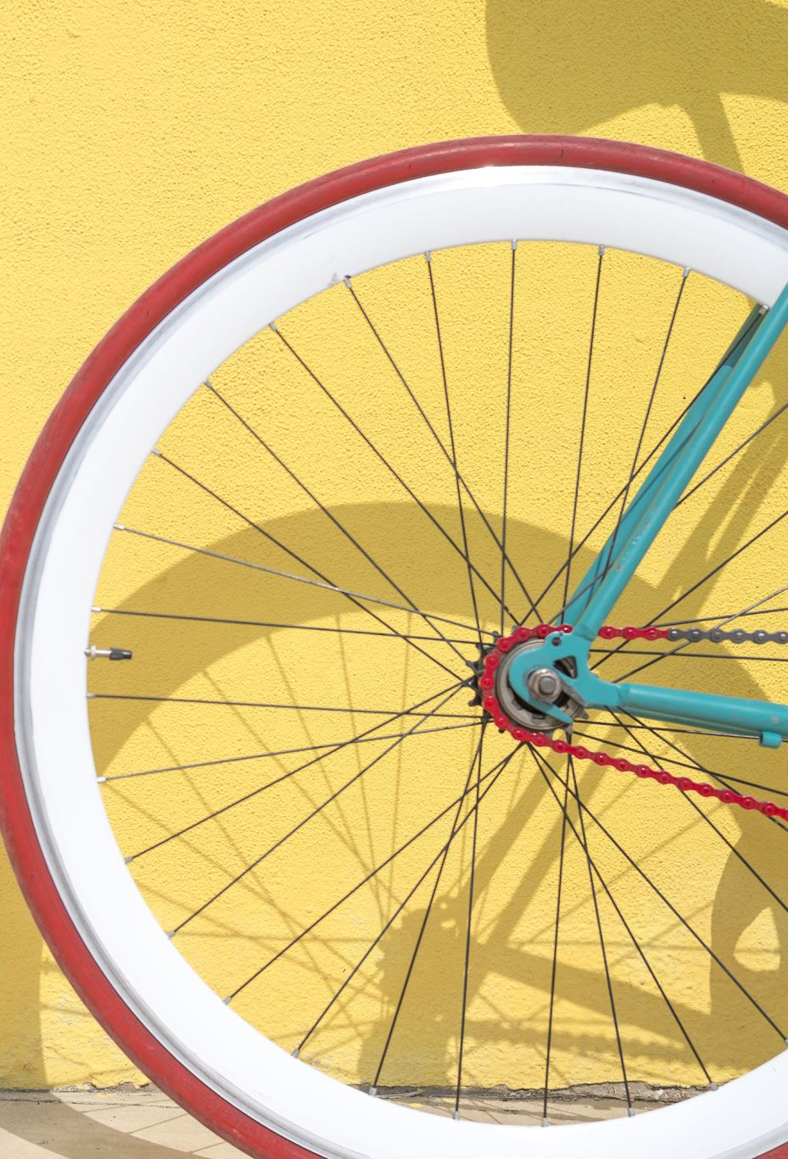
Acceleration-Brake (AB)
It is characterized by making use of the brakes immediately after an acceleration period.
It is an inefficient pattern of driving
KPI is defined to be the number of these events happening every 5 km.

Slide 12
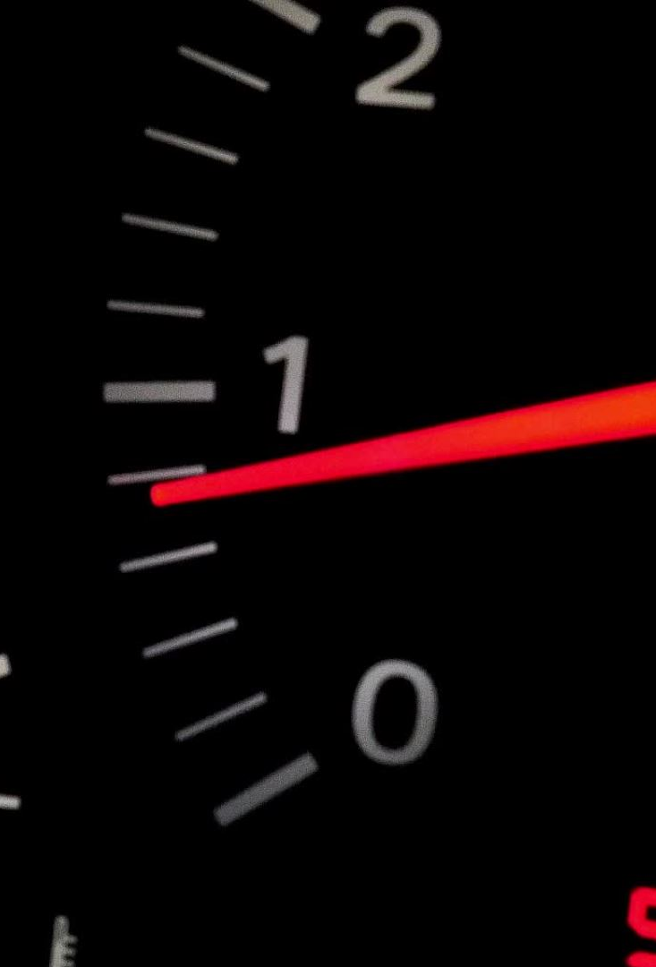
Brake-Acceleration (BA)
It consists of harsh breaking followed by acceleration (without stopping)
This is an inefficient and unsafe driving pattern
This pattern is a consequence of rash driving and not maintaining the safety distance.
The KPI is the number of these events happening every 2 km.

Slide 13

Stop Driving Pattern
Divided into two driving patterns
Idle driving pattern
Corrected Inertia Long Pattern (CIL)

Slide 14

Idle driving pattern
It is characterized by the situations in which the vehicle is idle but the engine is running for long periods of time.
This is an inefficient pattern of driving
The KPI is the percentage of time when the vehicle is idling

Slide 15
Corrected Inertia Long Pattern (CIL)
This is described as a succession of inertia events (with or without using the brakes) to stop the vehicle
This is an efficient driving pattern
The KPI for this is defined as the percentage of use of the brakes in the total duration of the pattern.

Slide 16
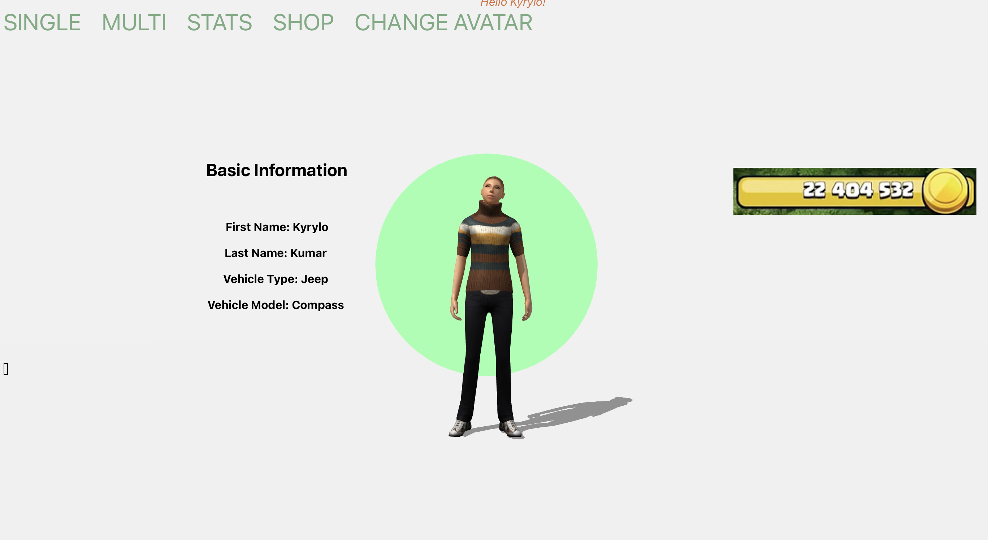
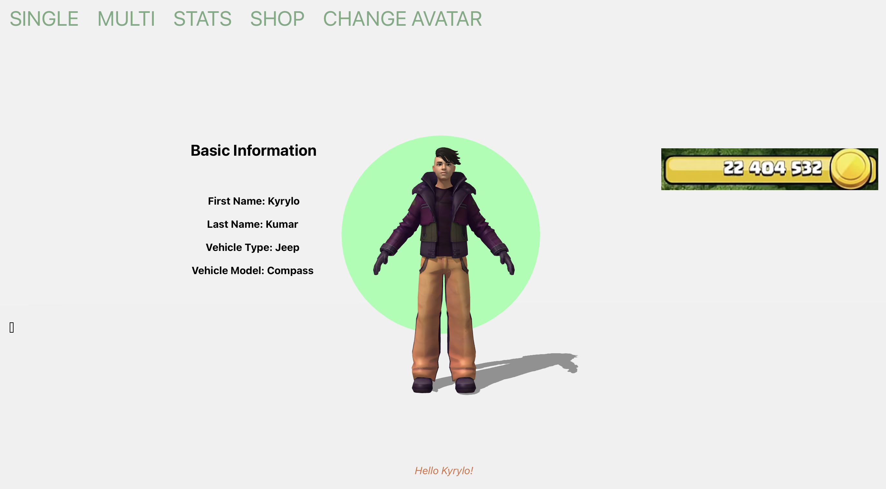
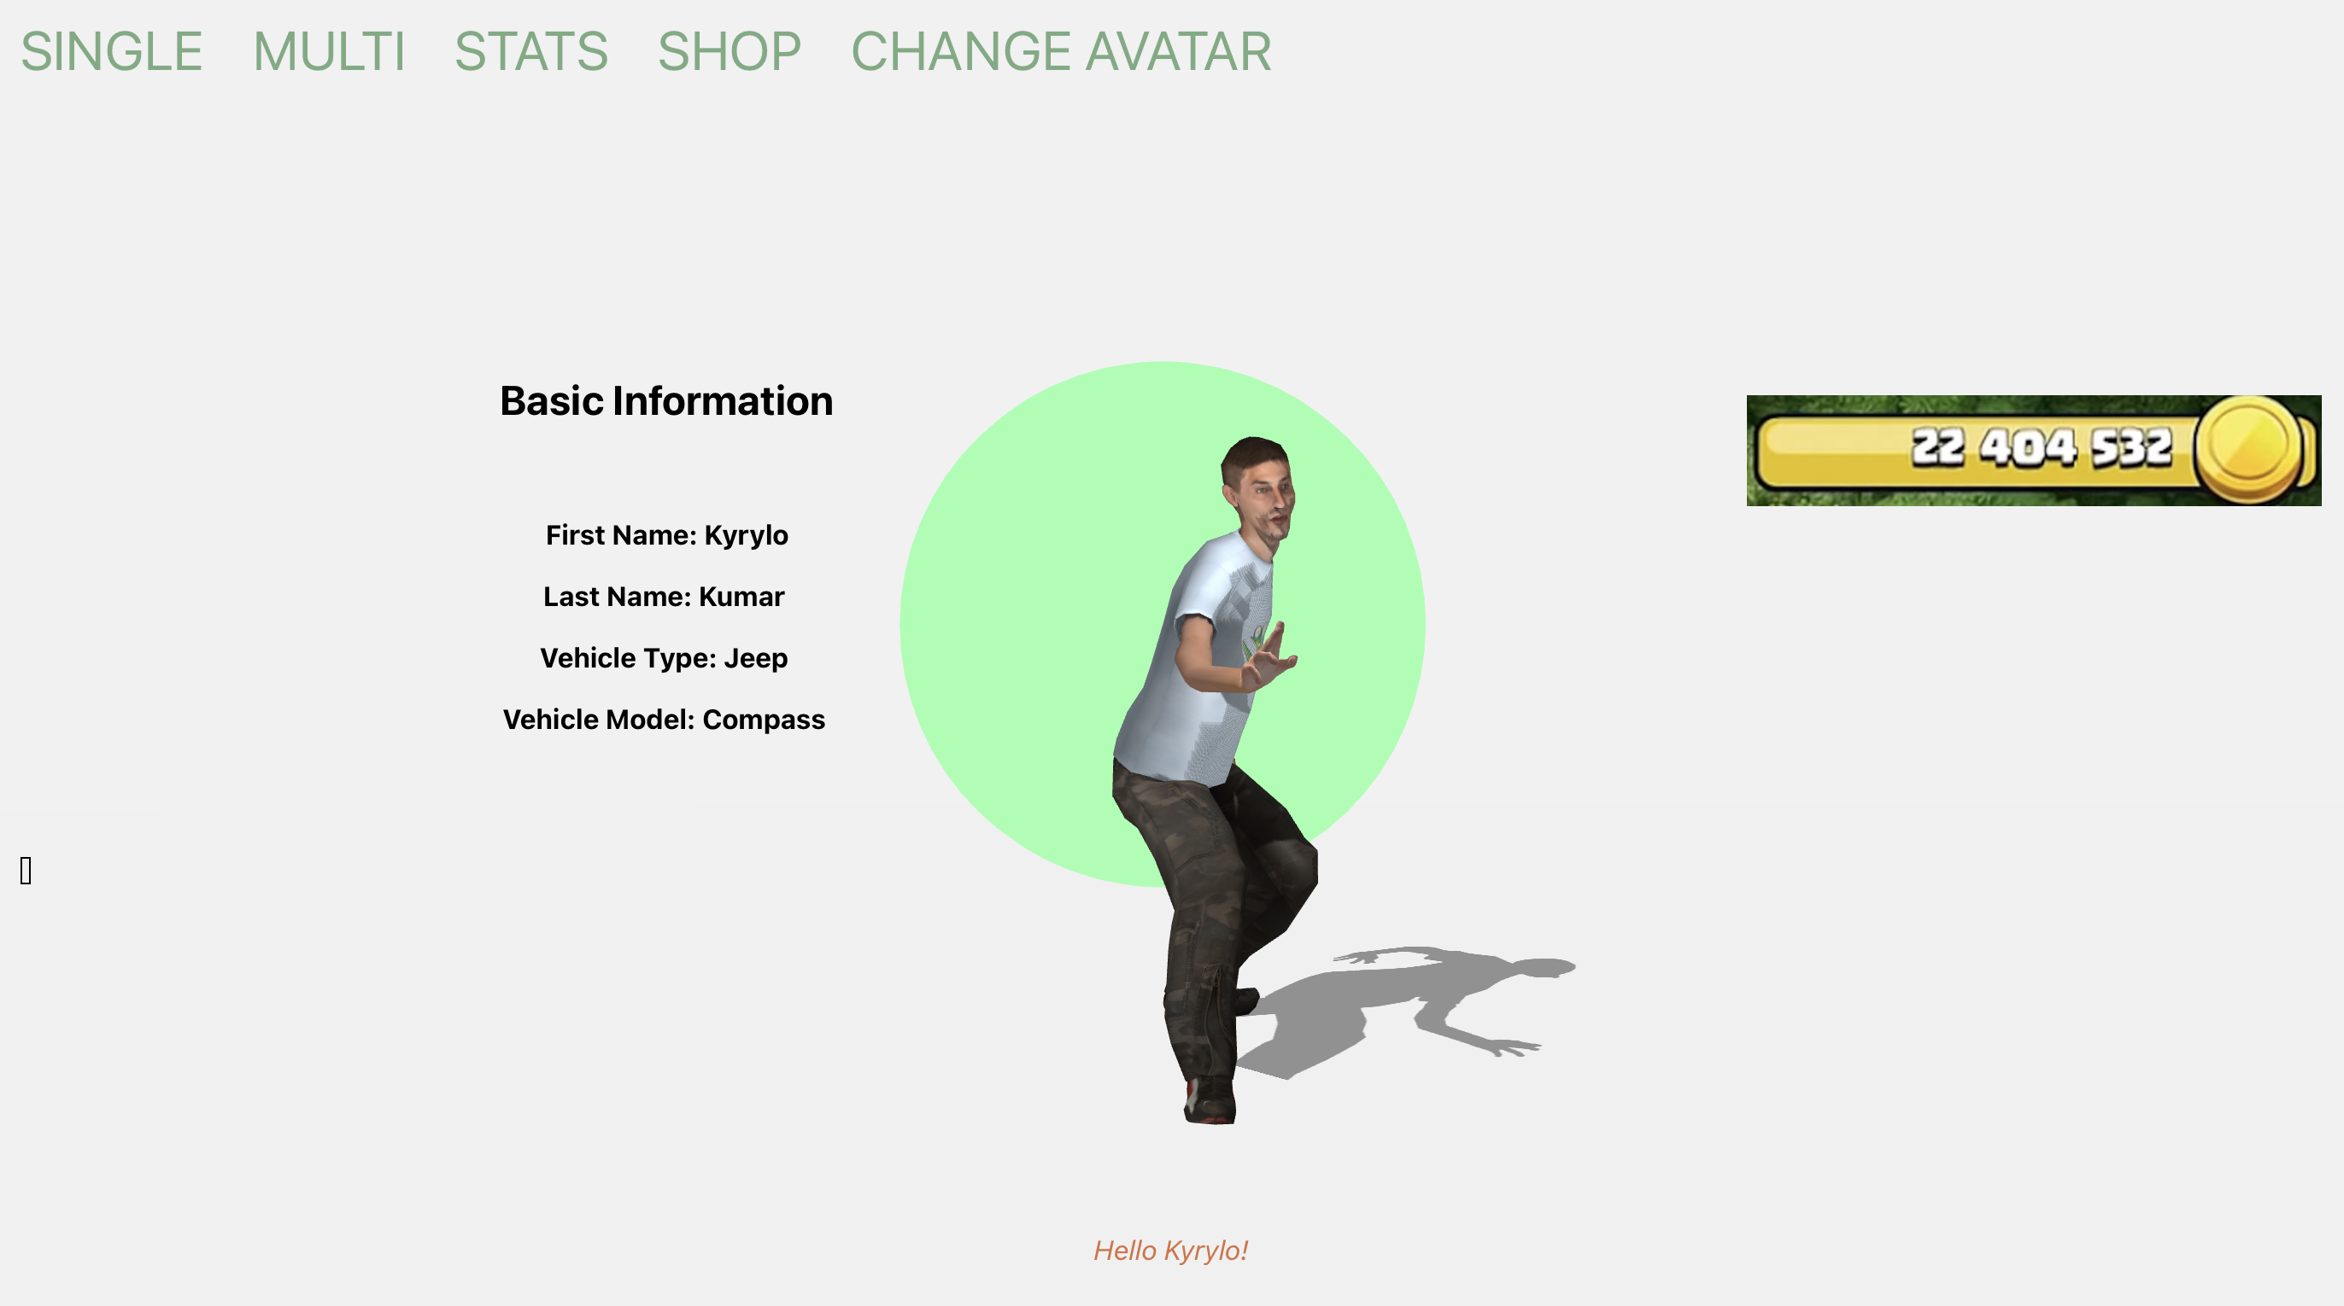
Player Profile

Slide 17
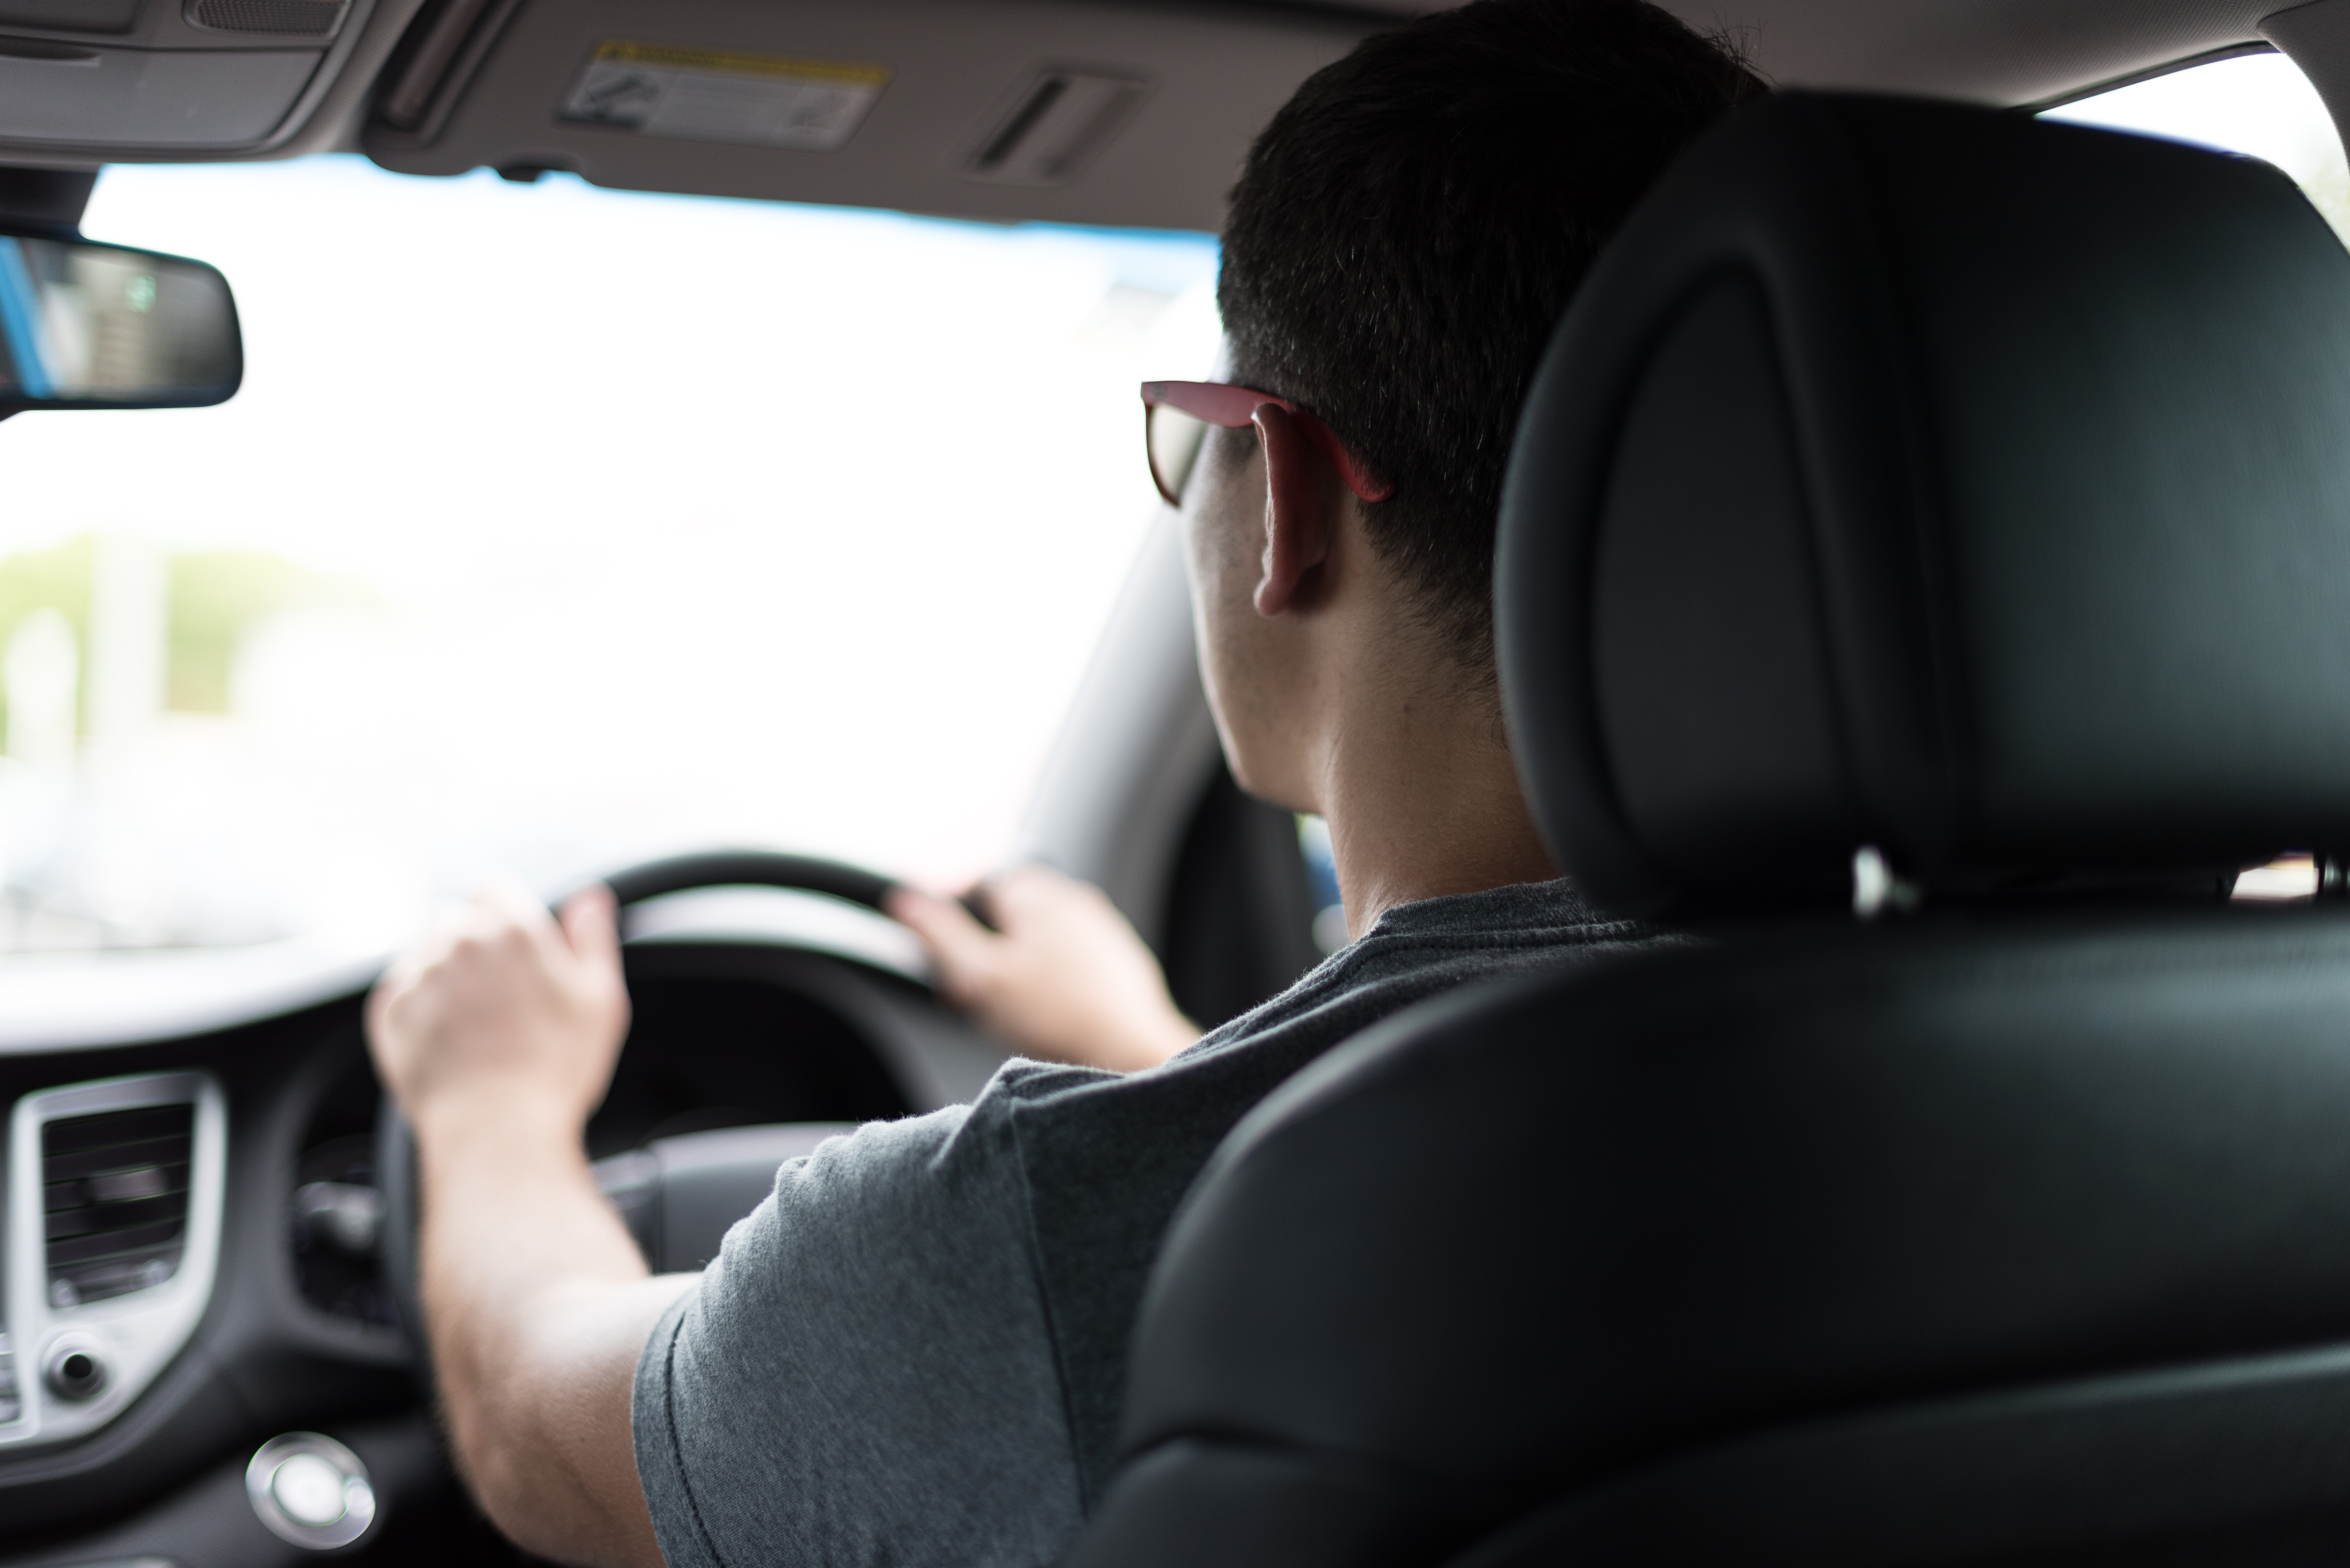
Single Player Mode
One can accumulate points by practicing safe driving techniques which will correspond to Stella Coins.
One cannot lose Stella Coins while playing in this mode.
This Photo by Unknown author is licensed under CC BY.

Slide 18
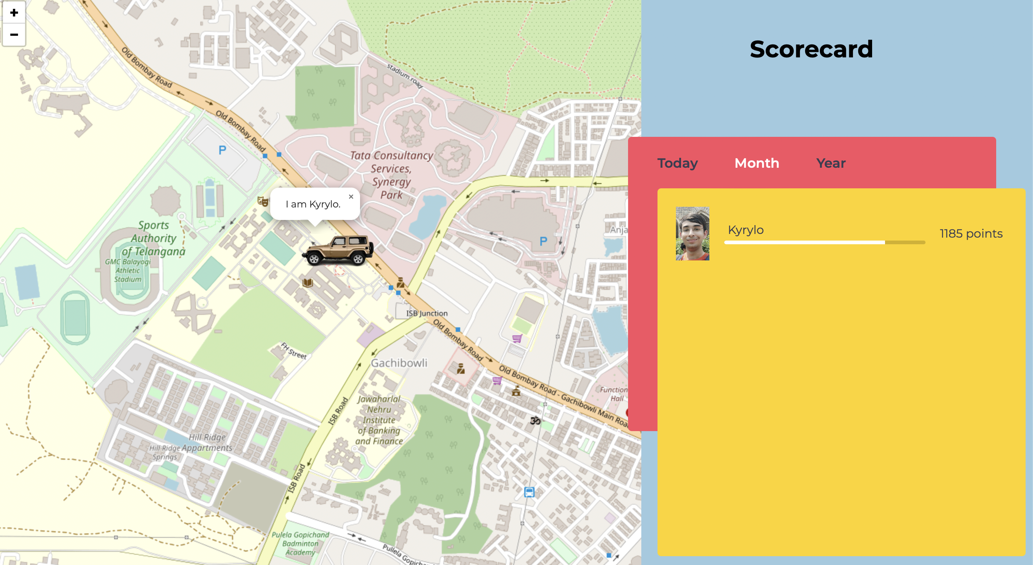
Interface for Single Player Mode

Slide 19
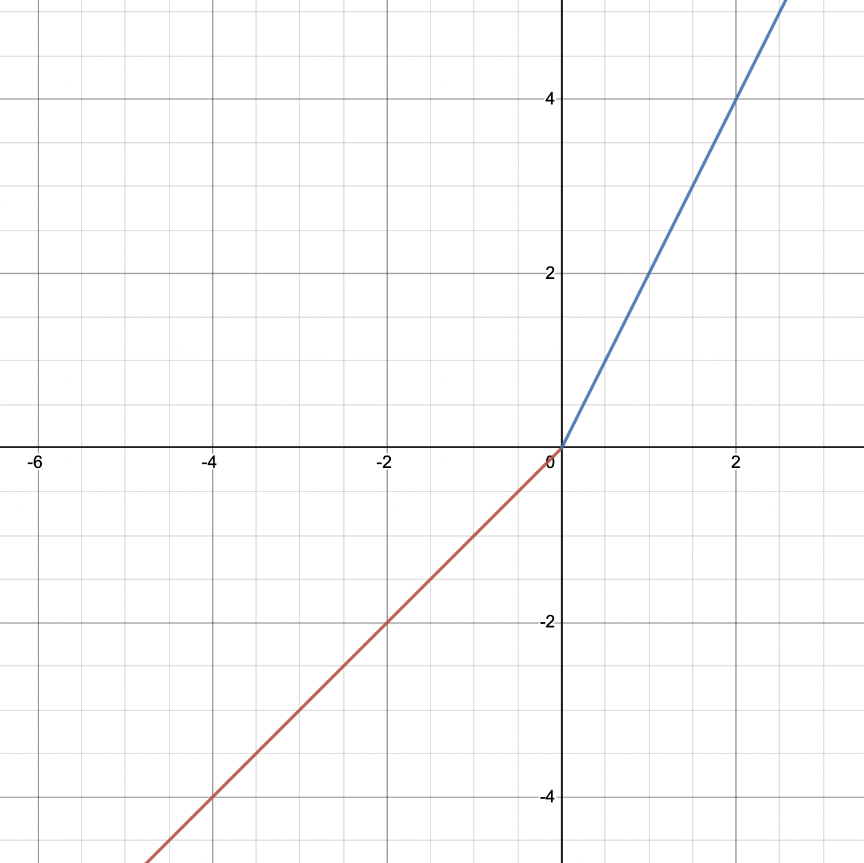
Multi Player Mode
Friends going to the same destination compete to steal the coins collected by other players in this route.
Players are incentivized to play this mode because they can collect upto twice as many coins in the same route.
Rankings amongst the players are based on their safe driving skills and punctuality.
After ranking is decided, players loose or gain coins based on the graph.
The competitiveness comes as one may lose coins in this mode.

Slide 20
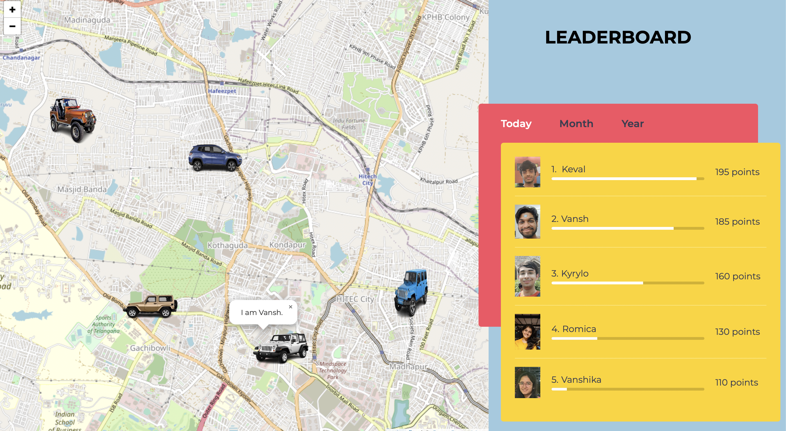
Interface for Multi Player Mode

Slide 21
Tournament Mode
Players can compete with anyone anonymously in the city using Tournament Mode even if they are not your friends.
Players do not have to go to the same destination rather they are ranked by total points collected over the entire tournament duration.
There is a registration cost for each tournament with heavy Stella Coin prizes to the winners.
There are three types of tournaments namely Blitz, Bullet and Classical based on the duration.

Slide 22

Player Rating
Player Rating is a dynamic value which is calculated by the aggregate of the safe driving parameter in the last 100 kms.
A low rating will inhibit players to buy items from the shop.
This Photo by Unknown author is licensed under CC BY-SA-NC.

Slide 23
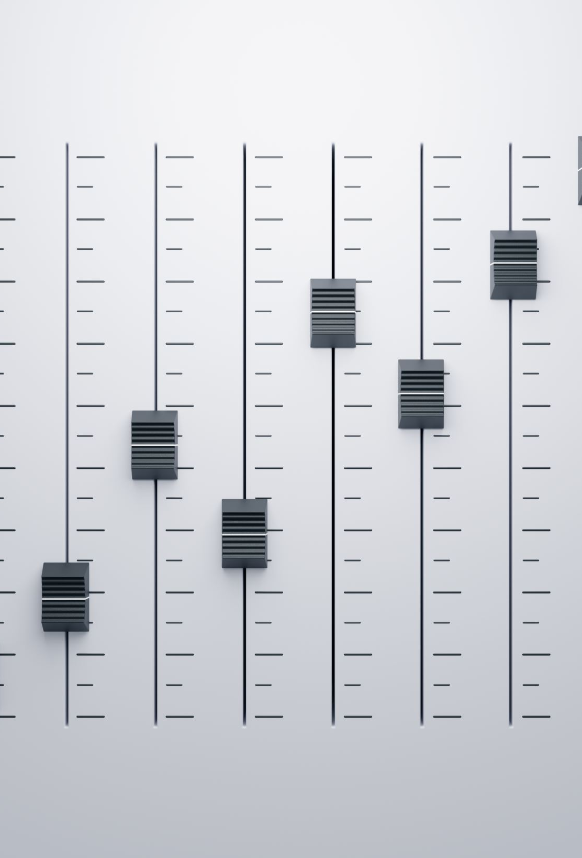
Levels
To level up, one must collect a certain number of points.
Levels are just an indication of player experience in this virtual world.
Items are unlocked in the shop based on the player's level.

Slide 24
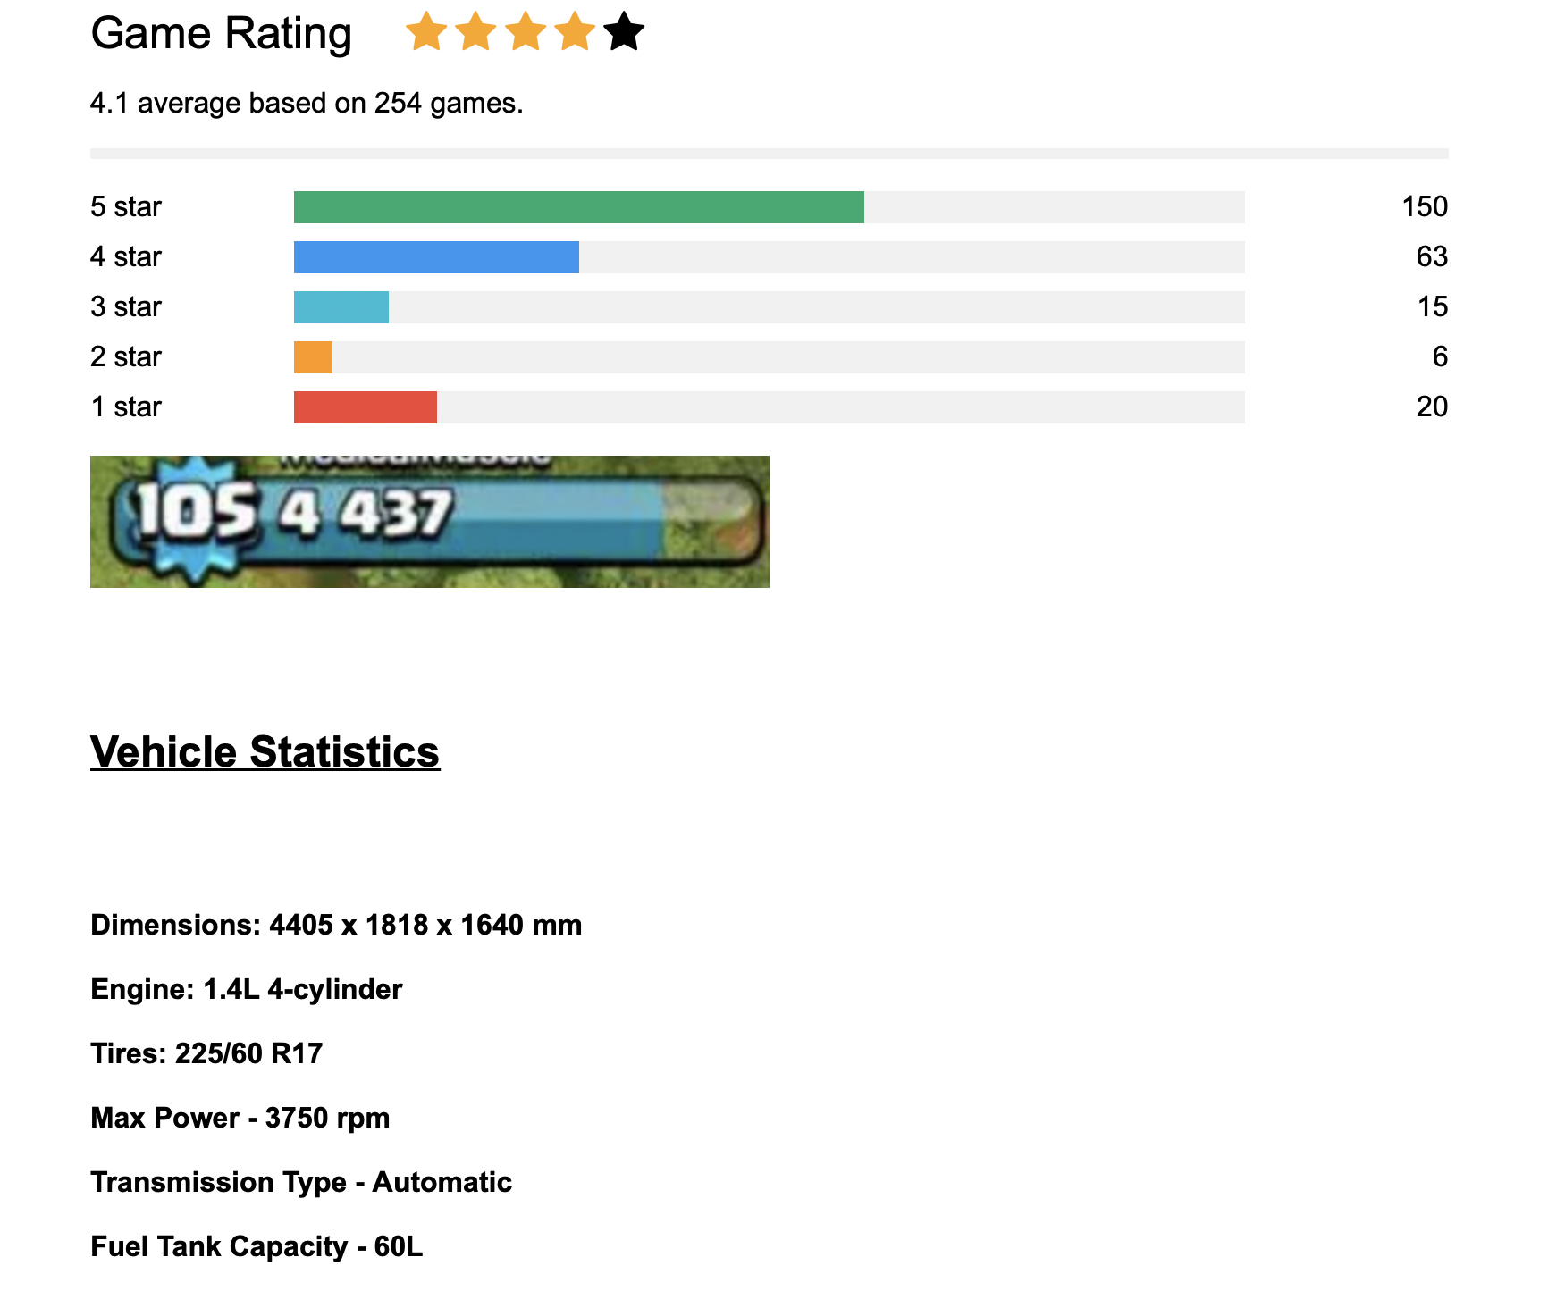
Statistics Page

Slide 25

Stella Coins
Stella Coins forms the backbone of our virtual world.
This currency can be used to buy items from the shop and compete in multiplayer events and tournaments.
It is controlled for inflation.
Stella Coins can also be used for mini games which can be added in the future.

Slide 26

Citation
https://www.sciencedirect.com/science/article/pii/S0968090X17302656

Slide 27
ENJOY THE GAME

