Slide 1
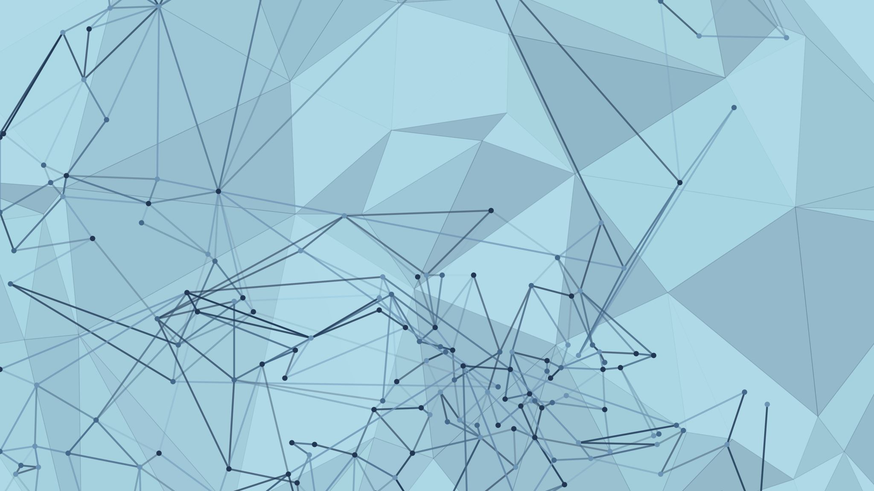
Enhancing User Travel Experience
By: Dining Philosophers

Slide 2
OUR TEAM
Kyrylo Shyvam Kumar
Vansh Garg
Keval Jain
Vanshika Dhingra
Romica Raisinghani

Slide 3
PROBLEM STATEMENT
Enhance the travel experience for users.
- AI-based trip enhancement - creating a movie and sharing for a trip inside vehicle
- Alexa skills linked AI bot / avatar for visual interaction
- NLP processing for Indian languages

Slide 4
INTRODUCTION
Imagine you are on a long road trip with friends and family. It becomes hard to chose a song which suits everyone's general preferences and their current mood. For example generally my father likes slower songs, and I prefer something more up-beat.
Our project model aims to seamlessly solve this issue, by suggesting a song from Spotify which is a good match of everyone's taste and mood

Slide 5

How we are solving the problem
Detecting the people present in the car using face detection AI
Having a database of preferred settings for each person along with their song history stored in the database
Configuring the car according to each person's preferred settings (e.g. seat inclination, lowering the window by a certain amount, etc)
Estimate the emotion of all the people present in the car
Predict a song based on people's combined music history and their current emotion using our song prediction AI

Slide 6
FACE RECOGNITION
What we try to achieve here is the fact that whenever a person or a group of people enter the car, our model should be able to detect as well as identify the person by some face detection mechanism which uses AI and enter their name in some csv file which can be used for further analysis by extracting information from the database.

Slide 7

Implementation of Face Detection
We require a pre-existing database that consists of multiple images of several people that we can use to identify a person entering the car with
This existing set of images is first encoded from BRG to RBG format as cv2 recognizes RBG format
The image captured by the webcam is also converted to the same format
The above two images are then compared by using the face_recognition library in python (using the face_distance parameter)

Slide 8
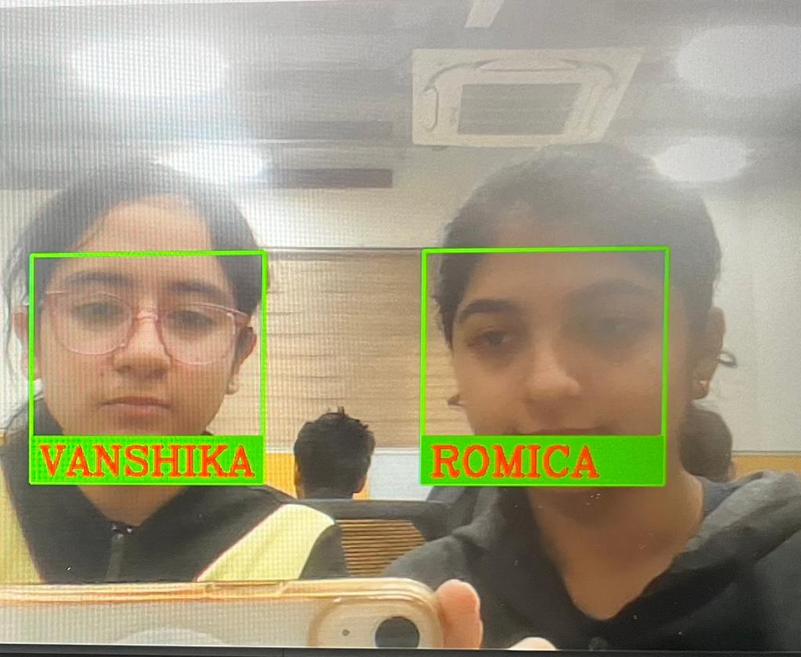
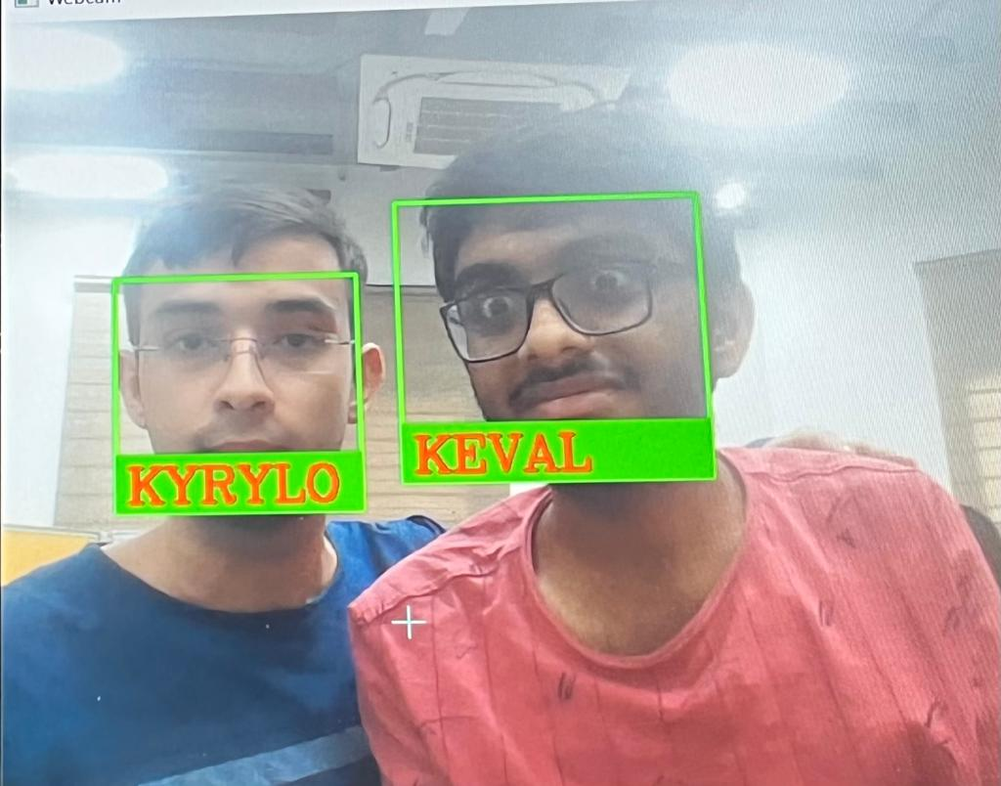
SNIPPETS OF FACE RECOGNITION

Slide 9
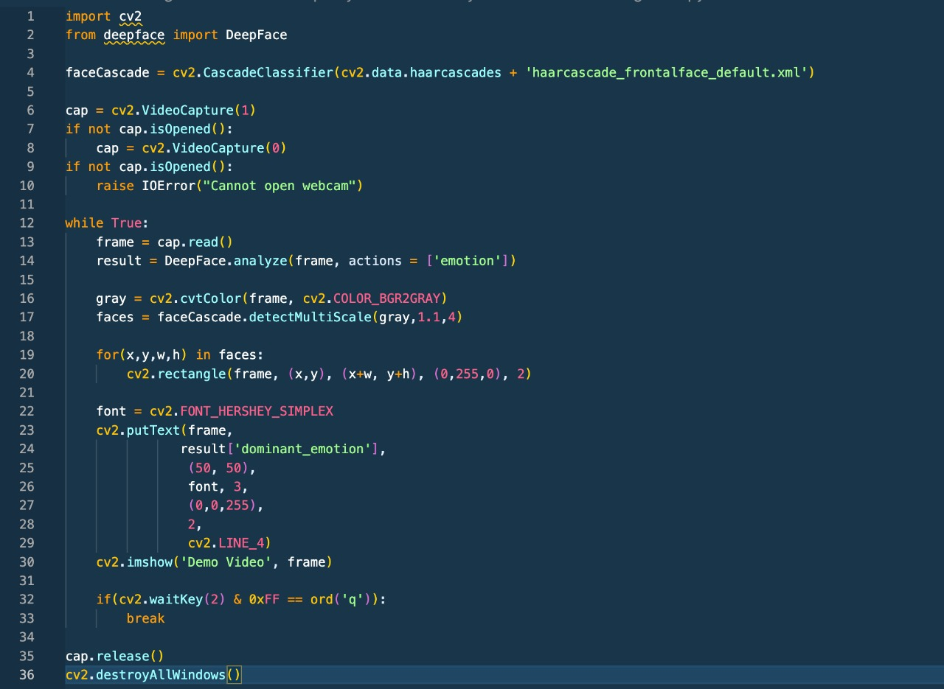
CODE SNIPPET OF FACE DETECTION ALGORITHM

Slide 10
Emotion Detection
One of the most effective ways to detect emotion is analyzing people's facial expression.
By using DeepFace (a lightweight face recognition analysis framework), we aim to guess the passenger's current mood.
We will guess the mood of all passengers in the car at every appropriate interval, which we pass to the Song Prediction AI along with their Music History to predict which song should be played next.

Slide 11
Implementation of Emotion Detection
The face recognition pipeline of DeepFace consists of four stages:
Detection, Allignment, Representation, Verification
The program employs a nine-layer neural network with over 120 million connection weights and was trained on four million images uploaded by Facebook users, reaching an accuracy upto 97%.

Slide 12
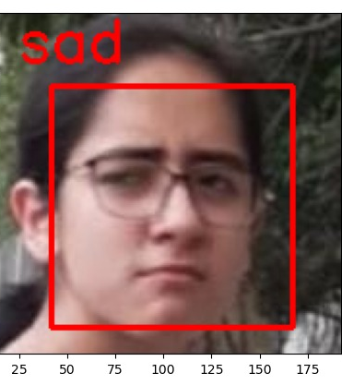
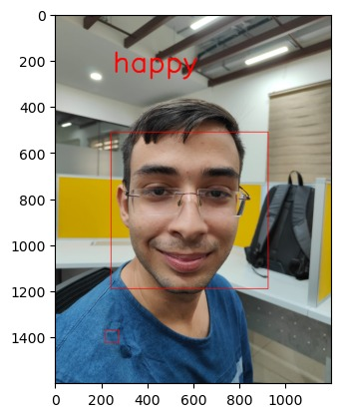
Snippets of Emotion Detection

Slide 13
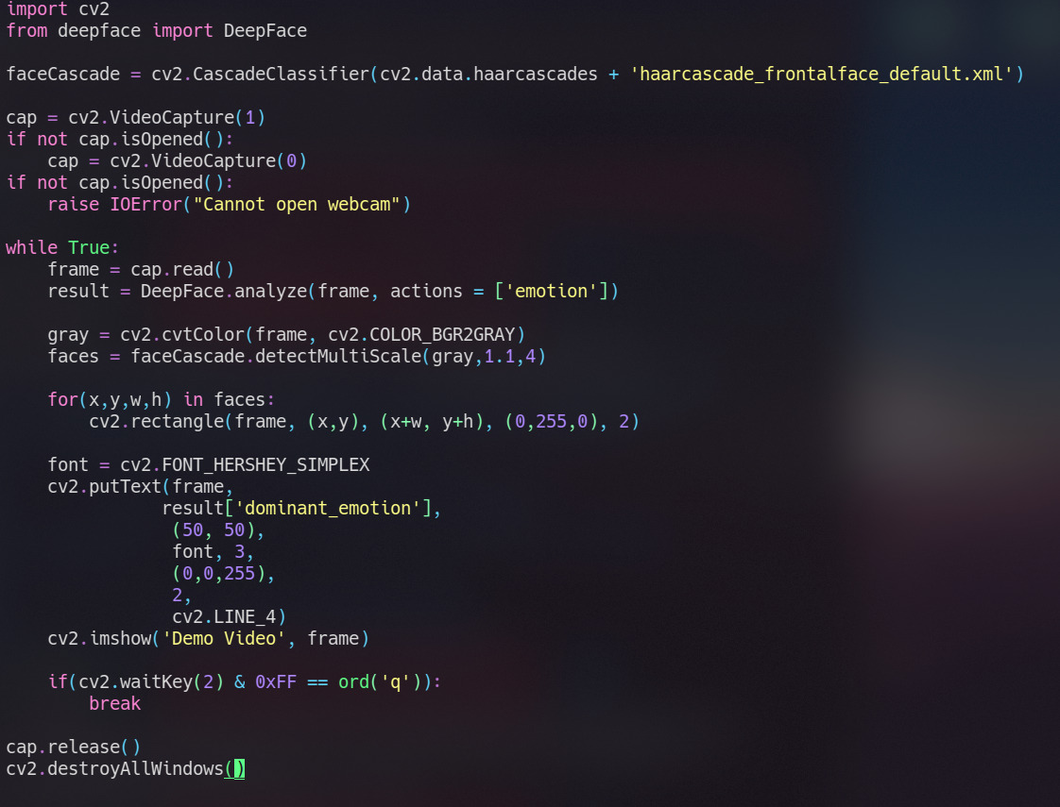
Snippets of Code for Emotion Detection

Slide 14

Implementation of song recommendation system
We have characteristics of different genres like energy, danceability etc.
Then we cluster these songs according to genres using k means method.
Combination of multiple playlists are used for this so as to recommend songs based upon their common interests

Slide 15
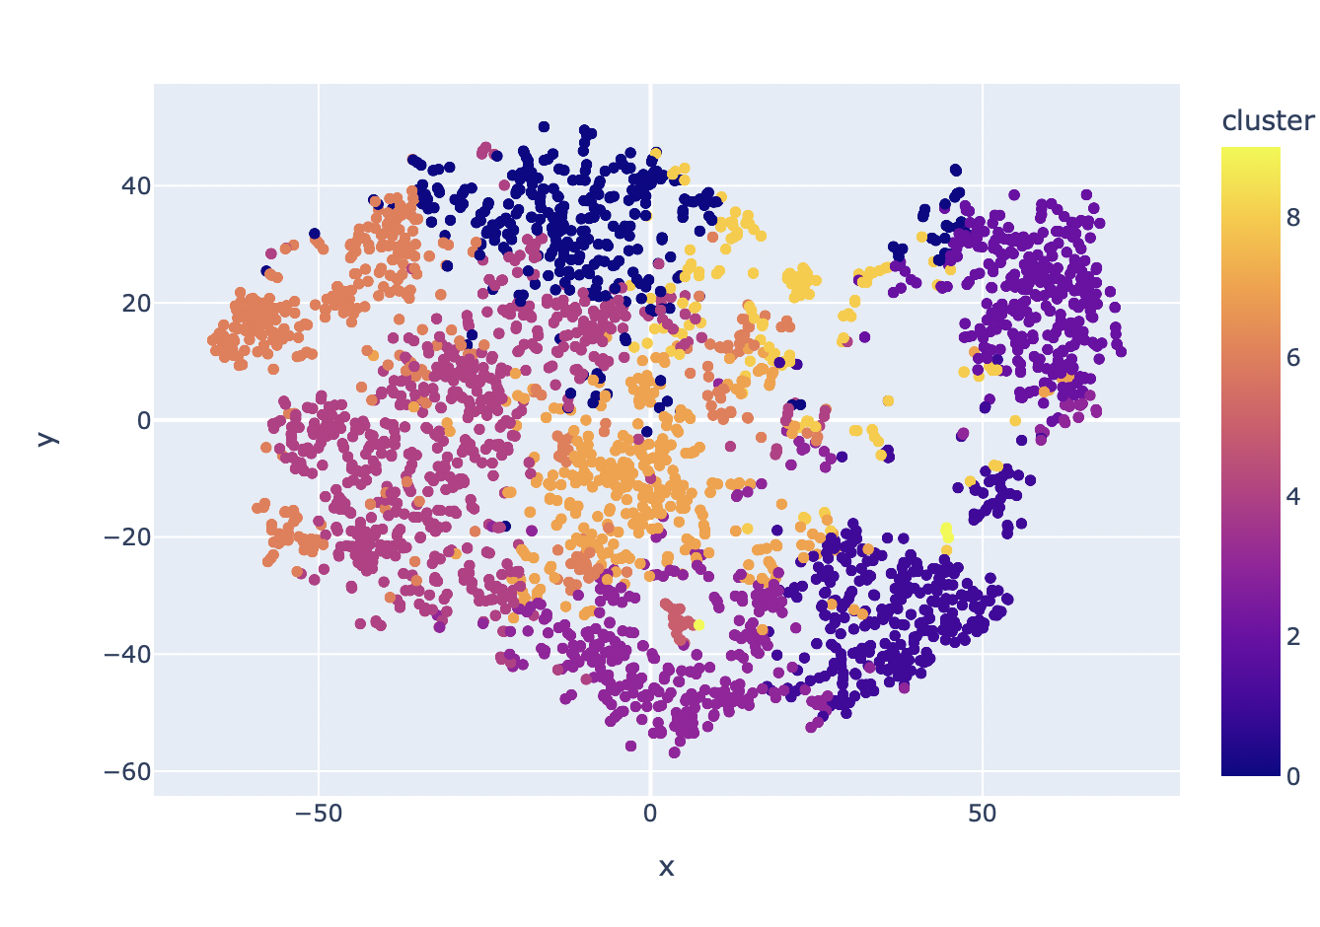
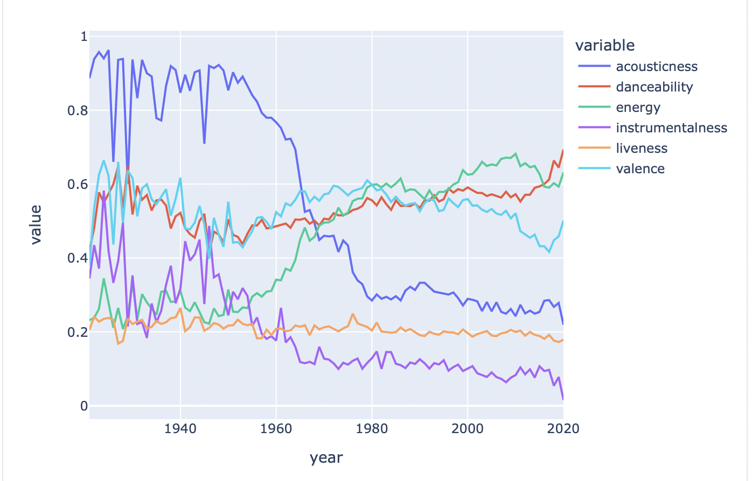
GRAPHICAL ANALYSIS OF SONG RECOMMENDATION

Slide 16

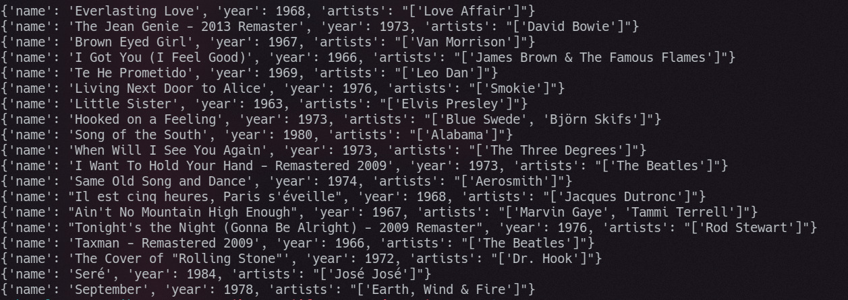
Input and Output samples in Song recommendation implementation

Slide 17
THANK YOU :)

