Slide 1

Helium

Slide 2
The Helium network is a decentralized wireless network that enables devices anywhere in the world to wirelessly connect to the Internet and geolocate themselves without the need for power-hungry satellite location hardware or expensive cellular plans.

Slide 3
Evolution
The Helium network is a wide-area wireless networking system, a blockchain, and a protocol token. The blockchain runs on a new consensus protocol, called the Helium Consensus Protocol, and a new kind of proof, called Proof-of-Coverage.
Helium Network We demonstrate an entirely new purpose-built blockchain network built to service WHIP and provide a system for authenticating and identifying devices, providing cryptographic guarantees of data transmission and authenticity, offer transaction primitives designed around WHIP, and more.

Slide 4
Proof-of-Coverage We present a computationally inexpensive Proof-of-Coverage that allows Miners to prove they are providing wireless network coverage. We anchor these proofs using a Proof-of Serialization that allows miners to prove they are accurately representing time relative to others on the network in a cryptographically secure way.
Proof-of-Location We outline a system for interpreting the physical geolocation of a Device using WHIP without the need for expensive and power-hungry satellite location hardware. Devices can make immutable, secure, and verifiable claims about their location at a given moment in time which is recorded in the blockchain.

Slide 5
Devices –(WHIP)-→ Miners---→ Routers(end point for Device data encryption)
Devices are hardware products that contain a WHIP-compatible radio transceiver and communicate with Hotspots. WHIP is designed to facilitate low power data transmission and reception, so typically Devices exist in the form of battery-powered sensors that can operate for several years using standard batteries. Device manufacturers are encouraged to use hardware-based key storage which can securely generate, store, and authenticate public/private key pairs without leaking the private key.
Miners provide wireless network coverage to the Helium network via purpose-built hardware, called Hotspots, which provide a long-range bridge between WHIP devices and the Internet.
Hotspots transmit data back and forth between Routers on the Internet and Devices while generating Proofs-of-Coverage
Hotspots can connect to the Internet using any TCP/IP capable backhaul, such as Ethernet, WiFi or Cellular.
Hotspots require a GPS or GNSS receiver to obtain accurate position and date/time information.

Slide 6
Routers can pay several Miners to obtain enough copies of a packet to geolocate a Device without needing satellite location hardware, which we call Proof-of-Location.
Routers are responsible for confirming to Hotspots that Device data was delivered to the correct destination and that the Miner should be paid for their service.

Slide 7
Motivation behind Helium Consensus protocol
Sybil attacks in which dishonest Miners create pseudonymous identities and use them to subvert the Helium network and gain access to block rewards to which they should not be entitled.
Alternate reality attacks, which exist where a dishonest group of Miners are able to simulate that wireless network coverage exists in the physical world when it in fact does not.

Slide 8
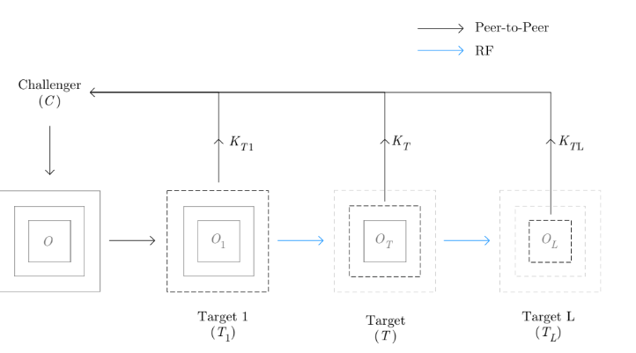
Multi-Layer Data Packet Deconstruction

Slide 9
Initial Target always with the lowest score

