Slide 1
Single cell RNA-sequencing data scaling and dimension reduction
Romika Kumari
scRNA-seq workshop
06.10.2022

Slide 2
What is data scaling?
Transforming your data so that it fits within a specific scale, like 0-100 or 0-1. Scaling of data is useful and/or necessary when variables span different ranges.
You want to scale data when you're using methods based on measures of how far apart data points, like support vector machines, or SVM or K-nearest neighbors or KNN.
By scaling your variables, you can help compare different variables on equal footing.

Slide 3
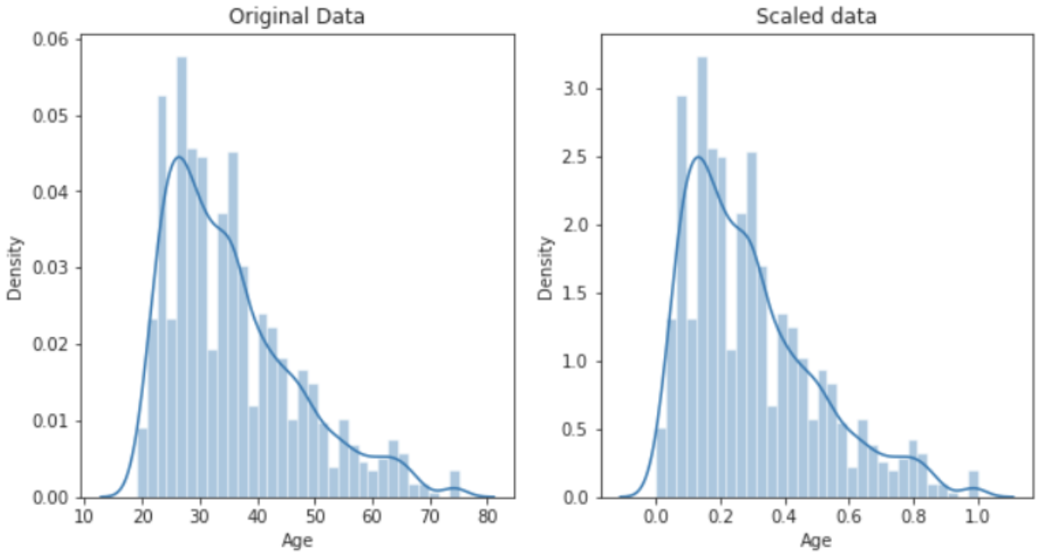
Example of data scaling

Slide 4
Scaling expression values prior to dimension reduction
Standardize expression values for each gene across all cells prior to PCA
This gives equal weight in the downstream analyses, so that highly expressed genes do no dominate.
Z-score normalization in Seurat’s ScaleData function
Shifts the expression of each gene, so that the mean expression across cells is 0.
Scales the expression of each gene, so that the variance across cells is 1.
ScaleData has an option to regress out unwanted source of variation
E.g., cells might cluster according to their cell cycle state rather than cell type.

Slide 5
Principal component analysis
Principal component analysis, or PCA, is a dimensionality-reduction method that is often used to reduce the dimensionality of large data sets.
It transforms a large set of variables into a smaller one that still contains most of the information in the large set.
And smaller data sets are easier to explore and visualize and make analysing data much easier and faster for machine learning algorithms.

Slide 6
Steps involved in PCA
Standardization
The aim of this step is to standardize the range of the continuous initial variables so that each one of them contributes equally to the analysis.
Covariance matrix computation
The aim of this step is to understand if there is any relationship between variable of the input data. If the variables are positively or negatively correlated to each other.
Compute the eigenvectors and eigenvalues of the covariance matrix to identify the principal components
Principal components are new variables that are constructed as linear combinations or mixtures of the initial variables. PCA tries to put maximum possible information in the first component, then maximum remaining information in the second and so on.

Slide 7
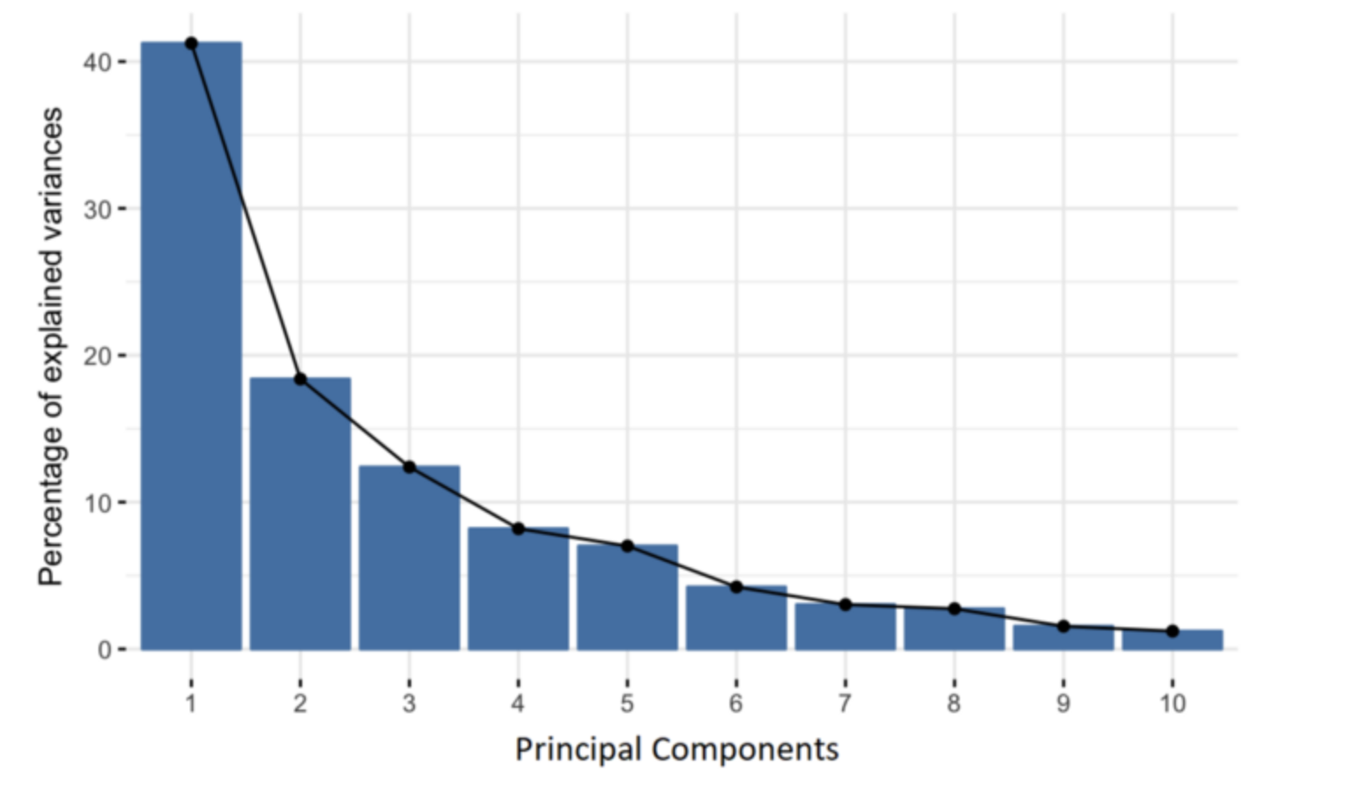
Organizing information in principal components this way, will allow you to reduce dimensionality without losing much information.

Slide 8
Seurat’s linear dimension reduction
Seurat provides a function RunPCA() that performs PCA on the scaled data.
We can specify the input features to use using the features argument. By default, only the previously determined variable features are used as input.
Cells and features that define the PCA can be visualized using functions VizDimReduction(), DimPlot(), and DimHeatmap().
How many components should we choose to include for downstream analysis?
JackStraw() and ElbowPlot

