Slide 1
Cell type annotation, pathway analysis and GO annotation

Slide 2
Challenge post clustering: to identify biological state of each cluster
Cell type
Gene ontologies
Pathway or Biological processes enriched in each cluster
Molecular function
Cellular compartment

Slide 3
Cell type annotation
Various methods
1) Manual annotations
Canonical markers curated from Databases and Literature.
2) Multimodal reference mapping
Multimodal single-cell technologies: simultaneously profile multiple data types in the same cell
Weighted-nearest neighbor” (WNN) analysis: analytical framework to integrate multiple data types measured within a cell and to obtain a joint definition of cellular state
A multimodal reference “atlas”:
CITE-seq reference of 162,000 PBMC measured with 228 antibodies
CITE-seq reference of human BMNC (bone marrow mononuclear)
3) Tools
SingleR
Sctype
SCSA

Slide 4
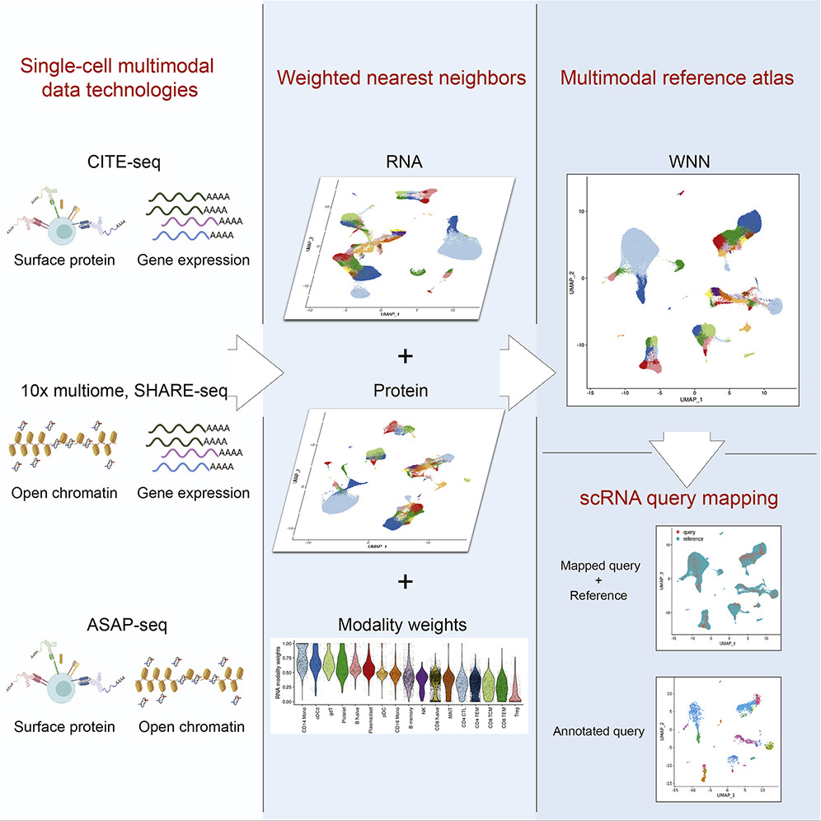
Multimodal reference mapping
Annotate each query cell based on a set of reference-defined cell states
Project each query cell onto a previously computed UMAP visualization
Hao, Yuhan, et al. "Integrated analysis of multimodal single-cell data." Cell 184.13 (2021): 3573-3587.

Slide 5
Weighted Nearest Neighbor Analysis
WNN workflow consists of three steps
Independent preprocessing and dimensional reduction of each modality individually
Learning cell-specific modality ‘weights’, and constructing a WNN graph that integrates the modalities
Downstream analysis (i.e. visualization, clustering, etc.) of the WNN graph

Slide 6
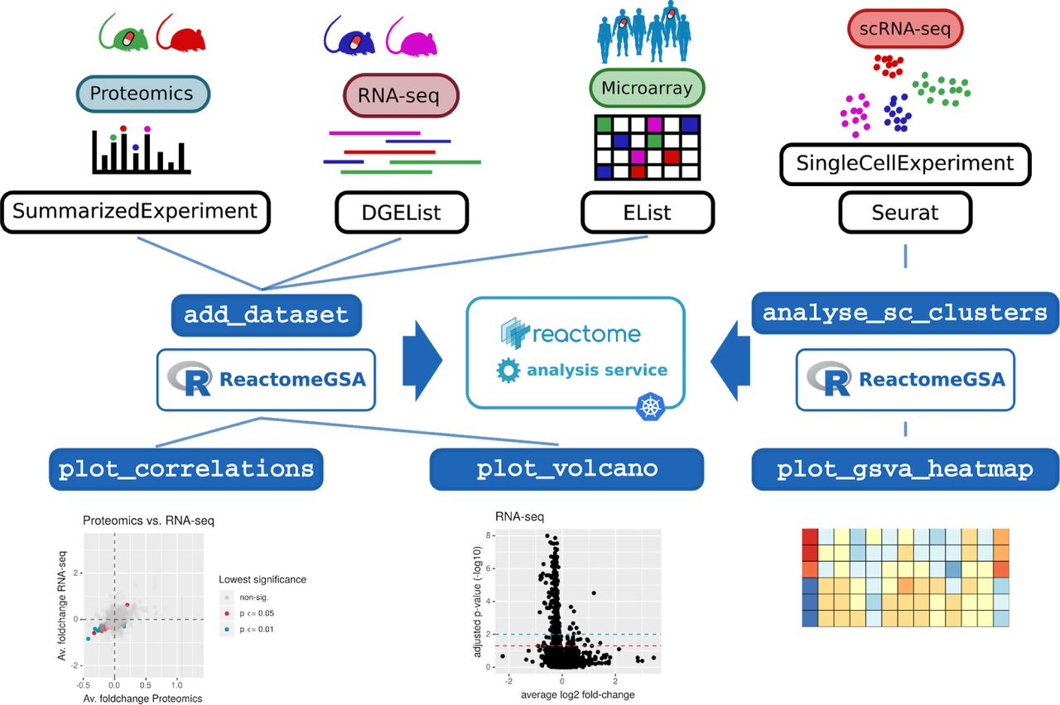
Pathway and GO annotations
ReactomeGSA
Griss, Johannes, et al. "ReactomeGSA-efficient multi-omics comparative pathway analysis." Molecular & Cellular Proteomics 19.12 (2020): 2115-2125.

Slide 7
Pathway and GO annotations
2) ssGSEA
3) EnrichR

