Slide 1

Leveraging Data Relationships to Resolve Conflicts from Disparate Data Sources
Romila Pradhan, Walid G. Aref, Sunil Prabhakar

Slide 2
Fusing data from multiple sources
Data Item | S₁ | S₂ | S₃ | S₄ | S₅
Basera |  | 745 9th Avenue | 357 East 50th St. | Midtown East
Alto | New York City | 520 Madison Avenue | 11 East 53rd St. | Midtown East | East 50s
A voce | New York | 41 Madison Avenue | Flatiron/Union Square | Gramercy/ Flatiron | Flatiron
Notes:
Consider a large collection of web data that is used to obtain facts about data items, e.g., websites providing information on locations of restaurants. Each cell on this table is a claim provided by a source toward the location of a data item. We can see conflicts on data items from the different sources -= conflicts arise because sources often make mistakes -- either unknowingly (providing erroneous information, copying from other sources), or deliberately (to mislead facts). For each data item, there could be a single or multiple correct claims. Data fusion, or truth discovery, deals with the problem of identifying correct information about data items given conflicting information from multiple data providers.

Slide 3
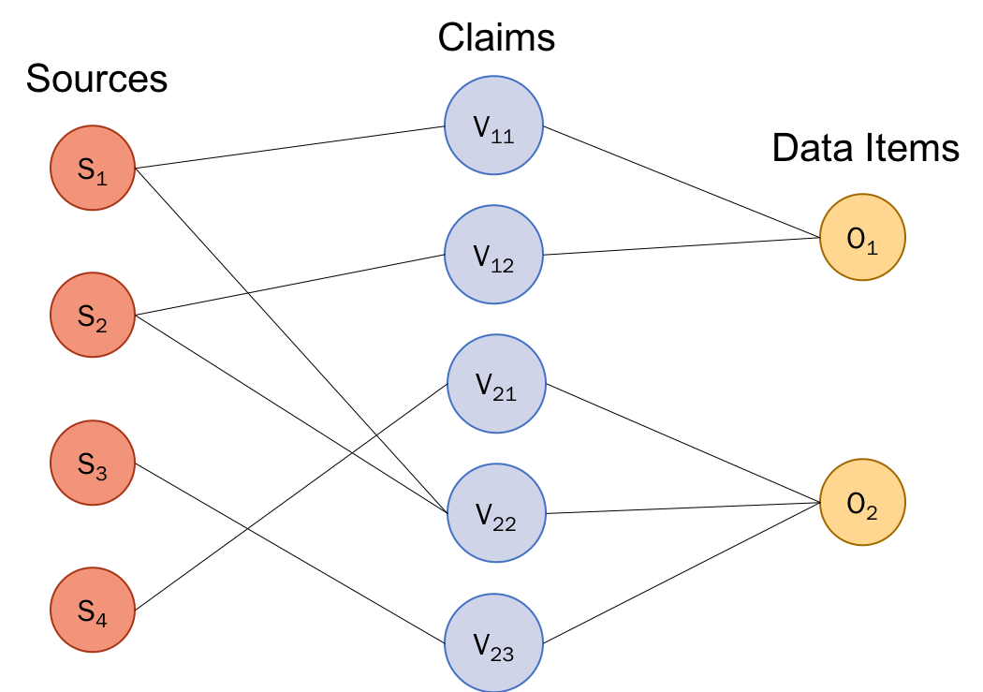
General principle of data fusion
Sources determine the correctness of claims
Source quality measures
Correctness of claims
0.7
v₁₁ | 0.79
v₁₂ | 0.82
v₂₁ | 1.00
v₂₂ | 0.31
v₂₃ | 0.45
0.9
0.5
Failing to acknowledge claim relationships has been observed to account for as much as 35% of false negatives in data fusion tasks¹.
1.0
Training Data
1. X. L. Dong, E. Gabrilovich, G. Heitz, W. Horn, K. Murphy, S. Sun, and W. Zhang, “From data fusion to knowledge fusion”. PVLDB, 2014.
Notes:
Data fusion has the underlying assumption that the quality of sources plays an important role in determining the correctness of claims, e.g., information provided by a highly trusted data source is trusted more often that that provided by a less trusted source.
Given a set of data items and sources that provide claims about those data items, data fusion systems characterize sources by their quality measures -- that could be either a single metric such as accuracy, i.e, how many times did the source provide correct information, or a set of metrics such as precision and recall to quantify how good a source is. Given these quality measures, data fusion models adopt either a Bayesian-based formulation or an iterative approach or an optimization-based approach or an approach based on probabilistic graphical models to estimate the correctness of claims.
The source quality measures are obtained either from training data or estimated based on the claim correctness estimates in which case it becomes an iterative fusion model.
A lot of work has been done in considering dependence between data sources -- where dependencies could be in the form of copying or positive/negative correlations between sources. However, the space of relationships among claims has largely been unexplored. Failing to acknowledge ~35% false negatives.

Slide 4
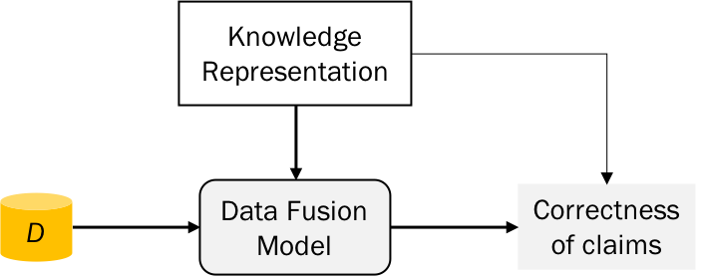
This talk
Representing claim relationships
Observed relations
?
Integration with data fusion models
Evaluation
Notes:
In this talk, we would talk about the relationships observed among claims of data items, how do we represent such relationships, how do we integrate this knowledge with data fusion models and finally evaluate our approach on a real dataset.

Slide 5
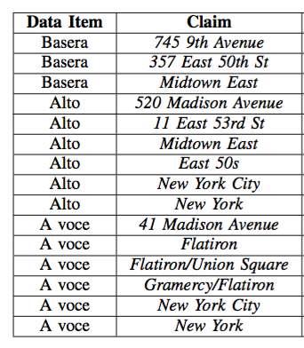
Relationships observed in data
Claims could be related through rich semantics, e.g., hierarchically
‘New York City’ is a city in ‘New York’ state
‘Midtown East’, ‘Flatiron’, ‘Union Square’, ‘Gramercy’ are neighborhoods in ‘New York City’
‘Flatiron’ is a part of the ‘Flatiron/Union Square’ and ‘Gramercy/Flatiron’ areas
observed relations | representing relationships | integration with fusion | evaluation

Slide 6
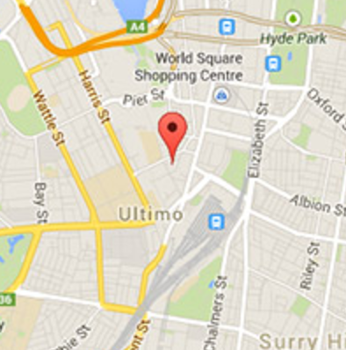
Relationships observed in data
There could be alternate representations for the same claim
520 Madison Avenue
11 East 53rd St
Represent the same physical location!
observed relations | representing relationships | integration with fusion | evaluation
Notes:
Such discrepancy may be because of the way data is collected by different sources – where one source may have obtained the mailing address or copied from another, some other source may have gone to the actual physical location and provided the best address that they could. In the above example, this particular restaurant was in a building that stands at the intersection of these two streets.

Slide 7
Integrity constraints on claim correctness
Correctness of a claim may support that of another or, contradict another claim
If ‘745 9th Avenue’ is not a part of the ‘Midtown East’ neighborhood, then both the claims cannot be be simultaneously correct
If ‘Flatiron’ is correct, ‘Flatiron/Union Square’ and ‘Gramercy/Flatiron’ should also be correct
observed relations | representing relationships | integration with fusion | evaluation

Slide 8
Likelihood of claim correctness
Correctness probability produced by data fusion models may not reflect the true likelihood of a claim being correct.
e.g., using TruthFinder², for item “A voce”,
P(41 Madison Avenue = true) = 0.97
P(New York = true) = 0.88
However, in the ideal case,
P(New York) > P(41 Madison Ave)
X. Yin, J. Han, and P. S. Yu, “Truth discovery with multiple conflicting information providers on the web,” TKDE, 2008.
observed relations | representing relationships | integration with fusion | evaluation

Slide 9
How do existing fusion models consider claim relationships ?
Single Truth
Each data item has one correct claim
Claims are often independent of each other but could be “similar” to other claims Implication/similarity based on ad hoc measures, e.g., Jaccard index, edit distance, numerical tolerance
Multiple Truths
Data items can have more than one correct claims. The correct claims do not need to be related.
Claims are independent of each other
observed relations | representing relationships | integration with fusion | evaluation
Notes:
The implication/similarity between claims of single-truth models is often based on ad hoc similarity measures that heavily depends on the data at hand -- such as edit distances for strings, tolerance value for numerical claims and Jaccard index for similarity between sets of claims.
On the other hand, multi-truth fusion models completely disregard the existence of relationships among claims of data items. Implications between observations may offer completely new scenarios in the multi-truth setting, e.g., integrity constraints may mandate that multiple true claims be associated to each other

Slide 10
Arbitrary directed graphs to represent claim relationships
New York
Nodes represent claims
Edge from a specific claim to a general claim
New York City
745 9th Ave
Midtown East
Gramercy/
Flatiron
Flatiron/
Union Sq.
East 50s
Flatiron
11 East 53rd St.
357 East 50th St.
520 Madison Ave
41 Madison Ave
observed relations | representing relationships | integration with fusion | evaluation
Notes:
In our search for a good representation of this knowledge, we realized that an arbitrary directed graph works remarkably well for our purpose where nodes represent claims of data items and an edge goes from a specific to a general claim.

Slide 11
Directed graph in the context of data fusion
New York
Relationships:
Subsumption
Equivalence
Mutual Exclusion
Overlaps between claims
New York City
745 9th Ave
Midtown East
Gramercy/
Flatiron
Flatiron/
Union Sq.
East 50s
Flatiron
11 East 53rd St.
357 East 50th St.
520 Madison Ave
41 Madison Ave
observed relations | representing relationships | integration with fusion | evaluation
Notes:
We see that arbitrary directed graphs of this manner are able to represent the different relationship semantics, e.g.,
(subsumption) A claim at the tail of an edge is a more specific claim than one at the head of the edge. (support) It also indicates that the claim at the tail implicitly supports that at the head.
(multiple implications) An edge from child to parent or parents indicates overlapping claims – with the overlap agreeing with more than just one claim.
(alternative representations) Mutually agreeing claims or claims that are equivalent representations of each other can be found by discovering strongly connected components of the graph. All claims in a strongly connected component are equivalent to each other.
(mutual exclusion) Claims that are not reachable from/to one another are mutually exclusive. For example, a song may not simultaneously be both classical and rap. Or, a building can be in only one city.

Slide 12
Notion of support among claims
Expressed through reachability:
A claim is supported by all claims that can reach it
A claim supports all claims that are reachable from it
New York
New York City
745 9th Ave
Midtown East
Gramercy/
Flatiron
Flatiron/
Union Sq.
East 50s
Flatiron
11 East 53rd St.
357 East 50th St.
520 Madison Ave
41 Madison Ave
observed relations | representing relationships | integration with fusion | evaluation

Slide 13
Pre-processing the graph for effective representation
Transitive reduction
Remove redundant edges
By using the property of transitivity
Condensation
Represent alternative representations
By identifying strongly connected components
Final result: Directed Acyclic Graph (DAG)
New York
New York City
745 9th Ave
Midtown East
Gramercy/
Flatiron
Flatiron/
Union Sq.
East 50s
Flatiron
11 East 53rd St.
357 East 50th St.
520 Madison Ave
41 Madison Ave
observed relations | representing relationships | integration with fusion | evaluation
Notes:
A directed graph such as this could have redundant edges and vertices. If “520 Madison Ave” supports “East 50s”, then by transitivity, it also supports “New York”. It would suffice to say that everything reachable “520 Madison Ave” is supported by it. In this case, redundant edges are those that exist between nodes that are reachable through other edges and are removed through a transitive reduction of the directed graph.
Similarly, the graph could have redundant vertices specified by nodes that are alternative representations of each other and support each other. Such nodes are removed through graph condensation where in nodes in strongly connected components are identified and replaced by a single node re[resenting all equivalent claims.
The final result is a directed acyclic graph that is devoid of loops and redundant edges.

Slide 14
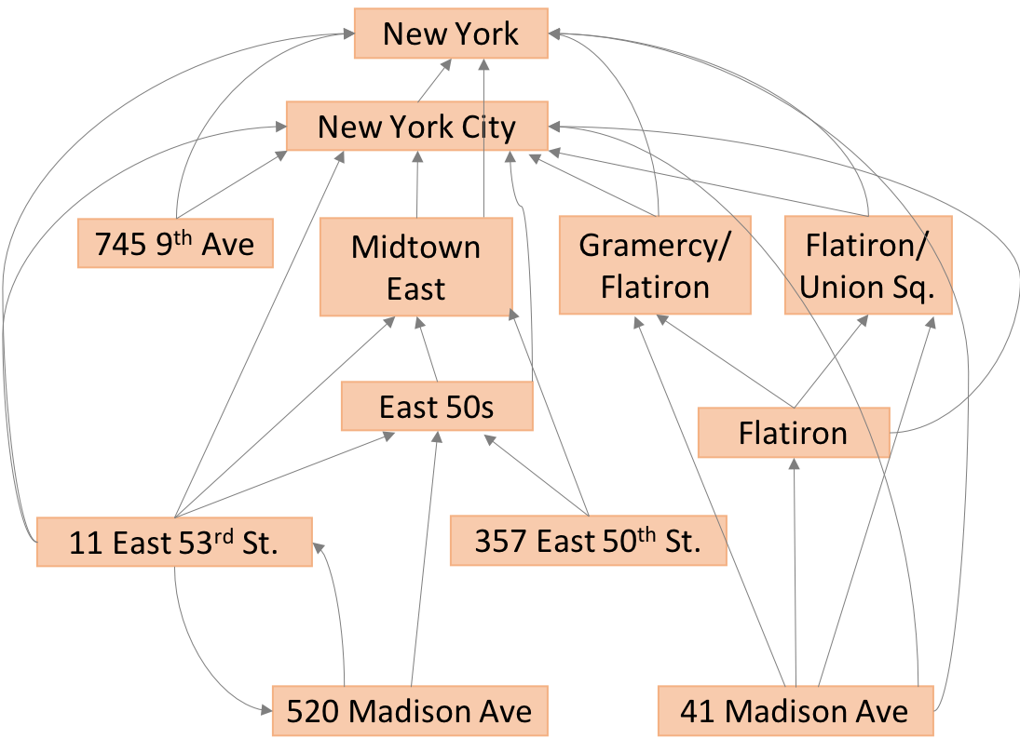
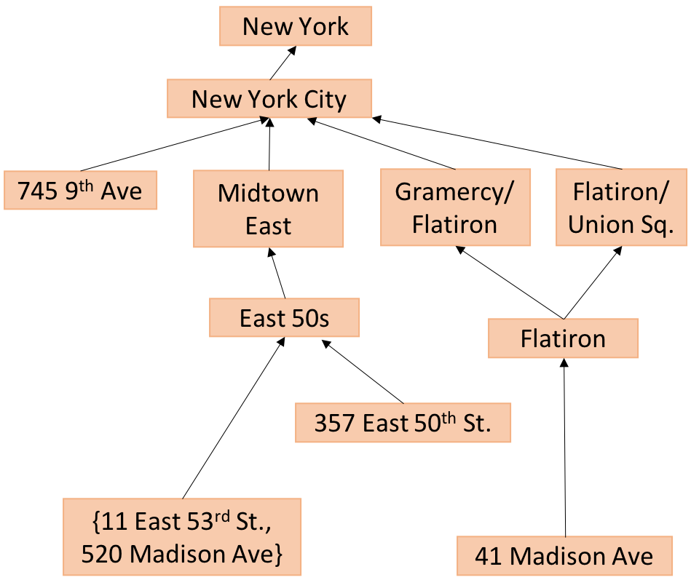
Pre-processing the graph for effective representation
Original directed graph
Directed acyclic graph without redundant edges and with collapsed nodes
observed relations | representing relationships | integration with fusion | evaluation

Slide 15
How to integrate directed graphs with data fusion models?
Directed graph
D
Correctness of claims
Data Fusion Model
observed relations | representing relationships | integration with fusion | evaluation
Notes:
Now given this directed acyclic graph, how can we use it to modify data fusion models and to estimate correctness probabilities of claims?

Slide 16
Source properties change
A source that provides claim “A” now implicitly supports claims that “A” supports
e.g. the accuracy of source S₂ that provides “41 Madison Ave” will depend on the correctness of claims “41 Madison Ave”, “Flatiron”, “Gramercy/Flatiron”, “Flatiron/Union Sq.”, “New York”
New York
New York City
745 9th Ave
Midtown East
Gramercy/Flatiron
Flatiron/Union Sq.
East 50s
Flatiron
357 East 50th St.
{11 East 53rd St., 520 Madison Ave}
41 Madison Ave
observed relations | representing relationships | integration with fusion | evaluation
Notes:
The first observation we make is that source quality measures are altered as a result of incorporating domain knowledge of claim relationships.
Any source that provides a claim at a leaf level implicitly supports claims that are reachable from the said claim. This way, sources may be perceived to have higher accuracies/recall-precision – whatever the source quality measures are, they may improve.

Slide 17
Correctness probabilities of claims change
The correctness of a claim is affected by sources that provide claims supporting it
e.g., correctness of claim “Flatiron” depends on source S₅ and also depends on source S₂ that provides claim “41 Madison Ave”
New York
New York City
745 9th Ave
Midtown East
Gramercy/Flatiron
Flatiron/Union Sq.
East 50s
Flatiron
357 East 50th St.
{11 East 53rd St., 520 Madison Ave}
41 Madison Ave
observed relations | representing relationships | integration with fusion | evaluation
Notes:
Secondly, the correctness probabilities of claims is also affected as a result of incorporating domain knowledge. The correctness of a claim not only depends on the quality of sources that provide it but also on the quality of sources that provide claims supported by the original claim.

Slide 18
Modified Data Fusion
Input: Database D, directed acyclic graph G, data fusion model F
Output: P correctness probabilities of claims
Estimate quality of sources
Q_{F} = EstimateSourceQuality(D,G,F,P)
Estimate correctness of claims
P = EstimateClaimCorrectness(D, G, F, Q_{F})
observed relations | representing relationships | integration with fusion | evaluation
Notes:
Together, with these two steps, we can modify existing fusion models where we first re-estimate the quality of sources and then (may be iteratively) estimate the correctness probabilities of claims.

Slide 19
Determining correct claims
Given the correctness probabilities of claims,
Single-truth fusion models will consider the claim with the highest probability as correct.
Lose granularity
Multi-truth fusion models will consider claims having probability greater than a threshold correct.
May generate claims that are inconsistent
0.9
New York
0.88
New York City
0.6
0.8
0.7
0.7
745 9th Ave
Midtown East
Gramercy/Flatiron
Flatiron/Union Sq.
0.64
0.71
East 50s
Flatiron
0.48
357 East 50th St.
0.49
{11 East 53rd St., 520 Madison Ave}
0.3
41 Madison Ave
observed relations | representing relationships | integration with fusion | evaluation
Notes:
Now given the correctness probabilities, how do we identify correct claims for any data item?
Single-truth fusion models will consider the claim with the highest probability as correct thus losing correct information at a granular level.
Multi-truth models will consider claims having probability greater than a threshold, say 0.5, as being correct and may, thus, deem inconsistent claims as being correct

Slide 20
Determining correct claims
Top-down approach where we follow the maximum probability path
Identify root nodes
Select the claim with the highest probability of being correct
Follow the path from the selected node down the hierarchy and repeat
0.9
New York
0.88
New York City
0.6
0.8
0.7
0.7
745 9th Ave
Midtown East
Gramercy/Flatiron
Flatiron/Union Sq.
0.64
0.71
East 50s
Flatiron
0.48
357 East 50th St.
0.49
{11 East 53rd St., 520 Madison Ave}
0.3
41 Madison Ave
Output: Consistent claims
observed relations | representing relationships | integration with fusion | evaluation
Notes:
To address this issue, we take a top-down approach where we identify root nodes and pick the highest quality sibling -- the one having the highest probability of being correct – and follow the max probability path from that node.
We are guaranteed that:
General claims have higher probability of being correct than specific claims
Multiple correct claims thus output are consistent with each other

Slide 21
Experimental Setup
Datasets
Addresses of 11, 589 restaurants in New York’s Manhattan area provided by 12 sources³
Relations among claims
Obtained from DBPedia and Google Maps
Ground truth
Manually obtained for 500 restaurants
Data fusion models
Single-truth: Voting, ACCU, Truthfinder
Multi-truth: PrecRec
Performance Metrics
Precision, Recall, F1-score
X. L. Dong, L. Berti-Equille, and D. Srivastava, “Truth discovery and copying detection in a dynamic world,” PVLDB, 2009.
observed relations | representing relationships | integration with fusion | evaluation
Notes:
We then tested our approach on real data comprising of restaurants in NY’s Manhattan area as provided by 12 sources.
From DBPedia, we extracted the relations among larger areas and neighborhoods in Manhattan, and also the area definitions for each sub-area (e.g., what streets and avenues bound an area), and coded that information to extract relations among streets/avenues and areas.
ACCU, Truthfinder single-truth fusion models:
ACCU – Bayesian-based fusion model that considers one claim to be correct and rest as false. Under this model, the correctness probability of a claim depends on the accuracies of sources that provide it and (1-accuracy) of sources that provide anything else.
Truthfinder – iterative fusion model that considers one claim to be correct. Correctness of a claim is computed as 1- the probability that all sources that provide the claim are wrong.
PrecRec – Bayesian multi-truth fusion model that characterizes sources by their recall and precision as computed over a set of ground truth training data.

Slide 22
Integrating knowledge of relations removes inconsistent output
Addresses of restaurants in NYC
Without relations
With relations
observed relations | representing relationships | integration with fusion | evaluation
Notes:
Takeaways:
Single-truth models (Voting, Truthfinder, ACCU) – provide single correct claim, therefore no inconsistency
Multi-truth model PrecRec – provides multiple correct claims. In real data, as much as 15% inconsistency –generated correct claims that were inconsistent with each other.

Slide 23
Knowledge of relations among claims improves fusion
Addresses of restaurants in NYC
Without relations
With relations
observed relations | representing relationships | integration with fusion | evaluation
Notes:
PrecRec has high recall which implies that out of all the locations for 500 ground truth restaurants, a high fraction were retrieved. However, as seen in the previous slide, as much as 15% of the predicted results were inconsistent with each other.
With the incorporation of domain knowledge,
1- PrecRec able to retrieve higher fraction of correct locations
2- single-truth fusion models were converted into multi-truth models
3- performing at par with multi-truth model PrecRec that relies on training data

Slide 24
Knowledge of relations among claims improves fusion
Addresses of restaurants in NYC
Without relations
With relations
observed relations | representing relationships | integration with fusion | evaluation
Notes:
PrecRec has a not-so high precision – because of the low correctness probability threshold.
With the incorporation of domain knowledge,
1- the precision of PrecRec (and single-truth models) is substantially improved
2- (single-truth models + domain knowledge) is at par with (precrec + domain knowledge)
3- important takeaway – even primitive fusion models (truthfinder, accu) achieve performance comparable to sophisticated models that rely on training data – no need for ground truth data

Slide 25
Takeaways
Leveraging the knowledge on relations among claims improves data fusion
Removed inconsistencies in output claims
Single-truth data fusion models converted to multi-truth models that perform comparable to multi-truth models relying on training data
observed relations | representing relationships | integration with fusion | evaluation
Notes:
This experiment gives rise to an important result: in the presence of domain knowledge, we may not need sophisticated models or ground truth to benefit from the domain knowledge
Proposed a framework to integrate the knowledge of relations during the process of data fusion
Demonstrated applicability of approach to a large number of existing data fusion models, and investigated diverse scenarios of complex relations among claims of data items
Compared against methods that incorporate such relation information in data
Showed that our algorithm achieves significant improvement in fusion results compared to the latter methods

