Slide 1

Staging User Feedback toward Rapid Conflict Resolution in Data Fusion
Romila Pradhan*, Siarhei Bykau✝, Sunil Prabhakar*
*Purdue University, ✝Bloomberg L.P.

Slide 2
Fusing data from multiple sources
Data Item | S₁ | S₂ | S₃ | S₄
Zootopia |  | Howard | Spencer | Spencer
Kung Fu Panda | Stevenson |  | Nelson
Inside Out |  | leFauve | Docter
Finding Dory |  |  |  | Stanton
Minions | Coffin | Renaud
Rio | Jones |  | Saldanha

Slide 3
Data fusion systems
Data Item | S₁ | S₂ | S₃ | S₄
Zootopia |  | Howard | Spencer | Spencer
Kung Fu Panda | Stevenson |  | Nelson
Inside Out |  | leFauve | Docter
Finding Dory |  |  |  | Stanton
Minions | Coffin | Renaud
Rio | Jones |  | Saldanha
ACCU¹
Source accuracy
iterative computation
Correctness of claims
Data Item | Correctness of claims
Zootopia | Howard (0.000) | Spencer (1.000)
Kung Fu Panda | Stevenson (0.015) | Nelson (0.985)
Inside Out | leFauve (0.001) | Docter (0.999)
Finding Dory | Stanton (1.000)
Minions | Coffin (0.921) | Renaud (0.079)
Rio | Jones (0.015) | Saldanha (0.985)
Data Item | Correctness of claims
Zootopia | Howard (0.000) | Spencer (1.000)
Kung Fu Panda | Stevenson (0.015) | Nelson (0.985)
Inside Out | leFauve (0.001) | Docter (0.999)
Finding Dory | Stanton (1.000)
Minions | Coffin (0.921) | Renaud (0.079)
Rio | Jones (0.015) | Saldanha (0.985)
Source | Accuracy
S₁ | 0.317
S₂ | 0.027
S₃ | 0.992
S₄ | 1.000
[1] Xin Luna Dong, Laure Berti-Equille, Divesh Srivastava. Data Fusion: Resolving Conflicts from Multiple Sources. WAIM 2013.

Slide 4


Comparison with ground truth
Data Item | S₁ | S₂ | S₃ | S₄
Zootopia |  | Howard | Spencer | Spencer
Kung Fu Panda | Stevenson |  | Nelson
Inside Out |  | leFauve | Docter
Finding Dory |  |  |  | Stanton
Minions | Coffin | Renaud
Rio | Jones |  | Saldanha
ACCU¹
Source accuracy
iterative computation
Correctness of claims
Data Item | Truth
Zootopia | Howard
Kung Fu Panda | Stevenson
Inside Out | Docter
Finding Dory | Stanton
Minions | Coffin
Rio | Saldanha
Data Item | Correctness of claims
Zootopia | Howard (0.000) | Spencer (1.000)
Kung Fu Panda | Stevenson (0.015) | Nelson (0.985)
Inside Out | leFauve (0.001) | Docter (0.999)
Finding Dory | Stanton (1.000)
Minions | Coffin (0.921) | Renaud (0.079)
Rio | Jones (0.015) | Saldanha (0.985)
Source | Accuracy
S₁ | 0.317
S₂ | 0.027
S₃ | 0.992
S₄ | 1.000
[1] Xin Luna Dong, Laure Berti-Equille, Divesh Srivastava. Data Fusion: Resolving Conflicts from Multiple Sources. WAIM 2013.

Slide 5

Involve the User
Validate data item
D
Data Fusion Model
Correctness of claims
User feedback to fusion model
Labels

Slide 6
How to be most effective
with user feedback?

Slide 7
This talk
4 ranking strategies
Query-by-committee
Maximum Expected Utility
Item-level ranking
Holistic ranking
Uncertainty Sampling
Approximate MEU
Feedback Errors
Evaluation
Confidence
Error-rate
Conflicting feedback
Non-expert

Slide 8
Query-by-committee (QBC)
item-level ranking | holistic ranking | feedback errors | evaluation
most sources agree
Data Item | S₁ | S₂ | S₃ | S₄
Zootopia |  | Howard | Spencer | Spencer
Kung Fu Panda | Stevenson |  | Nelson
Inside Out |  | leFauve | Docter
Finding Dory |  |  |  | Stanton
Minions | Coffin | Renaud
Rio | Jones |  | Saldanha
Zootopia |  | Howard | Spencer | Spencer
sources disagree
Rio | Jones |  | Saldanha

Slide 9
Uncertainty Sampling (US)
item-level ranking | holistic ranking | feedback errors | evaluation
Data Item | Correctness of claims
Zootopia | Howard (0.000) | Spencer (1.000)
Kung Fu Panda | Stevenson (0.015) | Nelson (0.985)
Inside Out | leFauve (0.001) | Docter (0.999)
Finding Dory | Stanton (1.000)
Minions | Coffin (0.921) | Renaud (0.079)
Rio | Jones (0.015) | Saldanha (0.985)
Data Item | Correctness of claims
Zootopia | Howard (0.000) | Spencer (1.000)
Kung Fu Panda | Stevenson (0.015) | Nelson (0.985)
Inside Out | leFauve (0.001) | Docter (0.999)
Finding Dory | Stanton (1.000)
Minions | Coffin (0.921) | Renaud (0.079)
Rio | Jones (0.015) | Saldanha (0.985)
Kung Fu Panda | Stevenson (0.015) | Nelson (0.985)
Minions | Coffin (0.921) | Renaud (0.079)

Slide 10
Implication of a validation
item-level ranking | holistic ranking | feedback errors | evaluation
S₂ | S₃ | S₄
Data Item | S₁ | S₂ | S₃ | S₄
Zootopia |  | Howard | Spencer | Spencer
Kung Fu Panda | Stevenson |  | Nelson
Inside Out |  | leFauve | Docter
Finding Dory |  |  |  | Stanton
Minions | Coffin | Renaud
Rio | Jones |  | Saldanha
Data Item | S₁ | S₂ | S₃ | S₄
Zootopia |  | Howard | Spencer | Spencer
Kung Fu Panda | Stevenson |  | Nelson
Inside Out |  | leFauve | Docter
Finding Dory |  |  |  | Stanton
Minions | Coffin | Renaud
Rio | Jones |  | Saldanha
Nelson
leFauve
Docter
Stanton
Renaud
Saldanha

Slide 11
Implication of a validation
item-level ranking | holistic ranking | feedback errors | evaluation
Data Item | S₁ | S₂ | S₃ | S₄
Zootopia |  | Howard | Spencer | Spencer
Kung Fu Panda | Stevenson |  | Nelson
Inside Out |  | leFauve | Docter
Finding Dory |  |  |  | Stanton
Minions | Coffin | Renaud
Rio | Jones |  | Saldanha
S₄
Spencer

Slide 12
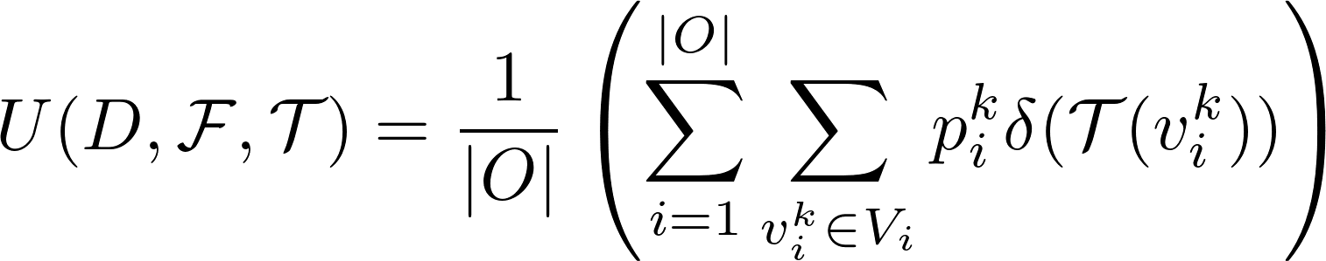
Ideal utility function
item-level ranking | holistic ranking | feedback errors | evaluation
truth function ?
truth function
fusion model
data
Utility Function
average correctness of true claims

Slide 13
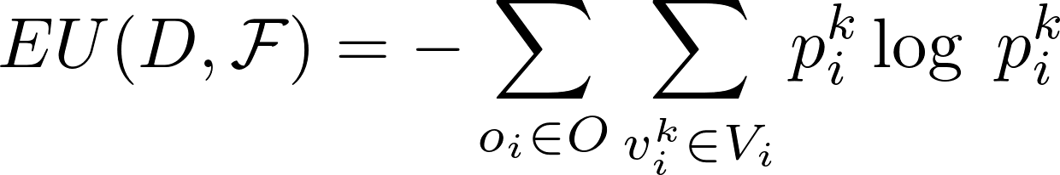
Practical utility function
item-level ranking | holistic ranking | feedback errors | evaluation
over correctness of all claims
entropies of all data items
Entropy Utility Function

Slide 14
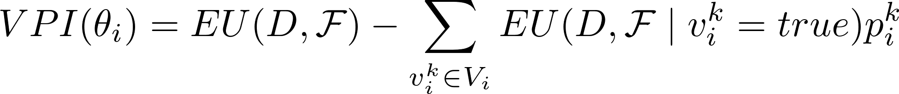
Maximum Expected Utility (MEU)
item-level ranking | holistic ranking | feedback errors | evaluation
Value of perfect information
entropy utility if claim is true
Best alternative in the absence of ground truth

Slide 15
Approximate-MEU
item-level ranking | holistic ranking | feedback errors | evaluation
Key idea: Propagation of changes
correctness of claims of validated data item
accuracies of sources
correctness of claims of unvalidated data items
no need to fuse for every claim!
removed bottleneck iterative computation of MEU

Slide 16

Users can be wrong
item-level ranking | holistic ranking | feedback errors | evaluation
Honest but unsure user
80% certain about a claim
Error-rate of user
user is correct 85% of the time
Conflicting feedback from a crowd of workers
Claim1
Claim2
Claim3
6/10
3/10
1/10

Slide 17
Real-world datasets
item-level ranking | holistic ranking | feedback errors | evaluation
 | Books¹ | FlightsDay² | Population³ | Flights²
Items | 1263 | 5836 | 40696 | 121567
Sources | 894 | 38 | 2545 | 38
Claims | 24303 | 80452 | 46734 | 1931701
Feedback Simulation
Books: silver standard provided in [4]
Flight information: data provided by carrier websites considered ground truth
Population: manually identified the true claim for data items having multiple claims
X. L. Dong, L. Berti-Equille, and D. Srivastava. Integrating conflicting data: The role of source dependence. PVLDB, 2009
X. Li, X. L. Dong, K. Lyons, W. Meng, and D. Srivastava. Truth finding on the deep web: Is the problem solved? PVLDB, 2012
J. Pasternack and D. Roth. Knowing what to believe(when you already know something). COLING, 2010
http://lunadong.com/fusionDataSets.htm

Slide 18
Competing methods
item-level ranking | holistic ranking | feedback errors | evaluation
Item-level ranking methods
QBC / US
Decision-theoretic ranking methods
MEU / Approx-MEU
Greedy Upper Bound (GUB)
Random
all data items equally beneficial
ground-truth-utility-based

Slide 19
Large number of sources, few claims: holistic ranking
item-level ranking | holistic ranking | feedback errors | evaluation
Books

Slide 20
Large number of sources, few claims: holistic ranking
item-level ranking | holistic ranking | feedback errors | evaluation
Population

Slide 21
Large number of claims, few sources: either QBC/holistic
item-level ranking | holistic ranking | feedback errors | evaluation
FlightsDay

Slide 22
Large number of claims, few sources: either QBC/holistic
item-level ranking | holistic ranking | feedback errors | evaluation
Flights

Slide 23
Contributions
Integrating user feedback to improve the performance of existing data fusion systems
Designed strategies to generate an effective ordering for validating claims
scalable decision-theoretic solution for iterative fusion
explored imperfect feedback scenarios
Evaluation on real-world datasets confirmed that guided feedback rapidly increases the effectiveness of data fusion

Slide 24
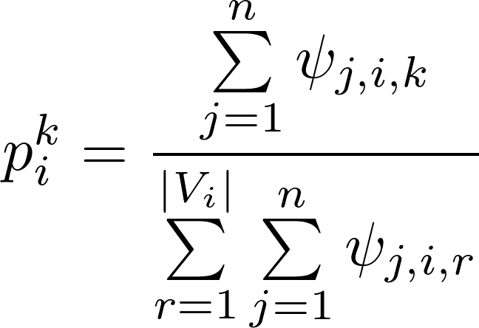
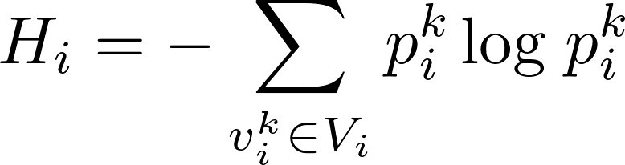
Query-by-committee (QBC)
item-level ranking | holistic ranking | feedback errors | evaluation
Correctness of a claim
number of sources that provide this claim
total number of sources that provide claims for the data item
Entropy of a data item
over all claims of data item

Slide 25
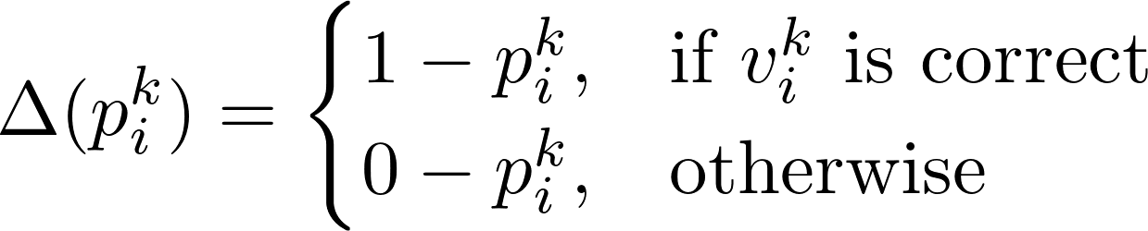
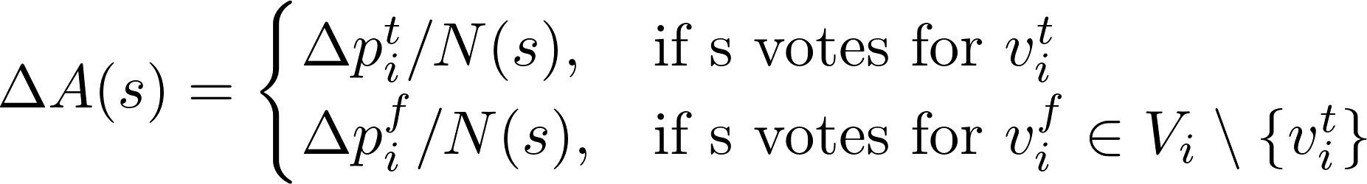
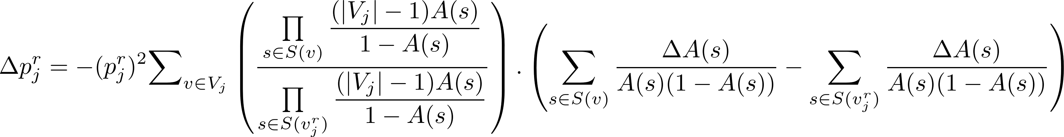
Approximate-MEU
item-level ranking | holistic ranking | feedback errors | evaluation
Correctness of claims of validated data item
Accuracies of sources
Correctness of claims of unvalidated data items

Slide 26
Long-tail data
item-level ranking | holistic ranking | feedback errors | evaluation

Slide 27
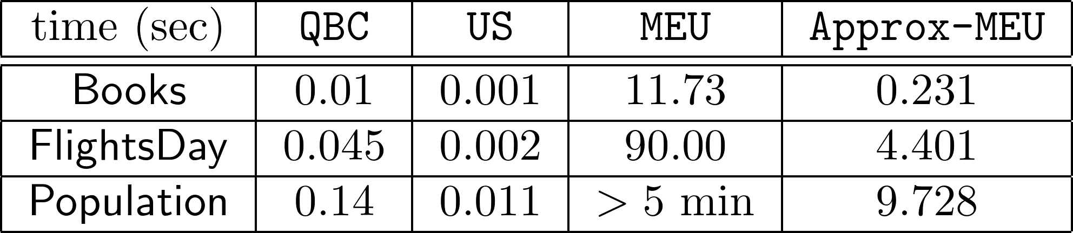
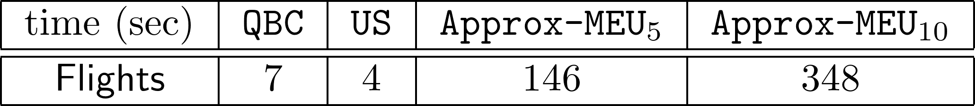
Time taken to determine the next action
item-level ranking | holistic ranking | feedback errors | evaluation

Slide 28
Conflicting feedback
item-level ranking | holistic ranking | feedback errors | evaluation
QBC
US
Approx-MEU
Books data: 10% of data items have conflicting feedback from a crowd

