Slide 1
Unlocking the potential of Transformers in Time Series Forecasting with Sharpness-Aware Minimization and Channel-Wise Attention
You can find this presentation on Romain ILBERT’s website here :
https://romilbert.github.io/
Accepted to ICML 2024

Slide 2
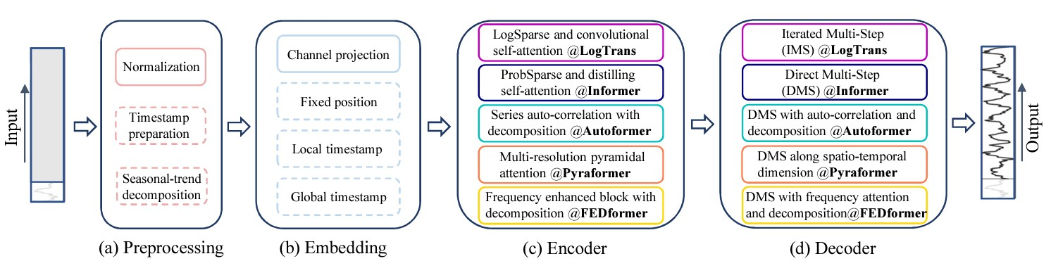
Introduction: Time Series Forecasting
Problem setup
Time series forecasting: given past observations , predict future ones
Univariate vs. multivariate (this work)
Short, medium and long-term (this work)
ML model for forecasting

Slide 3
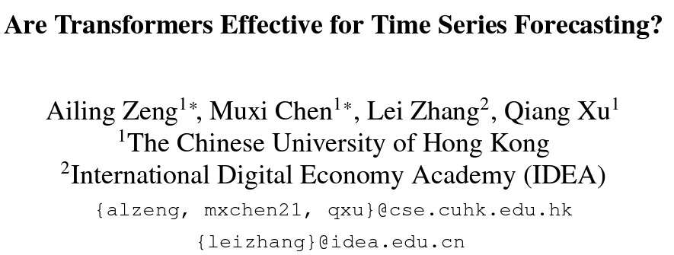
Introduction: Failure of Transformers
Motivation

Slide 4
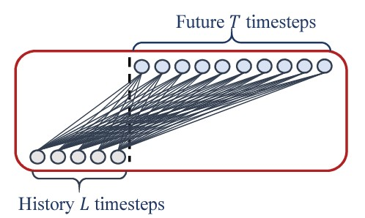
Introduction: Failure of Transformers
Motivation
Consider a simple linear model per variable (no cross-feature correlations)
2. Compare it to « SOTA » transformers
H

Slide 5
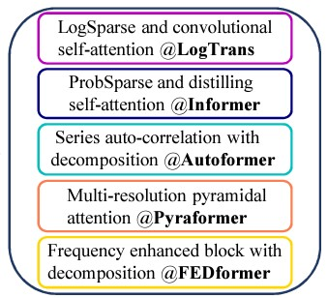
Introduction: Failure of Transformers
Motivation
H
vs.
“Surprisingly, Linear model surpasses the SOTA FEDformer (ICML’22) in most cases by 20%∼50%!”

Slide 6
Introduction: Failure of Transformers
Main conclusions by Zeng et al.
Existing transformer-based methods don’t work well in forecasting
Embarrassing failure in most basic scenarios
… yet they dominate NLP and vision. Why?

Slide 7
SAMFormer (Ilbert et al. 2024)
A transformer-based forecaster that actually works

Slide 8

Introduction: basic example
Why transformers fail?
Consider a toy regression problem (L=512, H=96, D=7)
Oracle = linear regression, closed-form solution
Competitor: shallow, linear transformer with channel-wise attention (DxD matrix, rather than LxL)
Can provably solve our problem!

Slide 9
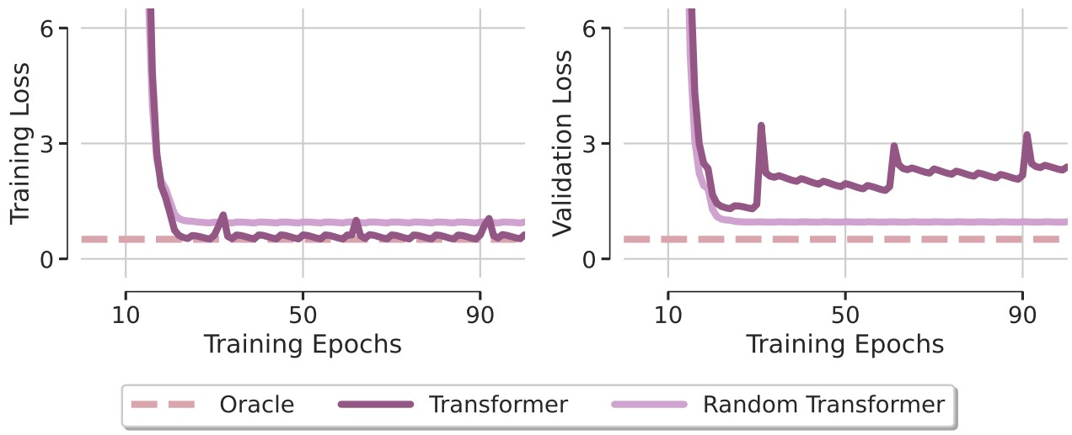
Introduction: basic example
Why transformers fail?
Linear, shallow transformer severly overfits!
… but it works better if we freeze the attention

Slide 10
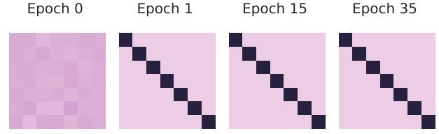
Introduction: basic example
Why transformers fail?
Let’s look at the attention matrix
The attention get’s stuck at identity … and doesn’t move afterward
Pathological behavior suggesting sharp local minima!

Slide 11
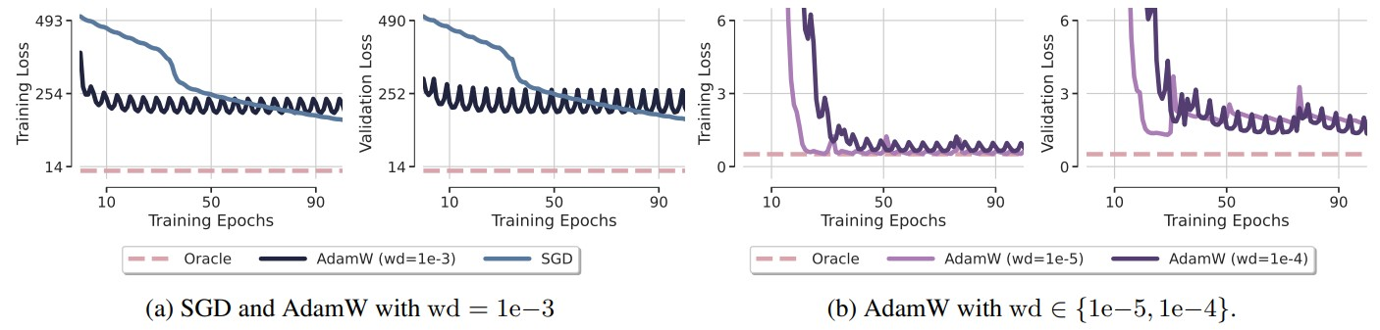
Introduction: basic example
Why transformers fail?
And no, tuning/changing the optimizer doesn’t help to solve this!

Slide 12
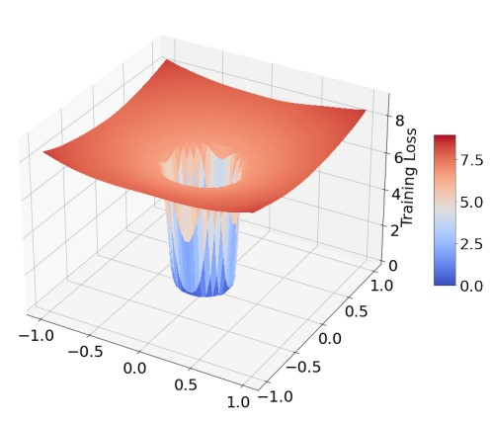
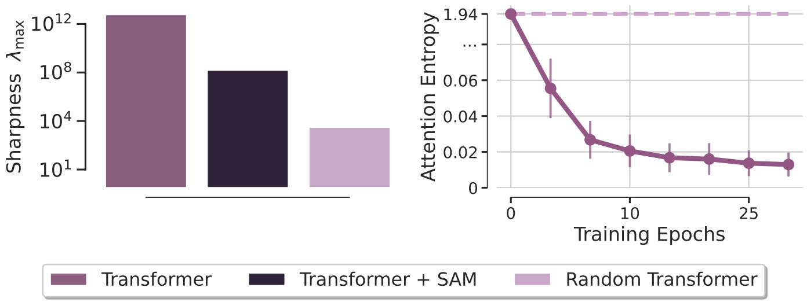
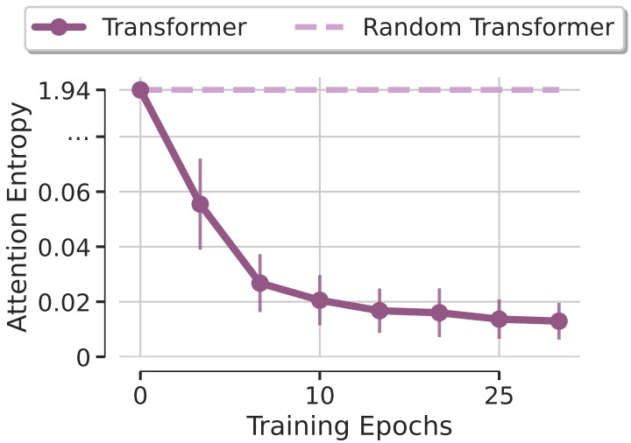
Introduction: basic example
Why transformers fail?
Transformers have a sharp loss landscape and suffer from entropy collapse
Well-known in NLP and vision (Chen et al., 2022, Zhai et al. 2023), ignored in TS
High sharpness
Entropy collapse

Slide 13


Introduction: basic example
How to fix this?
Reparametrization (Zhen et al. 2023)
- make attention matrix “more uniform” to avoid entropy collapse
Sharpness-aware minimization (Foret et al. 2021, Chen et al. 2022)
- converge toward weights that lie in neighborhoods having uniformly low loss

Slide 14
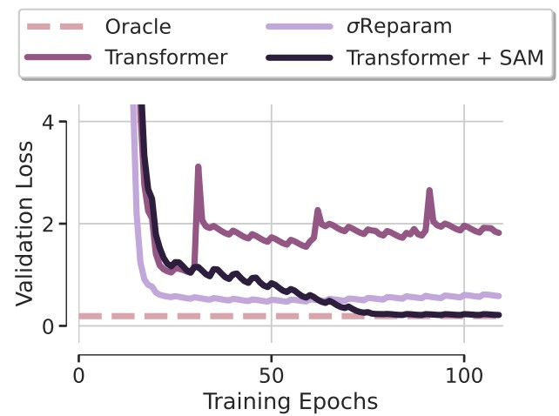
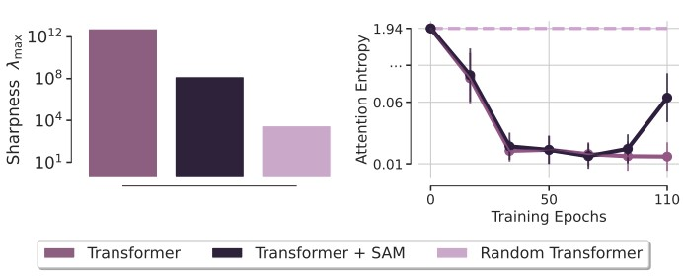
Introduction: basic example
Observations:
Reparametrization helps a bit!
Optimizing with SAM = desired solution!

Slide 15
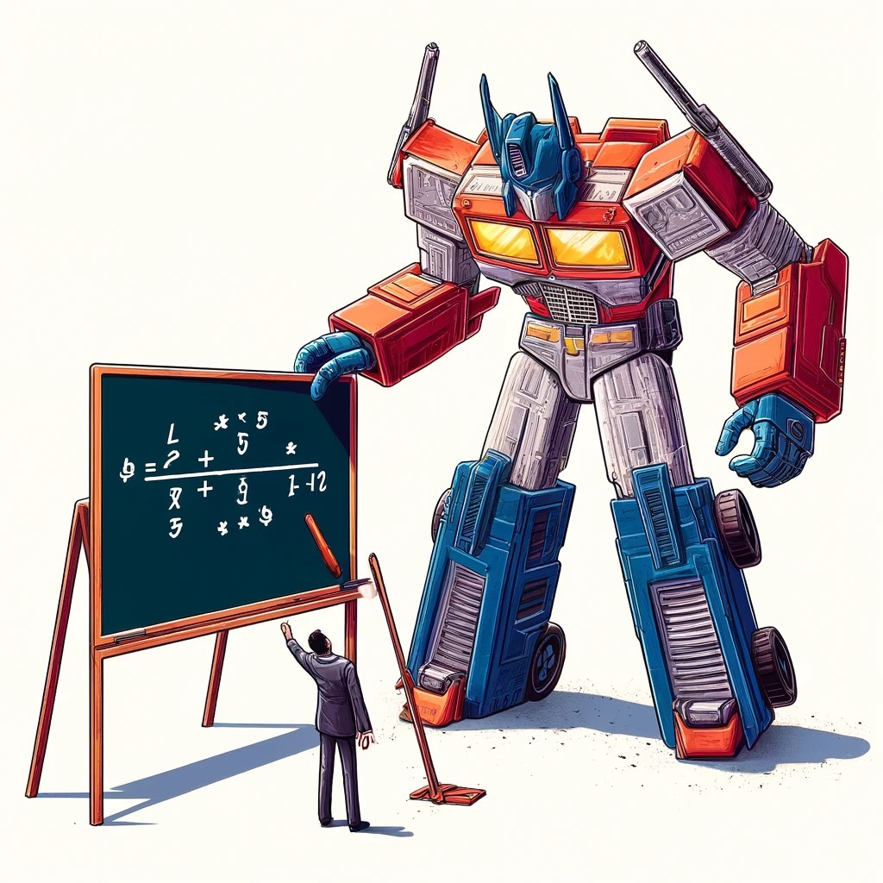
Congrats you now know how to solve a linear regression problem with transformers!
Y = XW + ε

Slide 16
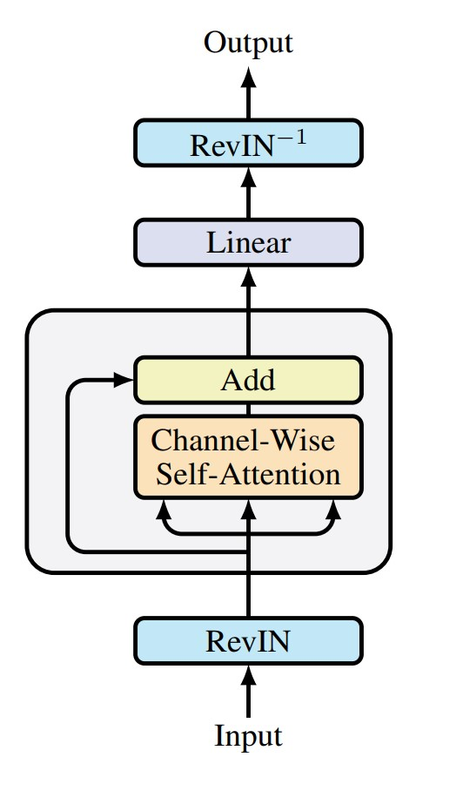
Proposed model: SAMformer
Let’s put it all together now:
Shallow transformer with a channel-wise attention
RevIN layer to be robust to train/test time shift
We optimize it with SAM

Slide 17
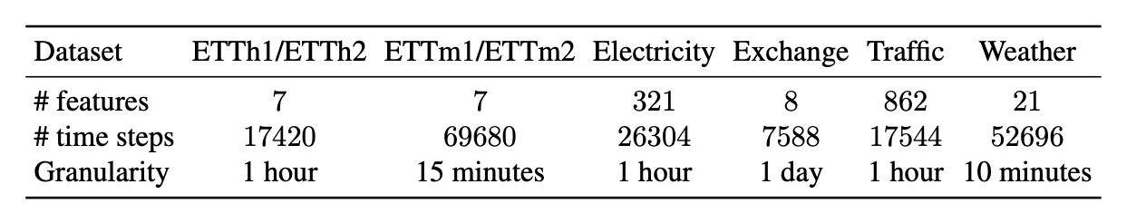
Experimental results: SAMformer
Datasets
Baselines
- TSmixer: MLPmixer model from Google (SOTA in 2023)
- Transformers: Informer (AAAI’21), FEDformer (ICML’22), Pyraformer (ICLR’22), Autoformer (NeurIPS’21), LogTrans (NeurIPS’19)

Slide 18
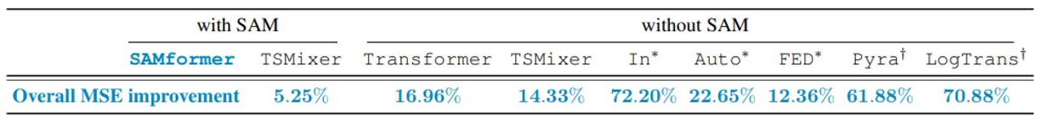
Experimental results: SAMformer
SAMFormer is 14% better than TSMixer
- much better than all transformer-based models
Sharpness-aware minimization improves TSMixer as well

Slide 19
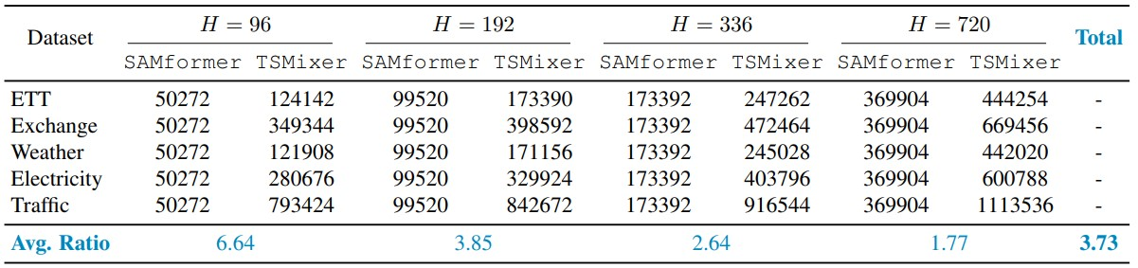
Experimental results: SAMformer
SAMFormer is smaller and more consistent than TSMixer
- the same model for all datasets/horizons
- Avg Ratio = nbre params TSMixer / nbre params SAMFormer

Slide 20
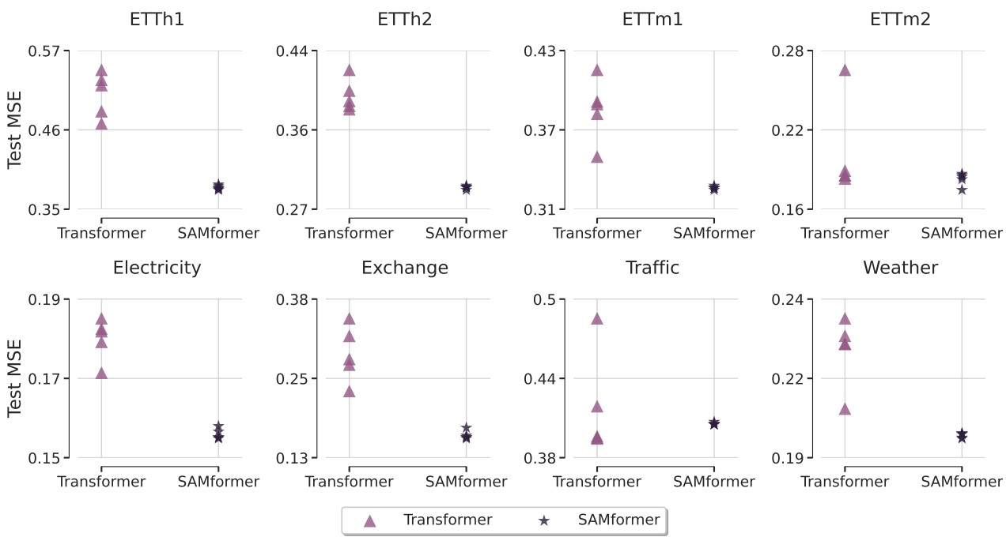
Experimental results: SAMformer
SAMFormer is robust to random initialization
- very low variance for random seeds

Slide 21
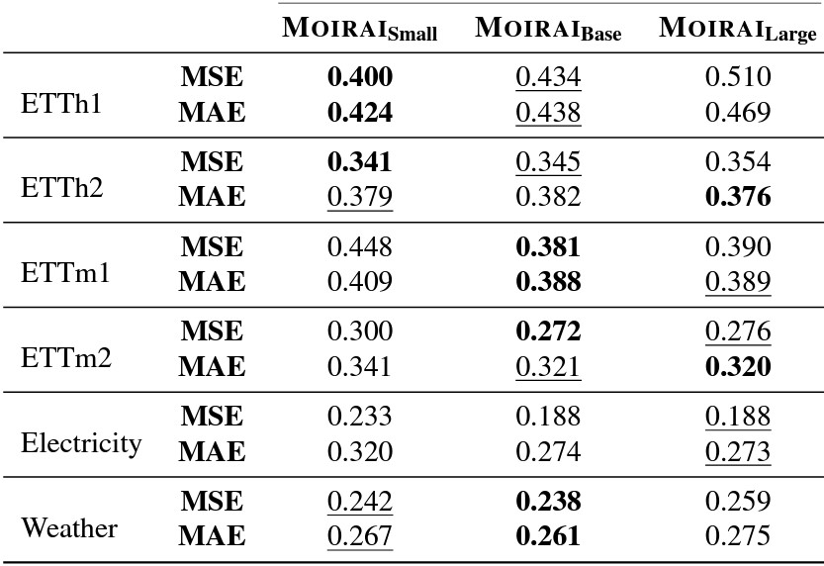
Experimental results: SAMformer
SAMFormer is on par with MORAI foundation model
- MORAI (Salesforce + Singapore University)
- trained on LOTSA with 27B samples from 9 domains
- comes in 3 sizes: small (14M), base (91M) and Large (311M)
SAMformer
0.41
0.344
0.373
0.2685
0.181
0.26

Slide 22
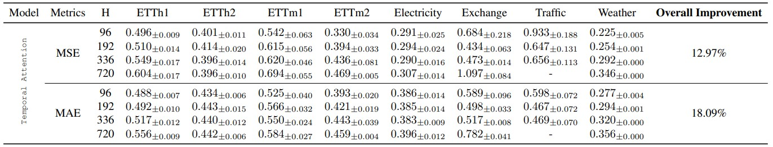
Experimental results: SAMformer
Ablation study: why channel-wise attention?
- Candidate 1: SAMformer with temporal attention (as used in all other transformers)
- Overall Improvement : Improvement of SAMFormer over Temporal

Slide 23
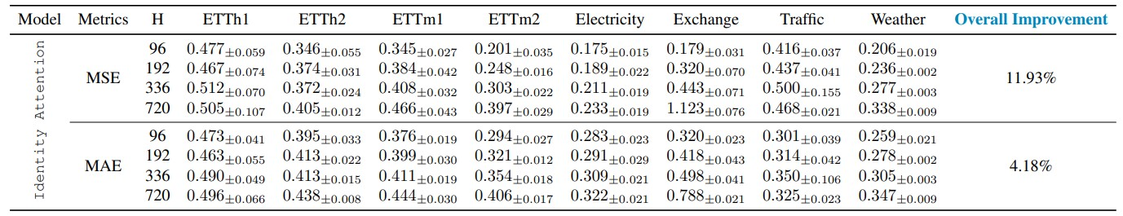
Experimental results: SAMformer
Ablation study: why channel-wise attention?
- Candidate 2: SAMformer with identity weight matrix attention
- Overall Improvement : Improvement of SAMFormer over Identity Attention

Slide 24
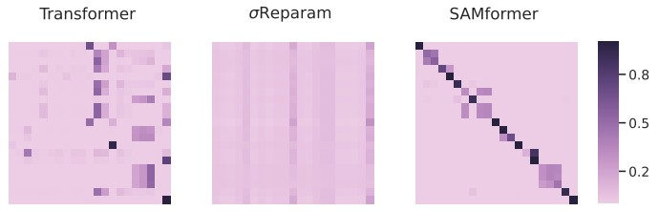
SAM vs weight reparametrization
Final word on weight matrix reparametrization
- proved to be efficient in NLP … but didn’t work for us
Observations:
- Transformers ignores diagonal elements
- SAMformer strongly encourages feature self-correlation (as in ViTs)
- Weight reparametrization oversmoothes the attention matrix

Slide 25
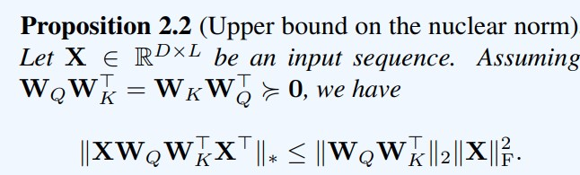
SAM vs weight reparametrization
Oversmoothing = rank collapse
- we prove that
- maximizing the entropy of the attention = rank collapse
- rank collapse = uninformative channel-wise attention
Roughly = rank of the attention matrix
Minimized by reparametrization

Slide 26
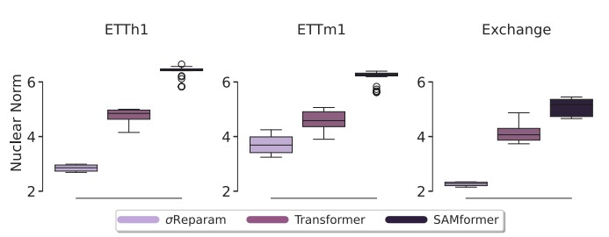
SAM vs weight reparametrization
Oversmoothing = rank collapse

Slide 27
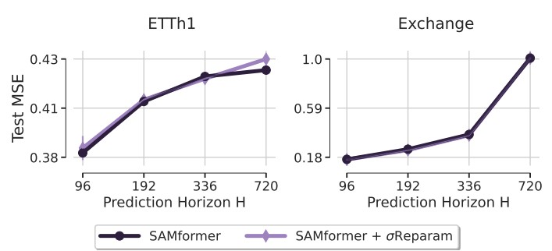
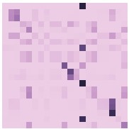
SAM + weight reparametrization
A bit of smoothing + SAM doesn’t help much!
+
=

Slide 28
SAMformer: conclusions
We studied pitfalls of transformers in time series forecasting
Sharp loss landscape = lack of generalization
Our proposal SAMformer
SAMformer = RevIN + channel-wise attention + SAM optimization
SOTA in long-term multivariate time series forecasting
Consistent = same architecture of different horizons/datasets
Lightweight = the smallest SOTA model
On par with large foundation model MORAI

