Slide 1
Software Engineering 2UCCE501
Module 4

Slide 2
Module 4 System Implementation, Configuration Management & Risk Management
4.1 Packages & Interfaces: Distinguishing between classes versus interfaces. Exposing class & package interfaces.
4.2 Mapping Model to code, Mapping object models to Database schema.
4.3 Component & Deployment Diagrams: Describing dependencies.
4.4 Managing & Controlling Changes: Managing & Controlling versions.
4.5 Categories of Risks. Nature of risks, Types of risks, Risk identification, Risk assessment, Risk Planning and control, Risk Management, Evaluating risk to schedule, PERT technique.

Slide 3
Risk Management
Risk Definition:
"Tomorrow problems are today's risk."
‘the chance of exposure to the adverse consequences of future events’
‘an uncertain event or condition that, if it occurs, has a positive or negative effect on a project’s objectives’
Risks relate to possible future problems, not current ones
They involve a possible cause and its effect(s)
e.g.
developer leaves -> task delayed
Misinterpretation of scope -> failure of acceptance test

Slide 4
Categories of Risk
Project Risks: These risks affect the project schedule, budget, and team performance. They may lead to project delays, increased costs, or failure to meet deadlines.
Examples:
Inadequate resources or skills.
Unrealistic timelines.
Poorly defined project requirements.
Technical Risks: Technical risks relate to the technologies, tools, or architecture used in the project. They could result in performance issues, integration problems, or difficulties in system implementation.
Examples:
Adoption of new or unproven technologies.
Challenges in software integration.
Inadequate system performance.

Slide 5
Business Risks: Business risks affect the organization's ability to achieve its objectives or benefit from the project. These risks may arise from changes in market conditions or organizational goals.
Examples:
Shifting business priorities.
Project misalignment with market needs.
Financial constraints.
Operational Risks: Operational risks involve challenges in daily business operations due to the project. These risks can impact the functionality or usability of the software.
Examples:
Difficulty in transitioning to the new system.
Software not meeting user requirements.
Disruptions in ongoing operations.
Security Risks: These risks pertain to vulnerabilities in the software that may lead to breaches, data loss, or unauthorized access.
Examples:
Weak data encryption or protection.
Cyberattacks and hacking threats.
Non-compliance with security standards.

Slide 6
Sources of Risks
Natures of risks
People (Human factor)
Type of resources mismatch,(people with different skill set allocated)
Less Number of people, skill gap etc
Technology
New technology used for implementation
Structure
Organization structure : Projectized / Strong Matrix / Weak matrix/ Open
Task
Activities are carried out for the first time
Complexity:
As software grows more complex, the likelihood of risks such as miscommunication, errors, and delays increases.
External Factors

Slide 7
Approaches to resolve risks
Proactive approaches & reactive approach
Proactive:
Proactive approaches aim to anticipate and prevent risks before they occur.
The goal is to identify potential risks early in the project and take steps to either avoid them or reduce their likelihood and impact.
Example: In a project, if you're using a new, untested technology, you identify the risk that the team may face difficulties due to a lack of expertise.
You arrange for training in advance, ensuring the team can handle it.

Slide 8
Risk Management
Reactive:
Reactive approaches focus on responding to risks after they have occurred.
This means dealing with risks once they manifest and taking steps to minimize their impact or resolve them after the fact.
Risk Acceptance: Some risks cannot be avoided or mitigated cost-effectively, so they are accepted and dealt with when they occur.
Example: If a project experiences minor delays due to a supplier not delivering materials on time,
but the delay does not significantly affect the project,
the team accepts the risk and adjusts the schedule to accommodate it.

Slide 9
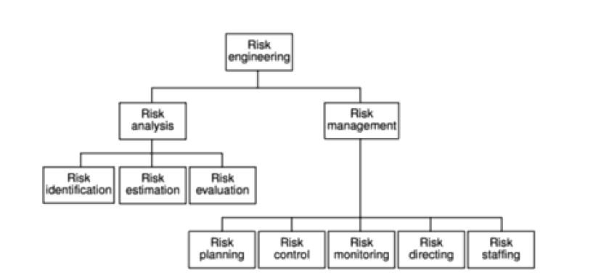
Boehm’s risk engineering task breakdown

Slide 10
Boehm’s top development risks & reduction strategies
Risk | Risk reduction techniques
Personnel shortfalls | Staffing with top talent; job matching; teambuilding; training and career development; early scheduling of key personnel
Unrealistic time and cost estimates | Multiple estimation techniques; design to cost; incremental development; recording and analysis of past projects; standardization of methods
Developing the wrong software functions | Improved software evaluation; formal specification methods; user surveys; prototyping; early user manuals
Developing the wrong user interface | Prototyping; task analysis; user involvement

Slide 11
Boehm’s top development risks & reduction strategies
Risk | Risk reduction techniques
Gold plating | Requirements scrubbing, prototyping, design to cost
Late changes to requirements | Change control, incremental development
Shortfalls in externally supplied components | Inspections, formal specifications, contractual agreements, quality controls
Shortfalls in externally performed tasks | Quality assurance procedures, competitive design etc

Slide 12
Risk management process
The planning for risk includes these steps:
Risk identification – what risks might there be?
Risk Assessment – which are the most serious risks?
Risk planning – what are we going to do about them?
Risk monitoring – what is the current state of the risk?

Slide 13
Risk identification
Objective: To recognize and document potential risks that could affect the project’s success.
Risk identification involves brainstorming activities.
It also involves the preparation of a risk list.
Brainstorming is a group discussion technique where all the stakeholders meet together.
This technique produces new ideas and promotes creative thinking.
Preparation of a risk list involves the identification of risks that are occurring continuously in previous software projects.

Slide 14
What Happens:
In this step, you brainstorm and list all possible risks, including internal and external risks.
This may involve workshops, interviews, checklists, or analysis of past projects.
Example: Identifying risks such as budget overruns, technology failures, or supply chain disruptions in a project.

Slide 15
Risk assessment
Risk exposure (RE)
= (potential damage) x (probability of occurrence)
Ideally
Potential damage: (PD) a money value
Probability (P) 0.00 (absolutely no chance) to 1.00 (absolutely certain)
RE = PoD x P

Slide 16
Objective: To analyze and prioritize risks based on their likelihood and potential impact.
What Happens: Each identified risk is evaluated to determine:
Likelihood: How probable it is that the risk will occur.
Impact: How severe the consequences will be if the risk occurs.
The risks are then ranked, often using a risk matrix, so the most critical risks are addressed first.
Example: Determining that a certain technology failure has a high probability and would cause significant delays in the project timeline.

Slide 17
Risk Analysis & Prioritization
Drawing up contingency plans to deal with the risk should it occur
Identifying the problems causing risk in projects
Identifying the probability of occurrence of the problem
Identifying the impact of the problem
Reduce the risk exposure by reducing the likelihood or impact
Risk Reduction Leverage (RRL) is a metric used to evaluate the effectiveness of risk mitigation strategies.
It helps in assessing how much the risk exposure has been reduced compared to the cost of implementing the risk reduction measures.
Risk Reduction Leverage (RRL)= (RE_{before}- RE_{afte}r)/ risk reduction cost
Where:
REbefore = Risk Exposure before implementing the risk reduction measures.
REafter = Risk Exposure after implementing the risk reduction measures.
Risk Reduction Cost = The cost incurred to implement the risk mitigation strategy. (The total cost spent on implementing risk reduction activities, such as developing backup plans, buying insurance, or investing in preventive technologies.)
If RRL > 1. it means the risk mitigation strategy is highly effective

Slide 18
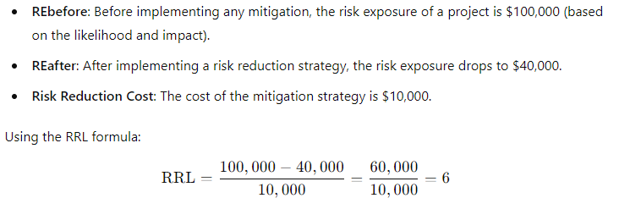
Example:
This means that for every $1 spent on risk reduction, the project reduces its risk exposure by $6. An RRL of 6 indicates a very effective risk reduction strategy.

Slide 19
Risk Avoidance and Mitigation/Risk planning
Objective: To develop strategies to handle or mitigate identified risks.
What Happens: Once risks are prioritized, the next step is to plan how to respond to them.
Responses may include:
Avoiding: Changing the plan to eliminate the risk.
Mitigating: Reducing the likelihood or impact of the risk.
Transferring: Shifting the risk to another party (e.g., through insurance).
Accepting: Acknowledging the risk and preparing to deal with it if it happens.
Example: Developing a backup plan for critical suppliers in case of supply chain delays.
Ex. Rain or storms could lead to lower attendance or cancellation of the event.

Slide 20
Risk Monitoring and Control
Objective: To track identified risks, monitor new risks, and ensure that mitigation plans are working effectively.
What Happens:
This is an ongoing process where risks are continuously monitored, and responses are updated as needed. New risks may emerge, and old ones may change in severity or likelihood.
Example: Regularly reviewing the risk register and monitoring key indicators to ensure that potential supply chain disruptions are being mitigated.

Slide 21
Project Evaluation and Review Technique (PERT)

Slide 22
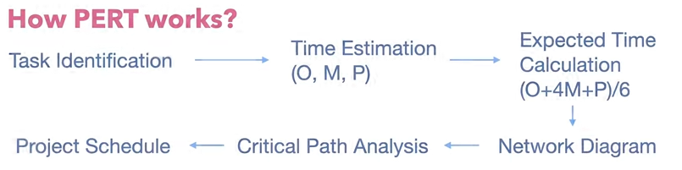
PERT is a procedure through which activities of a project are represented in its appropriate sequence and timing. It is a scheduling technique used to schedule, organize and integrate tasks within a project.
PERT is basically a mechanism for management planning and control which provides blueprint for a particular project.

Slide 23
PERT Method Implementation Steps
Track the following steps while creating a PERT Chart;
1. List the activities and milestones
The first step is to determine the tasks required to complete the project.
2. Determine the sequence of activities
The second step is to determine the order of the activities. Which activity is the predecessor which one is the successor? It is easy to determine the sequence of some activities however the sequence of some tasks may require deep analysis.
3. Build a network diagram
The third step is to create the network diagram with the help of software or by hand and place the activities on the diagram.
.

Slide 24
4. Estimate the activity durations
The PERT Method uses three duration estimates for activities which are;
Optimistic Estimate
Pessimistic Estimate
Most Likely Estimate
With the help of three estimates, expected duration is calculated.
5. Determine the critical path
The critical path is the longest path of the network diagram. Forward and backward pass calculations is used to determine the critical path

Slide 25
Example of PERT in Action:
Design Approval (Activity A):
Optimistic Time (O): 5 days
Most Likely Time (M): 8 days
Pessimistic Time (P): 12 days
Expected Time (TE) = (5+4(8)+12)/6= 8.5days
Foundation Laying (Activity B):
Optimistic Time (O): 7 days
Most Likely Time (M): 10 days
Pessimistic Time (P): 14 days
Expected Time (TE) = (7+4(10)+14)/6=10.5days
Framing the Structure (Activity C):
Optimistic Time (O): 10 days
Most Likely Time (M): 15 days
Pessimistic Time (P): 25 days
Expected Time (TE) = (10+4(15)+25)/6=16.7 days

Slide 26
Now, let’s look at the dependency of these activities:
Activity A (Design Approval) must be completed before Activity B (Foundation Laying) starts.
Activity B (Foundation Laying) must be completed before Activity C (Framing the Structure) starts.
Based on these dependencies, a network diagram can be created showing the flow of activities.

Slide 27
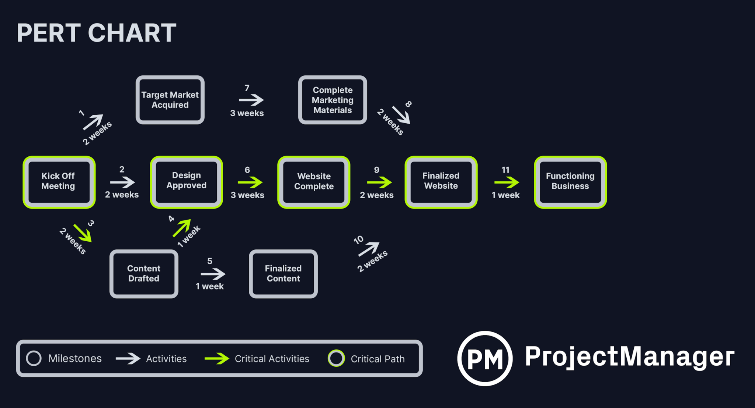

Slide 28
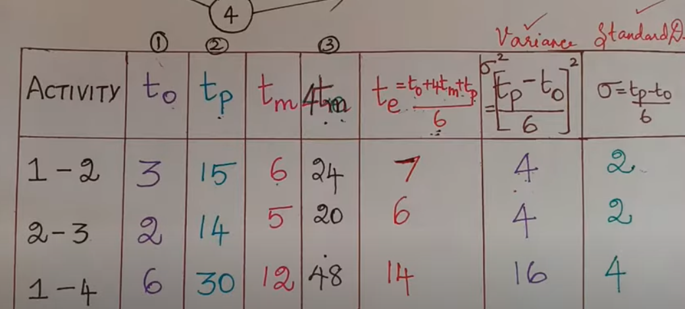
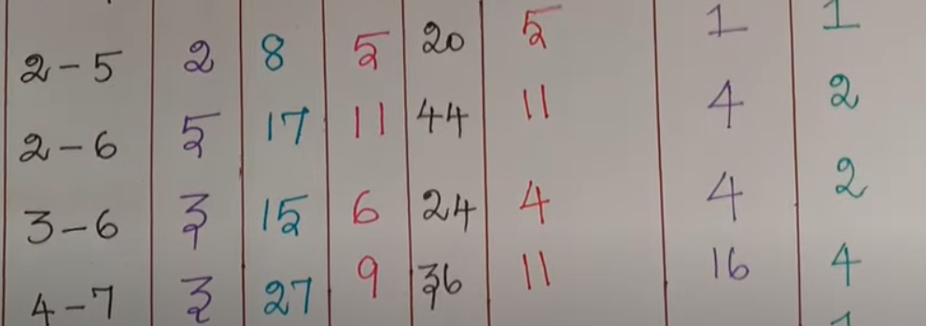

Slide 29
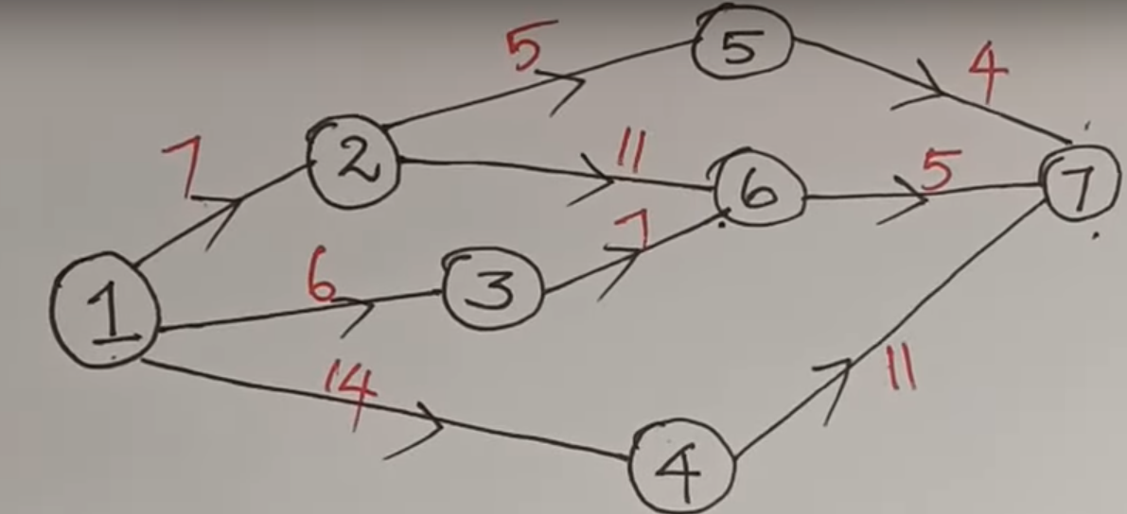
Example :

Slide 30
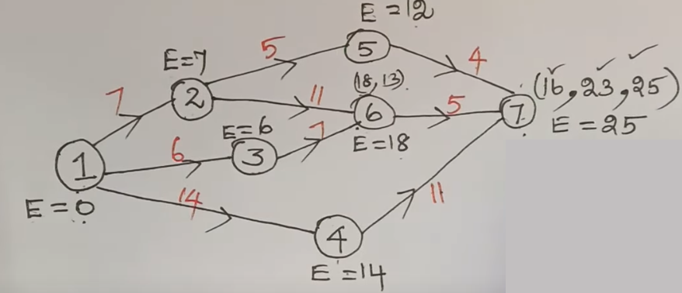

Slide 31
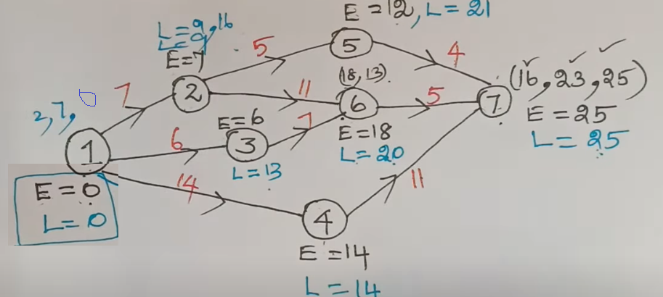

Slide 32
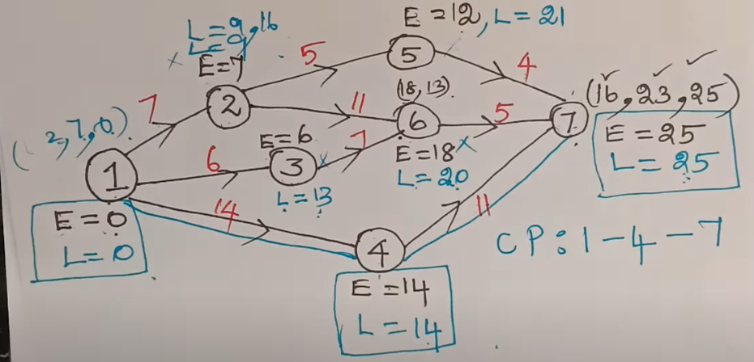

Slide 33
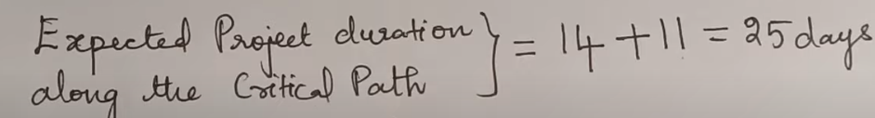
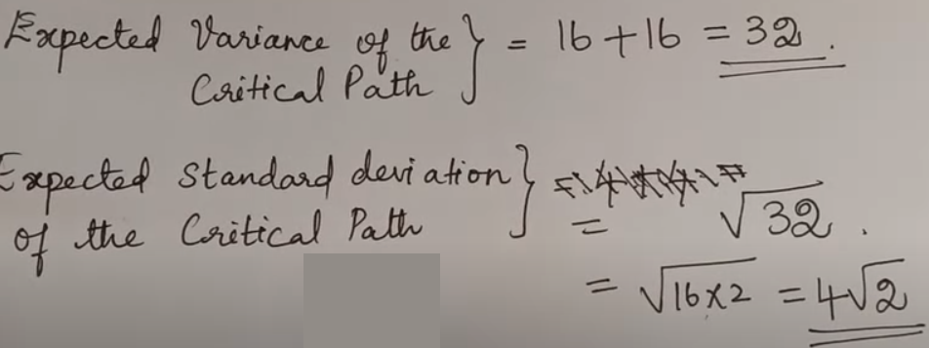

Slide 34
Calculate:
Variance
Standard deviation
Expected project duration along the critical path
Expected variance of the critical path
Expected standard deviation of critical
path
Activity | To | Tm | Tp
1-6 | 1 | 7 | 13
1-2 | 2 | 5 | 14
2-3 | 2 | 14 | 26
2-4 | 2 | 5 | 8
3-5 | 7 | 10 | 19
4-5 | 5 | 5 | 17
6-7 | 5 | 8 | 29
5-8 | 3 | 3 | 9
7-8 | 8 | 17 | 32

