Slide 1

Traffic Sign Detection and Classification
Romil Patel

Slide 2

Introduction
Problem Statement:
Real-time detection and classification of traffic signs using YOLO models.
Adapting to diverse conditions (lighting, weather, angles).
Importance:
Automotive Industry
Society
Researchers and Developers

Slide 3
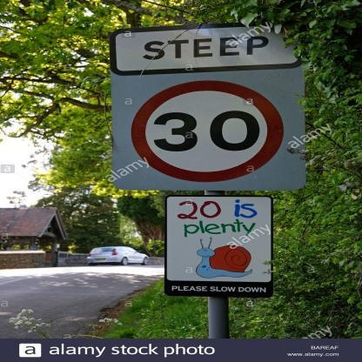
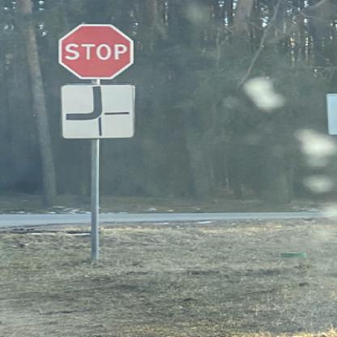

Dataset
Sourced from Kaggle.
Example:

Slide 4
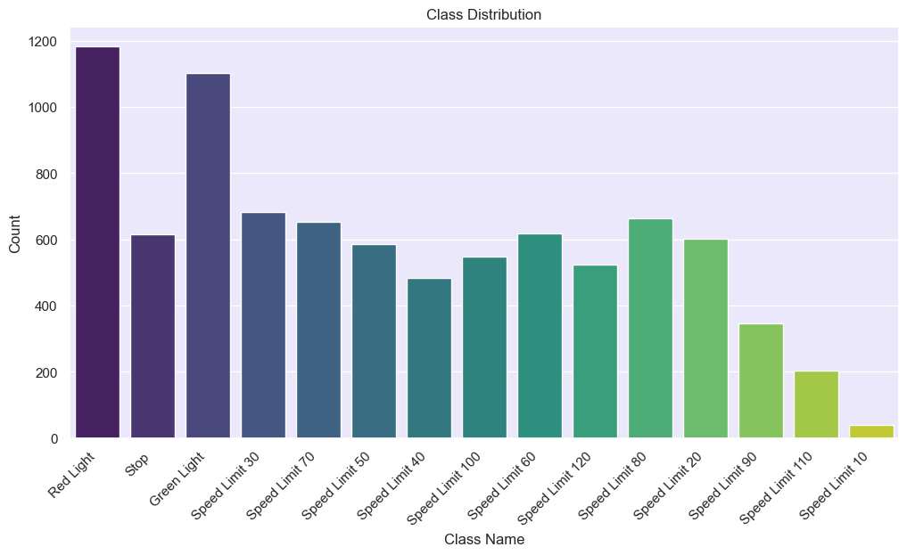
Class Distribution

Slide 5
Data Pre-Processing
Augmentation Techniques:
Brightness/contrast adjustments
Scaling
Rotation
Hue-saturation alterations
Preprocessing:
Images resized to 640x640 pixels for YOLO compatibility.

Slide 6
Methodology
Load the dataset
Apply data-preprocessing
Load the YOLO V8N model
Load the pre-trained model weights
Train the model
Evaluate
Down streaming

Slide 7
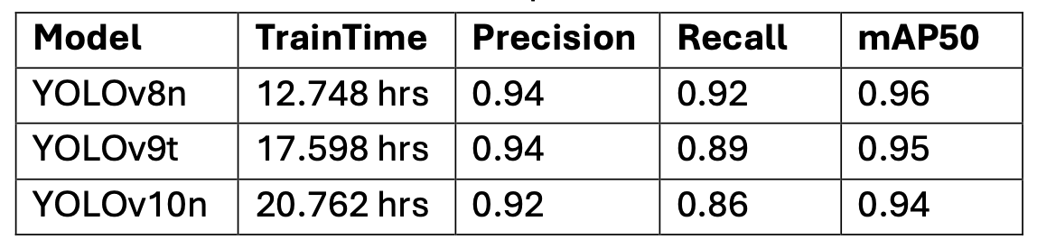
Model Selection
Yolo V8N
Lowest training time (37% lower than V9)
Highest Recall
Good mAP50 score

Slide 8
Yolo V8
Key Features:
Advanced Backbone and Neck Architectures
Anchor-free Split Head
Optimized Accuracy-Speed Tradeoff
Variety of Pre-trained Models

Slide 9
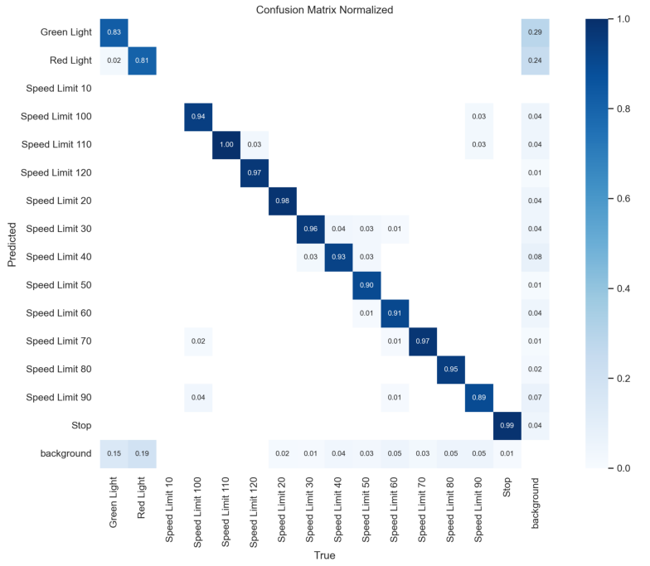
Results

Slide 10
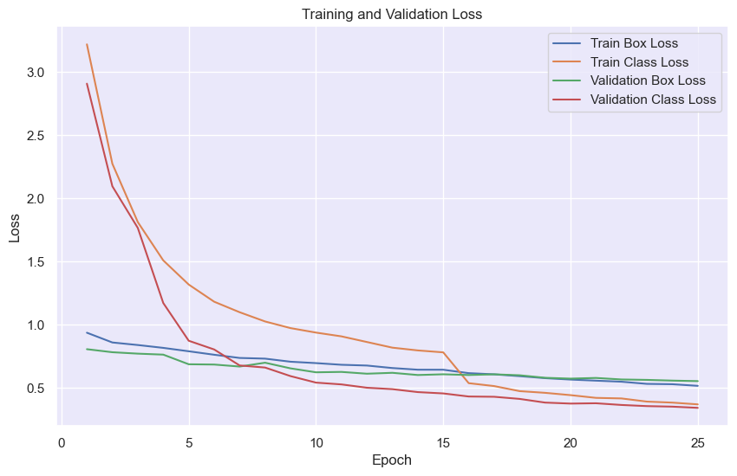
Results

Slide 11
Down streaming
1. Input:
Real-time camera feed from vehicles or static traffic cameras.
2. Detection:
Process images/video frames with the trained YOLO model to detect traffic signs.
3. Output Processing:
Generate predictions with labels, confidence scores, and bounding boxes.
4. Actionable Insights:
Send detection results to decision-making modules for:
Visualizing traffic signs on dashboards.
Triggering automated actions in vehicles (e.g., speed adjustments).
Alerting drivers to critical signs or hazards.

Slide 12
Challenges
Challenges:
Dataset Class Imbalance.
Representation Bias.
Constraints of CPU-only training.
Future Directions:
Dataset Enrichment
Temporal Analysis
Transferable Learning

Slide 13
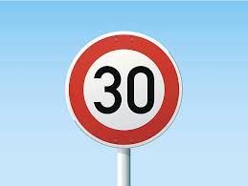
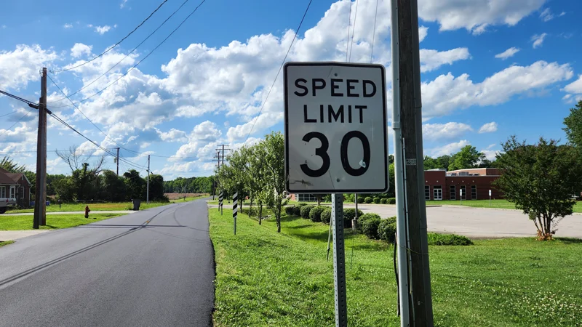
Class Imbalance
Representation Bias

Slide 14
Thank You

