Slide 1
«Ariadne’s thread» – how to find your way in a building
XIV Scientific Conference of Young Researchers
«Step To The Future, Moscow»
2012
Author: R.V. Inflianskas
IU7, BMSTU
Scientific supervisor: B.G. Trusov
Doctor of Technology, professor IU7, BMSTU

Slide 2
Goals and objectives
The goal is to develop software that would be able to display a floor plan of a building, find its different parts and shortcuts between them.
Objectives:
domain analysis;
development of software;
making floor plans of buildings for program testing.

Slide 3
Structure of Guide
The Guide consists of two programs: Theseus and Ariadne.
Theseus is able to display a floor plan of a building, find its different parts and shortcuts between them.
Ariadne has Theseus' functionality and it also allows to draw floor plan of a building.

Slide 4
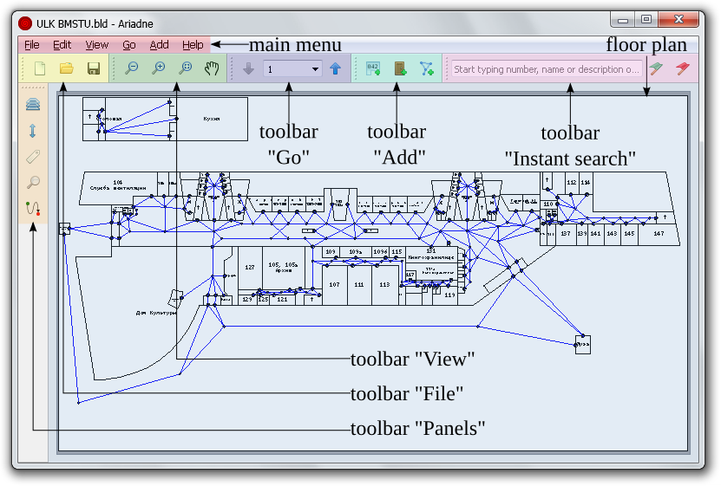
Program Ariadne

Slide 5
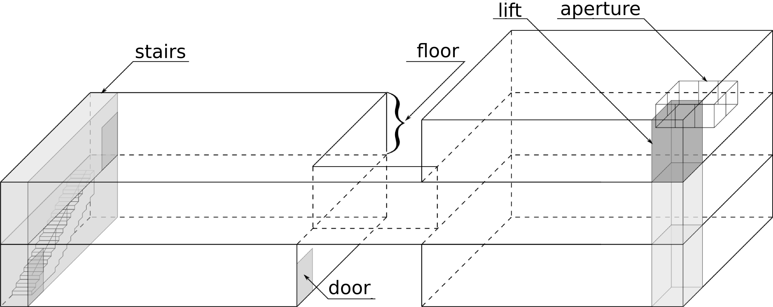
3D model of a building

Slide 6
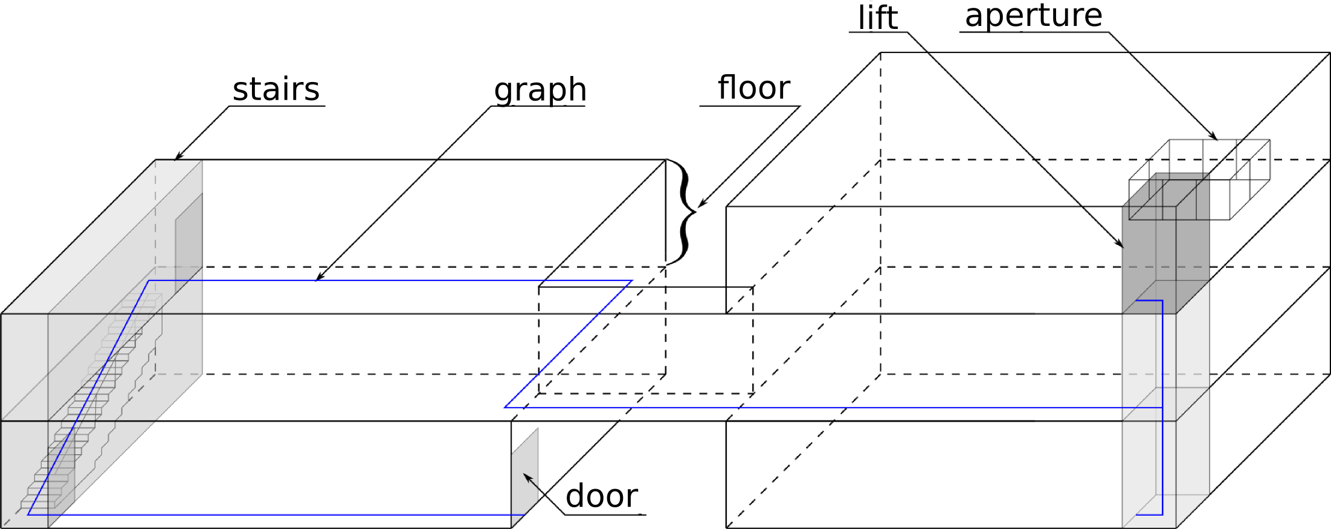
3D model of a building

Slide 7
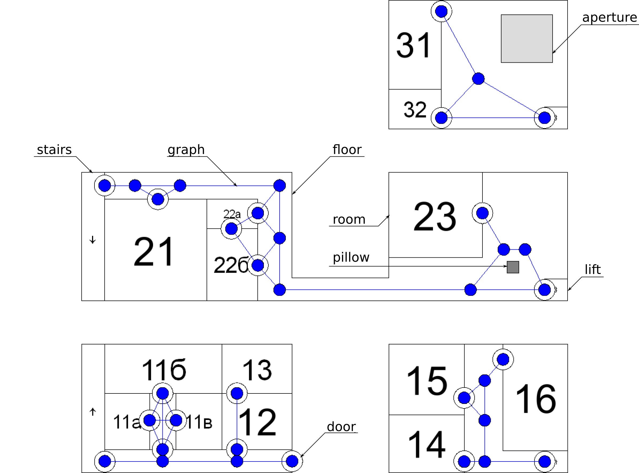
Floor plan

Slide 8
Program functions
Drawing floor plans
Drawing a graph
Connecting floors
Finding different parts of buildings
Finding shortcuts

Slide 9
Drawing floor plans
Drawing floors.
Drawing areas and doors:
  deposited in a tree structure;
  snap function;
  ability to use blueprints.
Designating areas:
  type: room, aperture, pillar;
  text fields: number, name, description, inscription.

Slide 10
Drawing a graph
Connecting nodes with doors.
Snapping to the doors and nodes.
Connecting different floors
Floors are interconnected with the help of verticals such as stairs and lifts. Verticals connect areas located on different floors.
Setting the weights of the edges:
in the plane: edge length;
between floors: distance covered during ascending (descending) time.

Slide 11
Finding shortcuts
Finding ways
between areas
Finding ways
between doors
Finding ways
between nodes
To find shortcuts between nodes we use an algorithm based on Dijkstra's algorithm.
The routing algorithm is used several times in various settings (allow/disallow stairs/lifts) and it finds different ways.

Slide 12
The results achieved
This work proves the need to design a guide to multi-storey buildings;
it analyses algorithms for finding shortcuts;
it has worked out the «Ariadne's thread» guide to multi-storey buildings;
it has developed plans for the BMSTU educational-laboratory building and the main building of The Pushkin Museum of Fine Arts.

