Slide 1

Google App Engine
Developer Workshop
January, 2013
Romin Irani, Mind Storm Software Pvt. Ltd. http://www.mindstormsoftware.com

Slide 2
Workshop Goals
Help you understand what is Google App Engine?
Setup your Google App Engine account and write a Hello World App.
Cover various App Engine APIs / Services.
Do code lab sessions to build out an “Exam Results” App Engine application and deploy it live.
Cover enough basics for you to take your next leap into writing Cloud Applications running on Google App Engine infrastructure.

Slide 3

Prerequisites
A laptop and Internet connection
Mobile Phone with a working phone number
Basics of Java / JSP / Servlets

Slide 4
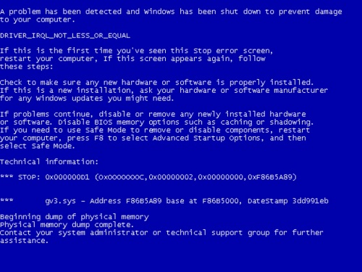
Course Requirements
Basic working knowledge of HTML, JavaScript and CSS
Use a Text Editor or any other IDE of your preference to write all code samples
We shall run all examples on various browsers

Slide 5


Session 1 – App Engine Overview

Slide 6
What is Google App Engine?
Application Hosting and Development Platform
Host your application on Google’s infrastructure
3 runtimes supported : Java, Python and Go
Variety of Services to boost developer productivity
Free Quota and then Pay per use
http://cloud.google.com/appengine

Slide 7
App Engine – History
April 7, 2008 : First Release (Python)
2009 : Support for Java
2011 : Go Language support
Current Version : 1.7.4 – 13 Dec 2012
Since 2012 - monthly release cycle

Slide 8
What does it provide?
Run time infrastructure
  Your applications run on same infrastructure that powers Google’s own applications
  Supports Applications written in Python, Java or Go
  One Google Account – 10 Applications with Free Quota
  Administrative Console
Developer Tools
  App Engine SDK
  Local Development Server
  Eclipse Plug-in to develop applications and 1-click deploy to Cloud

Slide 9
App Engine Advantages
Leading PaaS
Google Infrastructure
Generous Free Quota
Pay per use
Quick to start : no hardware / software required from your side to host/run the application
Global Data Locations
99.95 SLA
Paid support offered as part of Premier Accounts

Slide 10
App Engine Services
High Availability NoSQL and SQL Service
Support for Java Web Applications.
  Java version 6 recommended
Search API
App Engine Map Reduce
Logs API
SSL Support
Pagespeed service
Google Cloud Endpoints

Slide 11
App Engine Services
Blobstore API
Files API & integration with Google Cloud Storage (GCS)
XMPP API
Channel API
Memcache API
Users API
Task Queues & Crons
URL Fetch API

Slide 12
Usage Quotas
Requires Google Account
An Account can register up to 10 Applications.
Free Quota is available for each application.
Beyond that a pay per use policy applies
https://developers.google.com/appengine/docs/quotas

Slide 13
Usage – Free Quota
Quota | Limit (per day)
Instance-hours | 28 hours
Emails | 100 (5000 admin emails)
Bandwidth in | Unlimited
Bandwidth out | 1 GB
Datastore | 1 GB
Datastore Operations | 50k
Blob Storage | 5 GB
XMPP API | 10k stanzas
URLFetch API calls per day | 657,000
The power comes with certain restrictions like HTTP Request 60 second limit and more.

Slide 14
App Engine - Competition
Amazon Web Services
Engine Yard
Heroku
Force.com
Skytap
VMware
Rackspace Cloud
GoGrid
Windows Azure
OpenShift

Slide 15
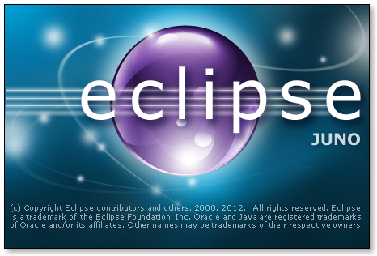

Session 2 – App Engine Setup

Slide 16
App Engine - Setup
What you need
  Java SDK (1.6 )
  App Engine SDK (Latest version is 1.7.4)
  Eclipse (Take the latest version – Eclipse Juno)
  Google Eclipse Plugin for Eclipse Juno

Slide 17
App Engine - Setup
We plan to make our lives simpler.
All the Software has been downloaded and available in a bundle, including Eclipse that is configured with the Google Eclipse Plugin.
Go to /hands-on-exercises and follow App Engine Dev Environment Setup.docx to get your Dev Environment ready!
Optional: If you wish to install the App Engine environment from scratch i.e. download Java, Eclipse, Google Plugin, refer to /hands-on-exercises folder and refer From Scratch From Scratch - Google App Engine Development Environment Setup.docx.

Slide 18

Hands On Exercise
Our goal here is to setup your Development Environment.
Go to /hands-on-exercises folder.
Follow App Engine Dev Environment Setup.docx

Slide 19

Session 3 – Hello World

Slide 20
App Engine – Hello World
Get our App Engine Account Setup and create an Application.
Develop the default App Engine application using Google Eclipse Plugin Project Wizard.
Deploy our Application into the App Engine cloud
See it live !
While the application does not do much, it will demonstrate your development / deploy workflow.

Slide 21
App Engine – Account Setup
Go to http://appengine.google.com
Sign in with your Google Account.
When you create Applications for the first time, it will ask for Mobile Number and Google will send you a verification code via SMS.
Complete the validation process with the code.
Each Google Account gives you 10 Applications
A Mobile number can be verified only once ;-)

Slide 22
App Engine – Create App
We do not want to stray from tradition, so let us create a Hello World application.
Use Eclipse and Google Eclipse plugin to generate default Application Template.
Test it out locally.

Slide 23
App Engine – Deploy App
Final Step is to deploy the App to the Cloud.
Step 1 : Create an Application that will host your application. This is a unique Application Id. This is done from http://appengine.google.com. Login and go to My Applications and then Create Application.
Step 2 : Use the Google one-click Deploy option in Eclipse to deploy your application directly under that Application Id.
The app on successful deployment will be available at http://<APPID>.appspot.com

Slide 24
Hands On Exercise
Go to /hands-on-exercises/HelloWorld.docx
Follow the document and deploy your First Google App Engine application.

Slide 25





Session 4 – Exam Results App

Slide 26
ExamResults App
Web Application
Lookup Exam Results
Web Interface to enter your Seat Number and it gives back results.
Accepts request over Google Chat and responds with Chat message.
Accepts request over Email and responds with Email.

Slide 27

Demos
Exam Results App – In Action
http://exam-results.appspot.com

Slide 28

Session 5 – Code Lab
Web Interface

Slide 29
Web Interface
We will start off with building a Web Interface as demonstrated in the demo
Make use of Servlets and JSP
App Engine supports Java Servlet 2.5 specification
If you are familiar with developing basic Java Servlet / JSP applications, you are all set.

Slide 30
Web Interface – The Flow
The flow is simple:
  Home page (index.html) that has a form that accepts a Seat Number of the student who took the exam
  This is submitted to a Servlet, which builds a dummy result
  The Servlet forwards control to a JSP page that will display the Exam result
  If there are any errors, an error JSP page that is configured will display the error

Slide 31
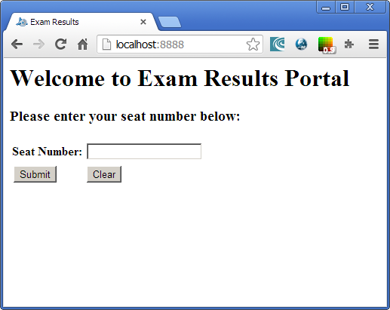
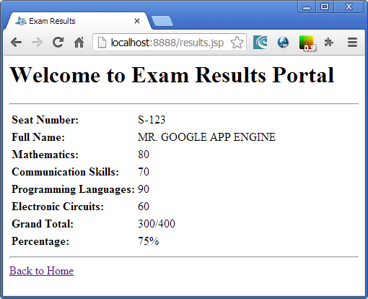
Web Interface – Visual Flow
ExamResultsServlet.java
Java Servlet
index.html
results.jsp

Slide 32
Hands On Exercise
Step by Step instructions to create the Exam Results Application and the Web Interface. It contains:
  Create a default Template for the Exam Results Application. Go to /hands-on-exercises/ExamResults-Step1.docx
  Build on that by developing the Web Interface. Go to /hands-on-exercises/ExamResults-Step2-WebInterface.docx

Slide 33

Session 6 – Code Lab
Datastore Service

Slide 34
App Engine Datastore
App Engine provides a highly scalable option for persisting your data
It is called the Datastore. The Datastore API is used to persist and retrieve data.
The Datastore API uses Google BigTable.
The datastore supports two standard Java interfaces: Java Data Objects (JDO) 2.3 and Java Persistence API (JPA) 1.0
Various 3rd party libraries also exist to make life easier. E.g. Objectify

Slide 35
App Engine Datastore
We shall use JDO Annotations to setup an Entity class to be persistent ready
@PersistenceCapable
public class ExamResult implements Serializable {
@PrimaryKey
@Persistent(valueStrategy = IdGeneratorStrategy.IDENTITY)
Key seatNumber;
@Persistent
String studentName;
@Persistent
String marks_Math;
...
}

Slide 36
Hands On Exercise
Step by Step instructions to create the Datastore Layer for the application.
We will build a persistable Entity named ExamResult and use the JDO API to write and search for the records. It will our Data Access Object (DAO).
Additionally, we will integrate it with the ExamResultsServlet code so that actual data is returned.
Go to /hands-on-exercises/ ExamResults-Step3-Datastore.docx

Slide 37
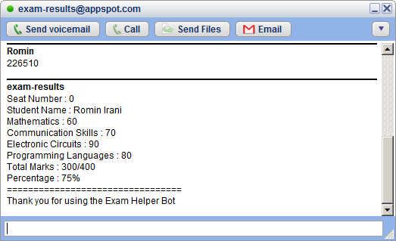
Session 7 – Code Lab
XMPP Service

Slide 38
App Engine – XMPP Service
Instant Messages or Chat.
App Engine Application can talk to any XMPP-compatible Chat Service such as Google Talk or Jabber.
Useful for creating interactive Chat based applications that a user can add to Google Talk and communicate via a subset of commands.
For e.g. A Weather XMPP Bot which when provided a city name, gives its current weather conditions.

Slide 39
App Engine – XMPP Service
XMPP Service support includes
  Sending XMPP Messages
  Receiving XMPP Messages
  Sending Invitations
  Managing Presence
https://developers.google.com/appengine/docs/java/xmpp/

Slide 40
App Engine – XMPP Service
Sending XMPP message is as simple as invoking the similar to invoking any HTTP request, simply invoke the XMPP API to send the message. Optionally, you can monitor for errors.
Receiving XMPP is similar to receiving HTTP requests. App Engine wraps the message and invokes standard Request Handlers for XMPP in your application.
The message is put in the HTTP Request payload and you can parse it out.

Slide 41
App Engine – XMPP JID
Each participant in an XMPP Application is identified by a Jabber ID (JID)
Jabber ID : username @ domain / resource
To send a XMPP Message, you send the message to your own server, which delivers it to the other server and if the user is online, the message is delivered to the client application e.g. Google Talk.
For XMPP Chat, your App Engine application can receive messages at app-id@appspot.com or anything@app-id.appspotchat.com

Slide 42
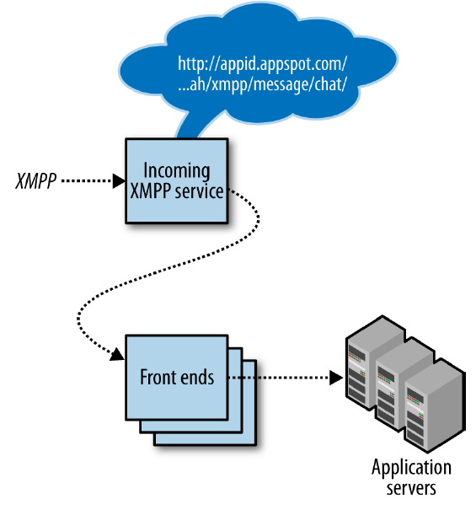
App Engine – XMPP Service

Slide 43
App Engine – Receiving XMPP Messages
To receive XMPP Message in your application, first enable the feature in the application configuration.
Go to appengine-web.xml in /WEB-INF folder and add the following entry:
<inbound-services>
<service> xmpp_message </service>
</inbound-services>

Slide 44
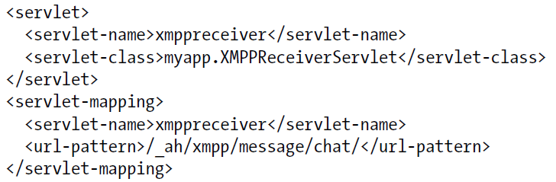
App Engine – Receiving XMPP Messages
Add the incoming XMPP Message URL Path to a Servlet
web.xml description
In the Servlet, handle the POST method to extract out the XMPP message payload

Slide 45
App Engine – Receiving XMPP Message
public class XMPPReceiverServlet extends HttpServlet {
public void doPost(HttpServletRequest req, HttpServletResponse resp)
throws IOException {
XMPPService xmpp = XMPPServiceFactory.getXMPPService();
Message message = xmpp.parseMessage(req);
// ... Use methods like
// message.getFromJid();
// message.getBody();
}
}

Slide 46
App Engine – Sending XMPP Message
XMPPService xmpp = XMPPServiceFactory.getXMPPService();
JID recipient = new JID(“romin.k.irani@gmail.com");
Message message = new MessageBuilder()
.withRecipientJids(recipient)
.withBody(“Welcome to App Engine!")
.build();
SendResponse success = xmpp.sendMessage(message);
if (success.getStatusMap().get(recipient) !=endResponse.Status.SUCCESS) {
// ...
}

Slide 47
Hands On Exercise
Allow for anyone to request their exam result via XMPP Chat
Write incoming XMPP handler to receive and parse request
Send out the response via XMPP itself
Flow is: User logs to Google Talk, adds the Application Chat Id to his/her friends list and interacts with the XMPP Chat Application
Go to /hands-on-exercises/ExamResults-Step4-XMPP.docx

Slide 48
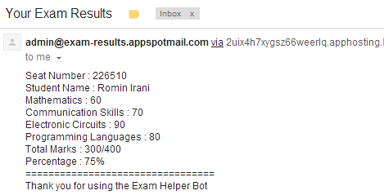
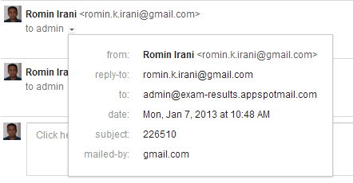
Session 8 – Code Lab
Email Service

Slide 49
App Engine – Mail Service
App Engine provides the Mail Service API
Used for sending and receiving email
Sending Email is similar to invoking any HTTP request, simply invoke the Mail API to send email.
Receiving Email is similar to receiving HTTP requests. App Engine wraps the message and invokes standard Request Handlers for Mail in your application
The message is put in the HTTP Request payload
https://developers.google.com/appengine/docs/java/mail/

Slide 50
App Engine – Mail Service
Each app has its own set of incoming email addresses, based on its application ID.
For email, the app can receive messages at addresses of these forms:
  app-id@appspotmail.com
  anything@app-id.appspotmail.com
Free Quota : 100 per day external, 5000 per day (Administrator)
Dev Server supports API but does not send out actual email. It just shows it in the Log.

Slide 51
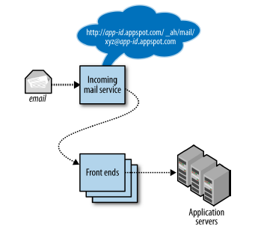
App Engine – Mail Service

Slide 52
App Engine – Receiving Email
To receive email in your application, first enabled the feature in the application configuration
Go to appengine-web.xml in /WEB-INF folder and add the following entry:
<inbound-services>
<service>mail</service>
</inbound-services>

Slide 53
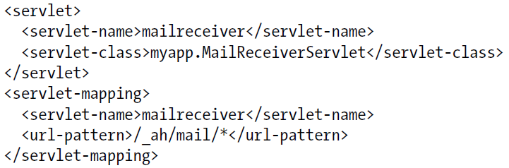
App Engine – Receiving Email
Add the incoming email URL Path to a Servlet
web.xml description
In the Servlet, handle the POST method to extract out the Email message payload

Slide 54
App Engine – Receiving Email
public void doPost(HttpServletRequest req, HttpServletResponse resp) throws IOException {
  Properties props = new Properties();
  Session session = Session.getDefaultInstance(props, null);
  try {
    MimeMessage message = new MimeMessage(session, req.getInputStream());
    String contentType = message.getContentType();
    Object content = message.getContent();
    if (content instanceof String) {
    // A plain text body.
    }
    else if (content instanceof Multipart) {}
  }
  catch (MessagingException e) {
  //..
  }
}

Slide 55
App Engine – Sending Email
To send Email, call the API of the Mail Service
Fill out From, To, CC, BCC, Subject, Message, Attachments.
Valid From Address
  The Google Account address of one of the application administrators
  The address of the user currently signed in to the app
  A valid incoming email address for the application

Slide 56
App Engine – Sending Email
String recipientAddress = <email address>;
Properties props = new Properties();
Session session = Session.getDefaultInstance(props, null);
String messageBody =“Hi”;
try {
  Message message = new MimeMessage(session);
  message.setFrom(new InternetAddress(“test@test.com"));
  message.addRecipient(Message.RecipientType.TO, new InternetAddress(recipientAddress));
  message.setSubject("Welcome to App Engine Workshop!");
  message.setText(messageBody);
  Transport.send(message);
}
catch (Exception e) {
}

Slide 57
Hands On Exercise
Allow for anyone to request their exam result via Email
Write incoming email handler to receive and parse request
Send out the response via email (Ideally this should be send out asynchronously via Task Queue API)
Go to /hands-on-exercises/ExamResults-Step5-Email.docx

Slide 58

Session 9 – Code Lab
Cron Service

Slide 59
App Engine – Cron Service
Ability to run tasks at regular intervals
Schedule one or more repetitive tasks to run at different intervals
Ability to specify Time Zones also
Examples
  Fetch the latest news every 1 hour
  Update App statistics every 6 hours
  Check system to send any email reminders every 12 hours
  Take a backup every week on Wednesday at 12:00 AM
https://developers.google.com/appengine/docs/java/config/cron

Slide 60
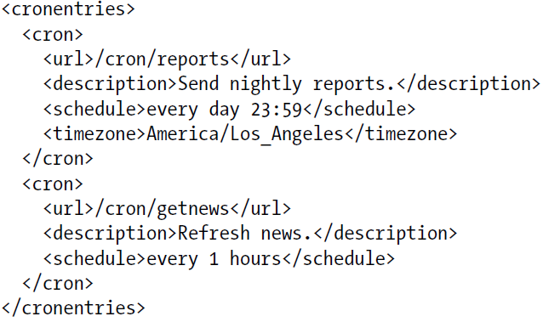
App Engine – Cron Service
Cron Schedules are specified in a cron.xml file that is placed in the /WEB-INF directory

Slide 61
App Engine – Cron Service
Each Cron Entry specifies the following:
  description : A description of the task
  url : the URL path of the Request handler to invoke. This will map to the Servlet that you will configure in the web.xml file
  schedule: the Cron expression that specifies the schedule on which to execute the task
  timezone: Optional. The Zone Info descriptor for the timezone e.g. America/Los Angeles. If omitted it is UTC
  target: Optional. ID of the App version to use for the task.

Slide 62
Cron Service - Schedules
  A Cron Expression for the schedule is a simplified English-like format that describes the recurrence of the task
  every 1 minutes
  every 10 hours
  every day 11:00
  every wednesday 15:00
  2nd sunday
  every 30 mins from 9:00 to 12:00

Slide 63
Hands On Exercise
Write out a Cron Job that executes every 2 or 1 hour and prints out a dummy string.
First configure your cron.xml file with the cron entry and place it in /WEB-INF folder
Map the Cron Job Request Handler to Servlet and code the Servlet
Deploy the application on App Engine and observe the results
Go to /hands-on-exercises/ExamResults-Step6-CronJob.docx

Slide 64
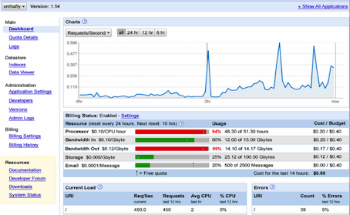
Session 10 – Code Lab
Administrative Console

Slide 65
Administrative Console
Login at http://appengine.google.com
Visit your list of applications
Click on a particular application to view the Administrative Console

Slide 66
Administrative Console
Dashboard shows current usage / quota limits
View Logs
View Datastore
Versions
Enable/Disable Application
and more …

Slide 67
Hands On Exercise
For one of your App Engine applications, login with your account credentials at http://appengine.google.com
Visit the Dashboard and visit the different links
Most important ones:
  Current usage
  Logs
  Datastore viewer

Slide 68
More Services
We have only seen a few of the App Engine Services
Investigate and learn about these additional ones
  Blobstore – for storing large amounts of data
  Memory Cache – store and retrieve data from memory
  Task Queues – Create asynchronous tasks that are executed by App Engine automatically
  And more …
  Visit : https://developers.google.com/appengine/docs/java/

Slide 69

Next Steps
Take a break
App Engine application ideas
Put down on paper what you want your app to do
Break down your app into App Engine services needed.
Now for some ideas ….

Slide 70
App Engine Ideas – List 1
Quiz
Monitor Social Media for mentions
Customer Support System / Tickets – driven via Email
Medical Applications
  Track activities / food
  Monitor Health Incidents
  Vaccination Reminders
  Alternative Drugs

Slide 71
App Engine Ideas – List 2
Game Scoring Platform
  API driven, Game -> High Scores, Leaderboard, etc
Speaker Feedback System
Employee / Kids Tracking System
Ad Platform
Document Sharing , Photo Sharing
Exam Results
Asset Management

Slide 72
App Engine Ideas – List 3
XMPP Bots
  Campus Information
  Events
  Local Goa stuff
  Train / Bus / Flight
Civic Apps
  Accident / Traffic Reporting
  Neighborhood Issues

Slide 73
App Engine Applications
App Engine applications can drive any kind of client
It can be :
  Web Browser
  Mobile Application (Android, iPhone)
  Chrome Browser Extension
Get ! Set ! Go !
All The Best !

Slide 74
Important URLs
Official Site : https://cloud.google.com/products/
AppEngine Console: http://appengine.google.com
Java Documentation: https://developers.google.com/appengine/docs/java/overview
AppEngine Code Lab: http://googcloudlabs.appspot.com

Slide 75
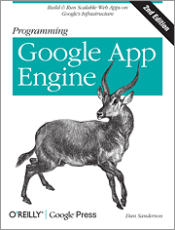
Books
Excellent in-depth book on Google App Engine covering both Python and Java
Code snippets in this presentation taken from book for demonstration purpose only
Programming Google App Engine, 2nd Edition
By Dan Sanderson
Publisher: O'Reilly Media
Released: October 2012
Pages: 538
http://shop.oreilly.com/product/0636920017547.do

Slide 76
Thank You
Q & A
Website : http://www.mindstormsoftware.com
Email : romin.irani@mindstormsoftware.com
Blog : http://www.romin.irani.com
App Engine Tutorials : http://www.rominirani.com/category/cloud-computing/google-app-engine/
Free Book on App Engine (dated but things should work with minor syntax changes in some examples): http://www.rominirani.com/2010/03/09/gaej-experiments-ebook/

Slide 77
Appendix
Some extra slides here
An Important one is on Java restrictions.
At the end of the day, App Engine is a PaaS and it puts some restrictions on what you can and more importantly cannot do. So certain Java classes might not be supported, etc.

Slide 78
App Engine – Do Note
Current supported languages : Python, Java & Go
It supports various JVM supported languages like Groovy, JRuby, Scala, Clojure, etc.
Supports standard Java Servlet 2.5 technology using Jetty Open Source Web Server
Several frameworks like Spring, Struts are supported with workarounds
Some APIs are experimental in nature. They could undergo changes till they reach Production status

Slide 79
App Engine – Java Restrictions
Developers have read-only access to the filesystem on App Engine.
App Engine can only execute code called from an HTTP request (scheduled background tasks allow for self calling HTTP requests).
Java applications may only use a subset (The JRE Class White List) of the classes from the JRE standard edition.
Datastore cannot use inequality filters on more than one entity property per query.
A process started on the server to answer a request can't last more than 60 seconds (with the 1.4.0 release, this restriction does not apply to background jobs anymore).

Slide 80
App Engine – XMPP Errors
When you invoke the XMPP Service to sending a message, the message is queued for delivery and the only error you will get is if the message is malformed
XMPP Service puts all incoming error messages onto a separate inbound service called xmpp_error
To enable this service, add the xmpp_error inbound service to the application configuration in appengine-web.xml

Slide 81
AppEngine – XMPP Errors
The entry to add to appengine-web.xml is shown below:
Error messages arrive as POST requests at this URL path:/_ah/xmpp/error/
You need to map the Request Handler i.e. a Servlet to the above path to receive the error messages.
<inbound-services>
<service>xmpp_message</service>
<service>xmpp_error</service>
</inbound-services>

