Slide 1


Android 101 - Developer Workshop
6th October, 2012
2011-2012

Slide 2
Goals of Workshop
Help you understand what Android is
Try out some Android APIs via Android Eclipse Projects
Build a simple Application (Quotes)
Build enough enthusiasm for you to take your next leap into Android Programming
2011-2012

Slide 3

Participant Requirements
Basic working knowledge of Java or any other OOP language
Eclipse IDE
Android SDK and Tools
We shall run all examples on the Android Emulator
A device is important to have but not necessary for this course
2011-2012

Slide 4
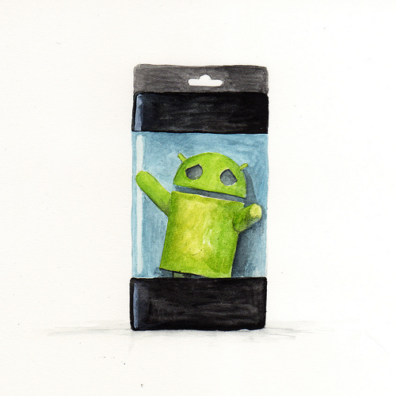


What is Android ?
2011-2012

Slide 5
What is Android?
A software stack for mobile devices
Includes Linux Kernel, OS Middleware, Application Framework & Applications.
Provides SDK for developers
From Google
Open Source and provided to Handset manufacturers
http://www.android.com
http://developer.android.com
2011-2012

Slide 6
Android - History
OS Version | Name | API Level | Date
Beta, 1.0 , 1.1 | - | -, 1 , 2 | Nov 2007, Sep 2008, Feb 2009
1.5 | Cupcake | 3 | April 2009
1.6 | Donut | 4 | September 2009
2.1 | Eclair | 7 | October 2009
2.2 | Froyo | 8 | May 2010
2.3 | Gingerbread | 10 | December 2010
3.0 | Honeycomb | 11 | February 2011
3.1.x, 3.2 | Honeycomb | 12,13
4.0, 4.0.1, 4.0.2 | Icecream Sandwich | 14 | October 2011
4.0.3, 4.0.4 | Icecream Sandwich | 15 | December 2011
4.1 | JellyBean | 16 | June 2012
2011-2012

Slide 7
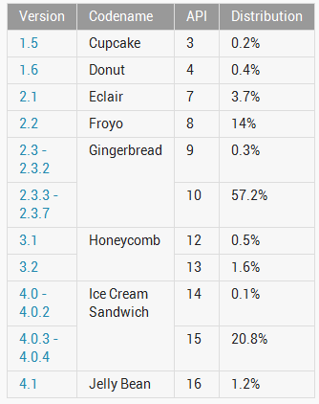
Android Device Dashboard
~ 75%
~ 22%
September 4, 2012 : http://developer.android.com/resources/dashboard/platform-versions.html
2011-2012

Slide 8
Android Features
Handset Layouts, Multiple Languages
Storage
Connectivity
Messaging
Media Support
Hardware support
  Cameras, touch screens, GPS, accelerometer, etc.
Reuse of Data
Reuse of Functionality
2011-2012

Slide 9
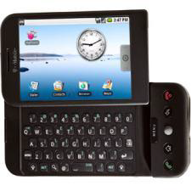
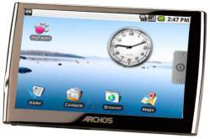
Why Android?
Android has garnered more than 50% of the current marketshare in Smartphones
Android by its nature is available across various devices (Phone, Tablet, TV, Navigation Devices, etc)
Robust Ecosystem : 300+ Hardware/Software partners
Open Source (http://git.android.com)
Good set of Developer Tools
25 Billion+ Downloads
2011-2012

Slide 10
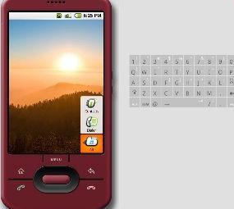



Android Developer Tools
Java SDK
Eclipse
Android SDK
  Android Emulator
  Command Line Tools
  Documentation + Samples
  Platform Libraries
Android Development Tools (ADT) for Eclipse (Recommended to begin with)
2011-2012

Slide 11

Development Environment Setup
2011-2012

Slide 12
Tools Needed
Java SDK
  http://www.oracle.com/technetwork/java/javase/downloads/index.html
Eclipse
  http://www.eclipse.org/downloads
Android SDK
  http://developer.android.com/sdk/index.html
Android Development Tools (ADT) for Eclipse
  http://developer.android.com/sdk/eclipse-adt.html
  (Recommended to begin with)
2011-2012

Slide 13
Android Virtual Device
SDK includes an Emulator - a virtual mobile device
Emulator helps your test your applications without a physical device
It mirrors the System Image and functionality as closely as possible
You need to create an Android Virtual Device for the Android OS that you wish to target. E.g. 2.2, 2.3, 3.x, 4.x
2011-2012

Slide 14
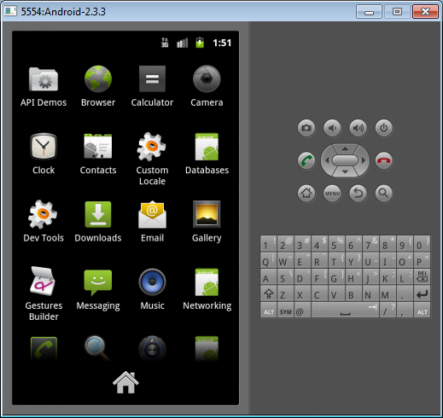
Android Emulator
Mimics a Normal
Android Device
Use it to get
familiar with the
functions
2011-2012

Slide 15

Your First Android App
2011-2012

Slide 16
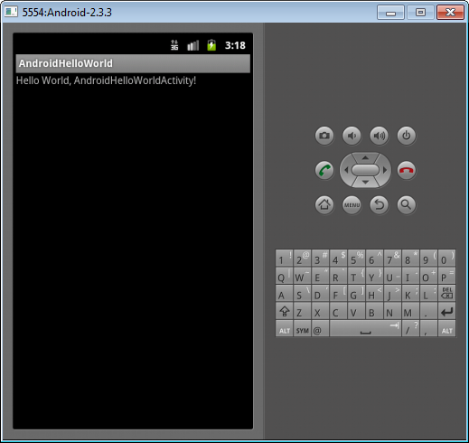
Hello World In Android
2011-2012

Slide 17
Steps to First Hello World
Development Environment !
Create the AVD and start the Device
Use Eclipse to create the Android Project
  Code, Code, Code
Run the Application either the AVD or a real device
2011-2012

Slide 18
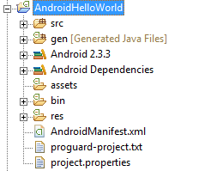
Project Structure
2011-2012

Slide 19
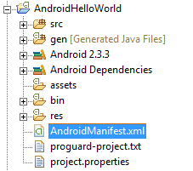
Android Manifest XML
Describes the Application
Activities and other components
Application Name
Application Version
Permissions
Android SDK Version
2011-2012

Slide 20
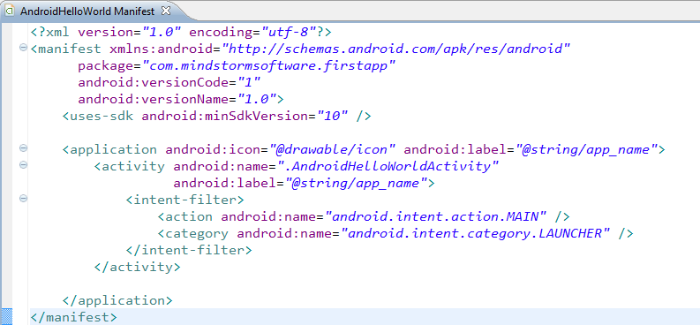
Android Manifest XML
2011-2012

Slide 21

Project Structure - Source
Contains all the Java Source files
2011-2012

Slide 22
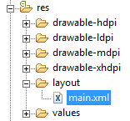
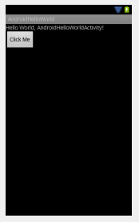
Project Structure - Layout
Defines how the User Interface
is laid out.
2011-2012

Slide 23
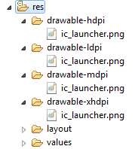

Project Structure – Image Resources
Define Image Resources for different resolutions
The runtime takes care of using the right image
If not present, it scales it accordingly.
2011-2012

Slide 24
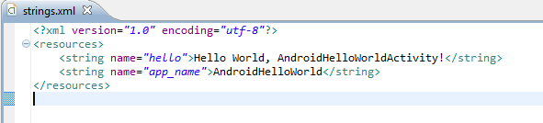
Project Structure – strings.xml
Externalize all String values
strings.xml is just one kind of resource you can put
Other examples are:
  colors.xml
  dimens.xml
  arrays.xml
2011-2012

Slide 25
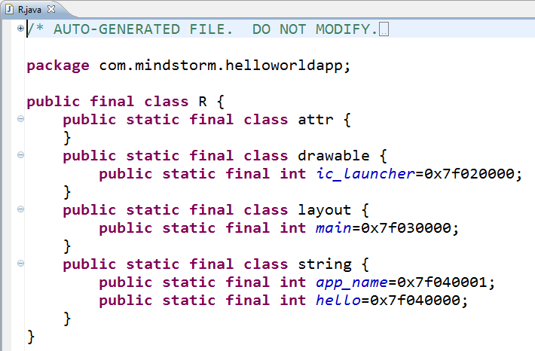
Project Structure – R.java file
Compiled version of all your resources
Can reference them from XML file or even from Java source file
Compiled and weaved into your code
2011-2012

Slide 26
Project Structure – R.java file
2011-2012

Slide 27

Hands On Exercise
Hands On Exercise : ex01 – Hello World.doc
  Hello World
Check List
  Developer Tools are setup
  Android Virtual Device has been created
2011-2012

Slide 28
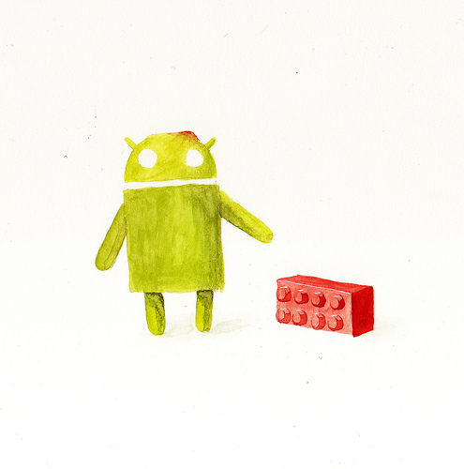

Android Building Blocks
2011-2012

Slide 29
Building Blocks
Important to understand what an Android Application is made up of
Android defines few buildings blocks that make up an application
  Activity
  Manifest File
  Resources
  Content Provider
  Broadcast Receiver
  Service
2011-2012

Slide 30
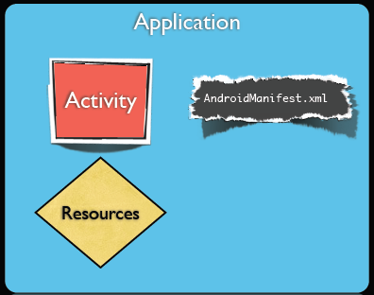
Android Application - Minimal
You need 3 things at least
  Activity
  Android Manifest XML
  Resources
2011-2012

Slide 31
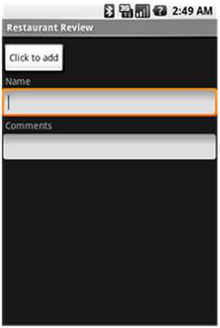
Android Activity
Most Basic Building Block
It is a Screen that users can interact with
Example: Filling out a text field, dialing a number, etc.
An Activity is typically written by
extending the Activity class.
You can implement the call back
methods to get notified of Activity
life cycle (onCreate(), onDestroy(), etc)
2011-2012

Slide 32
Android Activity
Creating an Activity
  Extend the Activity class
  Implement the following method
    onCreate() : In this method, you can specify the layout (UI) for the activity and write any other initialization functions
2011-2012

Slide 33
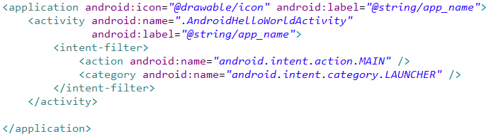
Android Activity
An Application can have one or more Activities
One Activity is designated as the Main Activity that is launched when the Application Starts
2011-2012

Slide 34
Android Activity – User Interface
An Activity can implement its User Interface by defining a XML file.
The User Interface will consist of ViewGroups (Layout) and Views.
You can set the View by calling the
setContentView() method in the
onCreate() method of the Activity
Pass the layout in the onCreate()
2011-2012

Slide 35
Android UI
Android supports
  Description of UI in XML
  Programming UI creation
Design Principle : Separate the UI Design from Behaviour (Event Handling e.g. Click)
Views
ViewGroups
2011-2012

Slide 36
Android UI - Views
View
Basic Unit of UI
Base class for all widgets
Examples : TextField, Button, etc.
2011-2012

Slide 37
Android UI - ViewGroup
ViewGroup serves as the base class for “Layouts”
Layout
  Allows to group Views
  Lay them out in various architectural ways
    Tabular
    Linear
    Relative
Layouts can be nested to create complex screens
2011-2012

Slide 38
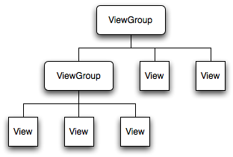
Android UI – ViewGroup + View
2011-2012

Slide 39
Android UI – View Types
Android supports variety of views that help capture various kinds of user input
What kind of data + User Experience
Button
EditText
TextView
ImageButton
CheckBox
RadioButton, RadioGroup
ToggleButton
SeekBar
ProgressBar
2011-2012

Slide 40
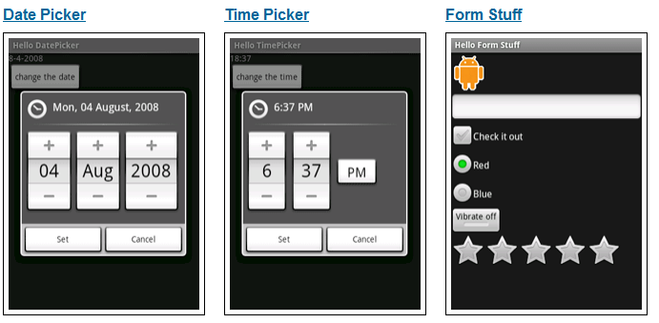
Android UI – Basic Views
2011-2012

Slide 41
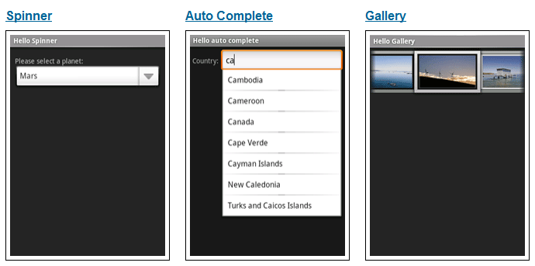
Android UI – Basic Views
2011-2012

Slide 42




Android UI – View Declaration
XML
Common attributes
  Id , text , layout_width, layout_height
  Various other fields
2011-2012

Slide 43
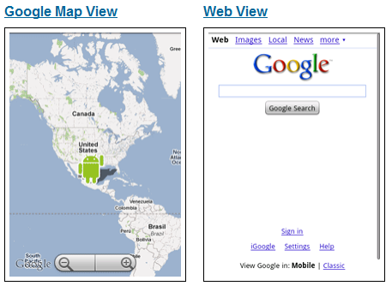
Android UI – Basic Views
2011-2012

Slide 44
Android UI – View Declaration
XML
Common attributes
  Id , text , layout_width, layout_height
  Various other fields
2011-2012

Slide 45
Android UI – Event Handling
Pattern for working with Widgets
Get the instance to the view
  findViewById(R.id.<viewid>)
Set up Event Handlers
  Example : onClick
Provide Event Handler implementation
Study the Java class for different methods and events that you can handle on the Widgets
2011-2012

Slide 46
Android UI – Layout
Layout – Recommended way is to define the Viewgroup hierarchy in an XML file
Different Layouts are supported. Common ones are:
  LinearLayout
  Framework
  TableLayout
  RelativeLayout
Other ViewGroups: Gallery, GridView, ScrollView, TabHost, etc.
2011-2012

Slide 47
Android UI – Linear Layout
Is a ViewGroup
Displays Child View Elements in a linear fashion
Linear = One After Another
Orientation attribute
  Horizontal
  Vertical
2011-2012

Slide 48
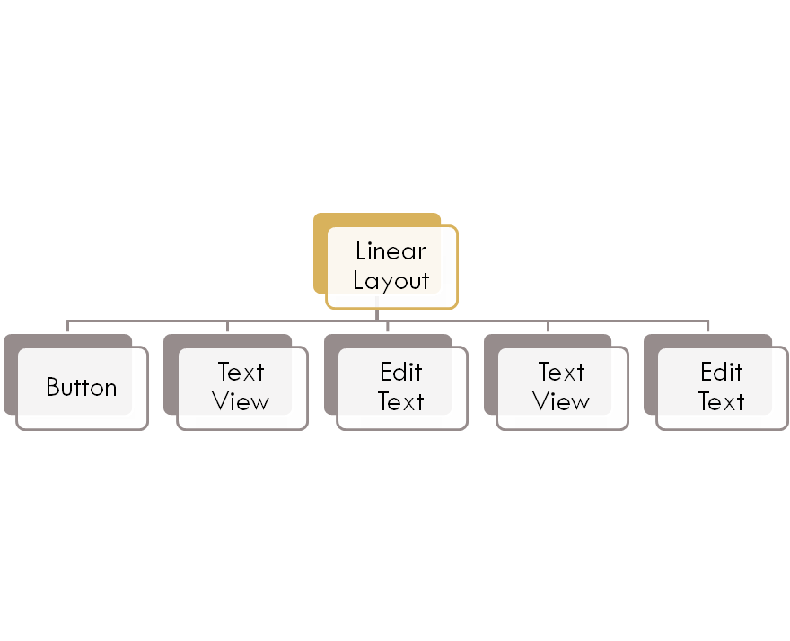
Android UI – Linear Layout
2011-2012

Slide 49
Android UI – Linear Layout
<LinearLayout xmlns:android="http://schemas.android.com/apk/res/android"
android:orientation="vertical"
android:layout_width="fill_parent"
android:layout_height="fill_parent">
<Button …. />
<TextView ….. />
<EditText …./>
<TextView …./>
<EditText …./>
</LinearLayout>
2011-2012

Slide 50
Hands On Exercise
Hands On Exercise
  ex02.docx – View and Layout Basics
2011-2012

Slide 51
Multiple Activities
2011-2012

Slide 52
Multiple Activities
You can define more than one Activity in an Application
Think of : Activity ←→ User Screen
You can launch an Activity from within an Activity
MainActivity
SignInActivity
Please click button
below to sign in first
User Name
onClick
Begin
Password
Start SignInActivity
Sign In
2011-2012

Slide 53
Android - Intent
An Intent can be loosely termed as what you want to do.
Examples:
  Start a particular Activity
  Send Email
  Send SMS
  View URL
Intents : Explicit and Implicit
2011-2012

Slide 54
Android – Explicit Intent
Explicit Intent
  Start Activity 2
  You need to know the class for Activity 2
  For e.g. if you have a screen (Activity 1) which has one button saying “Begin”
  On clicking “Begin”, you want to display another form (start Activity) where the user enters userid/password
2011-2012

Slide 55
Android – Explicit Intent
Intent intent = new Intent(this, SignInActivity.class);
startActivity(intent);
MainActivity
SignInActivity
Please click button
below to sign in first
User Name
onClick
Begin
Password
Start SignInActivity
Sign In
2011-2012

Slide 56
Android - Intent
An Intent can be loosely termed as what you want to do.
Examples:
  Start a particular Activity
  Send Email
  Send SMS
  View URL
Intents : Explicit and Implicit
2011-2012

Slide 57
Android – Explicit Intent
Explicit Intent
  Start Activity 2
  You need to know the class for Activity 2
  For e.g. if you have a screen (Activity 1) which has one button saying “Begin”
  On clicking “Login”, you want to display another form (start Activity) where the user enters userid/password
2011-2012

Slide 58
Android – Explicit Intent
Intent intent = new Intent(this, SignInActivity.class);
startActivity(intent);
MainActivity
SignInActivity
Please click button
below to sign in first
User Name
onClick
Begin
Password
Start SignInActivity
Sign In
2011-2012

Slide 59
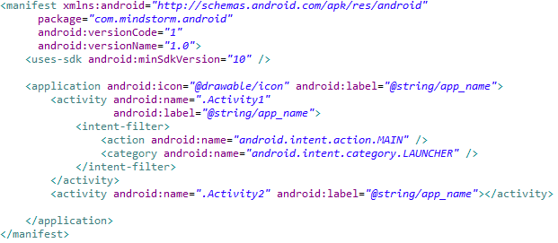
Android Activity - Manifest
All Activities need to be defined in the Android Manifest XML file
2011-2012

Slide 60
Android – Implicit Intent
Android supports various standard activties that are commonly clubbed under Implicit Intent
Examples:
  Send Email
  Send SMS
  Dial / Call a number
  View a web page
  View a Map
  Launch Camera
  Share Content
Android will look at all applications that are capable of handling the Intent and then it will launch that
2011-2012

Slide 61
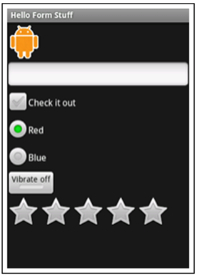
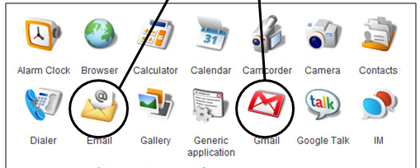
Android – Implicit Intent
I have 2 Apps for you
Intention : Send Email
SMS
Mail
Web
2011-2012

Slide 62
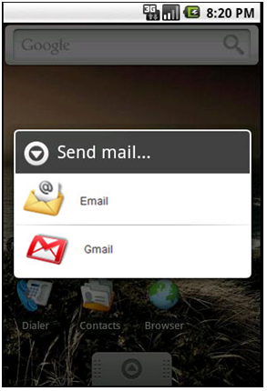
Android – Implicit Intent
I have 2 Apps for you
Intention : Send Email
SMS
Mail
Web
2011-2012

Slide 63
Android – Implicit Intents - 1
To Launch a Browser
Intent i = new
Intent(android.content.Intent.ACTION_VIEW,
Uri.parse("http://www.amazon.com"));
startActivity(i);
2011-2012

Slide 64
Android – Implicit Intents - 2
Built In Intent (ACTION_DIAL)
This will show the Dial Screen but not start calling
Example Project : BuiltInIntents
Intent i = new Intent
(android.content.Intent.ACTION_DIAL,
Uri.parse("tel:+9810020011"));
startActivity(i);
2011-2012

Slide 65
Android – Implicit Intents - 3
Built In Intent (ACTION_CALL)
This will start calling the number
Requires the following permission:
<uses-permission android:name="android.permission.CALL_PHONE">
Intent i = new Intent
(android.content.Intent.ACTION_CALL,
Uri.parse("tel:+9810020011"));
startActivity(i);
2011-2012

Slide 66
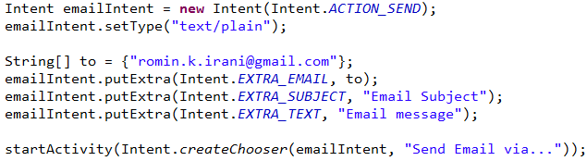
Android – Send Email
2011-2012

Slide 67
Android – Send SMS
Intent i = new Intent(android.content.Intent.ACTION_VIEW);
i.putExtra("address", “9821111111;9822211111");
i.putExtra("sms_body", "Hello");
i.setType("vnd.android-dir/mms-sms");
startActivity(i);
2011-2012

Slide 68
Hands On Exercise
Hands On Exercise
  ex03.docx -- Multiple Activities
  ex04.docx -- Built In Intents
2011-2012

Slide 69
Building a
Complete
Android Application
2011-2012

Slide 70
Quotes Application
Functional Specifications
  Displays Random Quotes
  User can share quotes via SMS
  Future Extensions
    User can view quotes by category
    User can mark some quotes as favourites
2011-2012

Slide 71
Quotes Application
Android Features to be used
  Activities
  Layouts for all activities
  Launch SMS App to share Quote via SMS
  Launch Email App to share Quote via Email
  File based database to store quotes
2011-2012

Slide 72
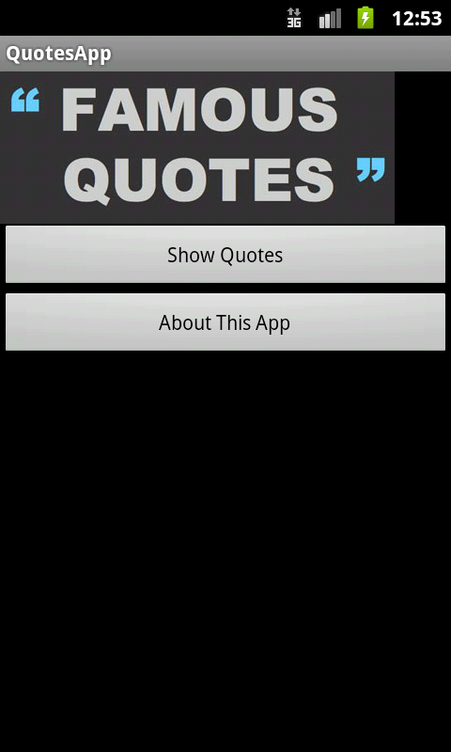
Quotes App in Action
QuoteActivity – Shows Main Menu
2011-2012

Slide 73
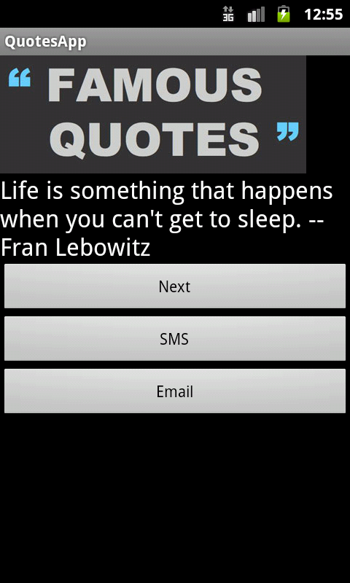
Quotes App in Action
Show Quotes retrieves a quote from Database
2011-2012

Slide 74
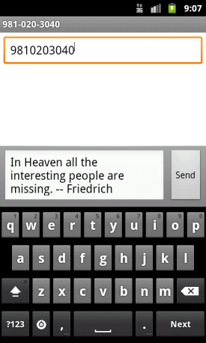
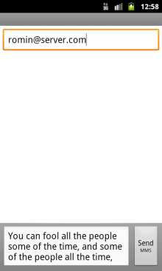
Quotes App in Action
Show Quote Activity – Other Functions
JSON
File
Retrieves another random quote from database and displays it
Launches SMS App on phone to share this quote
Launches Email App on phone to share this quote
2011-2012

Slide 75
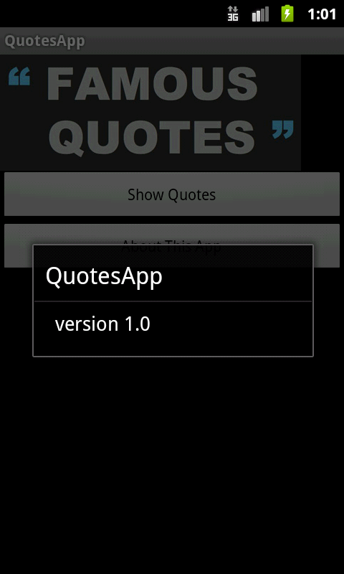
Quotes App in Action
About App – Displays a Dialog box
2011-2012

Slide 76
Quotes App – Step by Step
Quotes App – Step 1 - Navigation
Quotes App – Step 2
  Random Quotes
  Share a Quote via SMS
  Share a Quote via Email
Future - Quotes App – Step 3 - Favourites
Future - Quotes App – Step 4 – Category Quotes
2011-2012

Slide 77


Android Marketplace
2011-2012

Slide 78
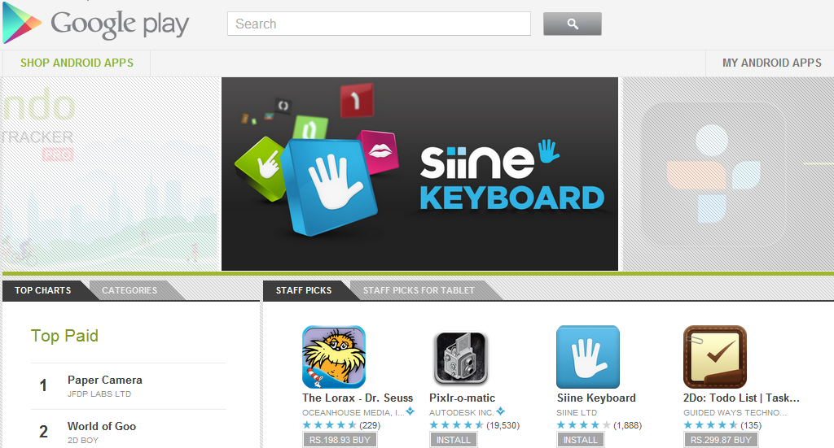
Android Marketplace (Google Play)
http://play.google.com
2011-2012

Slide 79
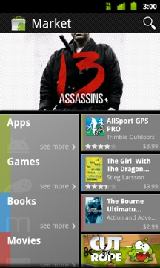
Android Marketplace
Web application + Android Application
Single Marketplace for eBooks, Music, Movies and Android Applications
Filters out the above categories if services are not available in particular country
Publisher Account
  Google Account
  Free Apps and Paid Apps (30% commission)
  Selling a Paid App currently not available for India
  Download Free Apps
  Download Paid Apps
  $25 Registration Fee
  Application Approval - Immediate
2011-2012

Slide 80
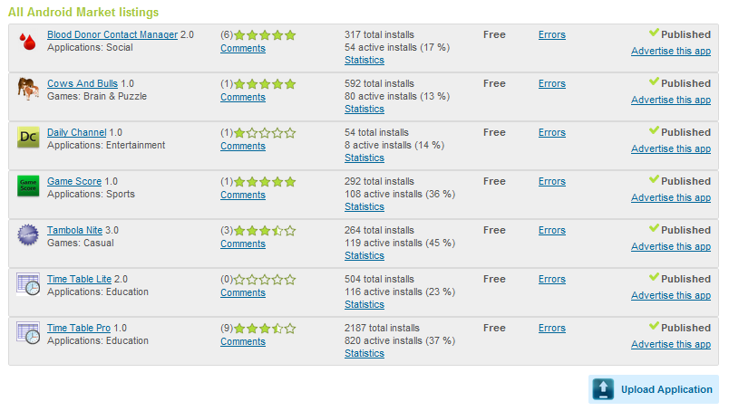
Android Marketplace
For the Publisher – Login and visit https://play.google.com/apps/publish/Home
2011-2012

Slide 81
Build the APK
APK = Android Application Package
File Format to distribute and install software on Android OS
Android Marketplace allows only signed APKs
APK = Archive File
  META-INF directory
  res
  AndroidManifest.xml
  classes.dex
  resources.arsc
2011-2012

Slide 82
Android Marketplace - Publish
Upload the APK
Hands On Exercise : Build the APK : ex15.docx
Provide 2 screenshots
Provide 1 High Resolution Image Icon (512 x 512)
Title , Description, Recent Changes
Application Type
Category
Contact Details
2011-2012

Slide 83
Build the APK – Short Check List
Test Your Application
Review your AndroidManifest.xml file
  Permissions (<uses-permission>)
  Icon and Label
  Application Version
  API Level : <uses-sdk>, minSDKVersion, targetSDKVersion
  Other Filters : <supports-screens>, etc
  http://developer.android.com/guide/appendix/market-filters.html
Compile Your Application
Export Signed Application (.APK)
2011-2012

Slide 84


Next Steps
Go back and absorb the material
Look at the examples again
Android Developer
http://developer.android.com
Android Training
http://developer.android.com/training
Get the Google Play Account…
… unleash your Apps
All The Best !
2011-2012

Slide 85


Q & A
Website : http://www.mindstormsoftware.com
Email : romin.irani@mindstormsoftware.com
2011-2012

