Slide 1


Android Developer Workshop
Student Dev Day 23.03.2013

Slide 2
Goals of Workshop
Help you understand what Android is
Get your Development Environment Setup
Introduce you to basic building blocks in Android
Do a few hands-on exercises, build an app and learn how to publish in Play Store
Requirements: Java language
Tools: Eclipse IDE / Android APIs
Simulator or Device

Slide 3


What is Android?
A software stack for mobile devices
Includes Linux Kernel, OS Middleware, Application Framework & Applications.
Provides SDK for developers
From Google
Open Source and provided to Handset manufacturers
http://www.android.com
http://developer.android.com

Slide 4
Android - History
OS Version | Name | API Level | Date
Beta, 1.0 , 1.1 | - | -, 1 , 2 | Nov 2007, Sep 2008, Feb 2009
1.5 | Cupcake | 3 | April 2009
1.6 | Donut | 4 | September 2009
2.1 | Eclair | 7 | October 2009
2.2 | Froyo | 8 | May 2010
2.3 | Gingerbread | 10 | December 2010
3.0 | Honeycomb | 11 | February 2011
3.1.x, 3.2 | Honeycomb | 12,13
4.0, 4.0.1, 4.0.2 | Icecream Sandwich | 14 | October 2011
4.0.3 | Icecream Sandwich | 15 | December 2011
4.1.x | Jelly Bean | 16 | July 2012
4.2 | Jelly Bean | 17 | November 2012

Slide 5
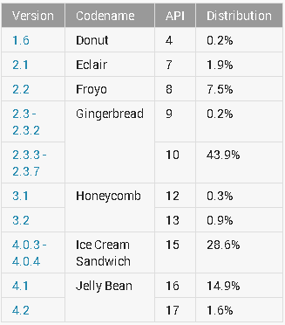
Android Device Dashboard
~ 53%
~ 45%
Mar 4, 2013 : http://developer.android.com/resources/dashboard/platform-versions.html

Slide 6
Why Android?
400 Million Activations in 2012
1 Million Devices / Day
850,000+ Apps
300+ Vendors
25 Billion+ Downloads
70% Smartphone Marketshare Q4
Open Source
Good Developer Tools
Across Devices

Slide 7

Android Market
http://play.google.com
Books + Movies + Videos + Apps
$25 Registration Fee
Website + Android App
850,000+ Apps
Actions
Publish
Download
Rate
Search

Slide 8
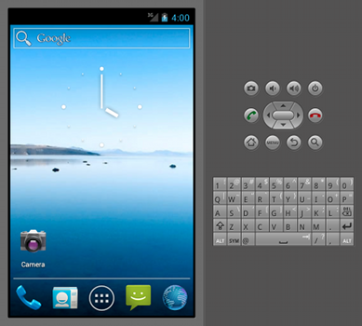



Android Developer Tools
Java SDK
Eclipse
Android SDK
Android Emulator
Command Line Tools
Documentation + Samples
Platform Libraries
Android Development Tools (ADT) for Eclipse (Recommended to begin with)

Slide 9

Development Environment Setup
Java SDK
ADT Bundle
Eclipse
Android Plugin
Latest Android SDK/Tools

Slide 10
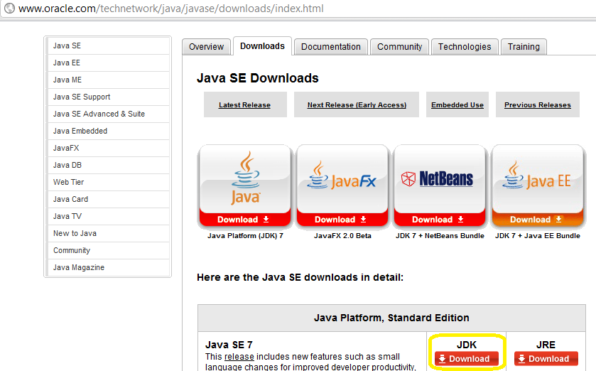
Tools Needed – Java SDK
Downloadable from http://www.oracle.com/technetwork/java/javase/downloads/index.html
Ensure JAVA_HOME is set to root directory of JDK
Eclipse : Window → Preferences → Java → JRE

Slide 11

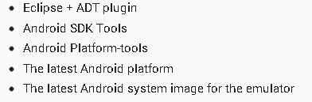
Tools Needed – Android SDK
Download the starter Package available at http://developer.android.com/sdk/index.html

Slide 12
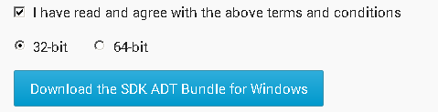
Android Starter Package - Setup
Select 32-bit or 64-bit
Download the bundle
The download is around 400 MB
Simply unzip the folder in c:\mindstorm-android-training

Slide 13

Android Starter Package - Setup
Assume you have downloaded adt-bundle-windows-x86.zip file and expanded in c:\mindstorm-android-training.
In the ADT Folder, you have the following:
In eclipse folder, you will have eclipse.exe, which is your environment for development. It has everything setup.

Slide 14
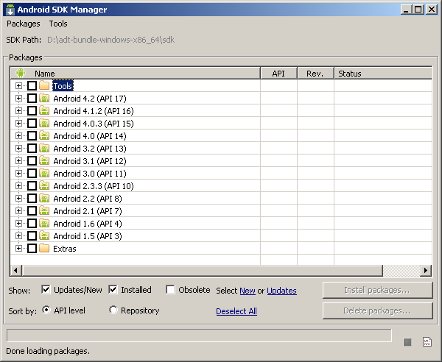
Android SDK Manager
Download SDK components and various versions
Available as SDKManager.exe from Android ADT Bundle Home Directory OR
Available from Eclipse as Android SDK Manager

Slide 15
Android Virtual Device
SDK includes an Emulator - a virtual mobile device
Emulator helps you test your applications without a physical device
It mirrors the System Image and functionality as closely as possible
You need to create an Android Virtual Device for the Android OS that you wish to target. E.g. 2.3.3 , 3.0.2, 4.0.3, 4.2 etc.

Slide 16
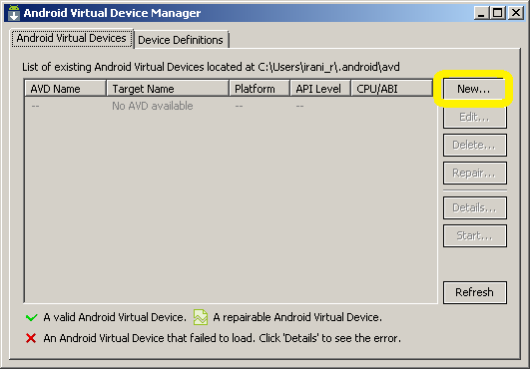
Android Virtual Device - Create
Go to Eclipse → Window → Android Virtual Device Manager

Slide 17
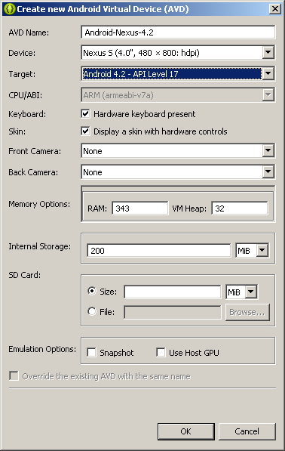
Android Virtual Device - Create
Specify Virtual Device Settings
Give a Name
Select a Device
Select API Level (Target)
Specify features
Click OK

Slide 18
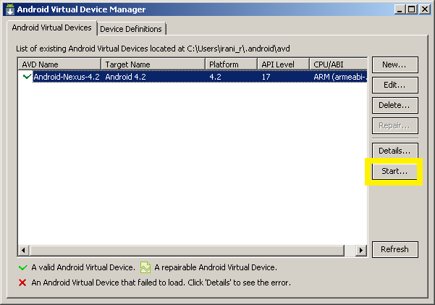
Android Virtual Device - Start
Select AVD and click on Start

Slide 19
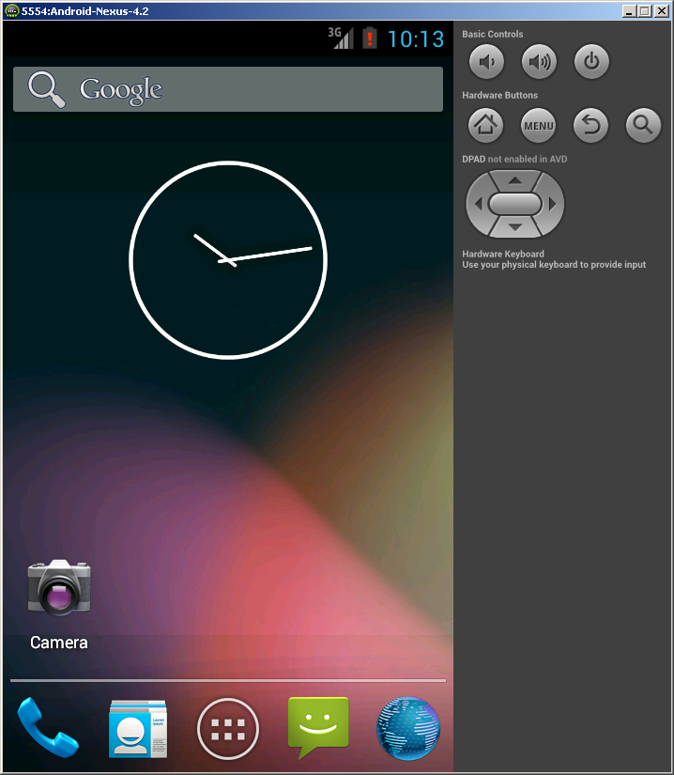
Android Emulator
Mimics a Normal Android Device
Use it to get familiar with the functions

Slide 20
Development Setup
Following Android Dev Environment Setup.docx to setup environment on your machine.

Slide 21

Your First Android App Hello World

Slide 22
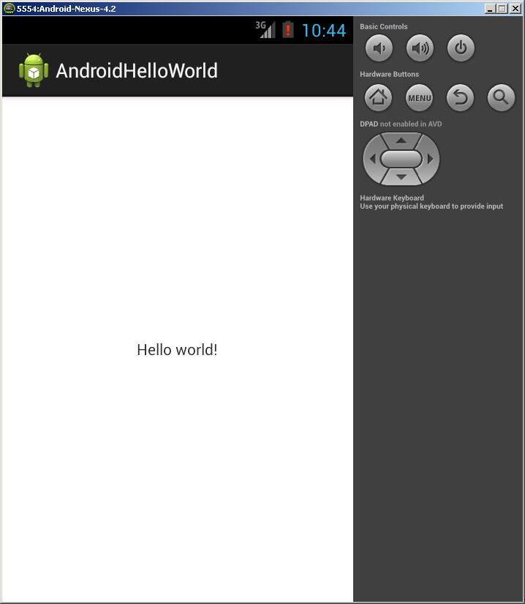
Hello World In Android

Slide 23
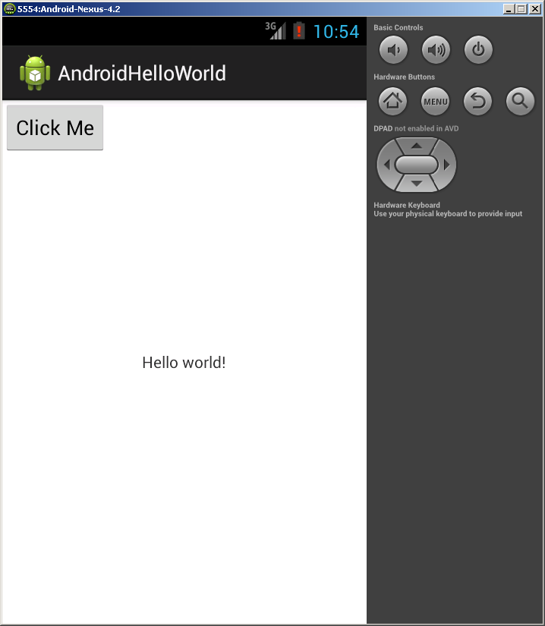
Hello World In Android

Slide 24
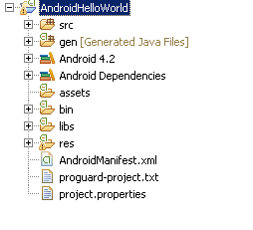
Project Structure

Slide 25
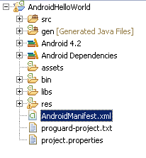
Android Manifest XML
Describes the Application
Activities and other components
Application Name
Application Version
Permissions
Android SDK Version

Slide 26
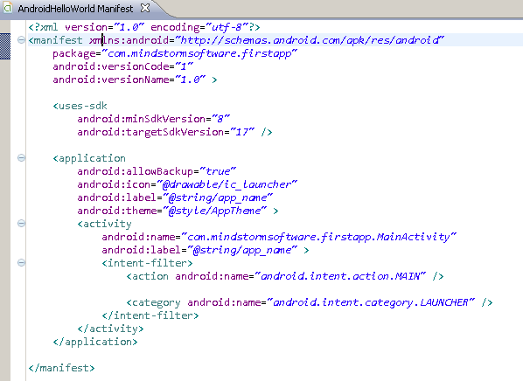
Android Manifest XML

Slide 27

Project Structure - Source
Contains all the Java Source files

Slide 28
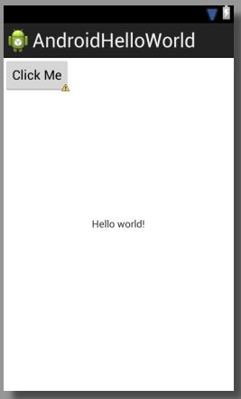
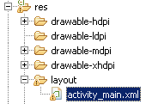
Project Structure - Layout
Defines how the User Interface is laid out.

Slide 29
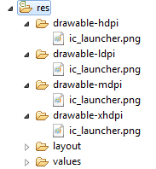

Project Structure – Image Resources
Define Image Resources for different resolutions
The runtime takes care of using the right image
If not present, it scales it accordingly.

Slide 30
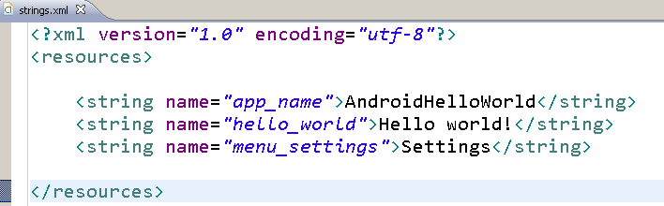
Project Structure – strings.xml
Externalize all String values

Slide 31

Hands On Exercise
Hands On Exercise : ex01 – Hello World.doc
Hello World
Check List
Developer Tools are setup
Android Virtual Device has been created

Slide 32


Android Building Blocks

Slide 33
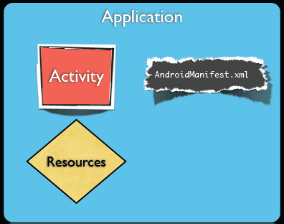
Android Application - Minimal
You need 3 things at least
Activity
Android Manifest XML
Resources

Slide 34
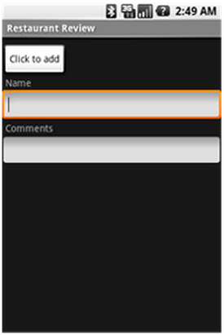
Android Activity
Most Basic Building Block
It is a Screen that users can interact with
Example: Filling out a text field, dialing a number, etc.
An Activity is typically written by extending the Activity class.
You can implement the call back methods to get notified of Activity life cycle (onCreate(), onDestroy(), etc)

Slide 35
Android Activity
Creating an Activity
Extend the Activity class
Implement the following method
onCreate() : In this method, you can specify the layout (UI) for the activity and write any other initialization functions

Slide 36
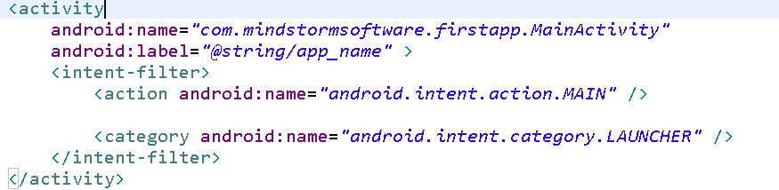
Android Activity
An Application can have one or more Activities
One Activity is designated as the Main Activity that is launched when the Application Starts

Slide 37
Android Activity – User Interface
An Activity can implement its User Interface by defining a XML file.
The User Interface will consist of ViewGroups (Layout) and Views. We shall see more of that in the User Interface Session.
You can set the View by calling the setContentView() method in the onCreate() method of the Activity
Pass the layout in the onCreate()

Slide 38
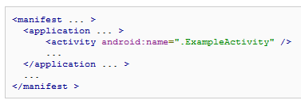
Android Activity - Manifest
All Activities need to be defined in the Android Manifest XML file
Example definition

Slide 39
Multiple Activities
You can define more than one Activity in an Application
Think of : Activity ←→ User Screen
You can launch an Activity from within an Activity
MainActivity
SignInActivity
Please click button below to sign in first
User Name
onClick
Begin
Password
Start SignInActivity
Sign In

Slide 40
Android - Intent
An Intent can be loosely termed as what you want to do.
Examples:
Start a particular Activity
Send Email
Send SMS
View URL
Share Content
Intents : Explicit and Implicit

Slide 41
Android – Explicit Intent
Explicit Intent
Start Activity 2
You need to know the class for Activity 2
For e.g. if you have a screen (Activity 1) which has one button saying “Begin”
On clicking “Begin”, you want to display another form (start Activity) where the user enters userid/password

Slide 42
Android – Explicit Intent
Intent intent = new Intent(this, SignInActivity.class); startActivity(intent);
MainActivity
SignInActivity
Please click button below to sign in first
User Name
onClick
Begin
Password
Start SignInActivity
Sign In

Slide 43
Android – Passing Data
You can pass data from one Activity to another when you start it.
Use Extras in the Intent
Intent i = new Intent(this,Activity2.class);
//Set the Data to pass
i.putExtra("name", "Mind Storm");
i.putExtra("timing", 30);
startActivity(i);

Slide 44
Android – Passing Data
You can read it back in the new Activity that you started.
Get the Intent and the Extras
Intent i = getIntent();
String name = i.getExtras().getString("name");
int timing = i.getExtras().getInt("timing",-1);

Slide 45
Hands On Exercise
Hands-On Exercise: ex02 –Multiple Activities.docx

Slide 46
Android Activities - Examples
Sample Projects
Multiple Activities : MultipleActivities
Passing Data across Activities : ActivityDataPassing
Hands On Exercise
ex02.docx – Multiple Activities
ex03.docx – Passing Data to Activities

Slide 47

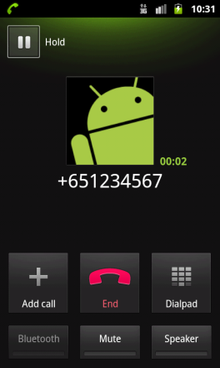


Session 5 Android – Implicit Intents SMS / Email / Call

Slide 48
Android – Implicit Intent
Android supports various standard activties that are commonly clubbed under Implicit Intent
Examples:
Send Email
Send SMS
Dial / Call a number
View a web page
View a Map
Launch Camera
Share Content
Android will look at all applications that are capable of handling the Intent and then it will launch that

Slide 49
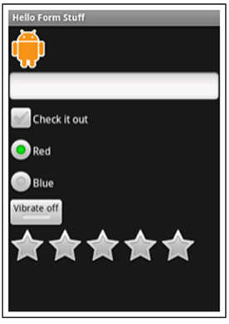
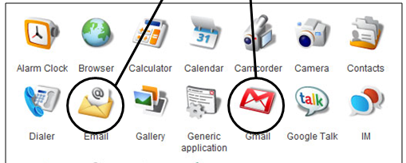
Android – Implicit Intent
I have 2 Apps for you
Intention : Send Email
SMS
Mail
Web

Slide 50
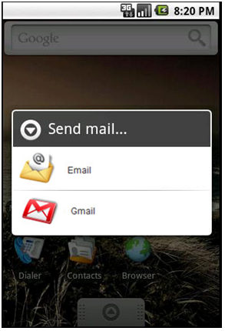
Android – Implicit Intent
I have 2 Apps for you
Intention : Send Email
SMS
Mail
Web

Slide 51
Android – Browse URL
To Launch a Browser
Intent i = new Intent(android.content.Intent.ACTION_VIEW,
Uri.parse("http://www.amazon.com"));
startActivity(i);

Slide 52
Android – Dial
Built In Intent (ACTION_DIAL)
This will show the Dial Screen but not start calling
Intent i = new Intent (android.content.Intent.ACTION_DIAL,
Uri.parse("tel:+9810020011"));
startActivity(i);

Slide 53
Android – Call
Built In Intent (ACTION_CALL)
This will start calling the number
Requires the following permission: <uses-permission android:name="android.permission.CALL_PHONE">
Example Project : BuiltInIntents
Intent i = new Intent (android.content.Intent.ACTION_CALL,
Uri.parse("tel:+9810020011"));
startActivity(i);

Slide 54
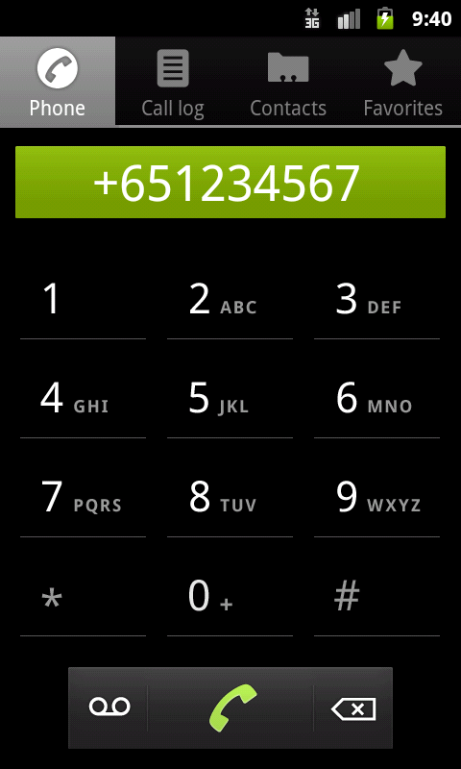
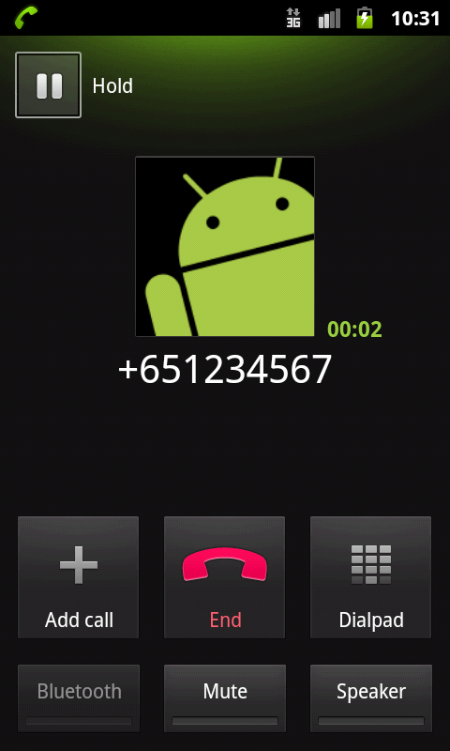
Android - Call
Default Phone Application is launched
ACTION_DIAL
ACTION_CALL

Slide 55
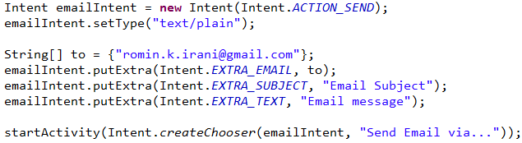
Android – Send Email

Slide 56
Android – Send SMS
Intent i = new Intent(android.content.Intent.ACTION_VIEW);
i.putExtra("address", “9821111111;9822211111");
i.putExtra("sms_body", "Hello");
i.setType("vnd.android-dir/mms-sms");
startActivity(i);

Slide 57
Hands On Exercise
Hands-On Exercise: ex03 - BuiltInIntents.docx

Slide 58

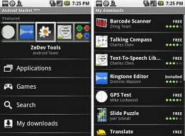
Android – Building A User Interface

Slide 59
Android UI
Android supports
Description of UI in XML
Programming UI creation
Design Principle : Separate the UI Design from Behaviour (Event Handling e.g. Click)
Views [Examples : TextField, Button, etc.]
ViewGroups

Slide 60
Android UI - ViewGroup
ViewGroup serves as the base class for “Layouts”
Layout
Allows to group Views
Lay them out in various architectural ways
Tabular
Linear
Relative
Layouts can be nested to create complex screens

Slide 61
Android UI – View Types
Android supports variety of views that help capture various kinds of user input
What kind of data + User Experience
Button
EditText
TextView
ImageButton
CheckBox
RadioButton, RadioGroup
ToggleButton
SeekBar
ProgressBar

Slide 62
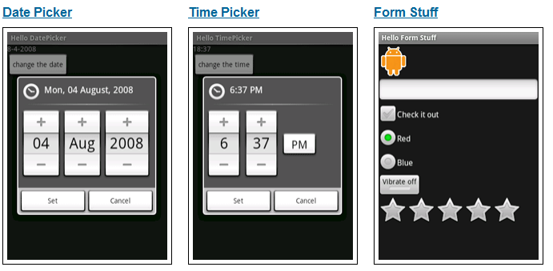
Android UI – Basic Views

Slide 63
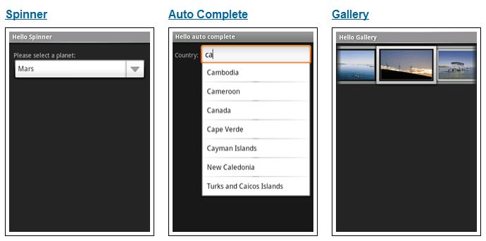
Android UI – Basic Views

Slide 64
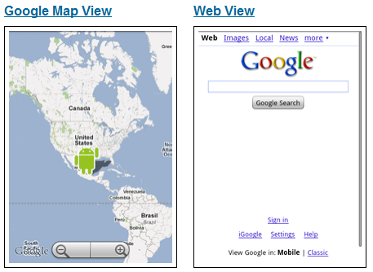
Android UI – Basic Views

Slide 65




Android UI – View Declaration
XML
Common attributes
Id , text , layout_width, layout_height
Various other fields

Slide 66
Android UI – Event Handling
Pattern for working with Widgets
Get the instance to the view
findViewById(R.id.<viewid>)
Set up Event Handlers
Example : onClick
Provide Event Handler implementation
Study the Java class for different methods and events that you can handle on the Widgets

Slide 67
Android UI – Layout
Layout – Recommended way is to define the Viewgroup hierarchy in an XML file
Different Layouts are supported. Common ones are:
LinearLayout
FrameLayout
TableLayout
RelativeLayout
Other ViewGroups: Gallery, GridView, ScrollView, TabHost, etc.

Slide 68
Android UI – Linear Layout
Is a ViewGroup
Displays Child View Elements in a linear fashion
Linear = One After Another
Orientation attribute
Horizontal
Vertical

Slide 69
Android UI – Linear Layout
Linear Layout
Button
Text View
Edit Text
Text View
Edit Text

Slide 70
Android UI – Relative Layout
Most flexible layouts
Along with flexibility comes complexity
Allows you to position Views relatively
Relatively to:
Parent
Other Views (each other)
Examples:
Position one element below the other but align to right border
Center the Element in the Screen

Slide 71
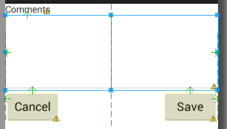
Android UI – Relative Layout

Slide 72
Android UI – Relative Layout
<?xml version="1.0" encoding="utf-8"?>
<RelativeLayout …>
<TextView android:id="@+id/lblComments“ android:text="Comments“ android:layout_alignParentTop="true"
android:layout_alignParentLeft="true"
/>
<EditText android:id="@+id/txtComments“ android:layout_below="@+id/lblComments“ android:layout_centerHorizontal="true"
/>
<Button android:id="@+id/btnSave“ android:text="Save“ android:layout_below="@+id/txtComments"
android:layout_alignRight="@+id/txtComments"
/>
<Button android:id="@+id/btnCancel“ android:text="Cancel“ android:layout_below="@+id/txtComments"
android:layout_alignLeft="@+id/txtComments"
/>
</RelativeLayout>

Slide 73
Android UI - Layout
This file will be typically placed in the res/layout directory
The Layout will be assigned to the Activity via the SetContentView() method in the OnCreate() method of the Activity.
For example. If res/layout directory contains the layout file main.xml , then you set the Layout for the Activity by :
setContentView(R.layout.main)

Slide 74
Hands On Exercise
Hands-On Exercise: ex04 - Basic UI.docx

Slide 75
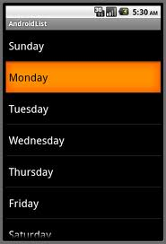
Android – List Activity

Slide 76
Android – ListActivity
Simply make your Activity extend ListActivity
The ListActivity has a ListView component embedded in it, which gets its data from an Adapter
You must set the data in the ListView by calling any of this in the onCreate() method:
setListAdapter(AdapterInstance)
getListView().setAdapter(AdapterInstance)

Slide 77
Android – Array Adapter
Adapter
Layout
List Activity
List View
Sunday
Monday
Tuesday
….
Data

Slide 78
Android – List Activity – sample code
class MyListActivity extends ListActivity
String[] states = {“Sunday”,”Monday”….}
In OnCreate() of the Activity
ArrayAdapter<String> statesAdapter =
new ArrayAdapter<String>(this, android.R.layout.simple_list_item_1,
states);
getListView().setAdapter(statesAdapter);

Slide 79
Android List Activity - Examples
ListActivity – Basic ListActivity
ListActivity2 – 1 + how to handle selected item
Override onListItemClick in Activity

Slide 80
Hands On Exercise
Hands On Exercise :
ex05 - ListActivity.docx – List Activity

Slide 81

Building a Complete Android Application

Slide 82
Study Notes Application
Functional Specifications
Show study notes for different subjects
User will select a particular subject
Notes for that subject will be shown
Future Extensions
User can add notes

Slide 83
Study Notes Application
Android Features to be used
Activities [Multiple Screens]
Layouts for all activities [LinearLayout]
ListActivity [for showing different subjects]
Built in Intents
Launch Email App to share Quote via Email
File based database to store notes
WebView to show study notes

Slide 84
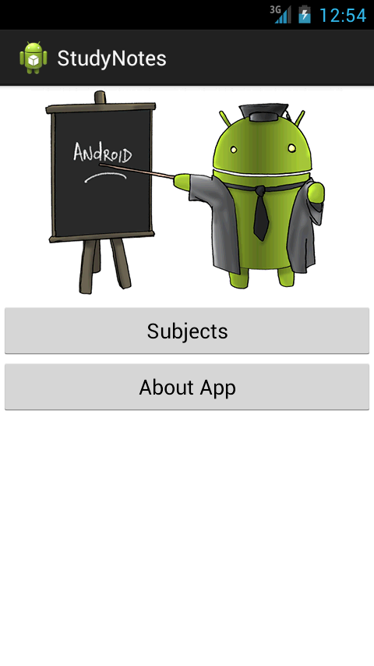
Study Notes App in Action
MainActivity – Shows Main Menu

Slide 85
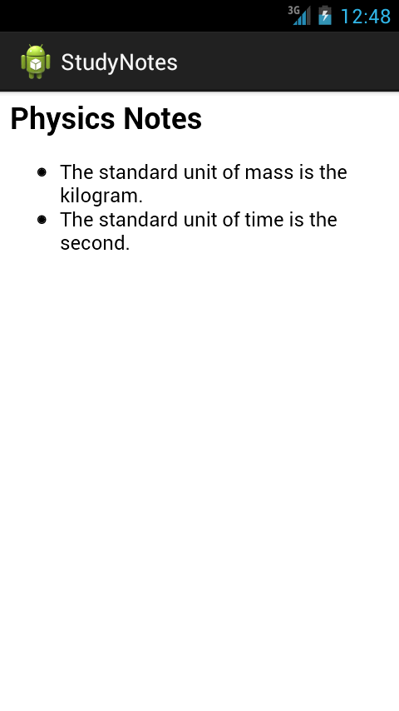
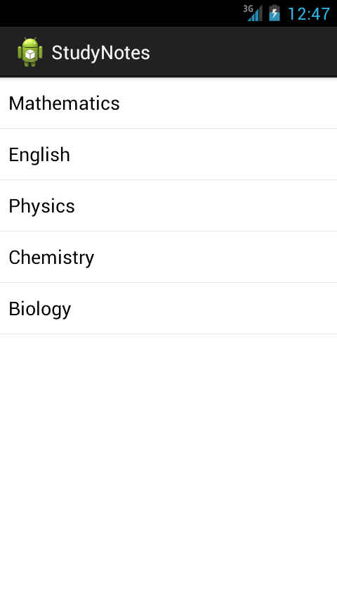
Study Notes App in Action
Show List of Subjects → Subject Notes

Slide 86
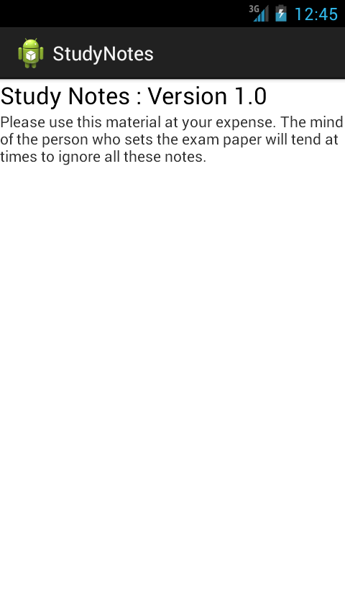
Study Notes App in Action
About App – Displays a Dialog box

Slide 87
Study Notes App
Import the Project : StudyNotes into your Eclipse workspace
File -> Import
Navigate to the folder of StudyNotes App and check Copy into Workspace

Slide 88

Android Marketplace –
Packaging + Distributing Your Application

Slide 89
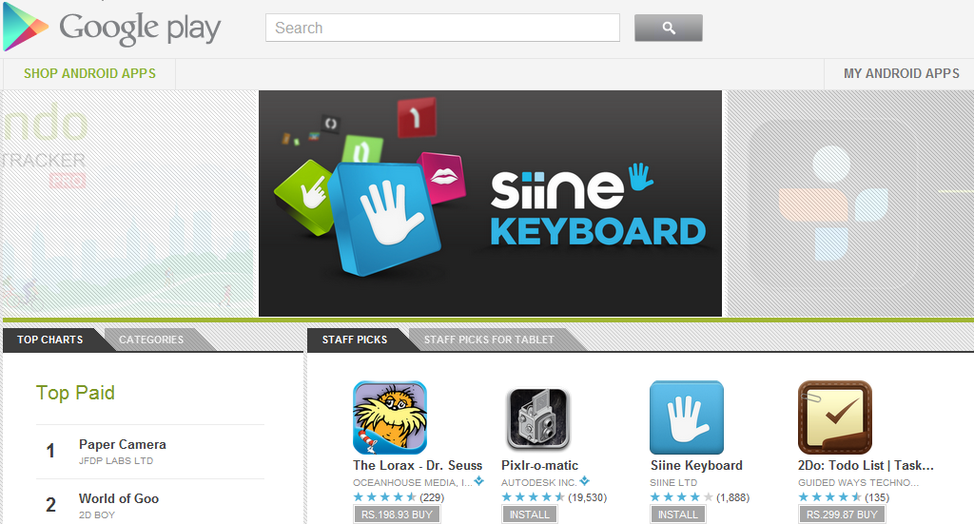

Android Marketplace (Google Play)
http://play.google.com

Slide 90
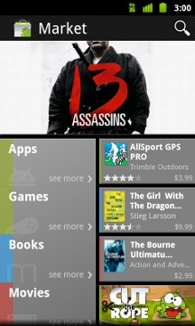
Android Marketplace
Web application + Android Application
Single Marketplace for eBooks, Music, Movies and Android Applications
Filters out the above categories if services are not available in particular country
Publisher Account
Google Account
Free Apps and Paid Apps (30% commission)
Download Free Apps
Download Paid Apps
$25 Registration Fee
Application Approval - Immediate

Slide 91
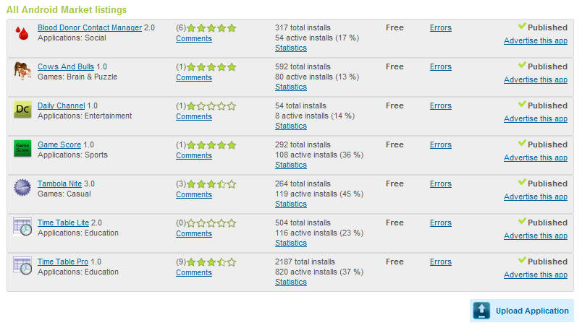
Android Marketplace
For the Publisher – Login and visit https://play.google.com/apps/publish/Home

Slide 92
Build the APK – Short Check List
Test Your Application
Review your AndroidManifest.xml file
Permissions (<uses-permission>)
Icon and Label
Application Version
API Level : <uses-sdk>, minSDKVersion, targetSDKVersion
http://developer.android.com/guide/appendix/market-filters.html
Compile Your Application
Export Signed Application (.APK)

Slide 93

Android Marketplace - Publish
Upload the APK
Provide 2 screenshots
Provide 1 High Resolution Image Icon (512 x 512)
Title , Description, Recent Changes
Application Type
Category
Contact Details

Slide 94
Hands On Exercise
APK Creation.docx – Generating a APK file for your Android Application

Slide 95
Android APIs
Persistence APIs
Notifications
Networking
Maps
Sensors
and more …

Slide 96


Next Steps
Go back and absorb the material
Take a look at the examples again
Determine what features you need in your mobile app
Refer to http://developer.android.com
Developer Resources: http://developer.android.com/index.html
Marketplace Account

Slide 97


Q & A
Website : http://www.mindstormsoftware.com
Email : romin.irani@mindstormsoftware.com
Twitter: @iRomin

