Slide 1



Dijkstra's Algorithm: Code Implementation in Python
by Sibtain Pathan

Slide 2
Introduction to Dijkstra's Algorithm
Purpose
Applications
Dijkstra's Algorithm aims to find the shortest path between two nodes in a weighted graph.
It's used in network routing, GPS navigation, finding shortest paths in maps, and many more applications.

Slide 3
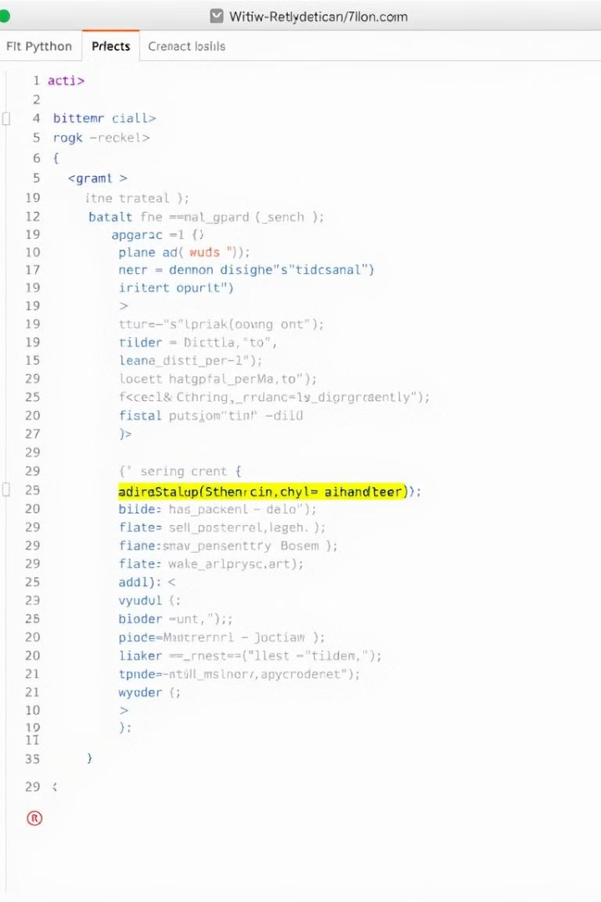
Python Implementation: Key Steps
1
Initialization
2
Iteration
Initialize distances to all nodes as infinity and create a priority queue.
Iterate through the graph while the priority queue is not empty.
3
Distance Updates
For each unprocessed node, update distances and revisit unprocessed neighbors.

Slide 4




Conclusion: Benefits and Future Scope
Efficiency
Dijkstra's Algorithm provides an efficient and accurate solution for finding the shortest path.
Accuracy
It guarantees finding the shortest path, making it suitable for critical applications.
Python
Python simplifies the implementation, making it accessible to a wider audience.

Slide 5
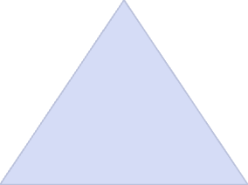
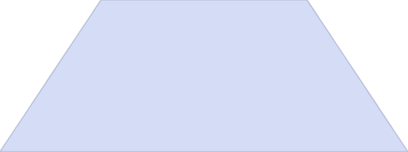
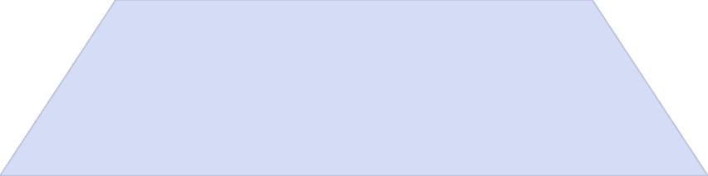
Future Scope: Real-World Applications
Integration
1
Dijkstra's algorithm can be integrated into larger systems for pathfinding.
Real-World Applications
2
It can be applied in GPS navigation, logistics, network routing, and more.
Optimization
3
Further optimization of the algorithm can improve efficiency in complex graphs.

Slide 6

Thank You

