Slide 1

PARKING MANAGEMENT SYSTEM
A project submitted in partial fulfilment of the requirements for BACHELOR IN INFORMATION TECHNOLOGY (BIT) 1st SEMESTER Of Purbanchal University, Biratnagar, Nepal
Presented By:
Romiya Dangol
Samira Shahi

Slide 2
Topics:
Introduction
Problem statement
Objectives
Scope
System flow
Waterfall model and User case diagram
Conclusion

Slide 3
Parking management system
1
Learn about the project

Slide 4
Introduction to our application:
Parking Management System is based on the concept of managing parking area record, Book parking slots and generate receipt.
It is an easy and time-efficient way of storing and retrieving recorded data.
The system will track entry and exit of vehicle, maintain the list and will determine the cost.
This project contains limited features, but the essential one.

Slide 5
Problem Statement
2
What issue does people have right now and
how does our software overcome this issue to people user

Slide 6
Problem statement
Without too many distinctions, the “parking war” is a dramatic scene of everyday life.The problem faced by the people during parking process is inevitable. Some of the problems are:
No idea about the parking space
No backup if the receipt is lost
Time consuming
More manual work
Overcharged parking fees

Slide 7
Objectives
3
What is our goal of this application?

Slide 8
Main objectives
To reduce time and increase efficiency of the current Parking Management System
To reduce manual labor and energy
To let customers make bookings for parking.
To manage all the details about vehicles, parking slots, customers, parking fees, duration.
To generate receipt including customer’s name, details of vehicles and parking fees.

Slide 9
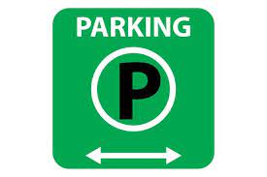

Slide 10
Scope
4
What is the scope of this application?

Slide 11
Scope
User friendly
More efficient
Maintains record in short period of time
Determines the parking area is full orr not.

Slide 12
System flow
5
Flowchart

Slide 13
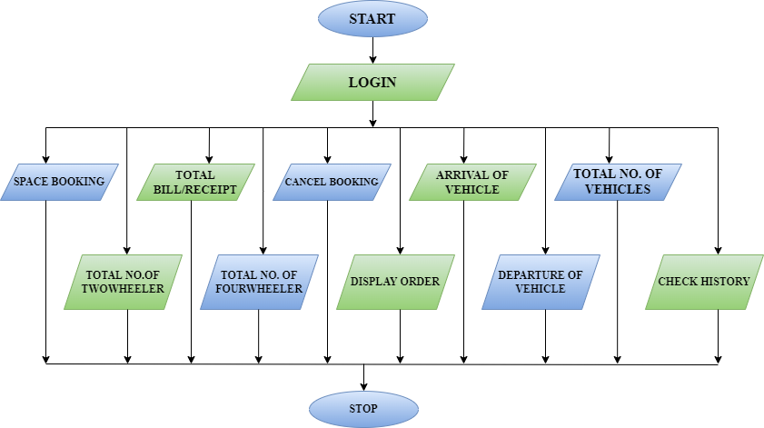

Slide 14
Waterfall model and usercase diagram
6

Slide 15
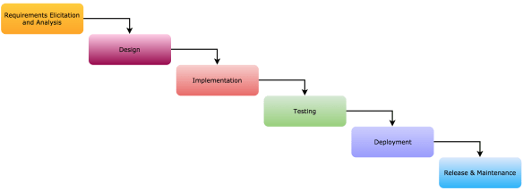
Waterfall model

Slide 16
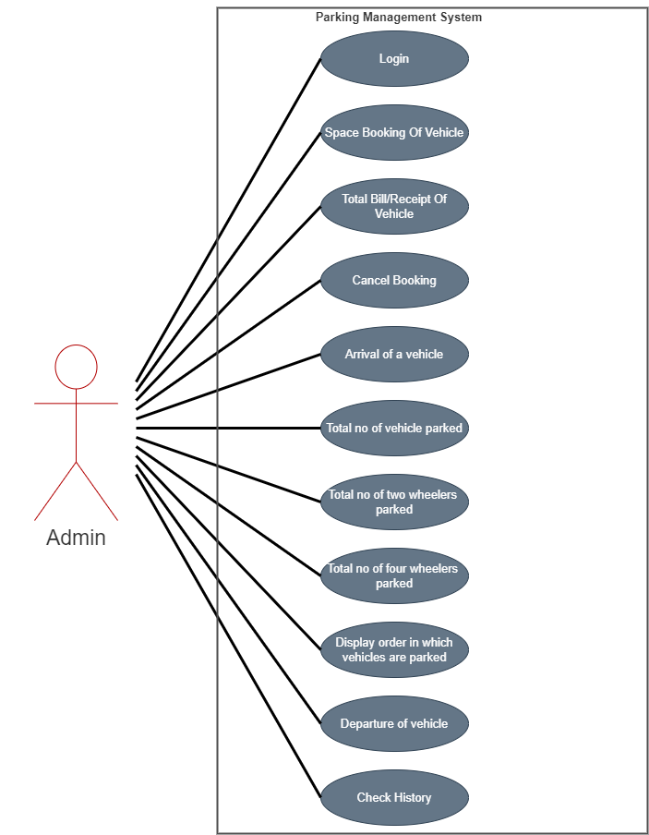
User case diagram

Slide 17
Conclusion and Result
7
Conclusion we came to when we completed this project

Slide 18
To conclude
In the context of Nepal the proper parking management has been a issue . Due to which our project “PARKING MANAGEMENT SYSTEM” was developed to overcome such shortcoming. With the usability of our application, this issue can be properly managed.
Through the project we have solved majority of our objectives (enhancing user experience, maintaining proper records, booking system).

Slide 19
THANKS!
Any questions?

