Slide 1
FYP Presentation
23/10/2024

Slide 2
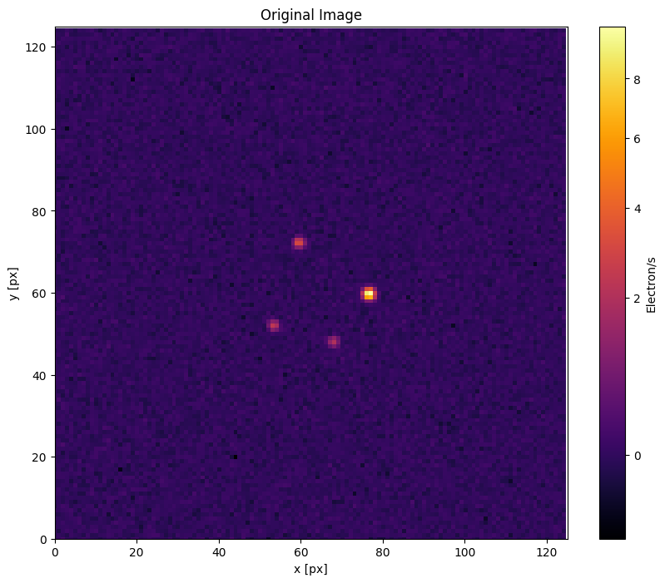

Slide 3
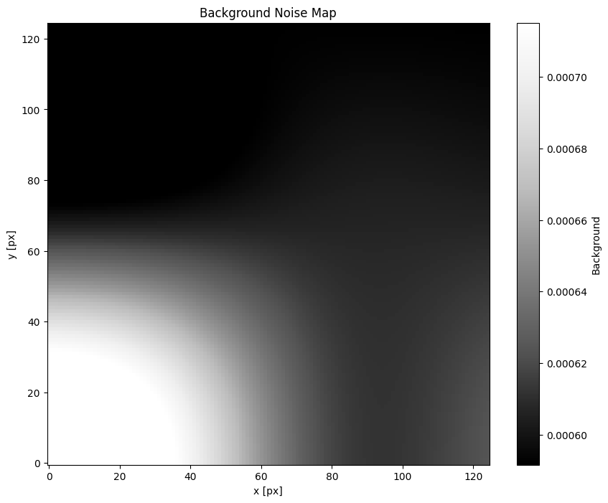
Remove Background

Slide 4
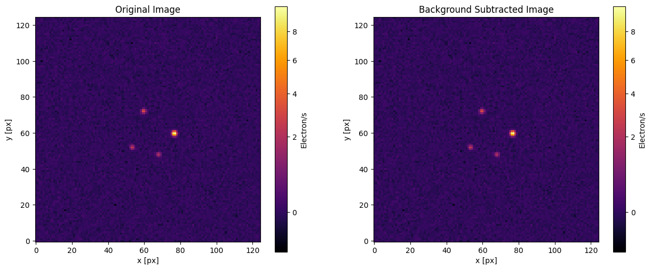
Remove Background

Slide 5
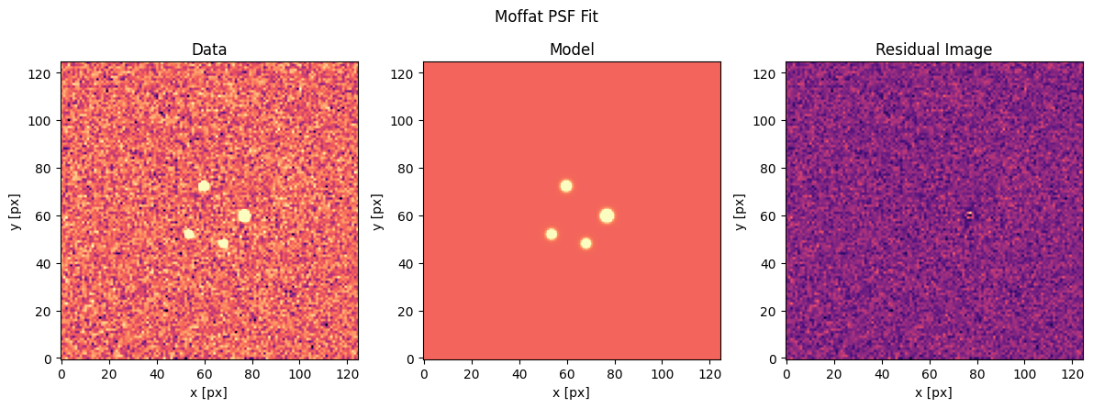
Resolve the PSF

Slide 6
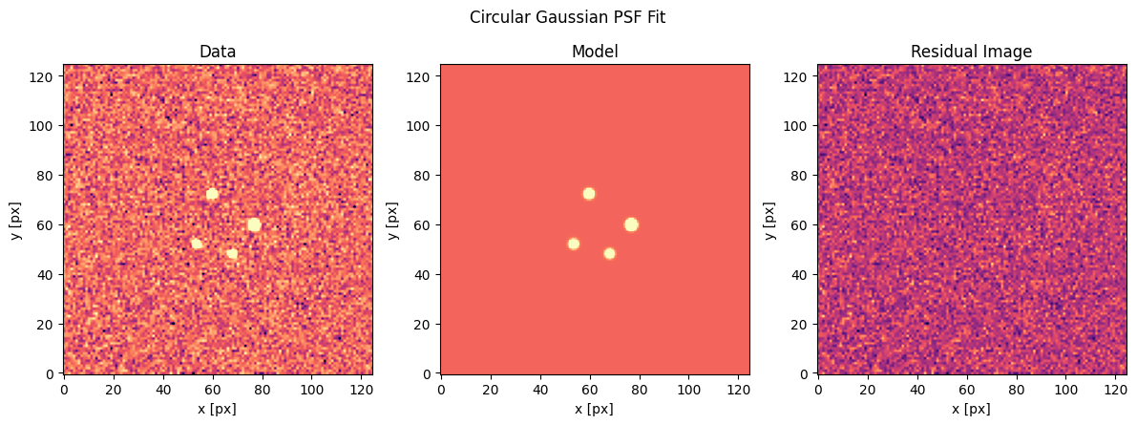
Resolve the PSF

Slide 7
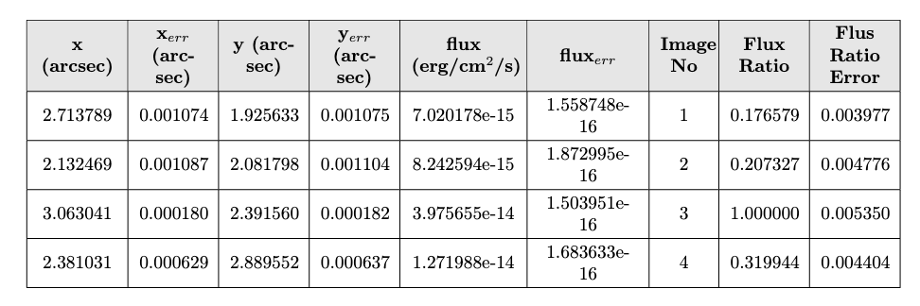
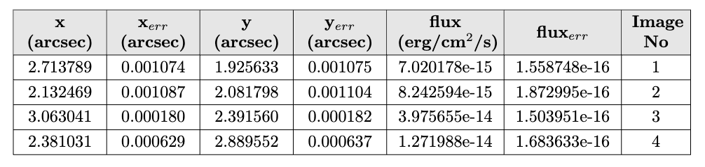
Resolve the PSF

Slide 8
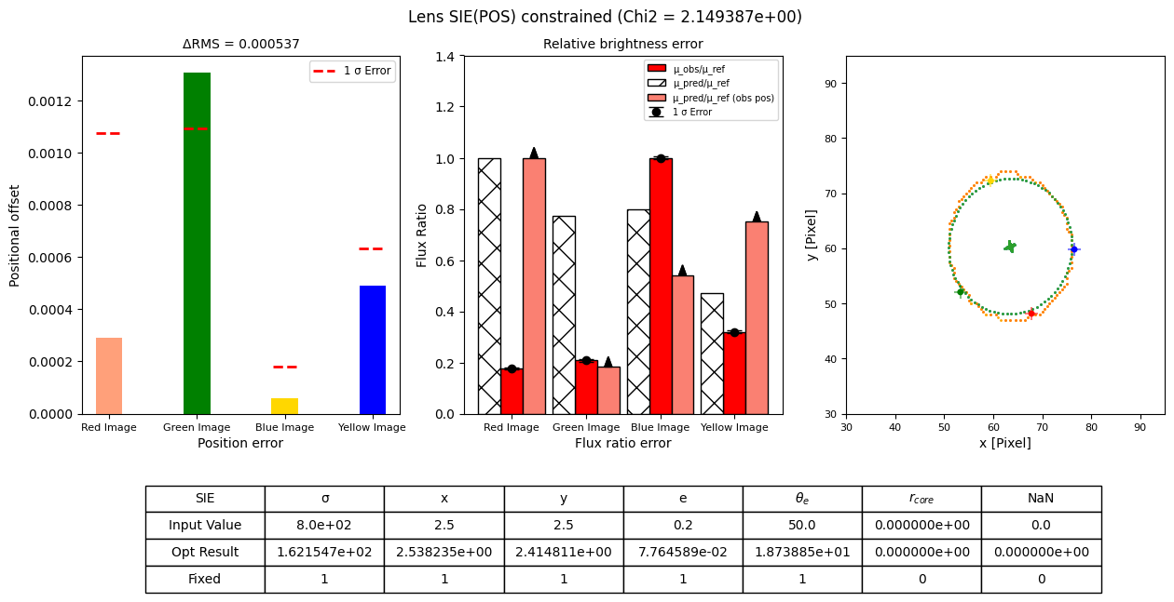
SIE (Position Constraint)

Slide 9
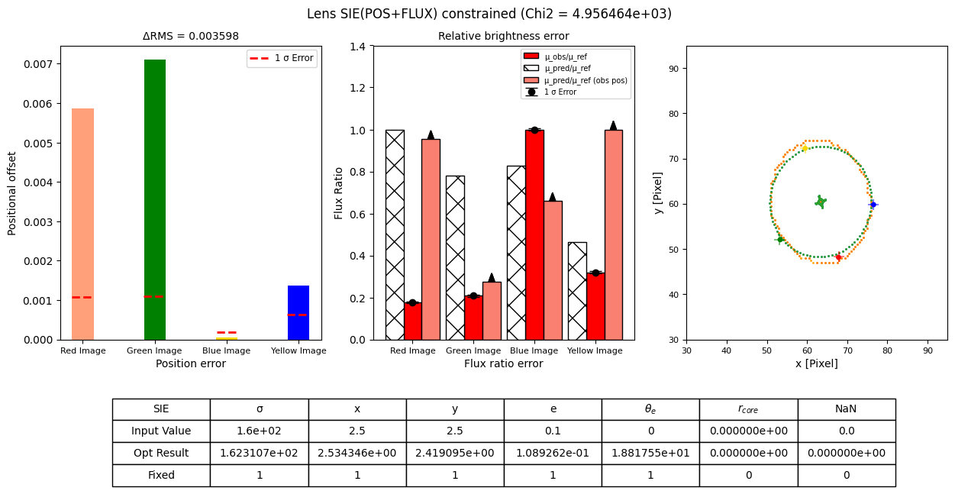
SIE (Position + Flux Constraint)

Slide 10

POW (Position Constraint)

Slide 11
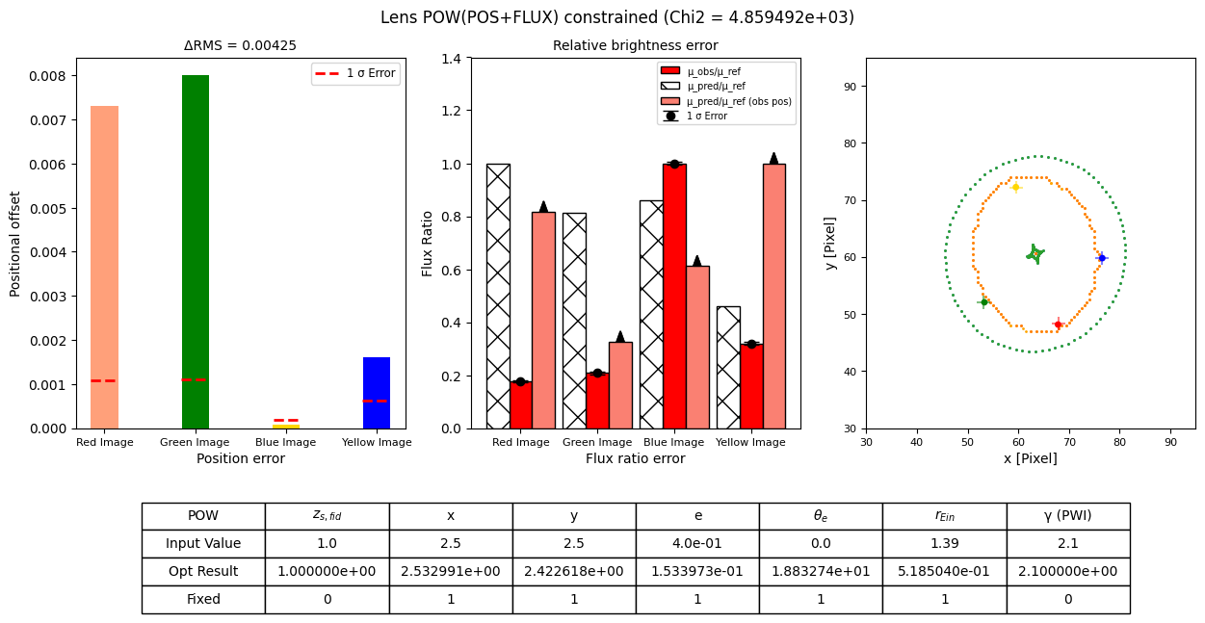
POW (Position + Flux Constraint)

Slide 12
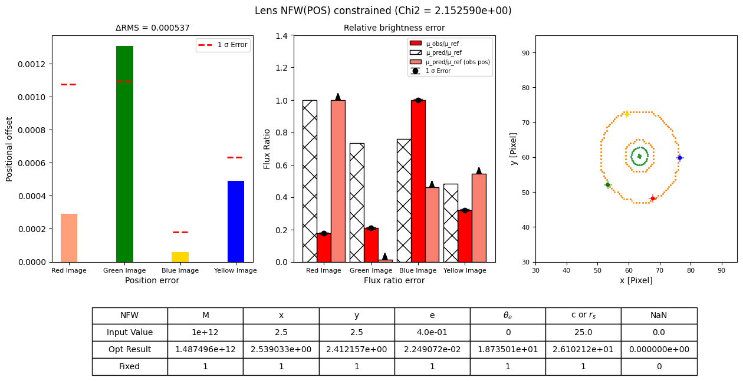
NFW (Position Constraint)

Slide 13
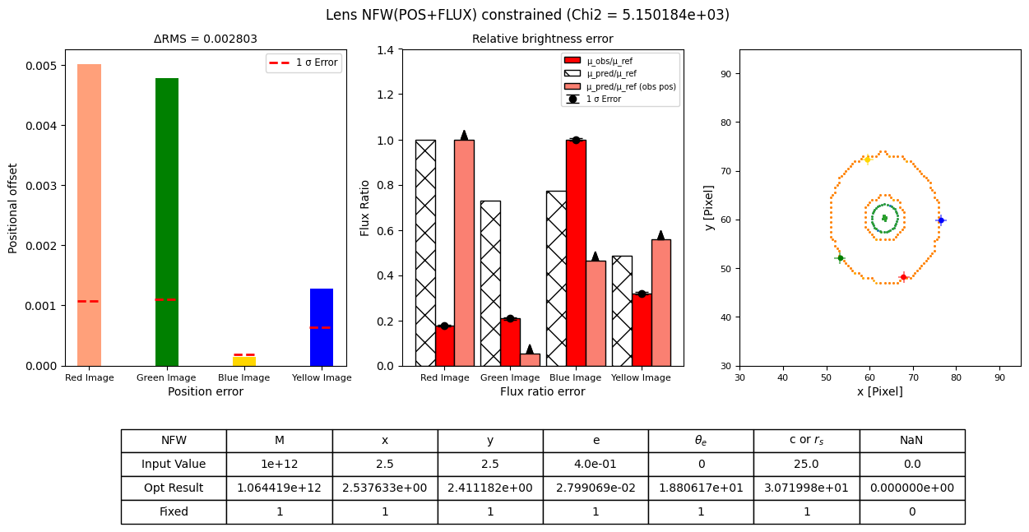
NFW (Position + Flux Constraint)

Slide 14
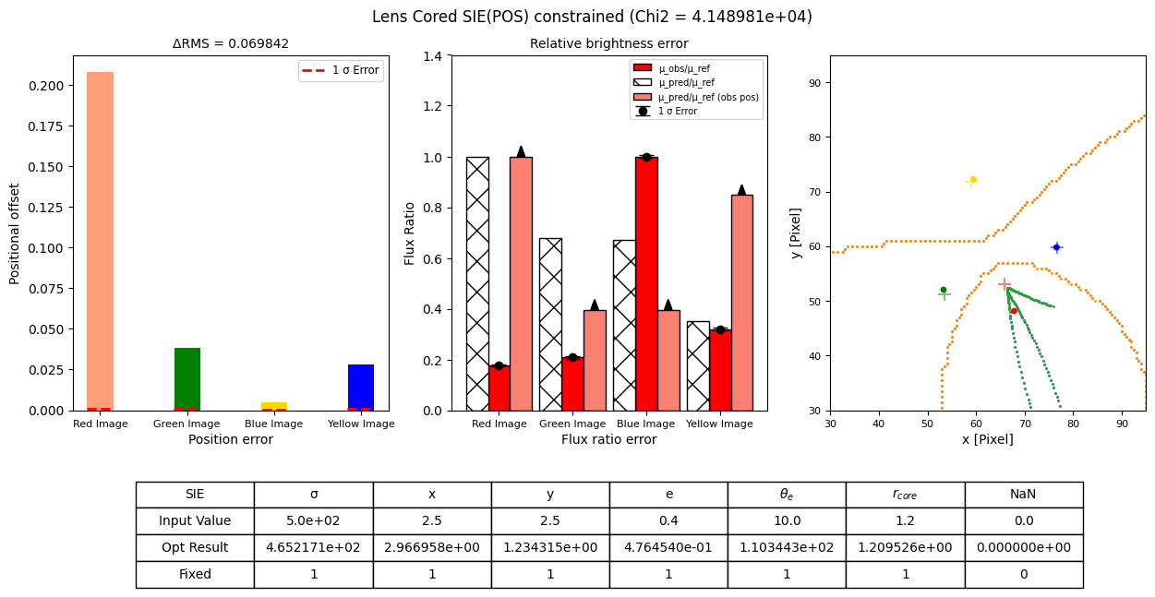
Cored SIE (Position Constraint)

Slide 15
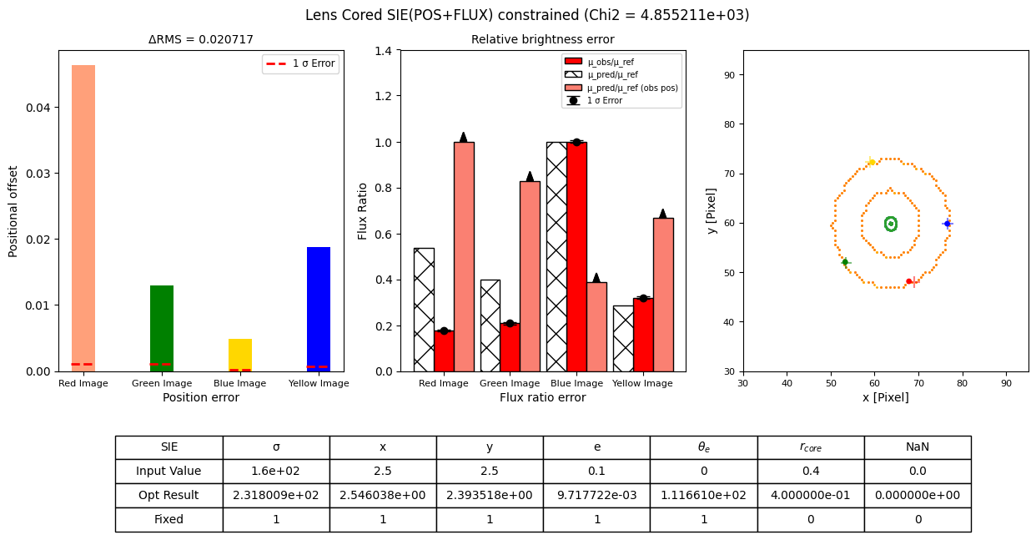
Cored SIE (Position + Flux Constraint)

