Slide 1


Distributed Systems
Introduction

Slide 2

Distributed System
A distributed system is a collection of independent computers that appears to its users as a single coherent system.
Two aspects:
1. Independent computing elements and
2. Single system Middleware

Slide 3

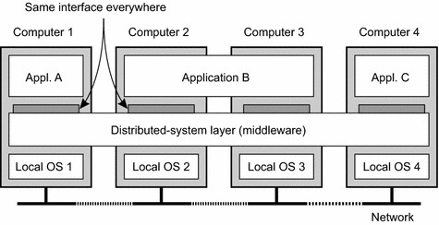



A distributed system organized as middleware.

Slide 4
Goals of distributed Systems
Making resources accessible:
to access remote resources, and to share them in a controlled and efficient way.
Examples: printers, computers, storage facilities, data, files, Web pages
Distribution transparency
to hide the fact that its processes and resources are physically distributed across multiple computers.

Slide 5
Types of transparency
Access transparency
Hide differences in data representation and how a resource is accessed.
Example: Dropbox, users can simply upload, download, or delete files without needing to understand the underlying infrastructure, such as servers, replication, or backup servers.
Location Transparency
Hide where a resource is located
Example: GPS navigation app, when you enter the destination, the app determines best route for you, considering the current traffic conditions and road closures. User don’t need to know the exact locations of each server or data center involved in processing the information.

Slide 6
Types of transparency
Relocation transparency
Hide that a resource may be moved to another location while in use without affecting the functionality of the system.
Example: Smartphones, ability to switch between Wi-Fi networks seamlessly
Migration Transparency
Hide that a data or processes may be moved to another location without disrupting normal operation.
Example: Email service, upgradation of smartphone.
When you switch to a new device, features like contacts are migrated from your old phone to new phone.

Slide 7
Types of transparency
Replication transparency
Hide that a resource is replicated
Example: Cloud-based note-taking application, Email Replication Transparency
Concurrency Transparency
Hide that a resource may be shared by several competitive users
Example: Collaborative Document Editing, Shared Shopping List App
Failure Transparency
Hide the failure and recovery of a resource
Example: Online Banking System

Slide 8
Types of Distributed Systems
Distributed Computing systems
Cluster Computing
the underlying hardware consists of a collection of similar workstations or PCs, closely connected by means of a high-speed local-area network.
In addition, each node runs the same operating system.
Example: Event registration System

Slide 9
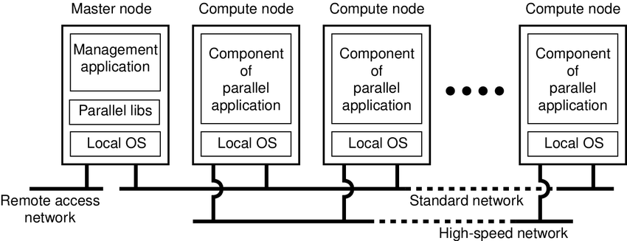
An example of a cluster computing system.

Slide 10
Types of Distributed Systems
Distributed Computing systems
Grid Computing
that involves the coordinated use of resources from multiple networked computers to solve a problem or perform a task.
In grid computing, the focus is on sharing computing power and resources across different administrative domains to achieve a common goal.
The resources in a grid can include processing power, storage capacity, and specialized software applications.
Example: A climate research project requires running complex simulations to model climate patterns over an extended period.

Slide 11
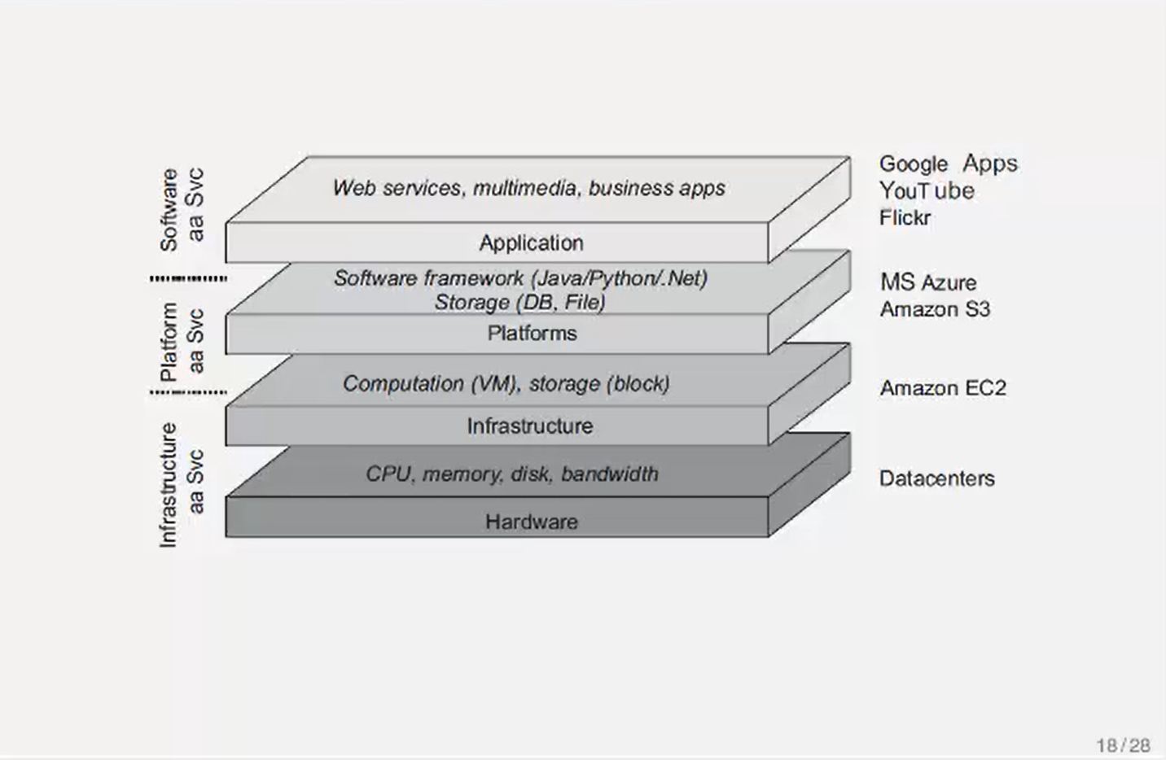
Distributed Computing Systems: Cloud
An example of a Distributed computing system.

Slide 12
Distributed Information Systems
A distributed information system refers to a network of interconnected and independent components or nodes that work together to achieve a common goal of managing, processing, and disseminating information.
Example: Transaction Processing System
A Transaction is a collection of operations on the state of object (database, object composition) that satisfies the following properties (ACID):
Atomicity
Consistency
Isolation
Durability

Slide 13
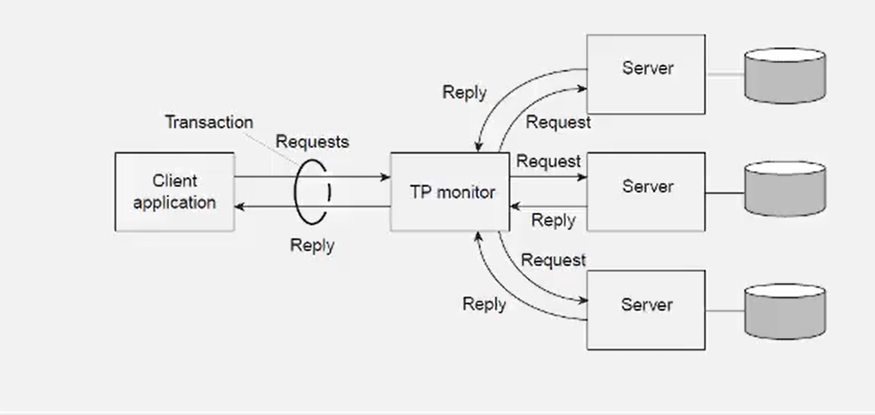
Distributed Information Systems
A TPS is a type of information system that processes and manages day-to-day transactions of an organization, such as sales, purchases, and inventory updates.
In a distributed TPS, the processing and storage of transactional data are spread across multiple nodes.
An example of Transaction Processing system using TP manager

Slide 14
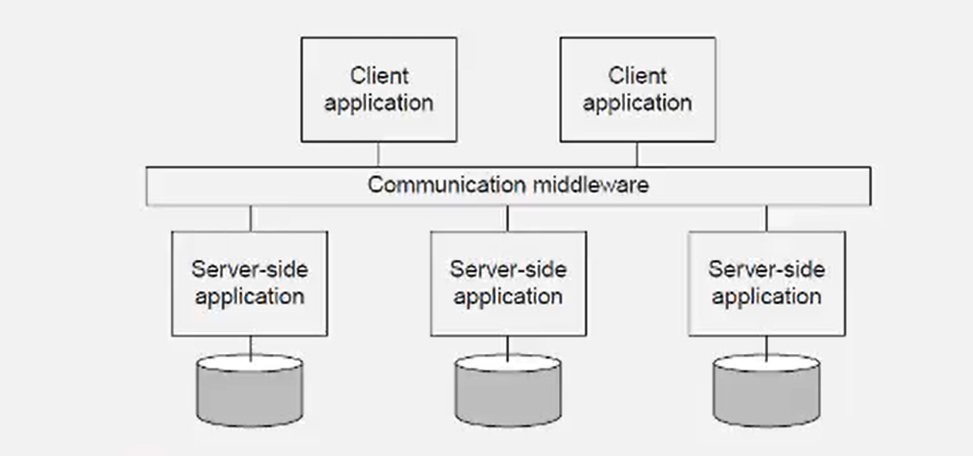
Distributed Information Systems
An example of Enterprise Application Integration.

