Slide 1


Distributed Systems
Introduction

Slide 2
Distributed Computing System & Distributed Information Systems
Distributed Computing System: This primarily focuses on distributing computation tasks across multiple nodes or machines to solve a complex problem or execute a task more efficiently.
The goal is to achieve parallel processing and improved performance by utilizing the computational resources of multiple nodes.
It deals with the execution of algorithms, programs, or processes in a distributed fashion to solve computational problems.
Examples include distributed processing of large datasets, parallel computing, and grid computing.
Example: MapReduce, Apache Hadoop, and MPI (Message Passing Interface) are examples of technologies used in distributed computing systems.

Slide 3
Distributed Computing System & Distributed Information Systems
Distributed Information System: This focuses on distributing and managing information or data across multiple nodes or locations.
The primary goal is to ensure efficient and reliable access to information, often involving data storage, retrieval, and management in a distributed manner.
It deals with the storage, retrieval, and management of data across distributed locations.
Examples include distributed databases, content delivery networks (CDNs), and distributed file systems.
Example: Google's Bigtable, Amazon DynamoDB, and Apache Cassandra are examples of distributed information systems that focus on managing and retrieving distributed data.

Slide 4
Distributed pervasive systems
Distributed pervasive systems refer to computing environments where computing devices are seamlessly integrated into the physical world and interact with users and other devices in a pervasive manner.
These systems often involve the use of sensors, actuators, and communication technologies to create an environment where computing is embedded in everyday objects and activities.
Smart Home Systems:
Example: Home automation systems that control lighting, heating, security cameras, and other devices.
These systems use sensors and actuators distributed throughout the home to respond to user preferences, environmental conditions, and security events.

Slide 5
Distributed pervasive systems
Industrial Internet of Things (IIoT):
Example: Manufacturing plants or industrial facilities where sensors and connected devices are distributed across the production line.
These devices monitor equipment health, track production metrics, and optimize processes in real-time.
Healthcare Systems:
Example: Remote patient monitoring systems that use wearable sensors to collect vital signs and health data.
This information is transmitted to healthcare professionals for real-time monitoring and intervention.
Smart Cities:
Example: Intelligent transportation systems that use sensors and communication networks to monitor traffic flow, manage parking, and optimize public transportation routes in a city.
Smart city initiatives often involve a distributed network of sensors and actuators to enhance urban living.

Slide 6
Architectural Styles
Basic idea is to organize into logically different Components and distribute those components over the various machines.
Layered Architecture
Object-based architectures
Data-centered architectures
Event-based architectures

Slide 7
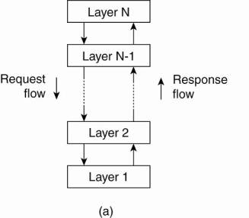
Architectural Styles
Basic idea is to organize into logically different Components and distribute those components over the various machines.
Layered Architecture: used for client-server system.
Layered based Architecture

Slide 8
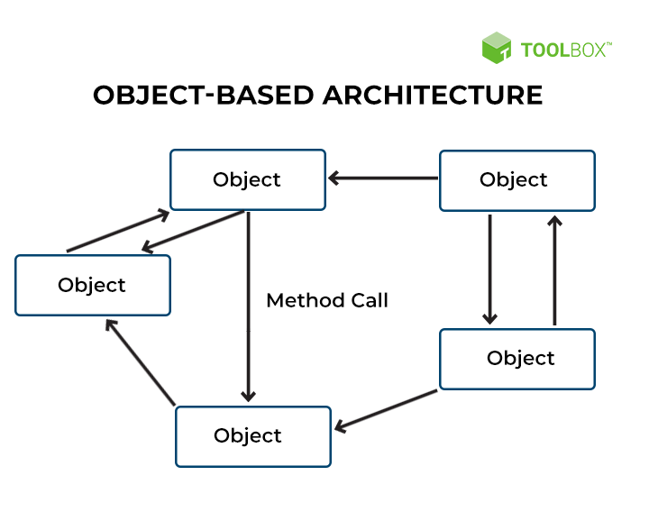
Architectural Styles
Object based Architecture:
Each object corresponds to what we have defined as component.
These components are connected through a (remote) procedure call mechanism.
Object based Architecture

Slide 9
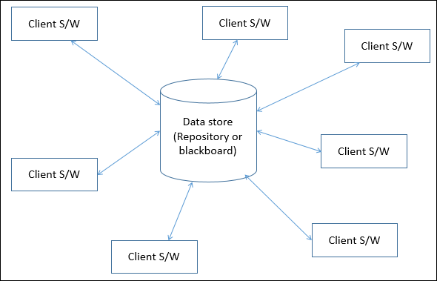
Architectural Styles
Data Centered Architecture:
Processes communicates through a common (active passive) repository.
Data-Centered Architecture places a strong emphasis on data and the way it is stored, accessed, and managed.
Data Centered Architecture

Slide 10
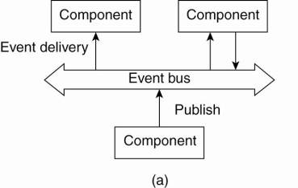
Architectural Styles
Event based Architecture:
Processes communicates through the propagation of events, which optionally also carry data.
Processes publish the events; middleware ensures only those processes that subscribed to those events will receive them.
Processes are loosely coupled.
Event based Architecture

Slide 11
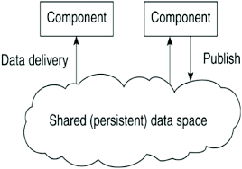
Architectural Styles
Shared Data Space Architecture:
Event based architecture can be combined with data-centered architecture, known as shared-data spaces.
Processes are decoupled in time, i.e. they need not both active when communication takes place.
Shared-data space Architecture

Slide 12
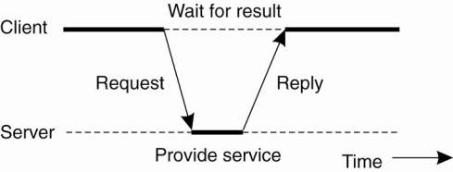
System Architecture
Client Server Architecture
Efficient unless and until message do not get lost or corrupted.
General interaction between client & Server

Slide 13
System Architecture
Centralized Architecture:
refers to a design where one central node or server is responsible for managing and coordinating the entire system.
This central node acts as a point of control, making decisions and handling the overall functionality of the distributed system.
Example: Traditional Database Management Systems (DBMS)
Advantages:
Simplicity in management and administration.
Centralized control over data consistency and integrity.
Challenges:
Single point of failure: If the central database server goes down, the entire system becomes inaccessible.
Scalability issues: As the system grows, the central server may become a bottleneck, limiting the overall performance.

Slide 14
System Architecture
Example: Web Application to retrieve web pages from server
User Request:
A user opens their web browser and enters a URL to access a social media platform.
Client-Server Interaction:
The user's device (client) sends a request to the central server hosting the social media application.
Server Processing:
The central server processes the request, fetching data from its database or performing necessary computations.
Data Retrieval:
If the user requested their profile page, for example, the server retrieves the user's data from the database.
Response to Client:
The server then sends the requested data (e.g., the user's profile information) back to the user's device.
Display on Client:
The client device receives the data and displays the user's profile on the web browser.

Slide 15
System Architecture
Limitations:
Single Point of Failure:
The central server represents a single point of failure. If it malfunctions or experiences downtime, the entire system becomes inaccessible.
Scalability Challenges:
Scaling the system may be challenging. As user demand increases, it becomes more difficult to handle a large number of requests with a single central server.
Performance Bottlenecks:
Heavy traffic or resource-intensive tasks can lead to performance bottlenecks. The central server may struggle to process numerous requests simultaneously, affecting response times.
High Network Dependency:
Users depend heavily on the network connection between their devices and the central server. Any network issues can disrupt the user experience.
Limited Fault Tolerance:
The system's fault tolerance is limited. If the central server fails, users may lose access to the entire application until the issue is resolved.

Slide 16
System Architecture
Limitations:
Data Security Concerns:
Concentrating all data on a central server raises security concerns. A security breach at the central point could compromise a significant amount of sensitive information.
Maintenance Challenges:
Maintenance and updates can be complex. Introducing changes or updates to the system may require downtime, impacting users' access to the service.
Geographical Dependency:
Users are typically geographically dependent on the location of the central server. This can result in latency issues for users accessing the system from distant locations.
Resource Utilization:
Resource utilization may not be optimal. The central server must have sufficient capacity to handle peak loads, leading to underutilization during periods of lower demand.

Slide 17
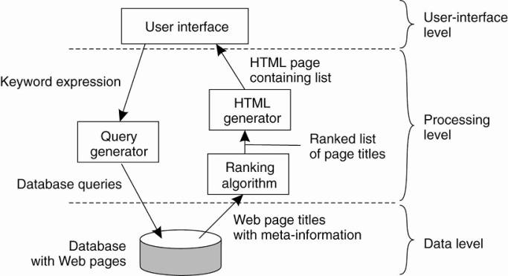
System Architecture
Application Layering
The simplified organization of an Internet search engine into three different layers.

Slide 18
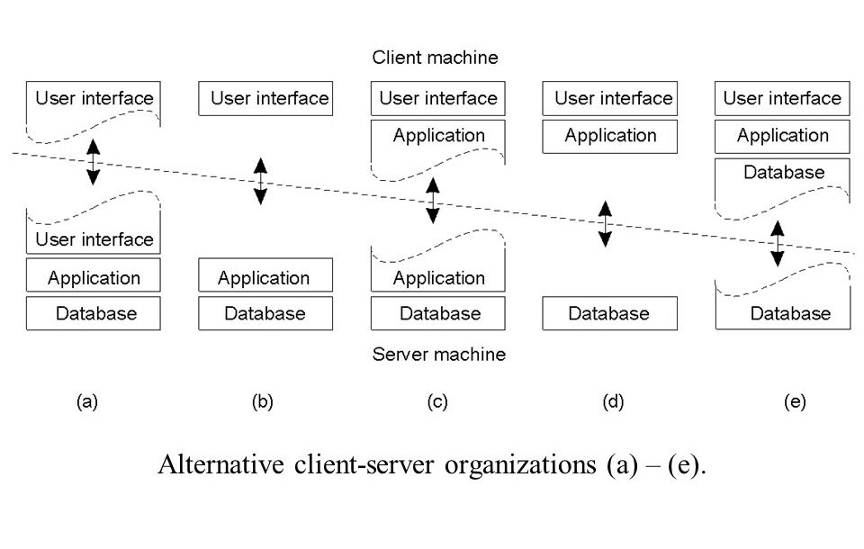
System Architecture
Multi-layered Architecture
Alternative client-server organizations (a)-(e).

Slide 19
System Architecture
Decentralized Architectures
involves distributing tasks and responsibilities across multiple nodes, avoiding reliance on a central authority.
One real-world example is blockchain technology, often seen in cryptocurrencies like Bitcoin.
Nodes communicate with each other in a peer-to-peer fashion, sharing information about transactions and reaching a consensus on the state of the block

Slide 20
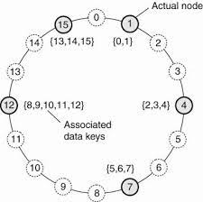
Decentralized Architectures
Structured peer-to-peer architecture
the nodes (computers or devices) are organized in a structured manner to efficiently locate and retrieve information or resources.
In structured P2P networks, each node has a specific responsibility, and there is a clear structure that guides how nodes are connected and how data is distributed across the network.
One real-world example is Chord
The mapping of data items onto nodes in Chord

Slide 21
Decentralized Architectures
Unstructured peer-to-peer architecture
nodes in the network are not organized according to a specific structure, such as a DHT (Distributed Hash Table).
Unlike structured P2P networks, unstructured P2P networks are more flexible and dynamic, making them suitable for scenarios where nodes join and leave the network frequently, and where there is no predefined organization of nodes.
there is no predetermined structure, unstructured P2P networks may be less efficient in terms of search and resource location compared to structured ones, but they are often more robust and adaptable.
Example: Gnutella

Slide 22
Decentralized Architectures
Example: Gnutella
No Centralized Index:
Gnutella does not rely on a central index or server. Each node is responsible for maintaining its information and contributing to the network.
Unstructured Search:
Gnutella uses an unstructured search mechanism where queries are flooded across the network. Nodes forward the queries to their neighbors, and responses are sent back through the same route.
Dynamic Network:
Nodes in Gnutella can join or leave the network at any time, making the network highly dynamic.
Peer-to-Peer File Sharing:
Users could search for files on the network and download them directly from other nodes that had the desired files.

Slide 23
Hybrid Architectures
A hybrid architecture in distributed systems refers to a combination of different architectural styles or approaches within the same system.
Hybrid architectures are common in distributed systems to achieve a balance between efficiency, scalability, fault tolerance, and other desired characteristics.
Example: Amazon Web Services (AWS), Retail Hybrid Architecture
A customer can start shopping online through the e-commerce platform, add items to their cart, and then choose to pick up the items in a physical store.
The hybrid architecture enables the customer to have a unified shopping experience, whether making purchases online or in-store, while the business efficiently manages inventory and sales data across both channels.

Slide 24
Edge server system
An edge server system in a distributed system refers to the deployment of servers at the edge of a network, closer to end-users or devices, to reduce latency, improve performance, and enhance the overall efficiency of data processing.
Edge servers play a crucial role in edge computing, a paradigm that brings computing resources closer to where data is generated or consumed, reducing the need for centralized processing in distant data centers.
Real-world Example: Content Delivery Networks (CDNs)
When a user requests content, such as a webpage, video, or image, the CDN uses edge servers to deliver that content from a server located near the user rather than from the origin server, which might be farther away.

Slide 25
Collaborative Distributed system
A collaborative distributed system involves multiple entities or components working together to achieve a common goal, often in a decentralized manner.
This type of system emphasizes cooperation, information sharing, and coordination among distributed participants.
Real-world Example: Wikipedia

