Slide 1


Distributed Systems
Introduction

Slide 2
Hybrid Architectures
A hybrid architecture in distributed systems refers to a combination of different architectural styles or approaches within the same system.
Hybrid architectures are common in distributed systems to achieve a balance between efficiency, scalability, fault tolerance, and other desired characteristics.
Example: Amazon Web Services (AWS), Retail Hybrid Architecture
A customer can start shopping online through the e-commerce platform, add items to their cart, and then choose to pick up the items in a physical store.
The hybrid architecture enables the customer to have a unified shopping experience, whether making purchases online or in-store, while the business efficiently manages inventory and sales data across both channels.

Slide 3
Edge Server system
An edge server system in a distributed system refers to the deployment of servers at the edge of a network, closer to end-users or devices, to reduce latency, improve performance, and enhance the overall efficiency of data processing.
Edge servers play a crucial role in edge computing, a paradigm that brings computing resources closer to where data is generated or consumed, reducing the need for centralized processing in distant data centers.
Real-world Example: Content Delivery Networks (CDNs)
When a user requests content, such as a webpage, video, or image, the CDN uses edge servers to deliver that content from a server located near the user rather than from the origin server, which might be farther away.

Slide 4
Collaborative Distributed system
A collaborative distributed system involves multiple entities or components working together to achieve a common goal, often in a decentralized manner.
This type of system emphasizes cooperation, information sharing, and coordination among distributed participants.
Real-world Example: Wikipedia

Slide 5
Middleware
Middleware in distributed systems refers to software that provides common services and capabilities to facilitate communication and interaction among different components or applications in a distributed environment.
It acts as an intermediary layer between the various distributed components, abstracting away the complexities of the underlying network and infrastructure, and enabling seamless communication and cooperation.
Middleware plays a crucial role in addressing challenges such as heterogeneity, transparency, and scalability in distributed systems.
Examples: Remote Procedure Call (RPC) frameworks (e.g., CORBA, DCOM, Java RMI), message-oriented middleware (e.g., JMS, AMQP), and web services (e.g., SOAP, REST).

Slide 6
Middleware Functions
Communication Abstraction: abstracts the communication details between different components, allowing them to communicate regardless of the underlying network protocols and technologies. This helps in achieving interoperability and simplifies the development of distributed applications.
Heterogeneity Handling: Distributed systems often involve components running on different platforms, using diverse programming languages, and employing various hardware architectures. Middleware provides a layer of abstraction that enables interoperability between heterogeneous components.

Slide 7
Middleware Functions
Transparency: Middleware aims to provide transparency to developers and users by hiding the complexity of the underlying distributed infrastructure. This includes location transparency (components can be located anywhere in the network), access transparency (access to remote resources is made to appear local).
Security: Middleware often includes security features to ensure secure communication and data transfer in distributed systems. This may involve encryption, authentication, and authorization mechanisms to protect data and ensure the integrity of communication.
Scalability: Middleware helps in managing the scalability of distributed systems by providing mechanisms for load balancing, dynamic resource allocation, and efficient communication between components.

Slide 8
Middleware Functions
Naming and Directory Services: Middleware often provides naming and directory services to enable components to locate each other in a distributed environment. This is important for dynamically discovering and connecting to services.
Event Handling: Middleware may offer event-driven communication mechanisms to facilitate the exchange of events or messages between distributed components. This is useful for building responsive and loosely coupled systems.

Slide 9
Models of Middleware
In distributed systems, middleware can be categorized into different models based on the services it provides and the way it facilitates communication between distributed components.
Some common models of middleware are as follows:
Remote Procedure Call (RPC)
Message-Oriented Middleware (MOM)
Object Request Broker (ORB)
Middleware for Publish/Subscribe Systems
Database Middleware
Web Services Middleware

Slide 10
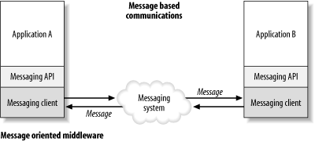
Message oriented Middleware (MOM)
Message Oriented Middleware is a concept that involves the passing of data between applications using a communication channel that carries self-contained units of information (messages).
In a MOM-based communication environment, messages are usually sent and received asynchronously.
Message oriented Middleware (MOM)

Slide 11
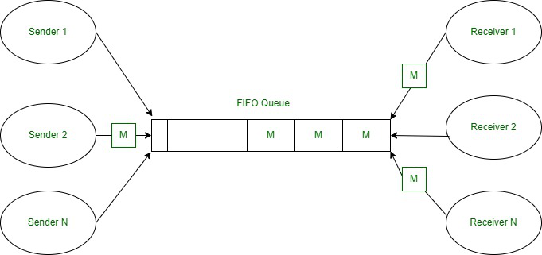
Message oriented Middleware (MOM)
In a messaging system, an application uses an API to communicate through a messaging client that is provided by the MOM vendor.
Using message-based communications, applications are abstractly decoupled; senders and receivers are never aware of each other.
Instead, they send and receive messages to and from the messaging system.
It is the responsibility of the messaging system (MOM) to get the messages to their intended destinations.
Messaging Queues

Slide 12
Message Oriented Middleware (MOM)
Characteristics:
Communication is based on message passing.
Supports publish/subscribe and point-to-point communication models.
Examples include Java Message Service (JMS), Advanced Message Queuing Protocol (AMQP), and IBM MQ.
Limitations:
Message Ordering:
Challenge: Guaranteeing strict message ordering can be difficult in MOM systems, especially in the presence of network delays, failures, or parallel processing of messages.
Ensuring a specific order of message delivery might compromise system performance or introduce complexity.

Slide 13
Message oriented Middleware (MOM)
Limitations:
Latency:
Challenge: The use of asynchronous messaging in MOM introduces a degree of latency due to the decoupling of message senders and receivers.
Complexity:
Challenge: MOM systems can become complex, especially as the number of distributed components and the volume of messages increase.
Managing and maintaining the configuration, addressing, and message formats across a distributed system can be challenging.

Slide 14
Message oriented Middleware (MOM)
Limitations:
Scalability concern:
Challenge: While MOM systems are designed to be scalable, managing a large number of subscribers and publishers can lead to scalability challenges.
Ensuring efficient message routing and delivery in highly dynamic and large-scale environments may require careful design and optimization.
Guaranteed Delivery Overhead:
Challenge: Providing guaranteed message delivery (reliable messaging) can introduce additional overhead in terms of resource utilization and performance.
Ensuring that messages are delivered exactly once and in the correct order may involve additional processing and coordination.

Slide 15
Message oriented Middleware (MOM)
Limitations:
Message Size and Payload:
Challenge: Large message sizes or payloads can pose challenges in terms of serialization, transmission, and storage.
Handling large messages may impact system performance and resource usage, especially in networks with limited bandwidth.
Synchronization Complexity:
Challenge: Coordinating and synchronizing distributed components using MOM can introduce complexity, especially in scenarios where ordering and timing are critical.

