Slide 1


Distributed Systems
Introduction

Slide 2
Models of Middleware
In distributed systems, middleware can be categorized into different models based on the services it provides and the way it facilitates communication between distributed components.
Some common models of middleware are as follows:
Remote Procedure Call (RPC)
Message-Oriented Middleware (MOM)
Object Request Broker (ORB)
Middleware for Publish/Subscribe Systems
Database Middleware
Web Services Middleware

Slide 3
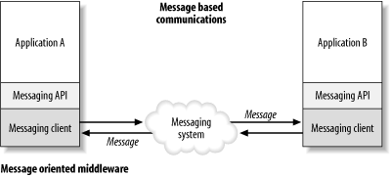
Message oriented Middleware (MOM)
Message Oriented Middleware is a concept that involves the passing of data between applications using a communication channel that carries self-contained units of information (messages).
In a MOM-based communication environment, messages are usually sent and received asynchronously.
Message oriented Middleware (MOM)

Slide 4
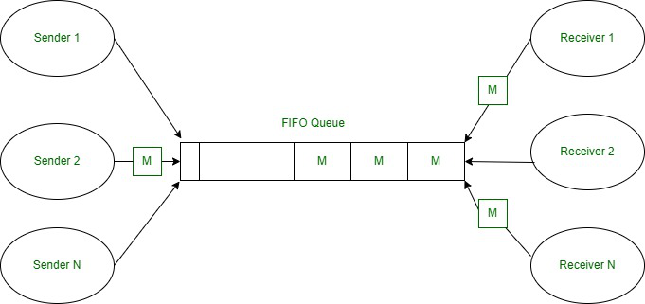
Message oriented Middleware (MOM)
In a messaging system, an application uses an API to communicate through a messaging client that is provided by the MOM vendor.
Using message-based communications, applications are abstractly decoupled; senders and receivers are never aware of each other.
Instead, they send and receive messages to and from the messaging system.
It is the responsibility of the messaging system (MOM) to get the messages to their intended destinations.
Messaging Queues

Slide 5
Message Oriented Middleware (MOM)
Characteristics:
Communication is based on message passing.
Supports publish/subscribe and point-to-point communication models.
Examples include Java Message Service (JMS), Advanced Message Queuing Protocol (AMQP), and IBM MQ.
Limitations:
Message Ordering:
Challenge: Guaranteeing strict message ordering can be difficult in MOM systems, especially in the presence of network delays, failures, or parallel processing of messages.
Ensuring a specific order of message delivery might compromise system performance or introduce complexity.

Slide 6
Message oriented Middleware (MOM)
Limitations:
Latency:
Challenge: The use of asynchronous messaging in MOM introduces a degree of latency due to the decoupling of message senders and receivers.
Complexity:
Challenge: MOM systems can become complex, especially as the number of distributed components and the volume of messages increase.
Managing and maintaining the configuration, addressing, and message formats across a distributed system can be challenging.

Slide 7
Message oriented Middleware (MOM)
Limitations:
Scalability concern:
Challenge: While MOM systems are designed to be scalable, managing a large number of subscribers and publishers can lead to scalability challenges.
Ensuring efficient message routing and delivery in highly dynamic and large-scale environments may require careful design and optimization.
Guaranteed Delivery Overhead:
Challenge: Providing guaranteed message delivery (reliable messaging) can introduce additional overhead in terms of resource utilization and performance.
Ensuring that messages are delivered exactly once and in the correct order may involve additional processing and coordination.

Slide 8
Message oriented Middleware (MOM)
Limitations:
Message Size and Payload:
Challenge: Large message sizes or payloads can pose challenges in terms of serialization, transmission, and storage.
Handling large messages may impact system performance and resource usage, especially in networks with limited bandwidth.
Synchronization Complexity:
Challenge: Coordinating and synchronizing distributed components using MOM can introduce complexity, especially in scenarios where ordering and timing are critical.

Slide 9
Object Request Broker (ORB)
An Object Request Broker is a middleware that enables communication between distributed objects in a distributed computing environment.
It allows objects to request and invoke services from other objects in a network, regardless of the programming languages or platforms they are implemented on.
Example: Common Object Request Broker Architecture (CORBA).

Slide 10
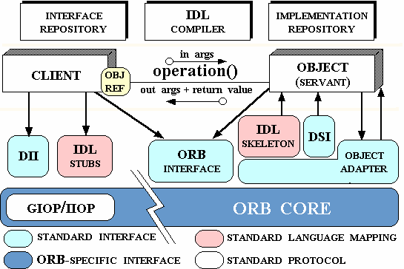
Object Request Broker (ORB)
Common Object Request broker Architecture (CORBA)

Slide 11
Object Request Broker (ORB)
Performance Overhead:
Marshalling and Unmarshalling: The automatic marshalling and unmarshalling of data between objects can introduce performance overhead, especially for large datasets.
Deployment Challenges:
Deployment Complexity: Deploying and configuring ORBs across different platforms and environments may pose challenges.

Slide 12
Object Request Broker (ORB)
Network Overhead:
Communication: between objects in distributed systems involves network communication which can introduce latency issue.
Resource Utilization:
ORBs often consumes significant systems resources.
This includes memory for maintaining object references, network bandwidth, and communication.

Slide 13
Design issues and challenges
Communication :
This task involves designing appropriate mechanisms for communication among the processes in the network. Some example mechanisms are remote procedure call (RPC), remote object invocation (ROI), message-oriented communication versus stream-oriented communication.
Processes :
Some of the issues involved are management of processes and threads at clients/servers; code migration; and the design of software and mobile agents.

Slide 14
Design issues and challenges
Naming :
Devising easy to use and robust schemes for names, identifiers, and addresses is essential for locating resources and processes in a transparent and scalable manner.
Naming in mobile systems provides additional challenges because naming cannot easily be tied to any static geographical topology

Slide 15
Design issues and challenges
Synchronization:
Mechanisms for synchronization or coordination among the processes are essential.
Mutual exclusion is the classical example of synchronization, but many other forms of synchronization, such as leader election are also needed.
In addition, synchronizing physical clocks, and devising logical clocks that capture the essence of the passage of time, as well as global state recording algorithms, all require different forms of synchronization.

Slide 16
Design issues and challenges
Data storage and access:
Schemes for data storage, and implicitly for accessing the data in a fast and scalable manner across the network are important for efficiency.
Traditional issues such as file system design have to be reconsidered in the setting of a distributed system.
Security:
Distributed systems security involves various aspects of cryptography, secure channels, access control, key management generation and distribution, authorization, and secure group management.

Slide 17
Design issues and challenges
Consistency and replication:
To avoid bottlenecks, to provide fast access to data, and to provide scalability, replication of data objects is highly desirable.
This leads to issues of managing the replicas and dealing with consistency among the replicas/caches in a distributed setting.
A simple example issue is deciding the level of granularity (i.e., size) of data access.

Slide 18
Design issues and challenges
Fault tolerance:
Fault tolerance requires maintaining correct and efficient operation inspite of any failures of links, nodes, and processes.
Process resilience, reliable communication, distributed commit, checkpointing and recovery, agreement and consensus, failure detection, and self-stabilization are some of the mechanisms to provide fault-tolerance
Scalability and modularity:
The algorithms, data (objects), and services must be as distributed as possible. Various techniques such as replication, caching and cache management, and asynchronous processing help to achieve scalability.

Slide 19
Design issues and challenges
Transparency:
The ability to relocate the resources as they are being accessed is relocation transparency.
Replication transparency does not let the user become aware of any replication.
Concurrency transparency deals with masking the concurrent use of shared resources for the user.
Failure transparency refers to the system being reliable and fault-tolerant.

Slide 20
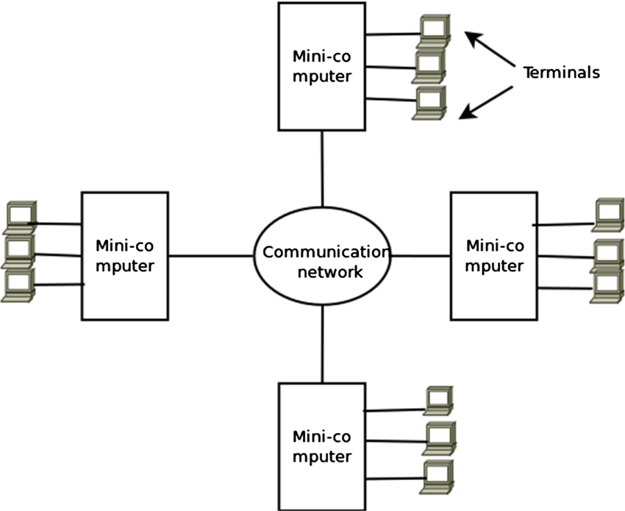
Distributed Computing Models
Minicomputer Model:
Extension of the centralized Time-sharing system.
Distributed Computing system based on Minicomputer Model

Slide 21
Distributed Computing Models
Minicomputer Model:
a configuration where multiple smaller-scale computers, often minicomputers, work together to achieve a common goal or to distribute computational tasks.
Each minicomputer may have its own local storage and processing capabilities.
Minicomputers are intermediate in size between mainframes and microcomputers, and in a distributed system context, they can collaborate to provide enhanced processing power, fault tolerance, and scalability.
Several interactive terminals are connected to each minicomputer with remote access to other minicomputers.

Slide 22
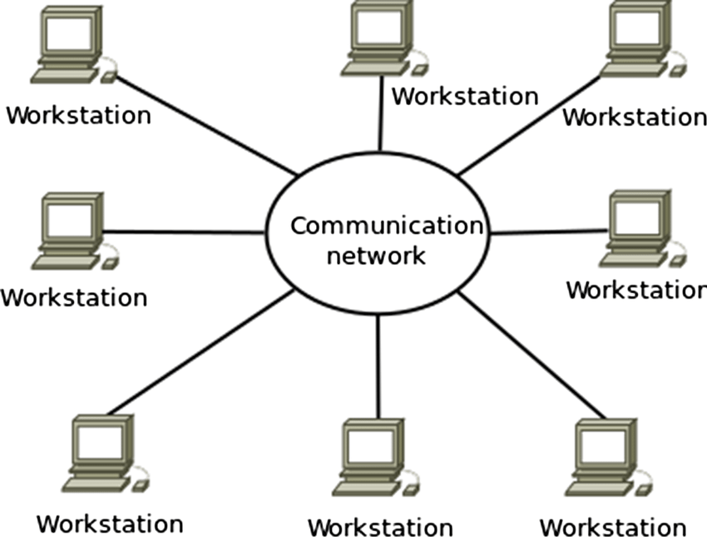
Distributed Computing Models
Workstation Model:
Several workstations connected by communication network.
Distributed Computing system based on Workstation Model

Slide 23
Distributed Computing Models
Workstation Model:
Concept is to interconnect all the workstations by a high-speed LAN so that ideal workstation is used to process jobs of users who logged on to their workstation and do not have sufficient processing power at their own workstation.
Example: company’s office or university campus
Implementation difficulties:
How to find idle workstation?
How to transfer process from one workstation to get it executed on another workstation?
What happens to a remote process if user logs onto a workstation that was idle until now and was being used to execute a process of another workstation?

Slide 24
Distributed Computing Models
Workstation Model:
Allow remote process to share the resources of the workstation along with its own logged-on user’s process. (what will be the drawback??)
Logged-on user does not get his or her guaranteed response.
Kill the remote process will results in inconsistent state as all the processing done on remote process gets lost.
Migrate the remote process back to its home workstation, so its execution can be done there.
Difficult to implement as we require a system that supports preemptive process migration.

Slide 25
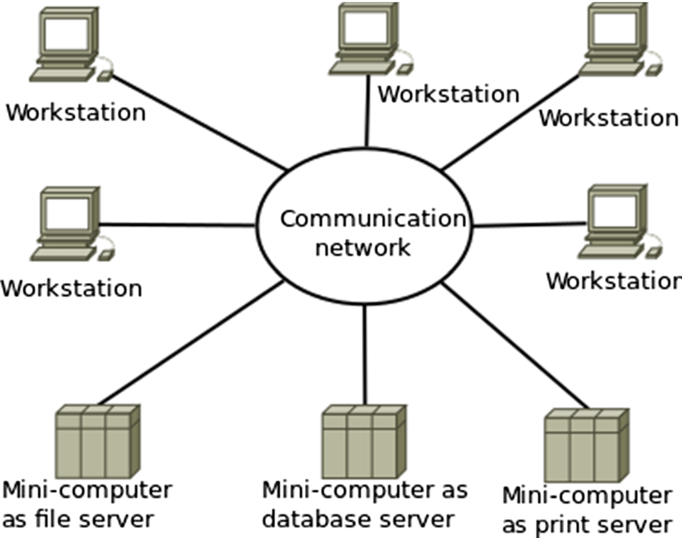
Distributed Computing Models
Workstation-server Model:
Network of personal workstations, each with its own disk and local file system.
Distributed Computing system based on Workstation-server Model

Slide 26
Distributed Computing Models
Workstation-server Model:
Combines the computational power of individual workstations (client machines) with dedicated servers to form a distributed system.
In this model, workstations perform some processing tasks locally, while more intensive or centralized tasks are offloaded to servers.
Example: Rendering Farms in Animation Studios
Scenario: Consider an animation studio producing a high-quality animated movie. The workstation-server model is employed to distribute rendering tasks efficiently.

Slide 27
Rendering Farms in Animation Studios
Components:
Workstations (Client Machines):
Animators use powerful workstations to create and edit scenes locally. These workstations are equipped with graphics processing units (GPUs) for real-time rendering and visualization.
Rendering Servers:
Dedicated rendering servers in the studio's data center or cloud infrastructure handle the computationally intensive task of rendering high-resolution frames for the animated movie.
Task Distribution:
Animators work on their local workstations to design scenes and create animations. When it's time to render the final movie, rendering tasks are distributed to the rendering servers for processing.

Slide 28
Rendering Farms in Animation Studios
Components:
Resource Sharing:
Workstations share local assets, scene files, and initial renderings. Rendering servers manage the centralized storage of shared assets and processed frames.
Communication Middleware:
A rendering management system acts as middleware, coordinating the distribution of rendering tasks, managing dependencies, and collecting results from rendering servers.

Slide 29
Distributed Computing Models
Workstation-server Model (Advantages)
Much cheaper to use few minicomputers equipped with large, fast disks than large number of diskful workstations.
Backup and hardware maintenance are easier to perform with few disks than with many small disks scattered over a building or campus.
All files are managed by file servers, users have flexibility to use any workstation and access the file in same manner irrespective of which workstation the user is currently logged on.
Does not need a process migration facility, which is difficult to implement.

Slide 30
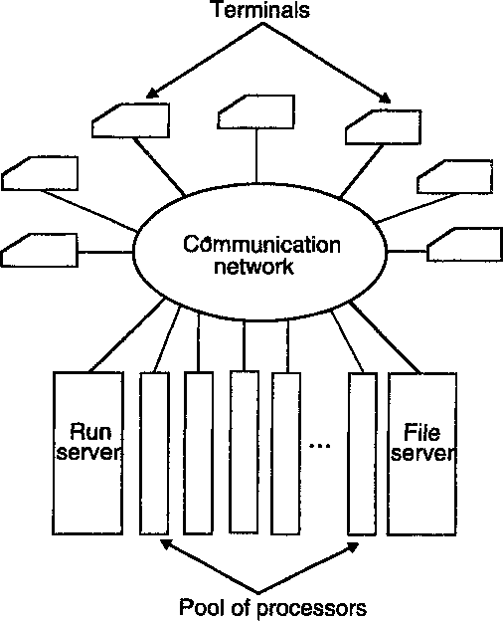
Distributed Computing Models
Processor-pool Model:
Processors are pooled together to be shared by the users as they needed.
Distributed Computing system based on Processor-pool Model

Slide 31
Distributed Computing Models
Processor-pool Model:
involves a pool of processors that collectively work on tasks submitted by clients.
In this model, multiple processors are available to handle parallelizable work, and tasks are distributed to them for concurrent processing.
Example: MapReduce in Distributed Data Processing
Consider a large-scale data processing scenario where a processor pool model is employed to analyze vast amounts of data efficiently.

Slide 32
Distributed Computing Models
Components
Processor Pool:
A cluster of computing nodes forms a processor pool. Each node in the cluster is equipped with processing capabilities and storage.
MapReduce Framework:
The MapReduce programming model is used for parallel data processing. This framework divides a large-scale data processing task into smaller Map and Reduce tasks.
Data Storage:
Large datasets are stored in a distributed storage system, such as Hadoop Distributed File System (HDFS).

Slide 33
Distributed Computing Models
Components
Task Distribution:
Clients submit data processing tasks to the MapReduce framework, specifying the map and reduce functions to be applied to the data.
Dynamic Allocation:
The MapReduce framework dynamically allocates map and reduce tasks to available processors in the cluster. Load balancing ensures that tasks are distributed efficiently.
Communication Middleware:
The MapReduce framework manages the communication between clients, the processor pool, and the distributed storage system. It handles task assignment, data distribution, and result aggregation.

Slide 34
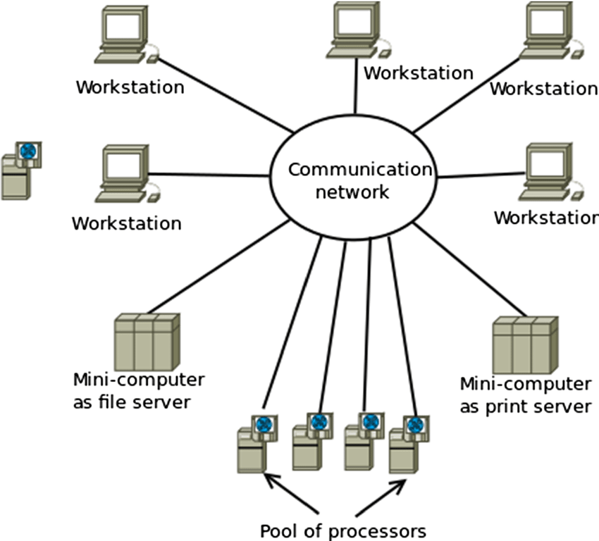
Distributed Computing Models
Hybrid Model:
typically refers to a combination of different computing paradigms or architectures to address specific requirements or challenges.
Distributed Computing system based on Hybrid Model

Slide 35
Distributed Computing Models
In a hybrid cloud and edge computing model, certain processing tasks are performed on local edge devices, while others are offloaded to a centralized cloud infrastructure.
This model is particularly beneficial in applications where real-time processing is required at the edge, but the cloud is leveraged for storage, analytics, and resource-intensive tasks.

Slide 36
Distributed Computing Models
Real-World Example:
Consider a smart city deployment with a network of sensors and cameras for traffic monitoring:
Edge Computing:
Local edge devices process video feeds from cameras in real-time to detect traffic patterns, identify accidents, and optimize traffic flow.
Immediate decisions can be made locally, such as adjusting traffic signals or notifying emergency services.
Cloud Computing:
Data from the edge devices is sent to the cloud for storage and further analysis.
Historical data can be used for long-term traffic planning, predictive maintenance of infrastructure, and city-wide analytics.

Slide 37
Distributed Computing Models
Advantages of Hybrid Model:
Low Latency: Edge computing reduces latency by processing data locally.
Scalability: Cloud resources can handle large-scale data storage and analytics.
Cost Efficiency: Edge devices can handle real-time processing, reducing the need for continuous high-bandwidth communication with the cloud.

