Slide 1
US Gun Violence:
2013-2018
Data Bootcamp

Slide 2
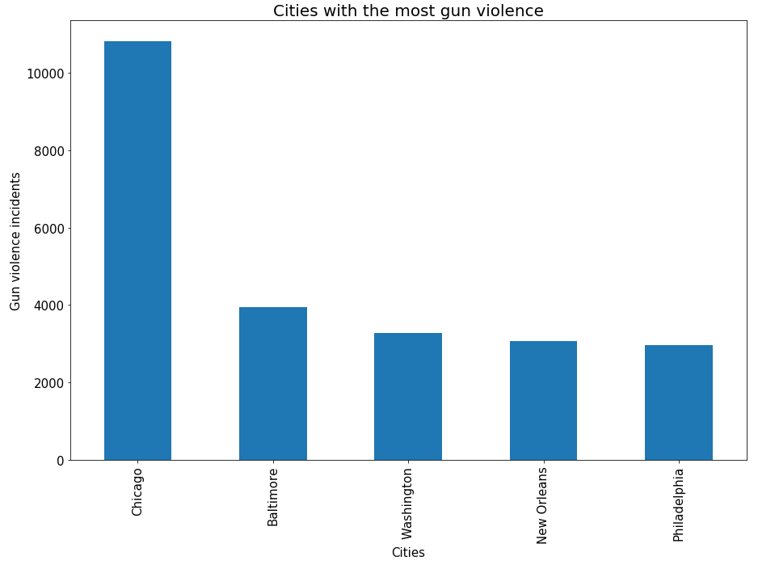
Cities with the most gun violence

Slide 3
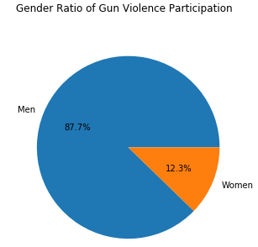
Gun violence gender ratio

Slide 4
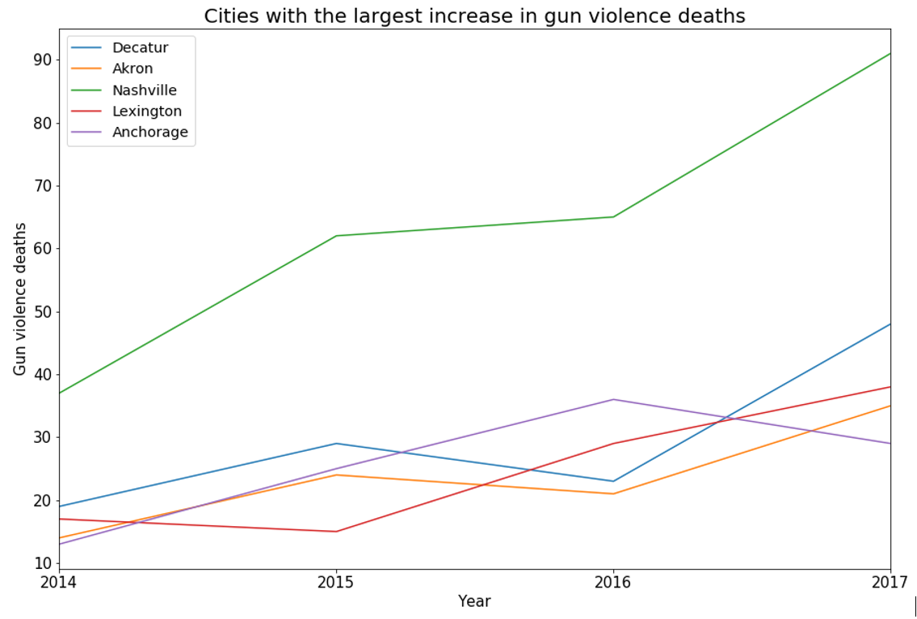
Cities with the largest increase in gun violence deaths

Slide 5
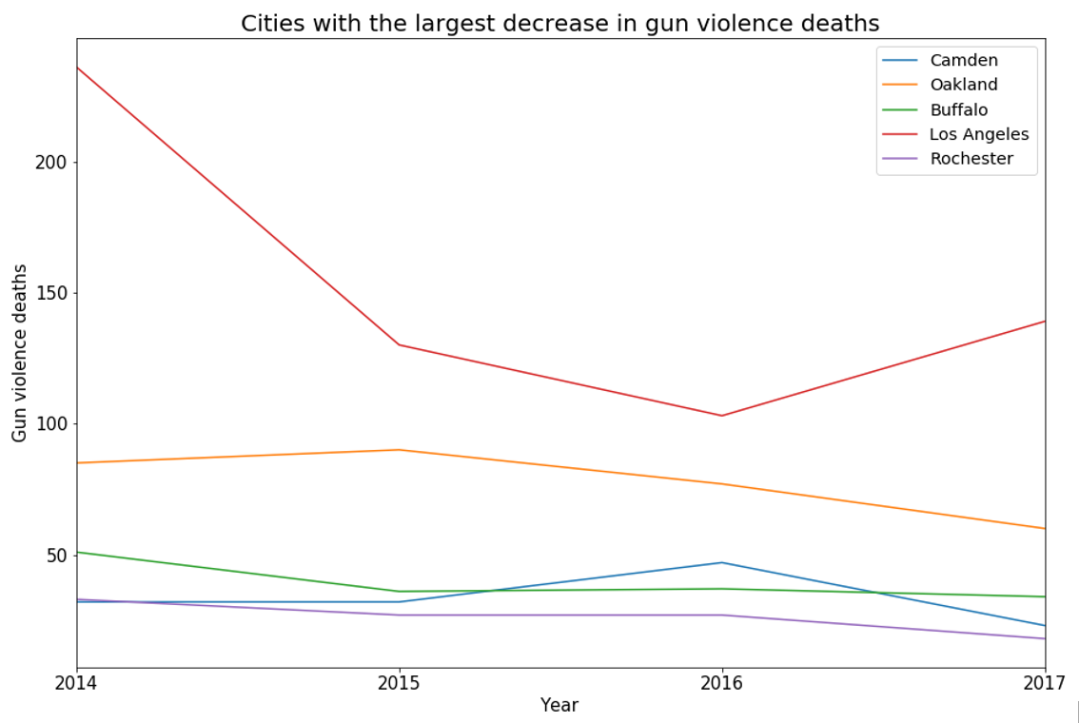
Cities with the largest decrease in gun violence deaths

Slide 6
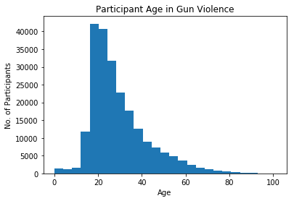
Gun Violence by Particpant Age

