Slide 1


Assessment in programming competitive evaluation
Manuel Palomo-Duarte

Slide 2
Table of contents
Introduction
Issues in competitive assessment
Case study
  First proposal
  Second proposal
Conclusions

Slide 3
Introduction
Real life is competitive
  Competition is “being the best” … candidate for a job / finding the best partner
  … but also comparing (rankings, Am I doing well?)
Some educational systems use global rankings of students
  You are in the “10% of the best grades”
Sometimes even courses use competitions
  It is an extra motivation students

Slide 4
Introduction
Pictures

Slide 5
Issues in competitive assessment
But it also has a “dark side”
  For every 1st place, you have a last place
  For every one in the top ten, you have other one in the lowest ten
  You can try to hide (only show details on the top half), but those students not there can feel down
How do you feel when competing in learning?
  In psychology, positive rewards work much better than negative ones

Slide 6
Issues in competitive assessment
Even more, there is a “legal” issue
  For example, in a multiple-choice exam, each student can get any grade. No matter how well/bad the rest of mates performed
  But in a competition …
    full of bright students, an average one could get D
    full of poor students, the same average one could get A+
  Competition is a comparative grading (not skills)
  Grading for achievements could be a solution …
    but falls into gamification, not competition

Slide 7
Issues in competitive assessment
Let's suppose a two-tournament competition
  First a round-robin (each team plays vs all others)
    5 point for beating a naive sparring team
    1 point for beating another team
    1 point for the half-top
    1 point for winning
  Secondly, a play-off (only the winner keeps playing)
    1 point for getting in the second round
    1 point for winning
Mathematically, the problem is that we have a limited amount of grades to divide into students

Slide 8
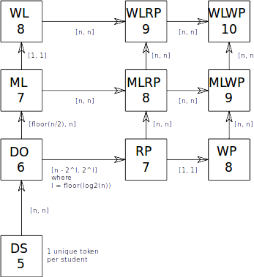

Slide 9
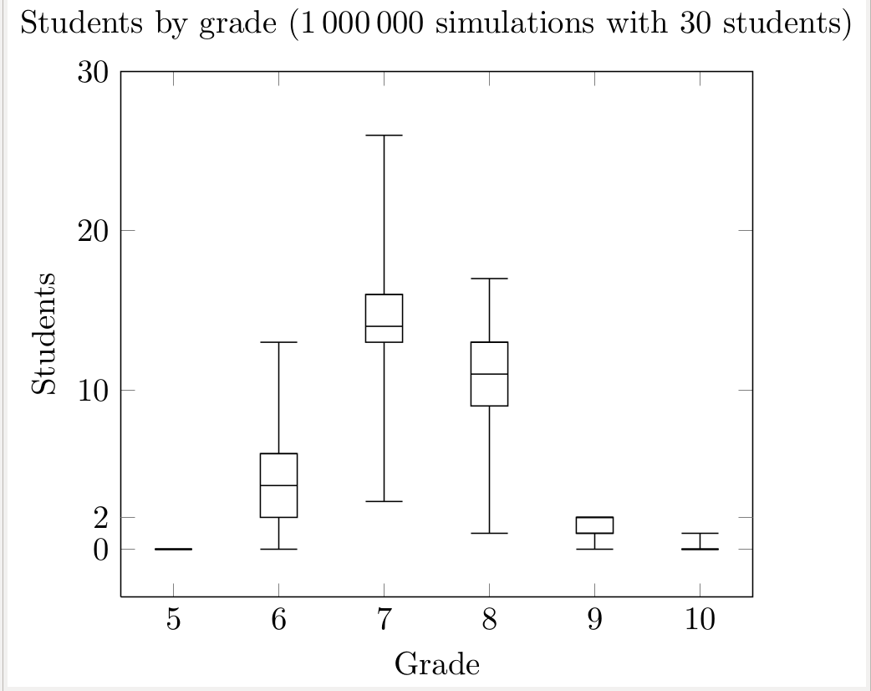

Slide 10
Case study
In University of Cadiz (Spain) we offered an elective course on Video Game Design
  For students of Computer Science: 3rd (last) year
  Prerequisites include several compulsory programming courses
  No knowledge on artificial intelligence (AI) needed
It follows a project-based learning approach
  Except for AI lesson, where they compete

Slide 11
Case study
In the AI lesson, students programmed IA strategies for a simplified version of Stratego
  Partial knowledge of the world: no best strategy
  Ideal for (rule-based) expert system programming
Their expert system (ES) are composed by:
  A set of prioritized (non-deterministic) if-then rules
  An initial setting for the pieces
We implemented and environment for playing batch of matches, replaying, human control, etc

Slide 12
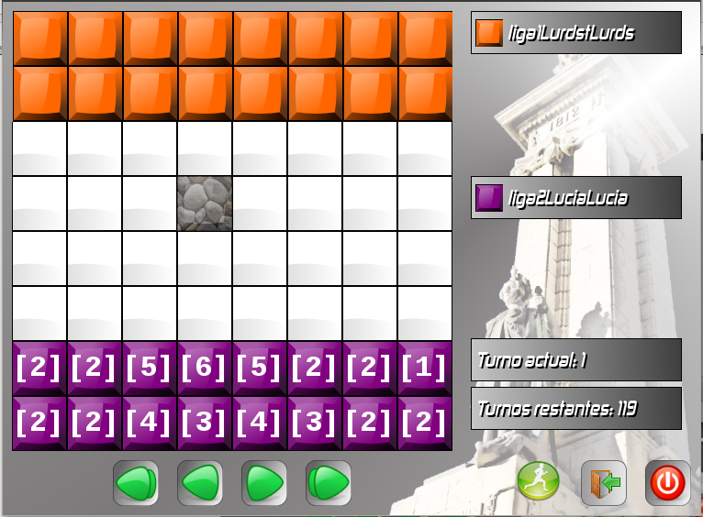

Slide 13
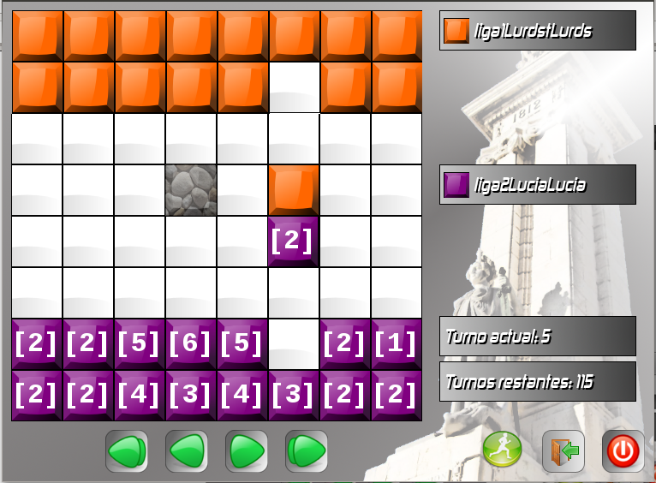

Slide 14
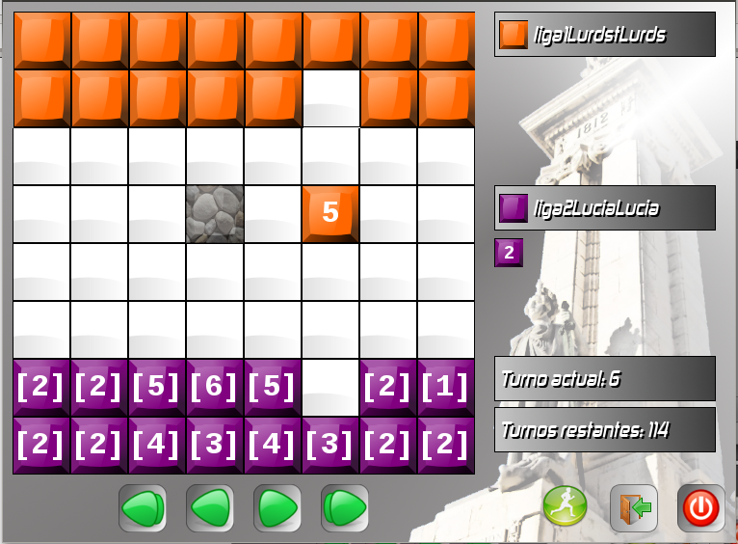

Slide 15
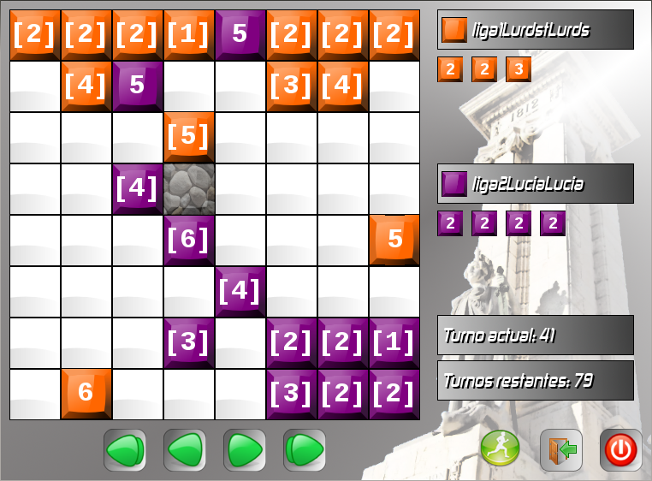

Slide 16
Fist proposal
We can take advantage of the nature of software artifacts to solve this issue
  Developing (and assessing) critical thinking
We let students refine their AI strategies after seeing the first competition
  We played a second competition
  We also play one competition for each improved strategy versus the rest of original ones (off-line)
  We assess according to improvement ratios

Slide 17
First proposal
Refining an ES is easy:
  Removing / adding rules
  Re-priorizing rules
And can lead to very different behavior

Slide 18
Fist proposal
We followed this schema:
  2 hours of lecture explaining ES basics
  2 hours of lab programming their first strategies
  They program their strategy at lab/home
  ES are uploaded the day before next lecture
  2 hours to watch a round-robin league
  1 hour to refine their strategies
  1 hour to watch a play-off of the improved strategies
  Off-line competitions of each improved strategy versus the rest of original ones

Slide 19
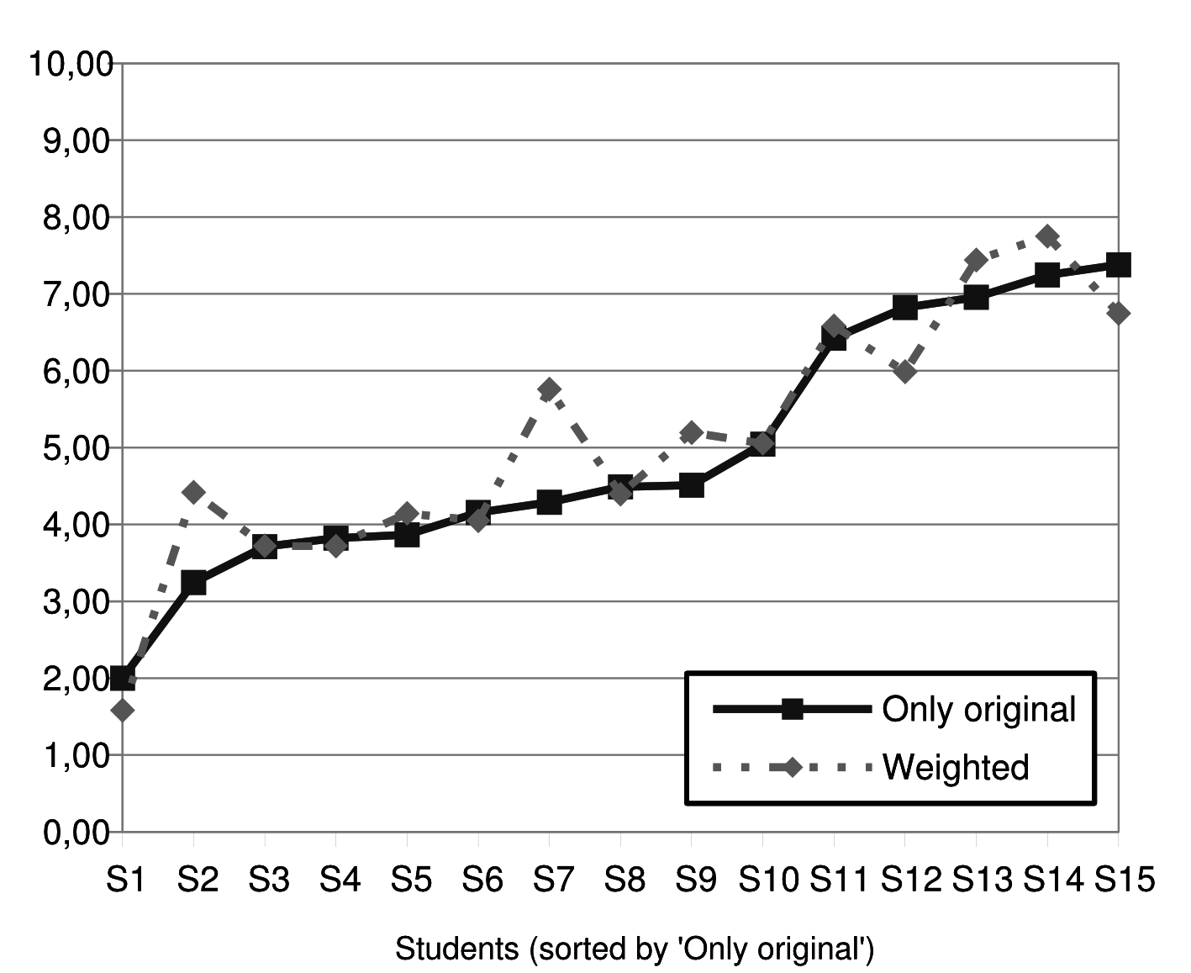
Fist proposal

Slide 20
Second proposal
Ok, students can refine but there is other issue
  There is no “clear goal”: trying to beat an unknown enemy depends on good ideas
Solution: we added a betting system
The schema now includes:
  Strategies uploaded by students (but not initial settings) are available to mates a few days before the competition
  Students can check colleagues' strategies
  In the competition, each student bets 10% to 50% of his grade for other ES

Slide 21
Second proposal
Now the grades can be more evenly distributed
Students do not only critically analyze their code for the second competition
  But also previously analyzed code written by others
Students who are not proficient programmers can have high grades
  If they are good at detecting the best ES

Slide 22
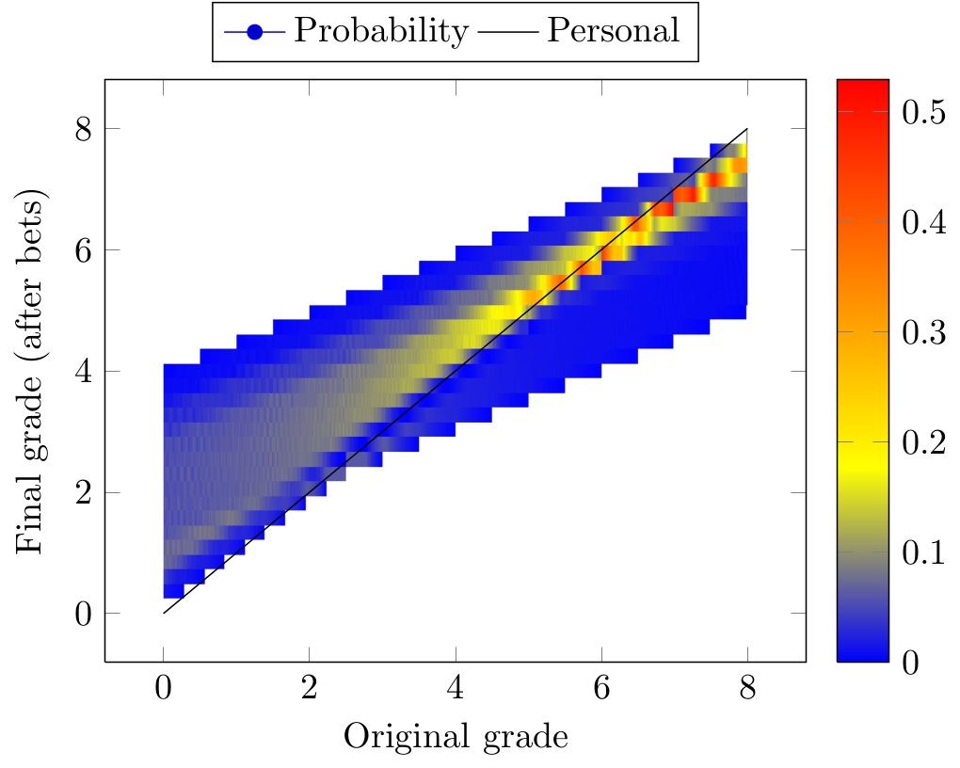
Second proposal

Slide 23
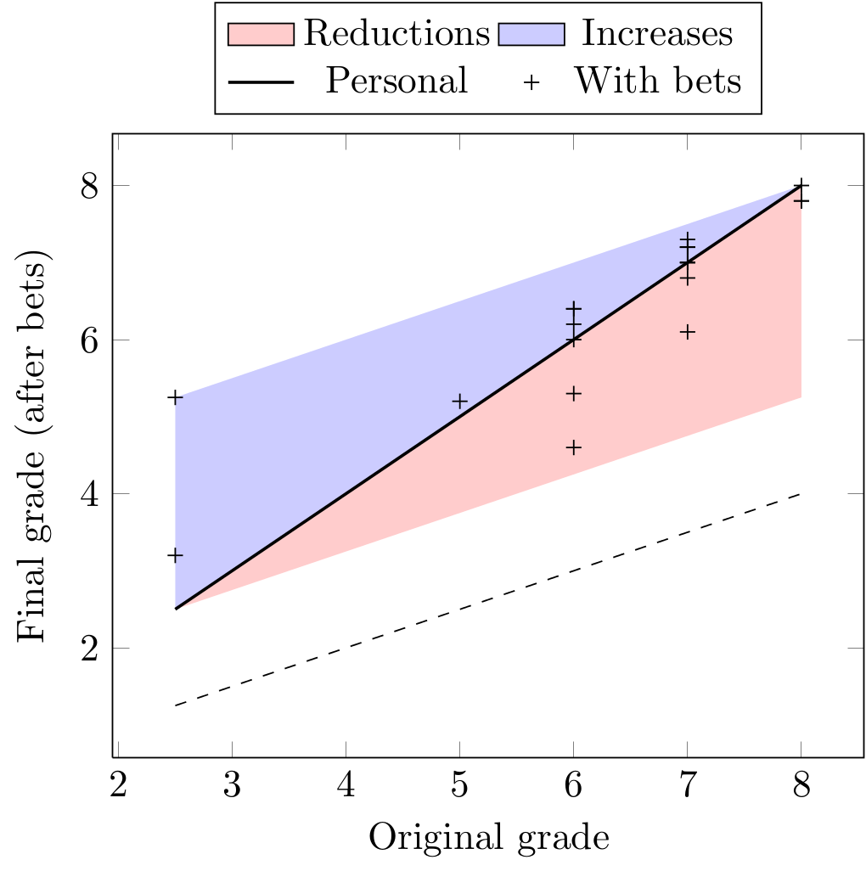
Second proposal

Slide 24
Second proposal
Some students informally acknowledged that they really paid more attention to the author of the code than to the code itself
  Question: is it fair rewarding higher grade for the student whose team received more bets?

Slide 25
Conclusions
We achieved our goals:
  Using a video game to learn artificial intelligence programming
  Doing it in just two weeks (8h max.)
  Motivate students through competitiveness
  Making students critically analyze their own work
  Making students read and analyze code written by others (transferable skill)

Slide 26
Conclusions
Future work:
  Easing game changes to avoid over-specialization
  Applying analysis tools to the logs obtained in the competitions
  Studying the relation between grades in previous courses and ES programming skills
  Checking if copying rules (from previous year or from winner) is a good idea
  Checking each improved team versus not improved ones, does it play better? Kind of post-test

Slide 27
References
  Manuel Palomo-Duarte, Juan Manuel Dodero, Antonio García-Domínguez: Betting system for formative code review in educational competitions. Expert Systems with Applications 41(5): 2222-2230 (2014)
  Manuel Palomo-Duarte, Juan Manuel Dodero, Antonio García-Domínguez: Competitive assessment in computer engineering scenarios. International Journal of Engineering Education. Special Issue in Current Trends of E-Learning in Engineering Education (to be published 2014)
  Website: http://code.google.com/p/gsiege (GPL)

Slide 28

Thank you for your attention
Questions?
manuel.palomo@uca.es
This work has been supported by the Proyecto de Innovación Educativa Universitaria del Personal Docente e Investigador ``La competitividad y el análisis crítico en la evaluación'' (CIE44) , funded by the Consejería de Innovación, Ciencia y Empresa of the Junta de Andalucía and the University of Cádiz (Spain)

