Slide 1


STACK OVERFLOW TAG CLASSIFICATION
Machine Learning II
Presented by:
Sang NGUYEN
Romain POIRRIER
MASTER MINDS – INSA LYON
Notes:
[Sources] - Uploaded project READMEs in this chat (README.pdf and README (1).pdf). - Deck structure updated from user-specified revised table of contents in chat.

Slide 2
Pipeline Overview
Stage | Methond
Input | Stack Overflow question text
Cleaning | HTML/Code-aware preprocessing
Features | Hancrafted + sparse text features
Vectorization | Word TF-IDF, Character TF-IDF, One-Hot Encoding
Base models | SGD, Ridge, Logistic Regression
Ensemble | Voting + Stacking
Evaluation | Accuracy, Micro-F1, Macro-F1, confusion-matrix
Notes:
[Sources] - VS Code Data Wrangler docs: https://code.visualstudio.com/docs/datascience/data-wrangler - Data Wrangler viewing-mode screenshot: https://code.visualstudio.com/assets/docs/datascience/data-wrangler/view-mode-ui.png - Uploaded README (EDA notebook, traffic/delay/airline/origin analyses).

Slide 3
2. Preprocessing
Data quality & Descriptive stats
Methods:
- Lowercasing and normalization
- HTML parsing with BeautifulSoup
- URL replacement
- Inline-code cleaning
- Code-block cleaning
- Stop-word removal
- Technical token preservation
Technical Token Preservation
Tokens we want to keep:
Example:
- `c++`, `c#`, `.net`
- method-like tokens
- array types
- regex/code fragments
Notes:
[Sources] - VS Code Data Wrangler docs: https://code.visualstudio.com/docs/datascience/data-wrangler - Data Wrangler viewing-mode screenshot: https://code.visualstudio.com/assets/docs/datascience/data-wrangler/view-mode-ui.png - Uploaded README (EDA notebook, traffic/delay/airline/origin analyses).

Slide 4
2. Preprocessing
Data quality & Descriptive stats
Raw text :
connection in .net i got <blockquote> <code>system.data.datarow.datarow(system.data.datarowbuilder)</code> is inaccessible due to its protection level. </blockquote> while connecting to sql-server. what does it mean
Preprocessed text :
connection .net got quote_block system.data.datarow.datarow system.data.datarowbuilder inaccessible protection level connecting sql server does mean
Notes:
[Sources] - VS Code Data Wrangler docs: https://code.visualstudio.com/docs/datascience/data-wrangler - Data Wrangler viewing-mode screenshot: https://code.visualstudio.com/assets/docs/datascience/data-wrangler/view-mode-ui.png - Uploaded README (EDA notebook, traffic/delay/airline/origin analyses).

Slide 5
3. Train/Test Split
Splitting strategy
- Stratified and balanced by class
- Same number of samples per label
- Fixed random seed
Setting | Value
Random seed | 42
Train per class | 1500 samples
Test per class | 500 samples
Notes:
[Sources] - Uploaded project READMEs in this chat (README.pdf and README (1).pdf). - User requested this revised table of contents in chat.

Slide 6
4. Handcrafted Features
Automatic discovery:
Search pattern based on tokens :
  Generic words (ex: python)
  Identifiers (ex: @decorator)
  Sequences of brackets, etc...
Variable 1 to 3 grams
Keep on constraint
Manual features:
Patterns specific to a language
  Ex : std:: for C++
Post metadata (ex: post length)
Keep on constraint
Added One-Hot encoding:
Auto + Manual features only cover 23250 posts
Constraint | Value
Coverage | >= 200 posts
Accuracy | >= 60%
Type | Amount
Auto Discovered | 146 features
Manual | 34 features
Notes:
[Sources] - VS Code Data Wrangler docs: https://code.visualstudio.com/docs/datascience/data-wrangler - Data Wrangler viewing-mode screenshot: https://code.visualstudio.com/assets/docs/datascience/data-wrangler/view-mode-ui.png - Uploaded README (EDA notebook, traffic/delay/airline/origin analyses).

Slide 7
5. Vectorization Strategy
Vectorization | Level | Purpose
Count | Word | Raw term frequency baseline
One-Hot | Word | Binary presence baseline
TF-IDF | Word | Main semantic representation
Char TF-IDF | Character | Syntax/pattern representation
Notes:
[Sources] - VS Code Data Wrangler docs: https://code.visualstudio.com/docs/datascience/data-wrangler - Data Wrangler viewing-mode screenshot: https://code.visualstudio.com/assets/docs/datascience/data-wrangler/view-mode-ui.png - Uploaded README (EDA notebook, traffic/delay/airline/origin analyses).

Slide 8
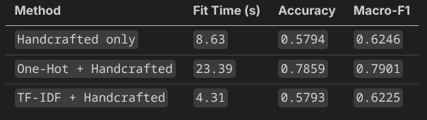
6. Model 3 - Benchmarking
Model selection
Method Benchmarking (LR)
Logistic Regression : Took ~3.2 hours of parameter tuning
XGB Classifier : Could not finish
One-Hot encoding + Handcrafted features achieve better results.
Conclusion : One-Hot Encoding + Handcrafted features & Logistic Regression are chosen for model 3
Notes:
[Sources] - VS Code Data Wrangler docs: https://code.visualstudio.com/docs/datascience/data-wrangler - Data Wrangler viewing-mode screenshot: https://code.visualstudio.com/assets/docs/datascience/data-wrangler/view-mode-ui.png - Uploaded README (EDA notebook, traffic/delay/airline/origin analyses).

Slide 9
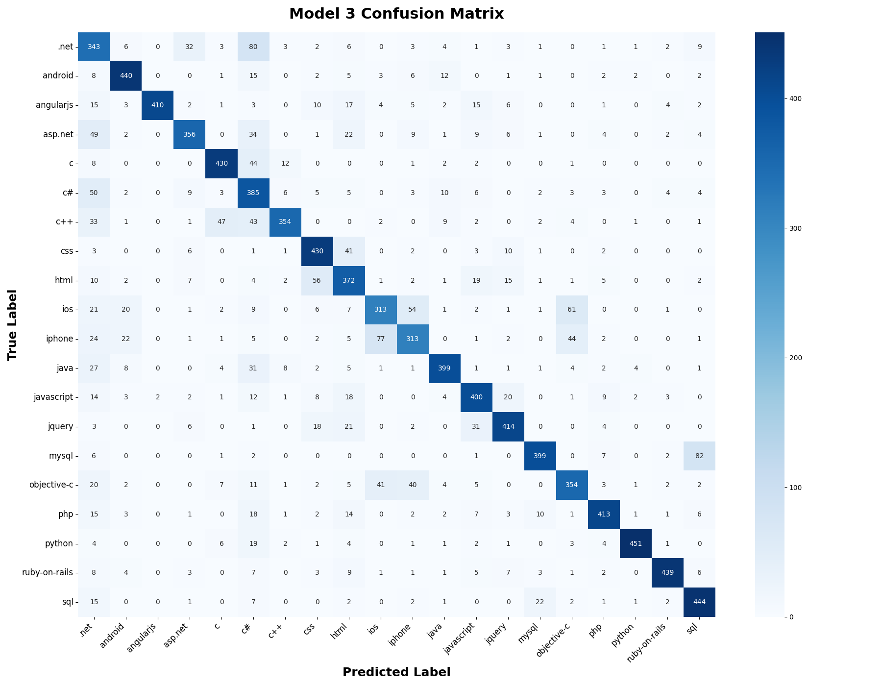
6. Model 3 - Metrics
Model performance
Misclassification mostly on similar tags
  Ex : SQL / MYSQL
More misclassification than model 1 & 2
Keep the same overall pattern
Notes:
[Sources] - VS Code Data Wrangler docs: https://code.visualstudio.com/docs/datascience/data-wrangler - Data Wrangler viewing-mode screenshot: https://code.visualstudio.com/assets/docs/datascience/data-wrangler/view-mode-ui.png - Uploaded README (EDA notebook, traffic/delay/airline/origin analyses).

Slide 10
THANK YOU
MASTER MINDS – INSA LYON
Notes:
[Sources] - Uploaded project READMEs in this chat (README.pdf and README (1).pdf). - Deck structure updated from user-specified revised table of contents in chat.

