Slide 1
KERNELs

Slide 2
Operaciones
En ocasiones los problemas que se presentan en imágenes pueden ser resueltos a través de un análisis individual de los píxeles como es el caso de la mejora de contraste donde cada píxel es sumado y multiplicado por una constante.

Slide 3
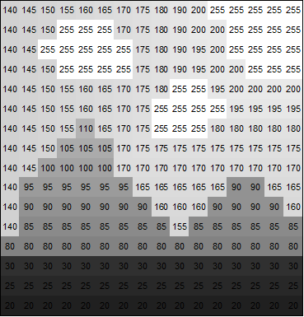
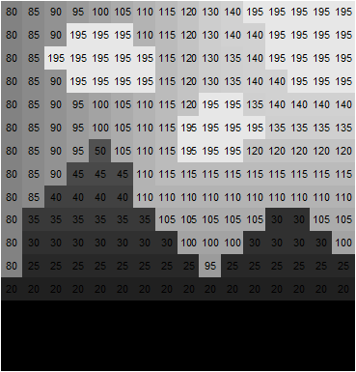
Ejemplo operación píxel a píxel

Slide 4
Operaciones
Algunos problemas requieren el análisis conjunto de múltiples elementos, en estos casos se hace utiliza la convolución y una matriz de convolución (también llamada kernel)

Slide 5
Kernel
It is a small matrix. It is used for blurring, sharpening, embossing, edge detection, and more. This is accomplished by doing a convolution between a kernel and an image.

Slide 6
Convolución
Convolution is the process of adding each element of the image to its local neighbors, weighted by the kernel. This is related to a form of mathematical convolution. It should be noted that the matrix operation being performed - convolution - is not traditional matrix multiplication, despite being similarly denoted by *.

Slide 7
Convolución
For example, if we have two three-by-three matrices, the first a kernel, and the second an image piece, convolution is the process of flipping both the rows and columns of the kernel and then multiplying locally similar entries and summing. The element at coordinates [2, 2] (that is, the central element) of the resulting image would be a weighted combination of all the entries of the image matrix, with weights given by the kernel:

Slide 8
Convolución
The other entries would be similarly weighted, where we position the center of the kernel on each of the boundary points of the image, and compute a weighted sum.
The values of a given pixel in the output image are calculated by multiplying each kernel value by the corresponding input image pixel values

Slide 9



Slide 10
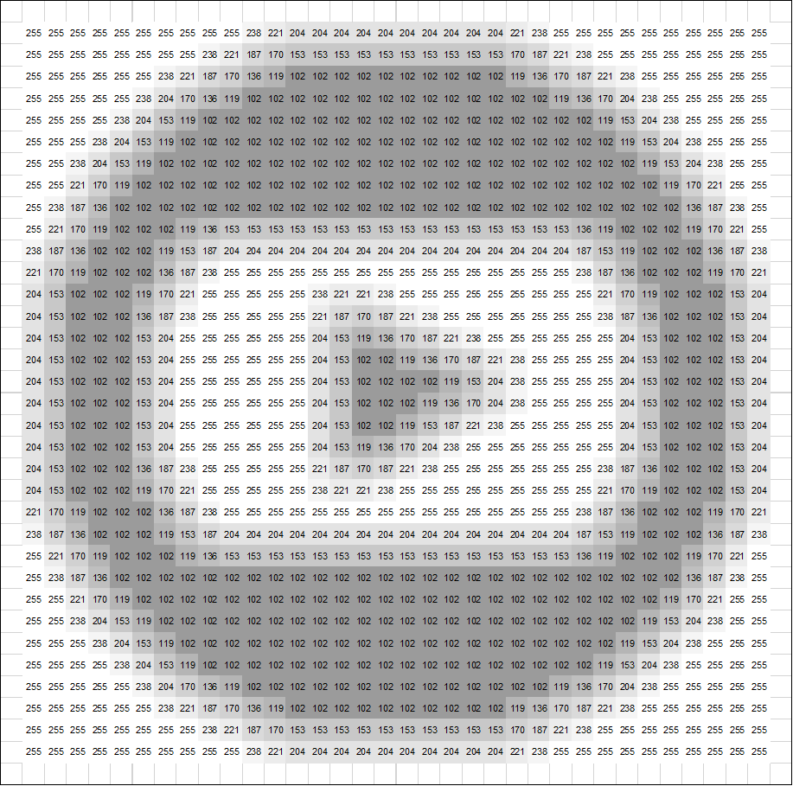

Slide 11
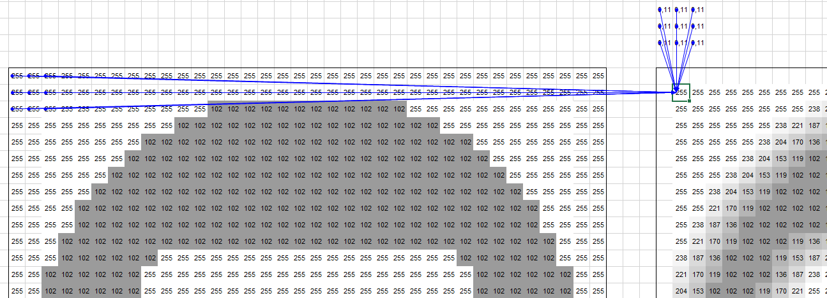

Slide 12
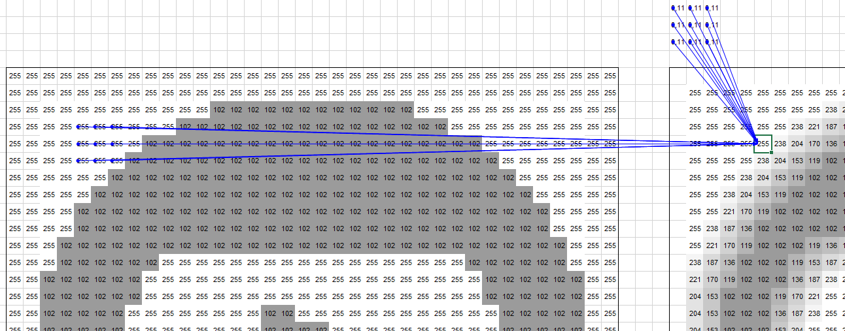

Slide 13
Evaluación
https://docs.google.com/spreadsheets/d/1dNB0kNA37Wxye2CkPG3iieuRCyTLQuZwKlMU3DlZIbg/edit?usp=sharing

