Slide 1
Book1
File created on: 17/06/19 17:22:57 GMT-03:00

Slide 2
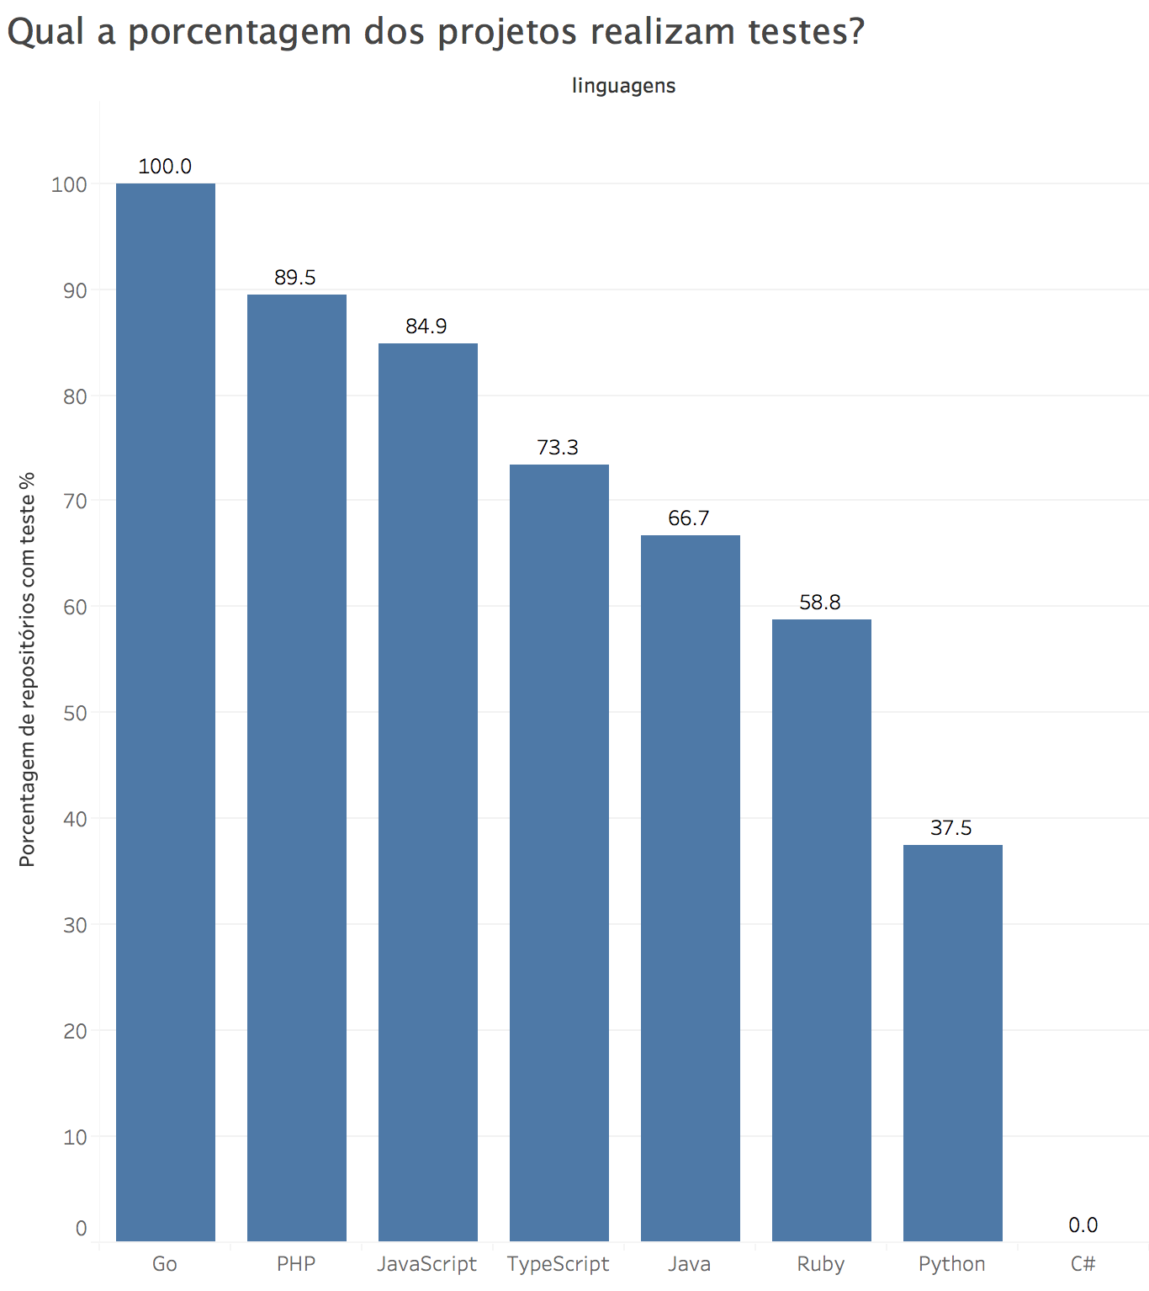

Slide 3
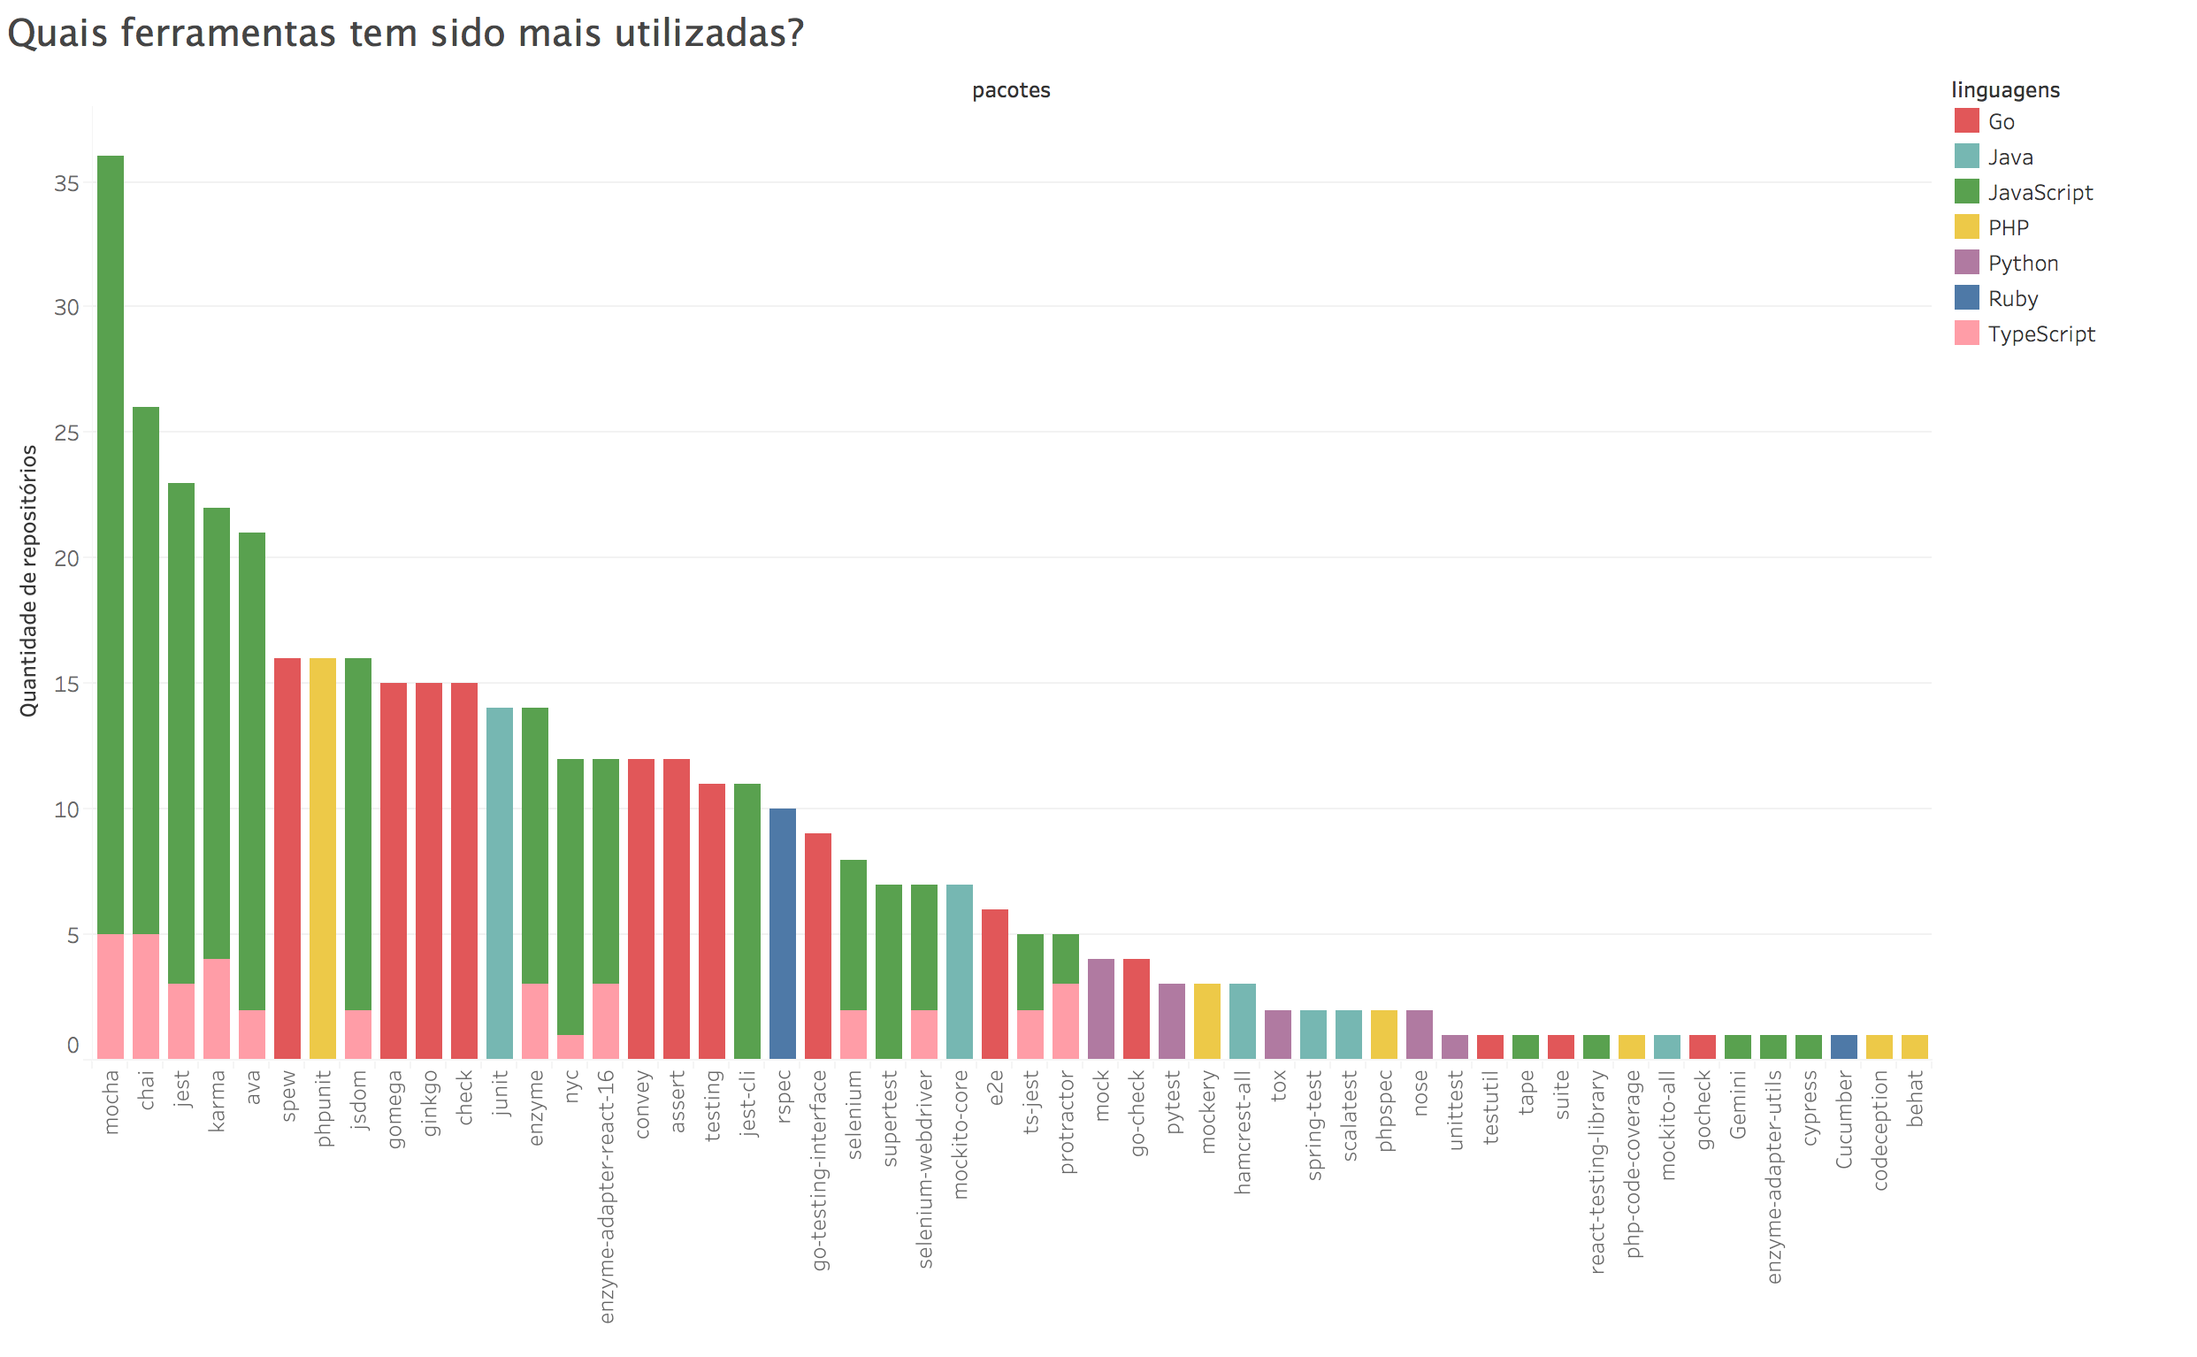

Slide 4
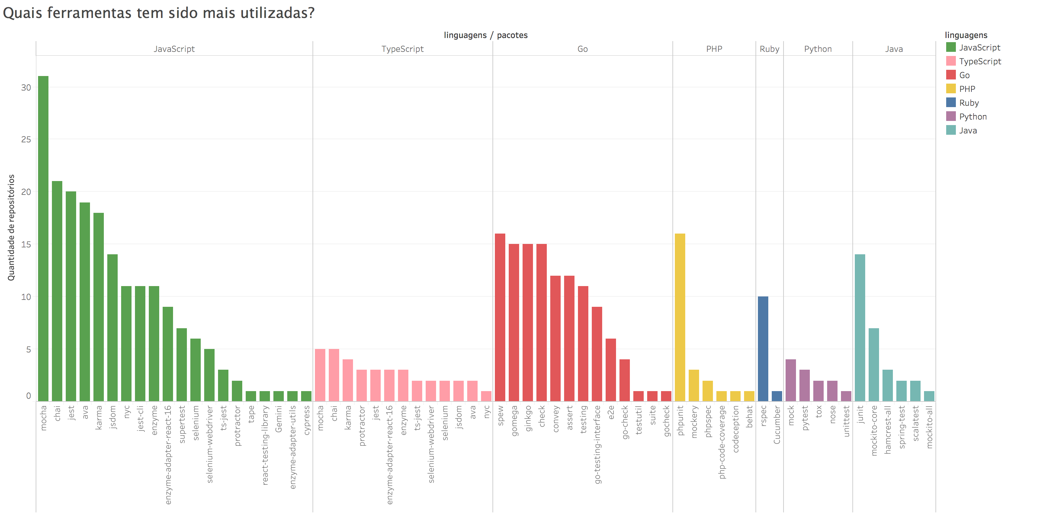

Slide 5
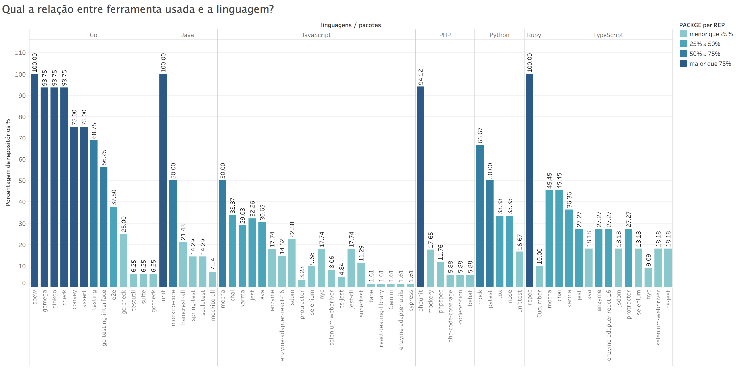

Slide 6
