Slide 1
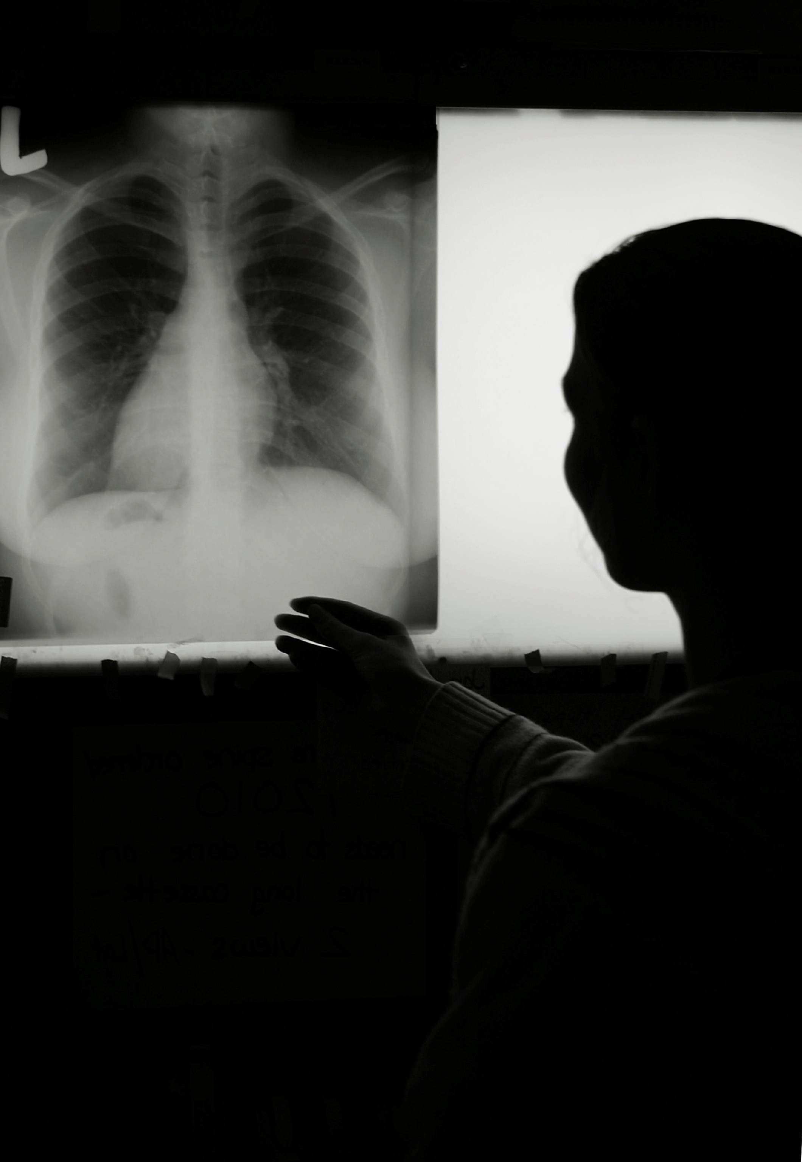

Slide 2
~
~

Slide 3
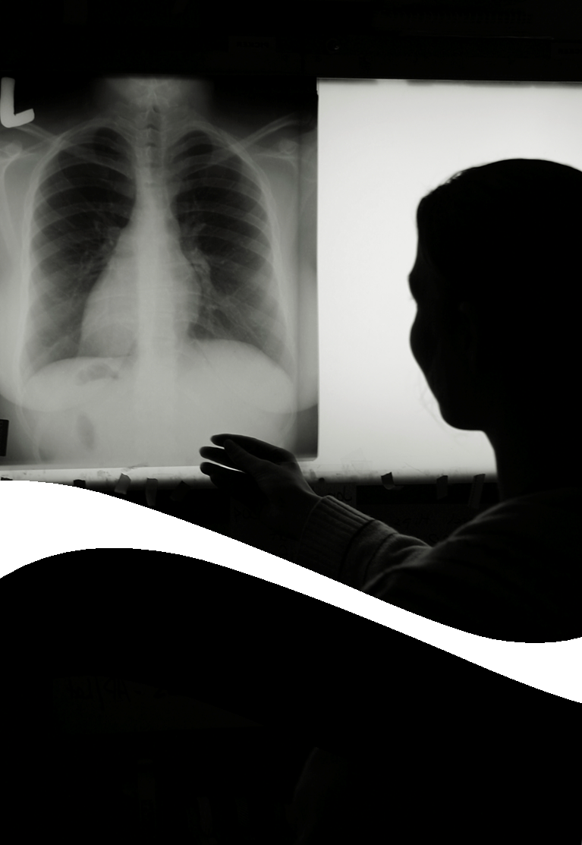
A Decision Support System for the
Assessment and Stenting of
Tracheal Stenosis

Slide 4


A Decision Support System for the
Assessment and Stenting of
Tracheal Stenosis
Rômulo PINHO
Promotor:
Prof. Dr. Jan Sijbers

Slide 5
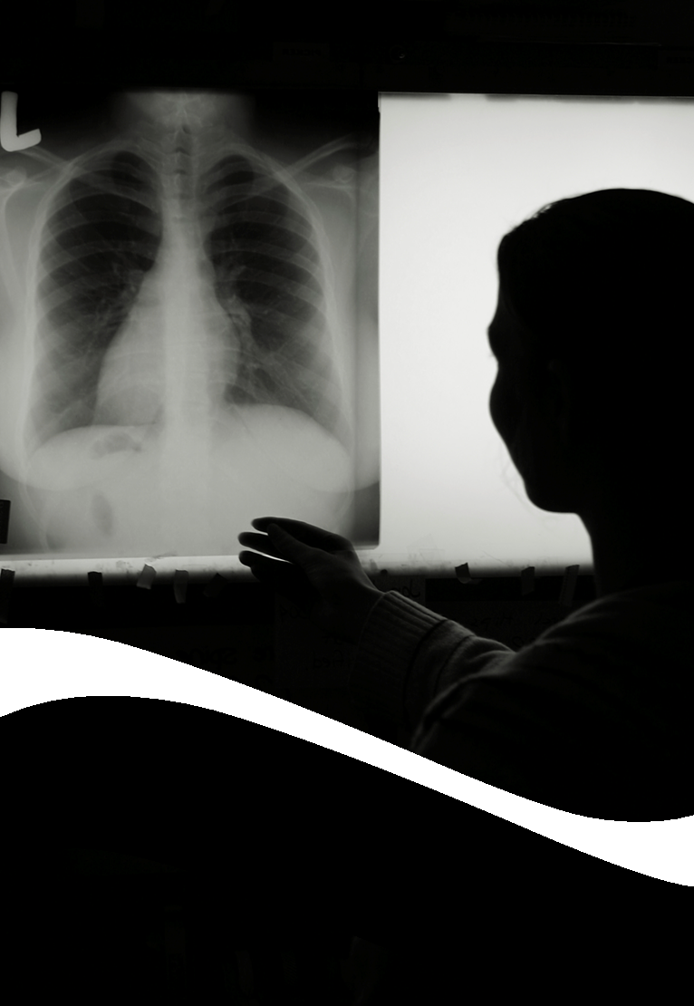
A Decision Support System for the
Assessment and Stenting of
Tracheal Stenosis
Rômulo PINHO
Proefschrift voorgelegd tot het behalen van de graad van Doctor in de Wetenschappen
Promotor:
Prof. Dr. Jan Sijbers

