Slide 1
Instale o Node.js

Slide 2
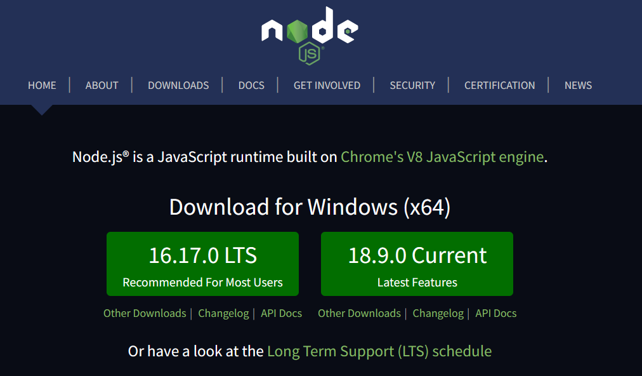

Slide 3
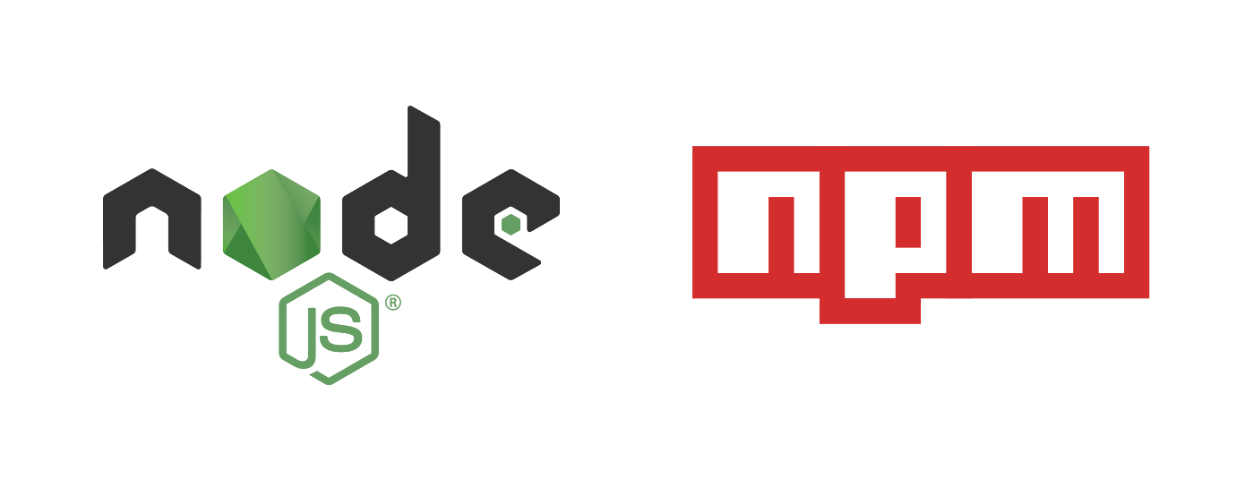

Slide 4


Slide 5


Slide 6


Slide 7


Slide 8


Slide 9


Slide 10
npx create-react-app

