Slide 1
Feature Encoding

Slide 2
What are Encoding Techniques?
In many practical data science activities, the data set will contain categorical variables. These variables are typically stored as text values”. Since machine learning is based on mathematical equations, it would cause a problem when we keep categorical variables as is. Many algorithms support categorical values without further manipulation, but in those cases, it’s still a topic of discussion on whether to encode the variables or not. The algorithms that do not support categorical values, in that case, are left with encoding methodologies.

Slide 3
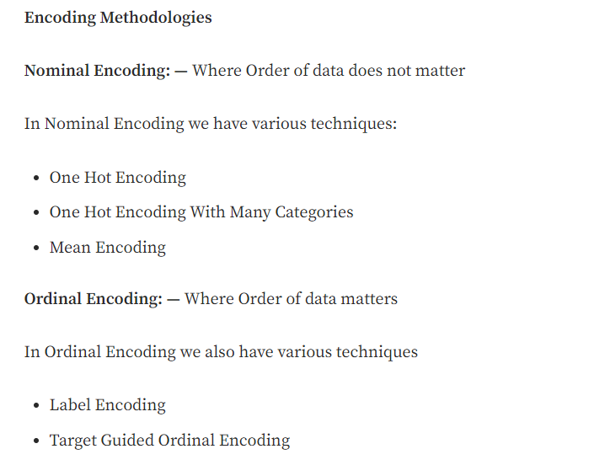

Slide 4
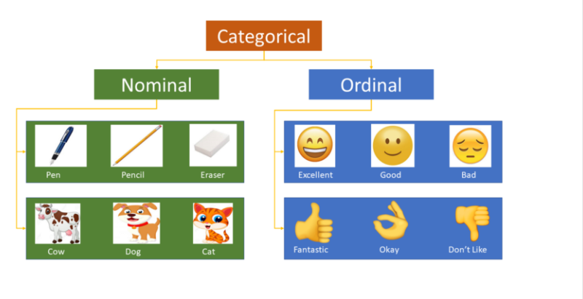

Slide 5
One Hot Encoding
In this method, we map each category to a vector that contains 1 and 0 denoting the presence of the feature or not. The number of vectors depends on the categories which we want to keep. For high cardinality features, this method produces a lot of columns that slows down the learning significantly. There is a buzz between one hot encoding and dummy encoding and when to use one. They are much alike except one hot encoding produces the number of columns equal to the number of categories and dummy producing is one less. This should ultimately be handled by the modeler accordingly in the validation process.

Slide 6
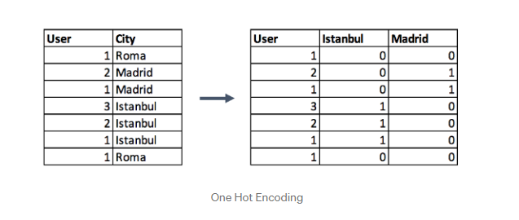

Slide 7
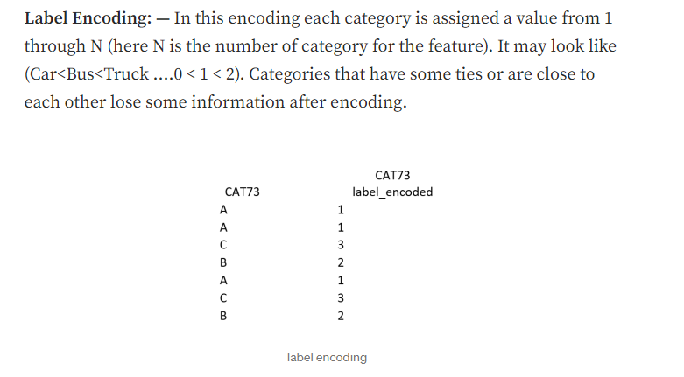

Slide 8
Thank You

