Slide 1
Web Solutions
An approach for developing
the most efficient
corporate Internet presentations

Slide 2
Web Solutions
State-of-the-art Internet marketing approach
Multilingual development
Complex product databases
Ordering process
Back-office automation and control

Slide 3
Internet Marketing Approach
We are not only selling
a technology and design…
…We are providing you complete
Web solutions that most effectively
market your products and services
Our Web solution is based on
the most efficient concept of the
state-of-the-art Web marketing:
gaining Most Wanted Response for you

Slide 4
We Are Making Web Sites That Effectively Meet Your Targets
Most Wanted Response (MWR) is a result
that you want to get from your Web site
MWR is usually – but not always –
to get RFQ, order or to sell your product
We are making complete Web site structure
in order to get MWR from your customers
From our own Web projects with users
from more than 100 countries,
we know exactly how to do it!

Slide 5
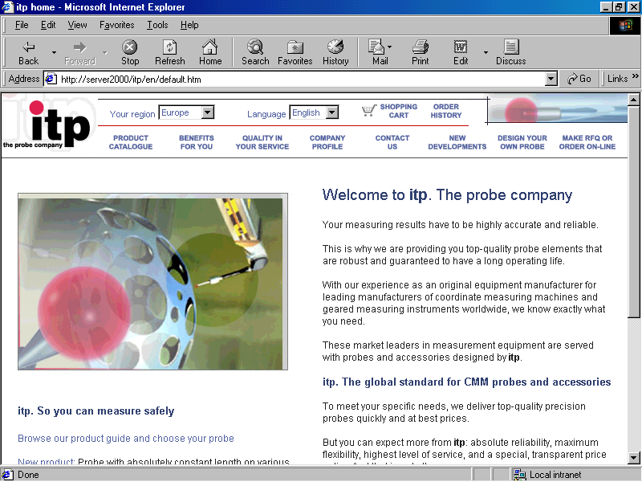
Internet Marketing Approach: Clear Web Site Structure
Navigation is easy,
and complete
layout follows
the natural way
to get your
customer to MWR
Convincing
sentences that
build trust of your
customer

Slide 6
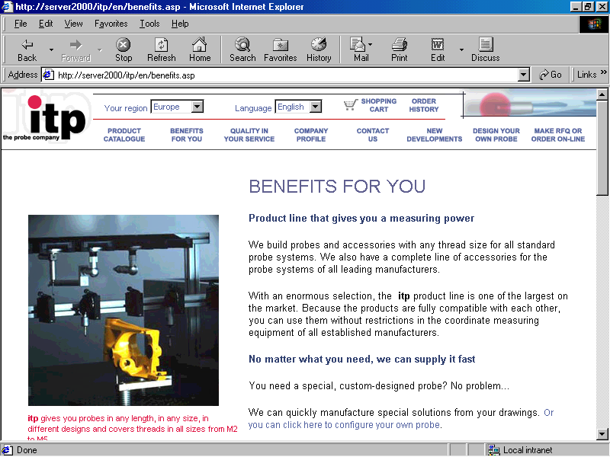
Presenting the Strength of Your Company
Most Wanted
Response is
always just
“one click”
away from
your customer
The very best
features of your
company are
clearly stated in a
“customer centric”
way

Slide 7
Web Solutions
State-of-the-art Internet marketing approach
Multilingual development
Complex product databases
Ordering process
Back-office automation and control

Slide 8
Multilingual Development
Multilingual work
is fully supported,
with an easily
accessible
selection
There is also
an option for
multiple market
definition
(for example,
with different
prices)

Slide 9
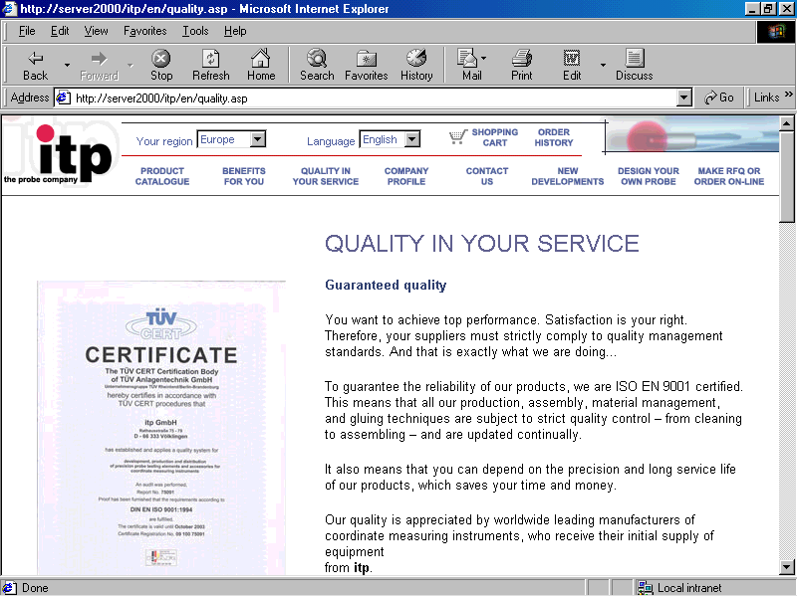
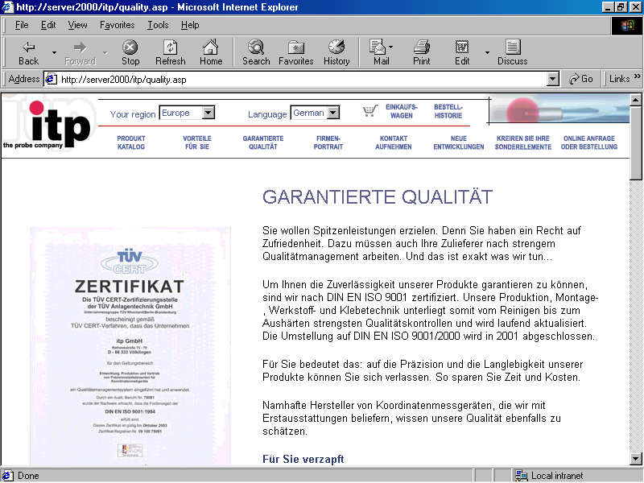
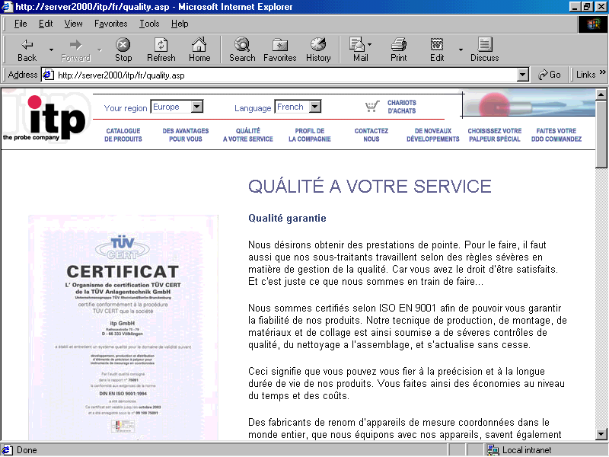
This gives your company
a real opportunity...
… to be presented
in a best way
worldwide

Slide 10
Web Solutions
State-of-the-art Internet marketing approach
Multilingual development
Complex product databases
Ordering process
Back-office automation and control

Slide 11
Product Databases
Your product catalogue is now presented
in a new, modern way
And there are no limitations in size:
by using robust relational databases and
Active Server Pages technology,
even the largest and most complex
product lines can be easily handled

Slide 12
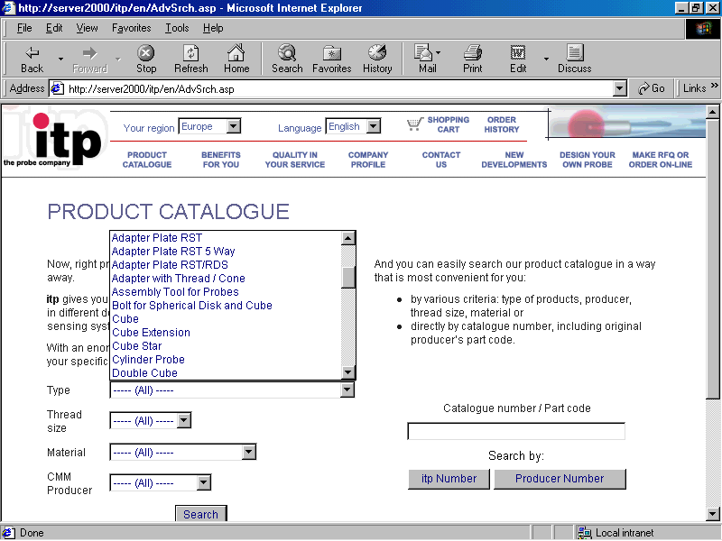
Product Catalogue Search
Searching your
product catalogue
can be done
by numerous
criteria,
very intuitively
and extremely fast

Slide 13
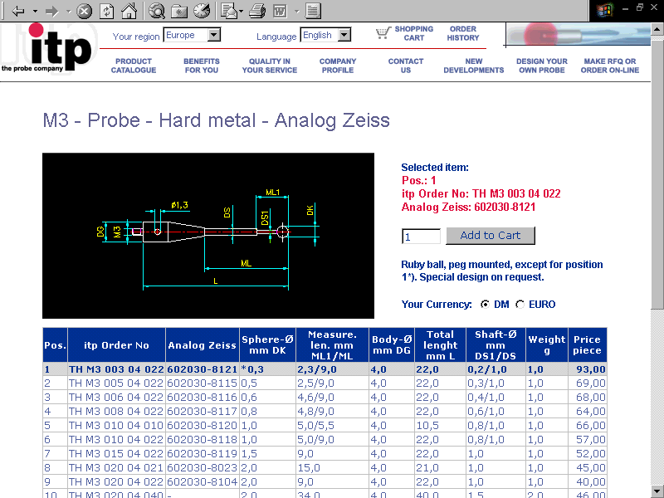
Product Catalogue (1)
Technical drawings,
pictures and different
product details
can be easily and
flexibly shown

Slide 14
Product Catalogue (2)
Shopping “cart”
and ordering
facility are
simple and only
one click away
Multiple currency
business is fully
supported

Slide 15
Web Solutions
State-of-the-art Internet marketing approach
Multilingual development
Complex product databases
Ordering process
Back-office automation and control

Slide 16
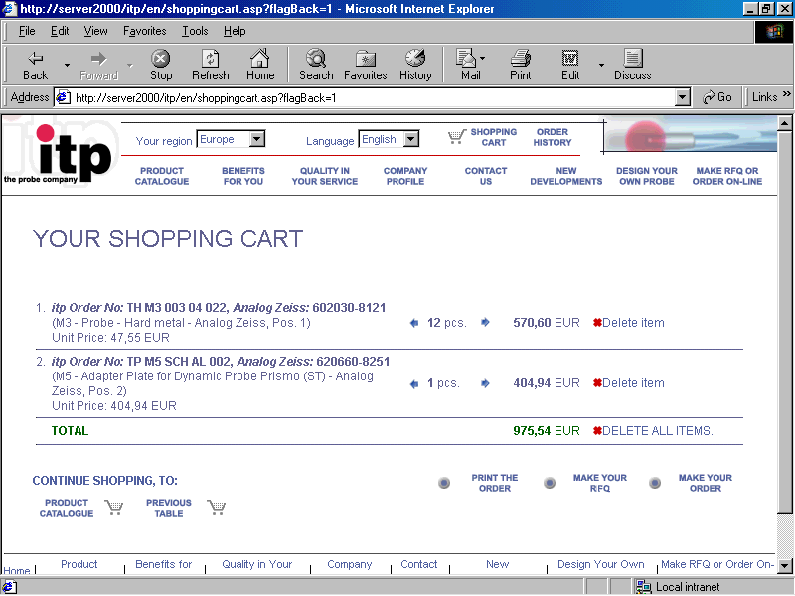
Ordering options
Besides direct
ordering online,
your customer
can make
a Request for
Quotation (RFQ),
or simply print
products of
his interest.
This gives you
full flexibility.

Slide 17
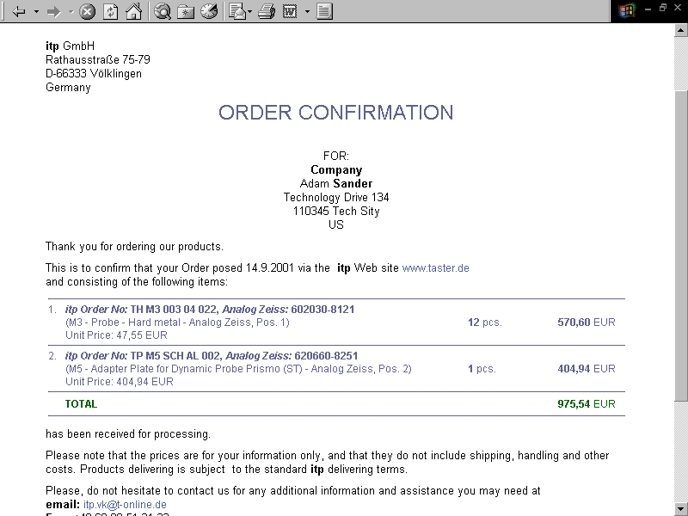
Streamlined ordering process
Ordering process
is completely
streamlined,
precise and
automated,
thus saving you
a significant amount
of back-office work
in processing
the orders.

Slide 18
Web Solutions
State-of-the-art Internet marketing approach
Multilingual development
Complex product databases
Ordering process
Back-office automation and control

Slide 19
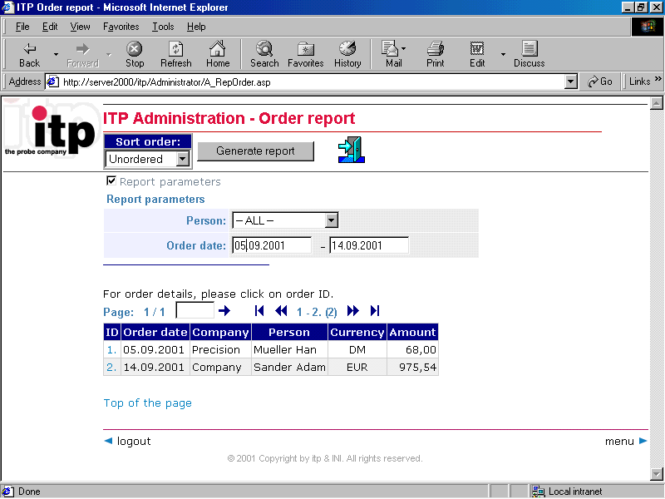
Control of the results
Besides front-end
presentation
to your customers,
you can
comfortably
control the results,
orders you got,
RFQs and other
elements

Slide 20
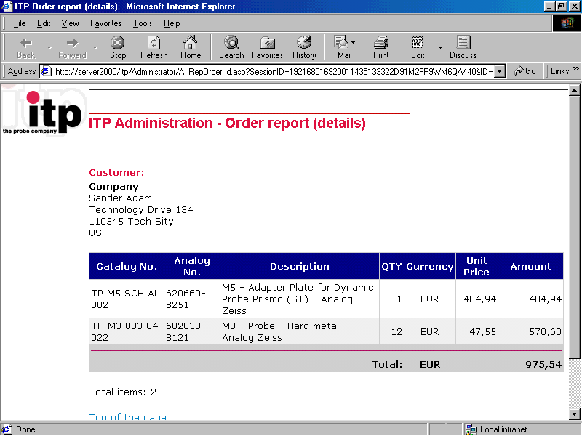
… and more
Not only you can
get detailed data
on activities of
every customer,
but you can also
organise a
communication
with your
distributors and
other partners
efficiently
through the
Internet

