Slide 1
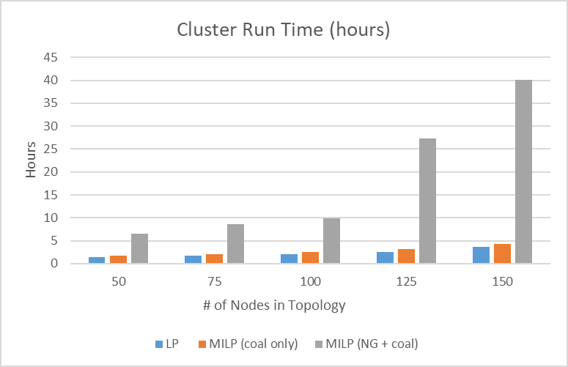
Running problem twice (MILP + LP)
1 Full Calendar Year (8760)

Slide 2
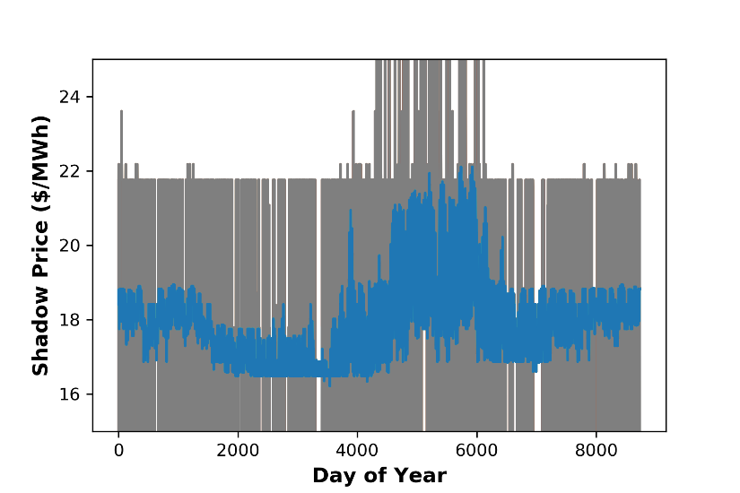
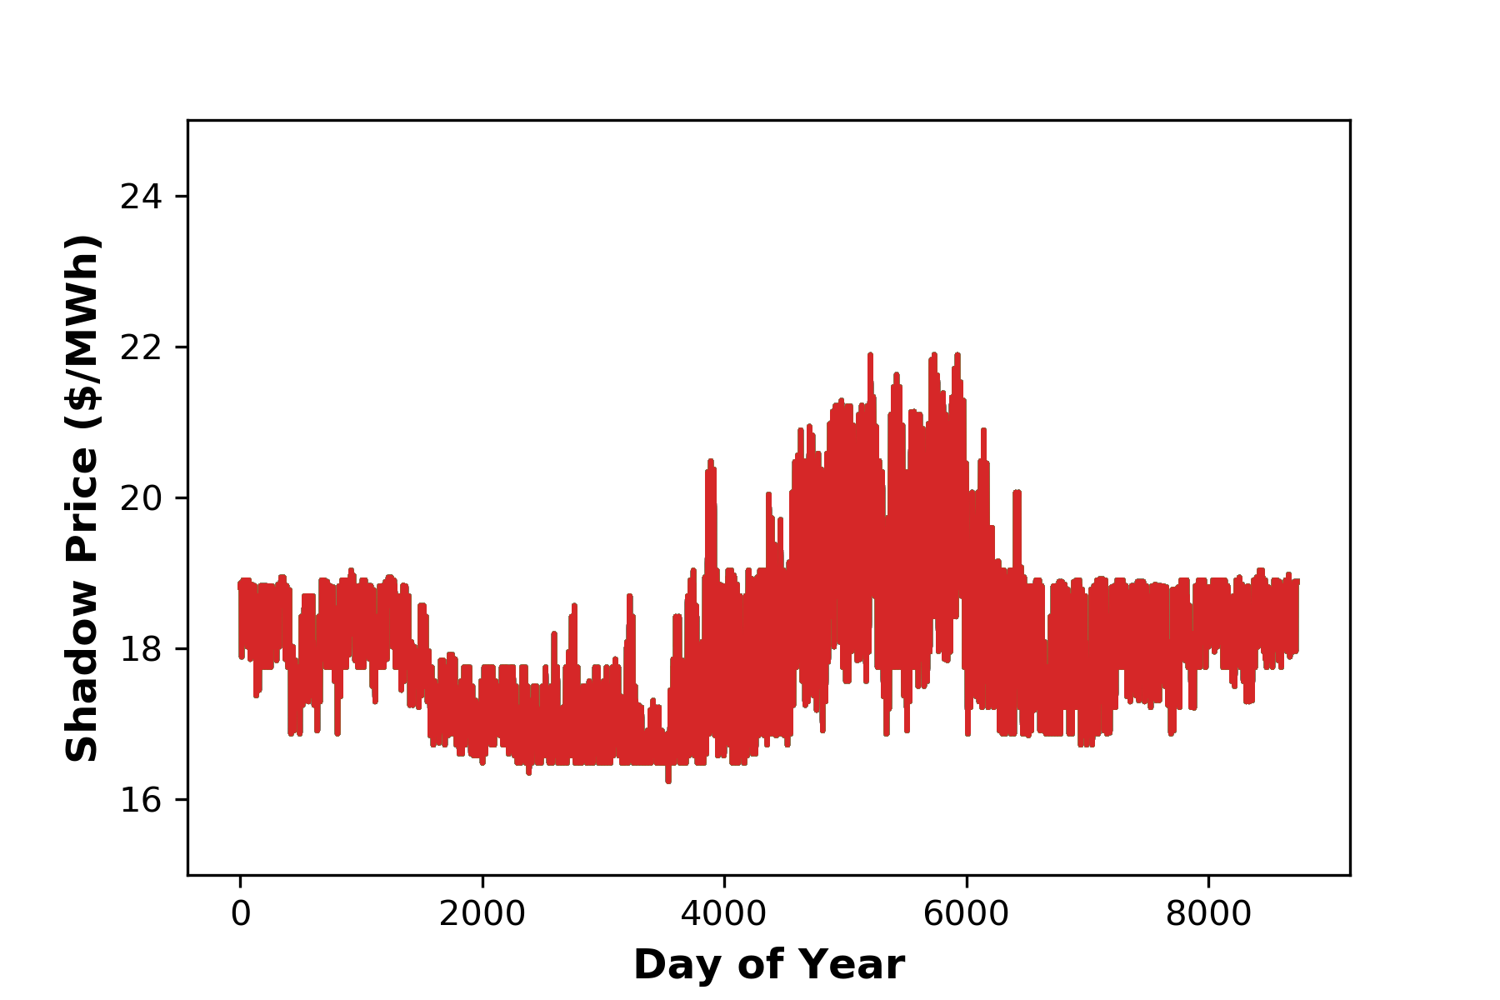
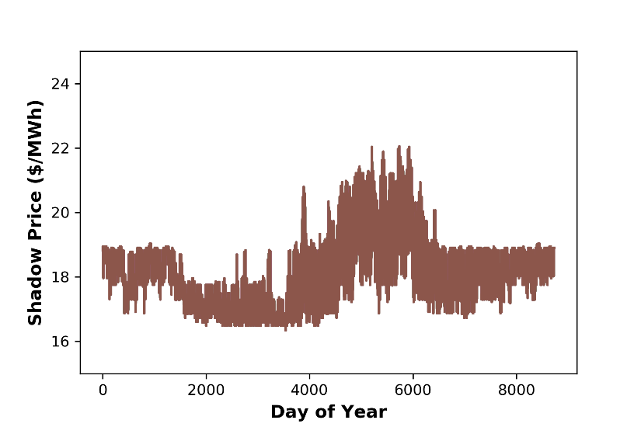
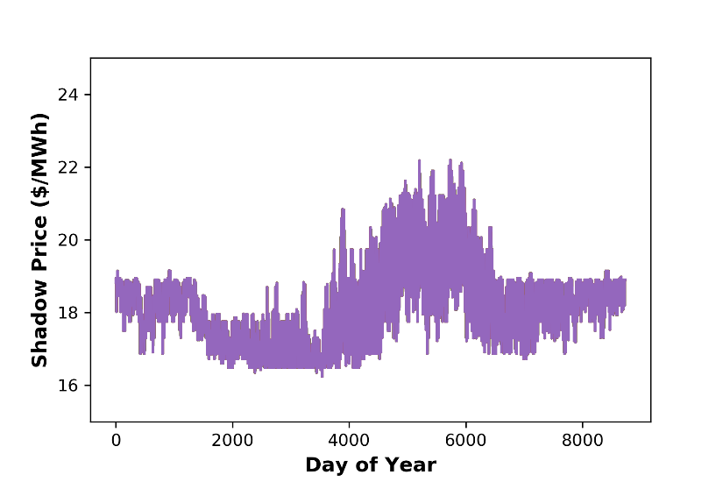
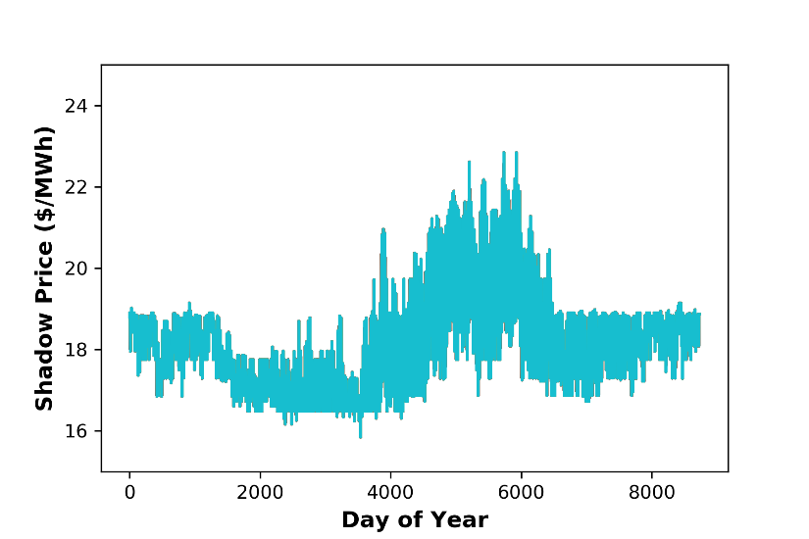
50 Nodes
75 Nodes
100 Nodes
125 Nodes
150 Nodes
Peak summer prices increase at higher node #s
For nodes 75-150, some nodes are triggering slack variables in every hour
Transmission issue?

