Slide 1
WECC

Slide 2
Approach
Pre-processing
All nodes mapped to balancing authority/control area and state
All unique combination of balancing authority/control area and state combinations assigned weight (by load); unrelated to topology assignment, but perhaps useful later in bridging TELL/EIA data with GCAM
Generator nodes are “combined” for each power plant (matched by alphabetical name, balancing authority); node of largest MW unit is chosen to represent all other generators in the same plant
All nodes with non-zero load filtered
All nodes with substations >= 500kV filtered
Assignment - # of generation nodes, demand nodes, and transmission nodes pre-specified by user
For each unique BA/state combination, the node with the maximum load is chosen and placed (63)
Remaining demand nodes are places, in order of decreasing load throughout the interconnection until specified number of demand nodes is reached
Generation nodes (unique from demand nodes) are placed throughout the interconnection in order of decreasing “aggregated” (plant level) capacity until specified number of generation nodes is reached
> 500kV transmission nodes (unique from demand and generation nodes) are are placed throughout the interconnection in order of decreasing load; then >= 500 kV, until specified number of generation nodes is reached

Slide 3
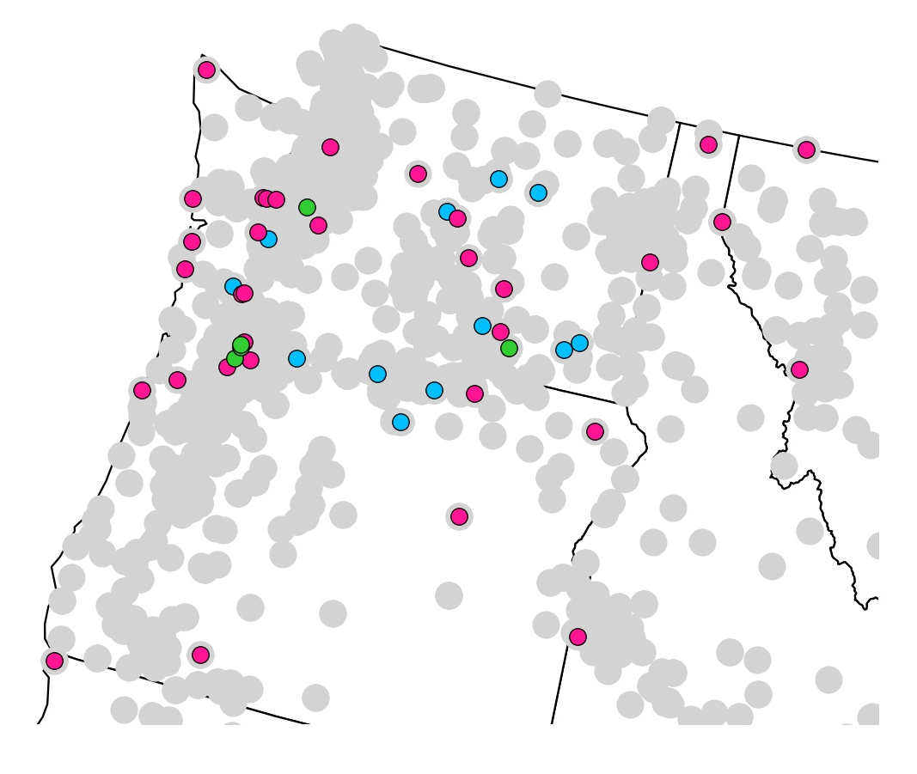
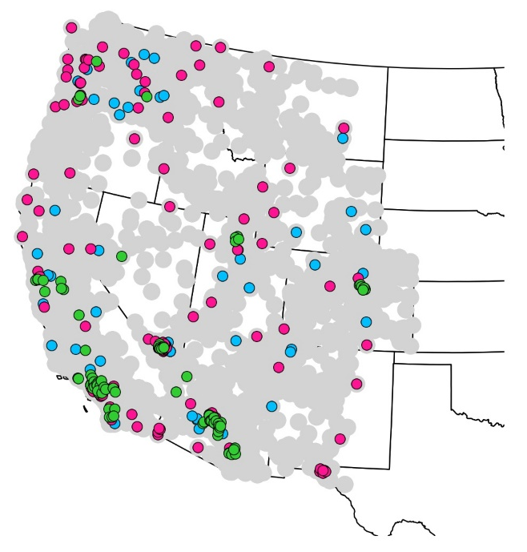
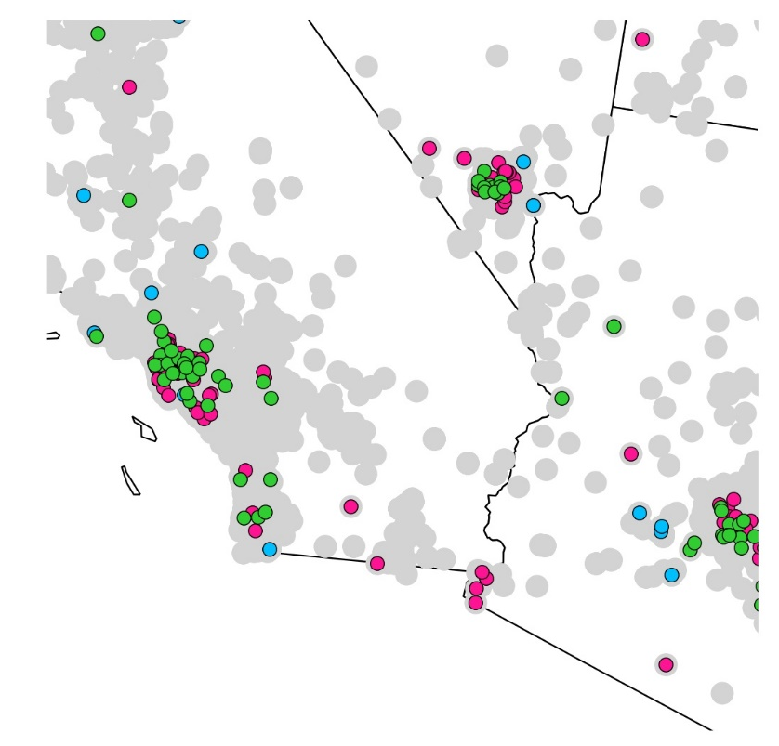
A
300 buses: 50 gen; 150 load; 100 trans
A
B
B

Slide 4
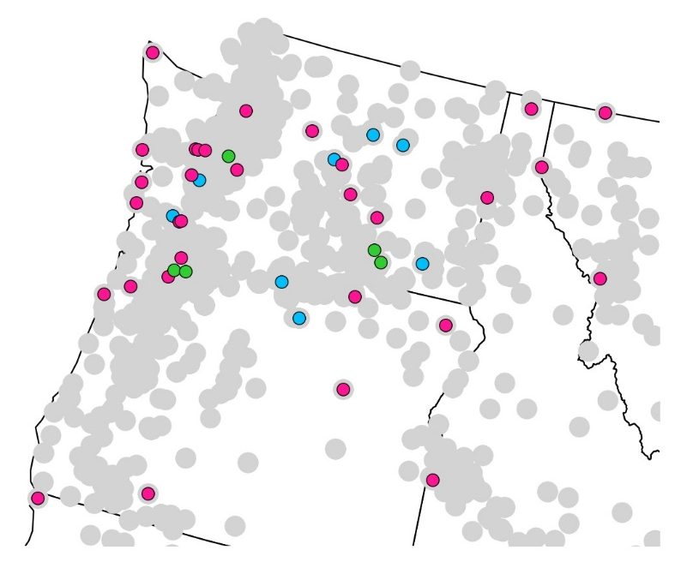
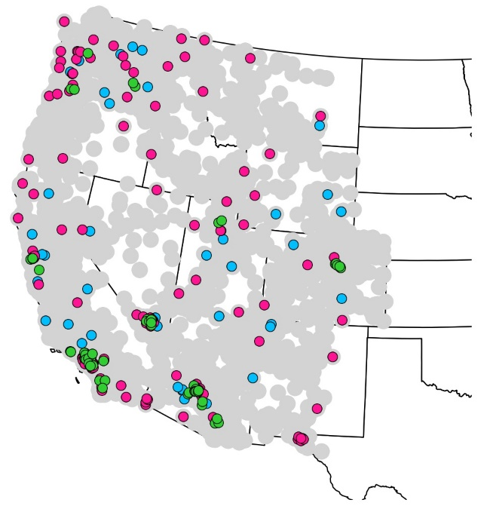
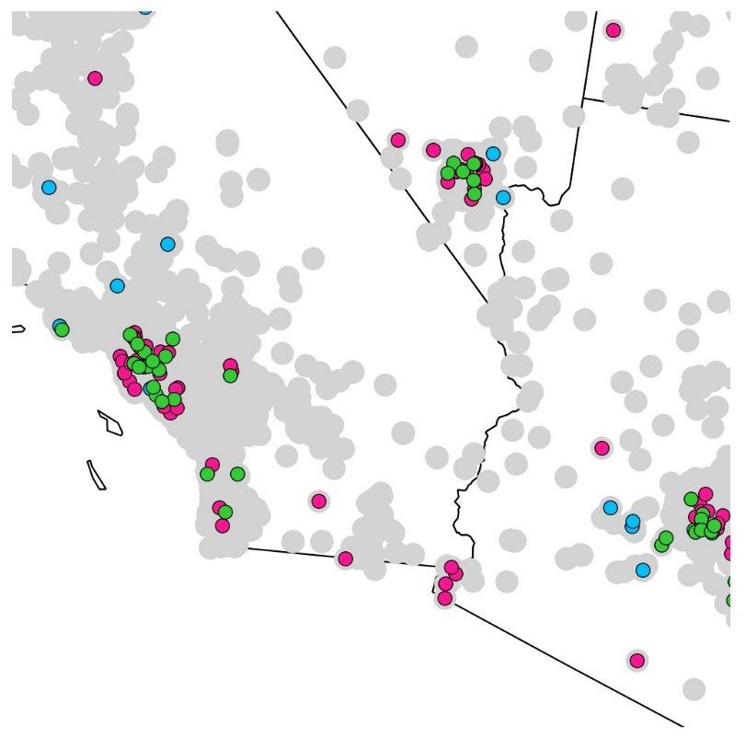
A
240 buses: 43 gen; 139 load; 58 trans
(Same as WECC 240)
A
B
B

Slide 5
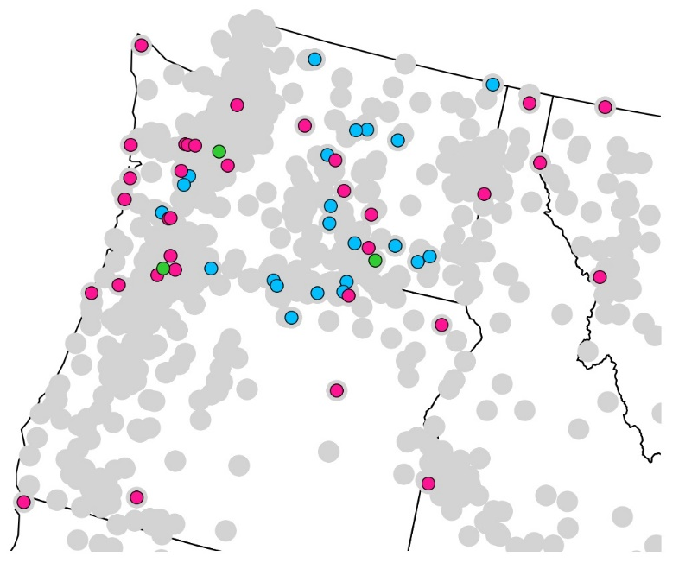
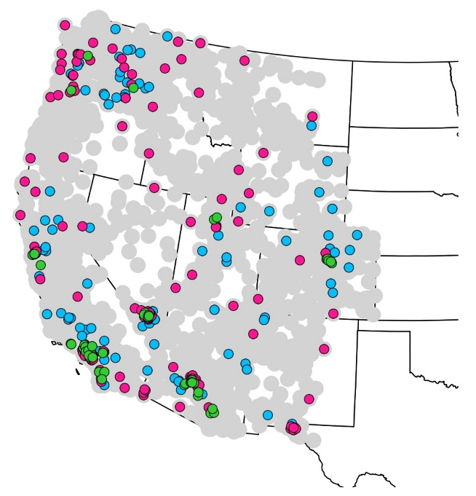
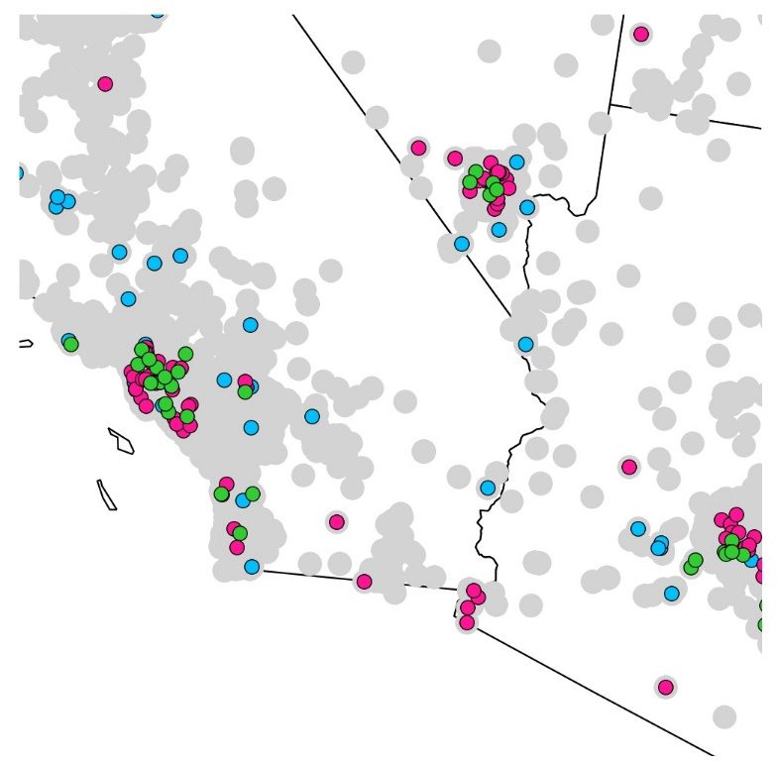
300 buses: 100 gen; 150 load; 50 trans
A
A
B
B
LA, Vegas, Phoenix

Slide 6
ERCOT

Slide 7
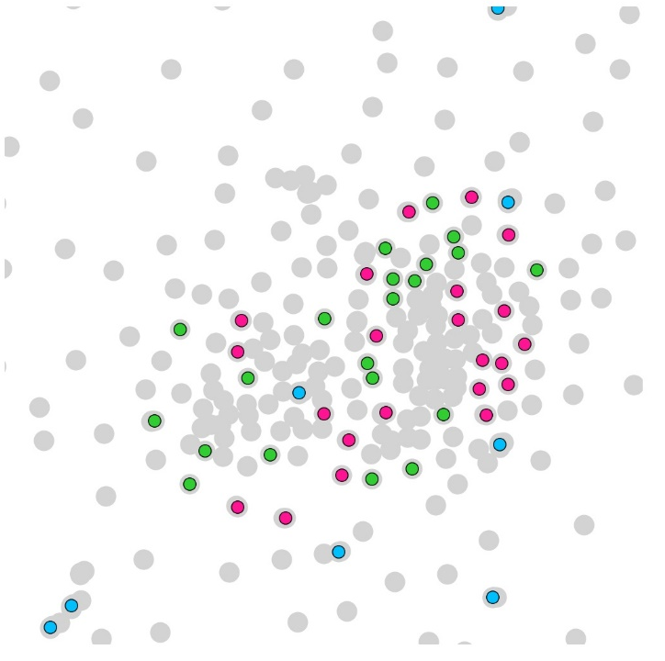
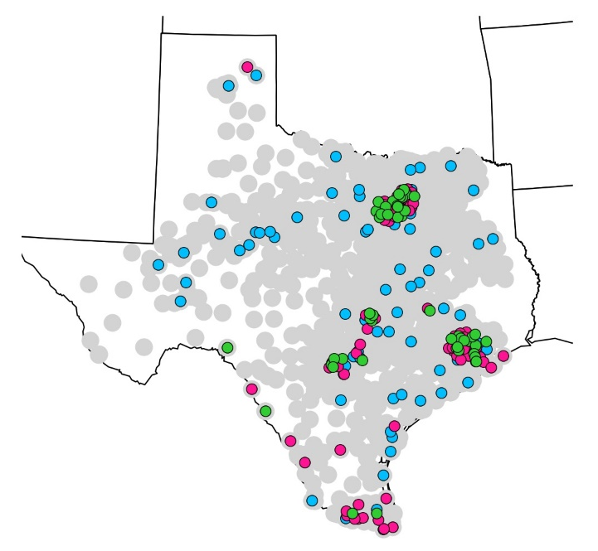
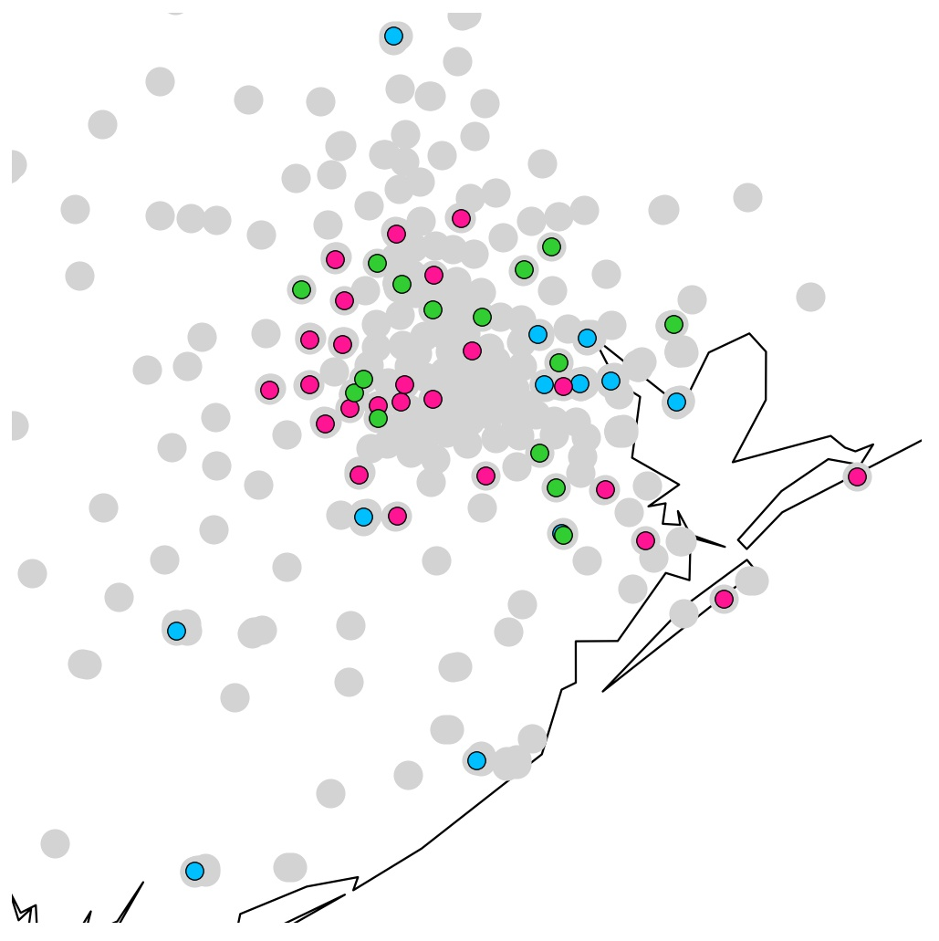
200 buses: 75 gen; 75 load; 50 trans
A
A
Dallas
Houston
B
B

Slide 8
EIC

Slide 9
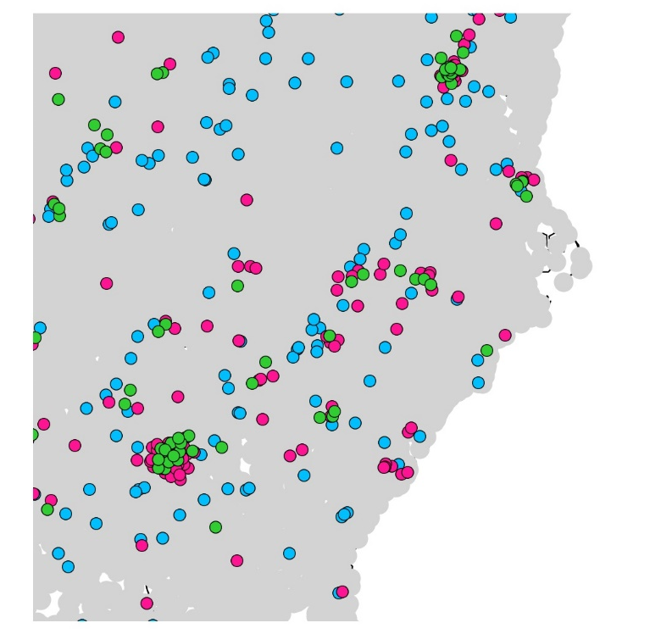
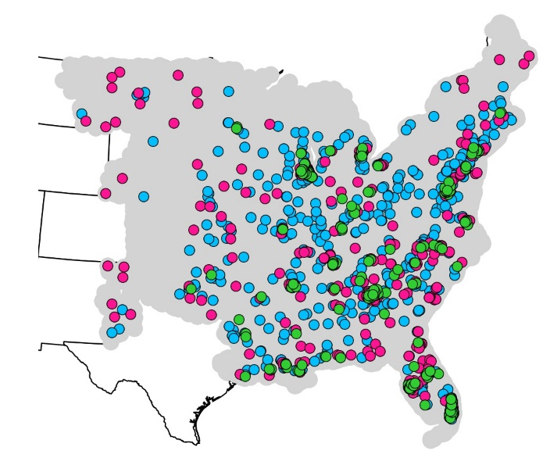
1000 buses: 400 gen; 400 load; 200 trans
A
A
DC, RTP, Atlanta

