Slide 1



Mountains to sea model (M2S): README
Luis Prieto

Slide 2
Instructions for running it in your PC
Open the file MTSDataSetup.py
There is a folder line looking at the folder where you stored the main inputs to the model, change it to match with the directory that you are working on
folder = '/home/lprieto/Research/M2S_line_outages/Inputs/’
Replace the values of outage data, solar-power and hourly load.
Save the file and run it!
You should see an output file with the name: MTS_data.dat
Open the file wrapper.py
Change the folder_2 line to where you want to store the outputs of the model.
Select the days of simulation, test it with 2 or 3 days: days = 3
Select your solver, the model can work with: gurobi, cplex and glpk (not tested)
Run the file and look for the outputs.

Slide 3
Instructions for using the cluster
Download MobaXterm, to run a virtual machine – Linux base
Login in henry2 : Use the command, ssh lprieto@login.hpc.ncsu.edu
Choose the authentication method.
Group folder: cd /share/infews
Create a new directory: mkdir
For running a code:
Initialize the conda environment (before even thinking on running anything)
module load conda
conda init tcsh
[log out then back in again]

Slide 4
Instructions for using the cluster
For running a code:
Create a .condarc file, this txt file should be made inside the linux environment, this is super important.
Inside the .condarc file, using the edit command I, fill with the following:
pkgs_dirs:
- /share/infews/lprieto/conda/pkgs
For saving this file, press Esc, then use the command: :wq
Check if the format from the submit_job.csh is in a DOS format, by doing:
dos2unix submit_job-copy.csh
Executable: open it using the 'vi' editor/command in Linux, change to 'edit' model by pressing 'i', and then changing the file name to be executed from wrapper.py to MTSDataSetup.py. Save by pressing Esc, then :wq and Enter.

Slide 5
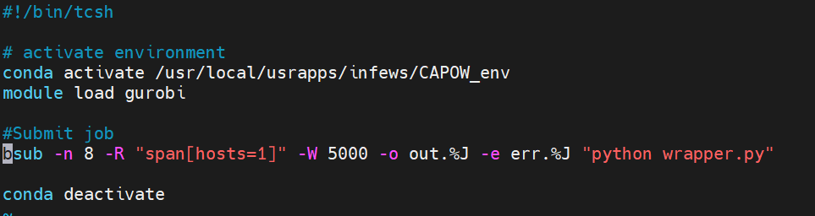
For running a code:
Delete the source line in submit_job.csh, so you can have something like this at the end::
Change the environment to group_env
To run the file on the cluster, first save the file as an executable using this command: chmod +x submit_job.csh
If you look in the file contents, you'll see that it's now green, indicating that it is an executable.
To run the file, at the command line do this: ./submit_job.csh and press enter.
If you type 'bjobs' on the command line, it will list the jobs that are running on the cluster. When it says 'No unfinished job', that either means there was an error, or the job is finished. If there was an error, the details are in the numbered error files, where the number = the ID of the job on the cluster.
This will create the .dat file. Then you need to change the file name back to wrapper.py, save, and run the submit_job.csh file again to run the actual model.

Slide 6
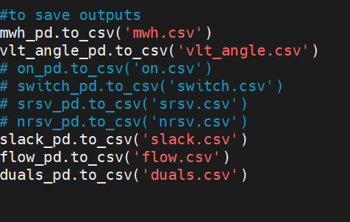
Outputs
Look for this files:

Slide 7
Thank you.
Luis Miguel Prieto Miranda
lprieto@ncsu.edu
North Carolina State University

