Slide 1
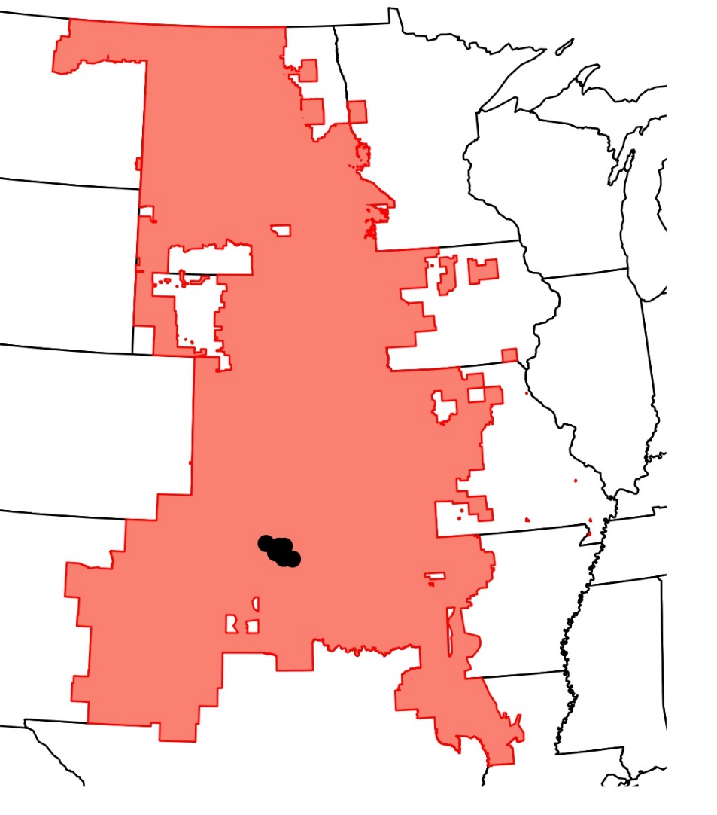
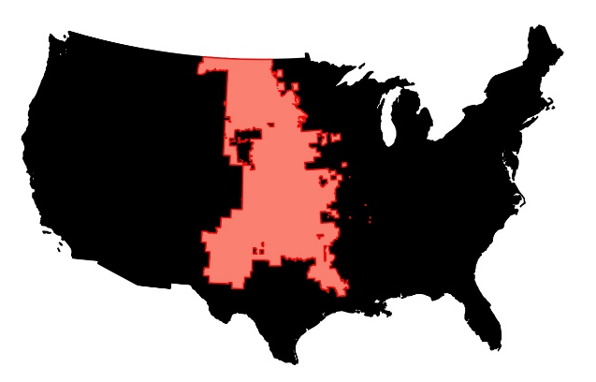

LMP Nodes
Gauge
Airport
9
10
7
6
5
3-4
8
1-2

