Slide 1
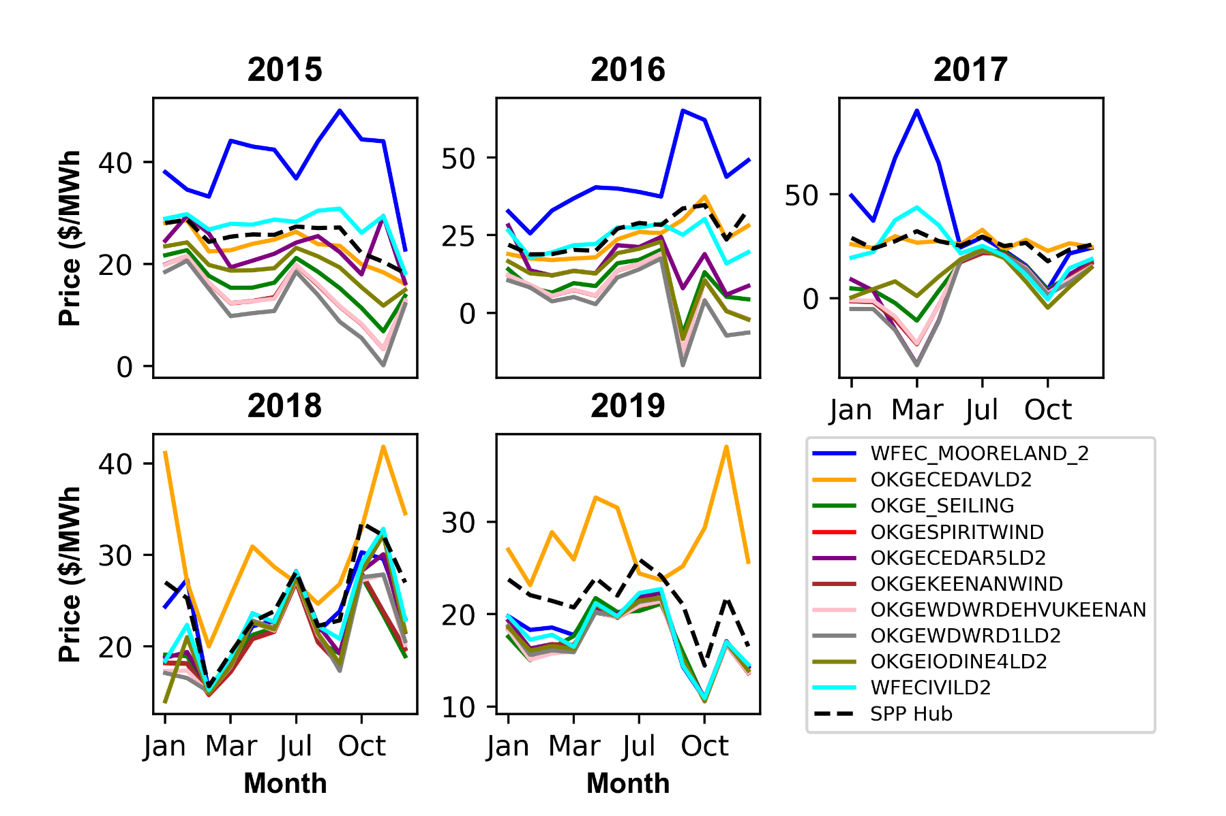
Figure 3

Slide 2
Table A1 (Appendix)
 | SPP Hub | WFEC-VICILD2 | OKGE-IODINE4LD2 | OKGE-WDWRD1LD2 | OKGE-WDWRDEHVUN KEENAN_WIND | OKGE-KEENAN WIND | OKGE-CEDAR 5LD2 | OKGE-SPIRIT WIND | OKGE-SEILING | OKGE-CEDAVLD2 | WFEC_ MOORELAND_2
SPP Hub | 1.000
WFECVICILD2 | 0.695 | 1.000
OKGEIODINE4LD2 | 0.610 | 0.837 | 1.000
OKGEWDWRD1LD2 | 0.491 | 0.614 | 0.907 | 1.000
OKGEWDWRDEHVUN KEENAN_WIND | 0.545 | 0.688 | 0.940 | 0.992 | 1.000
OKGEKEENANWIND | 0.666 | 0.465 | 0.742 | 0.826 | 0.818 | 1.000
OKGECEDAR5LD2 | 0.605 | 0.811 | 0.889 | 0.861 | 0.887 | 0.688 | 1.000
OKGESPIRITWIND | 0.665 | 0.465 | 0.743 | 0.827 | 0.819 | 0.999 | 0.688 | 1.000
OKGE_SEILING | 0.745 | 0.543 | 0.755 | 0.795 | 0.803 | 0.981 | 0.712 | 0.980 | 1.000
OKGECEDAVLD2 | 0.642 | 0.766 | 0.760 | 0.681 | 0.732 | 0.496 | 0.732 | 0.497 | 0.537 | 1.000
WFEC_MOORELAND_2 | 0.670 | 0.662 | 0.272 | -0.024 | 0.066 | 0.080 | 0.303 | 0.079 | 0.217 | 0.369 | 1.000

Slide 3
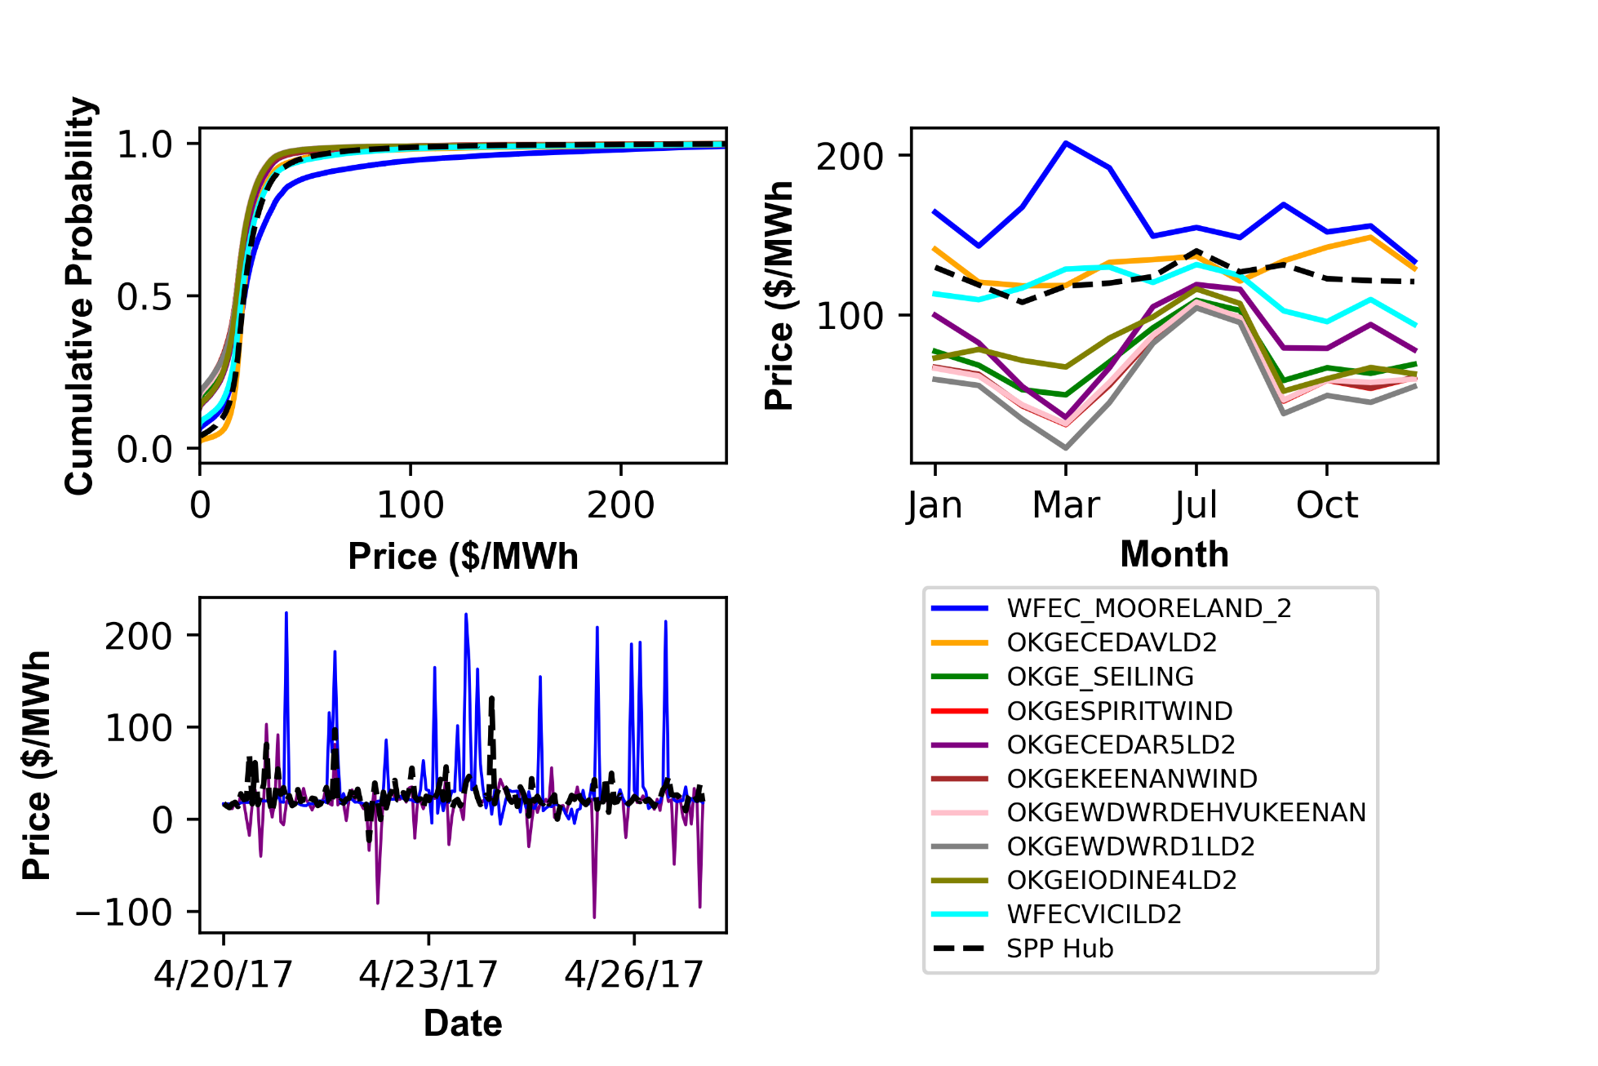
Figure 4
b
a
c

Slide 4
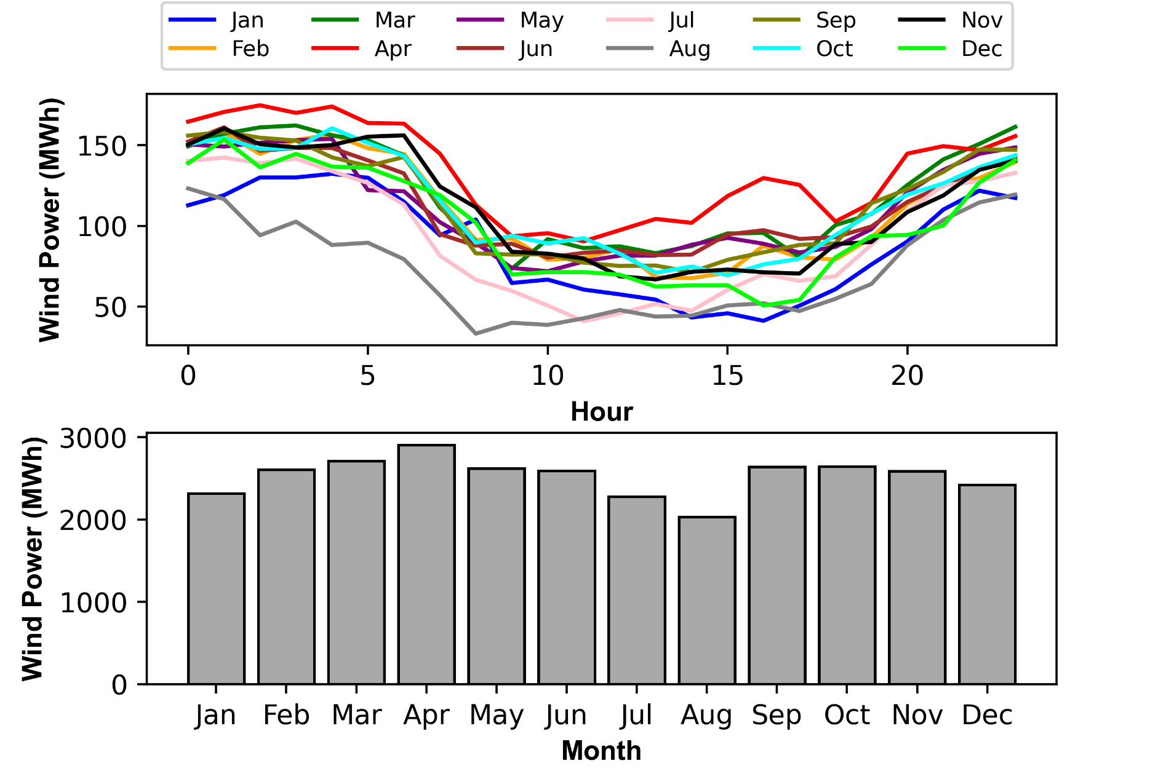
Figure 5
a
b

Slide 5
Figure 6

Slide 6
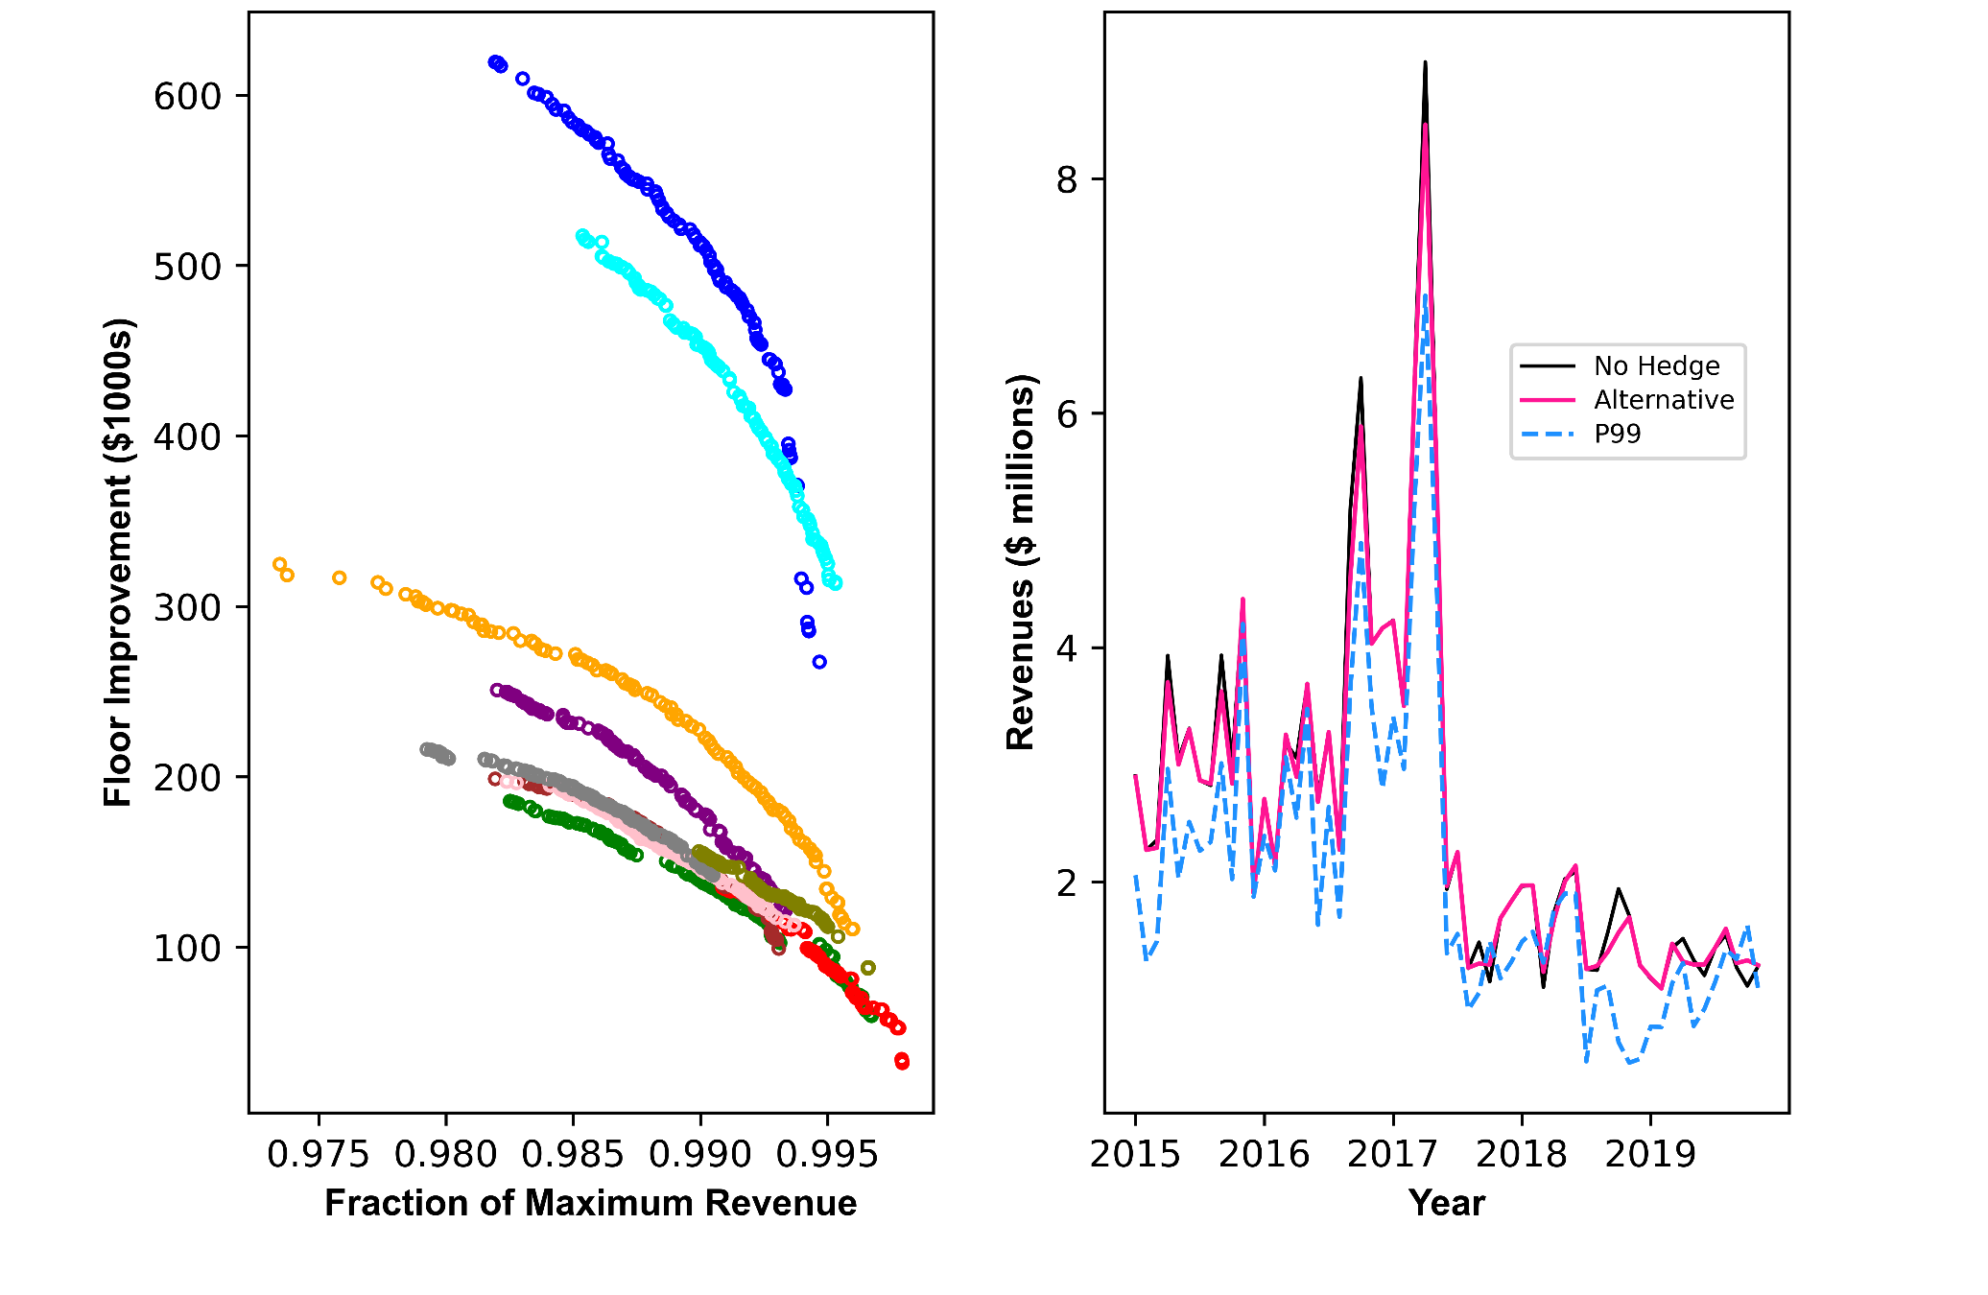
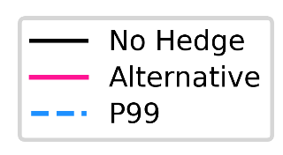

Figure 7
a
b

Slide 7
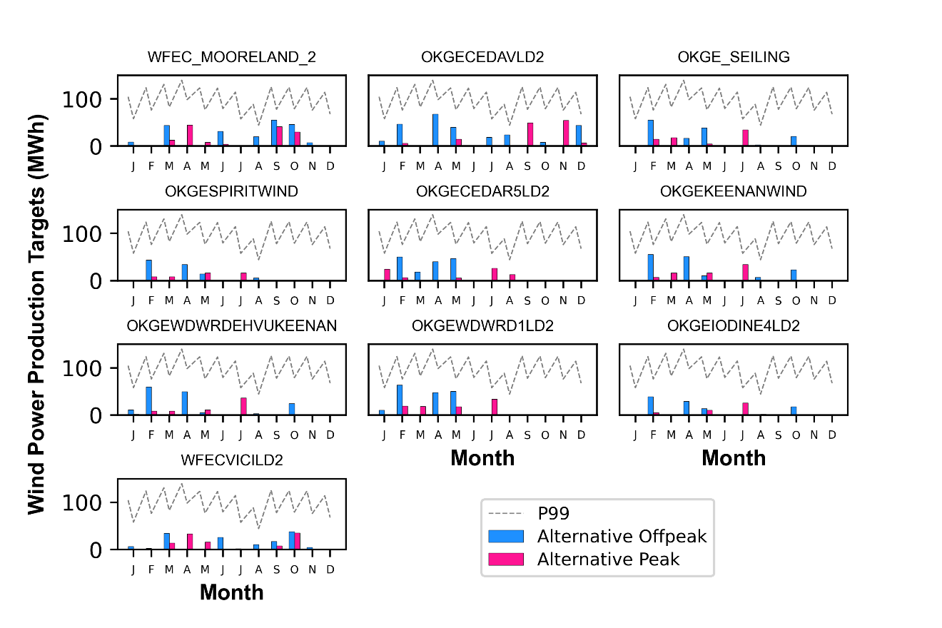
Figure 8

Slide 8
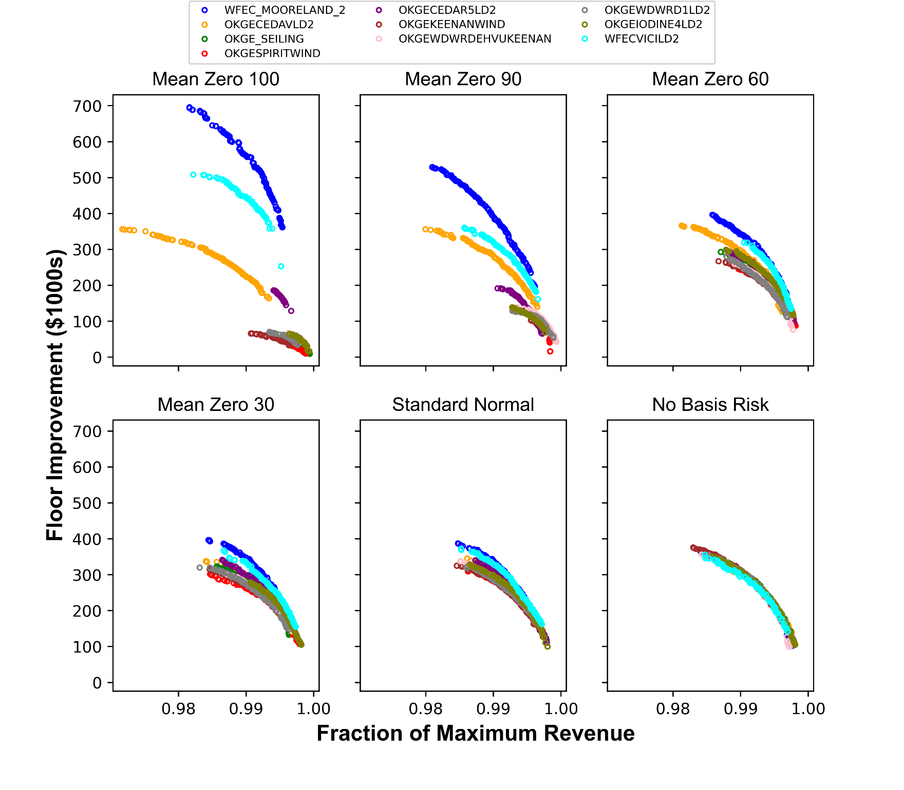

Figure 9

Slide 9
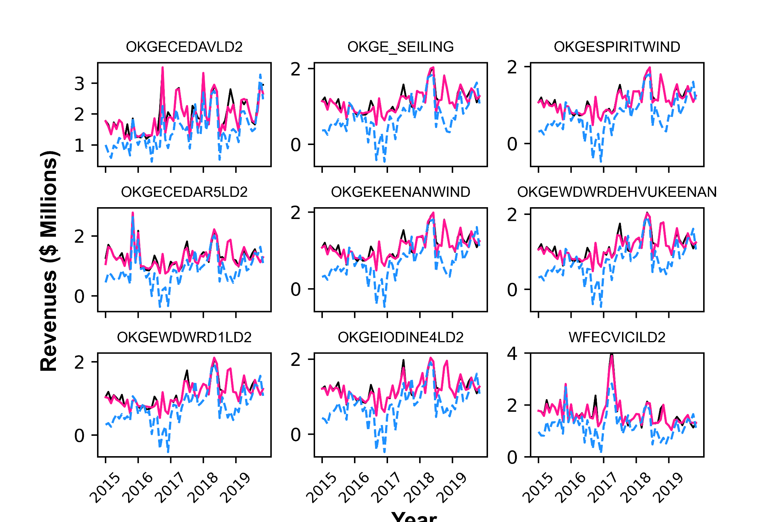
Figure A1 (Appendix)
Year

Slide 10
Figure A2 (Appendix)

Slide 11
Figure A3 (Appendix)

Slide 12
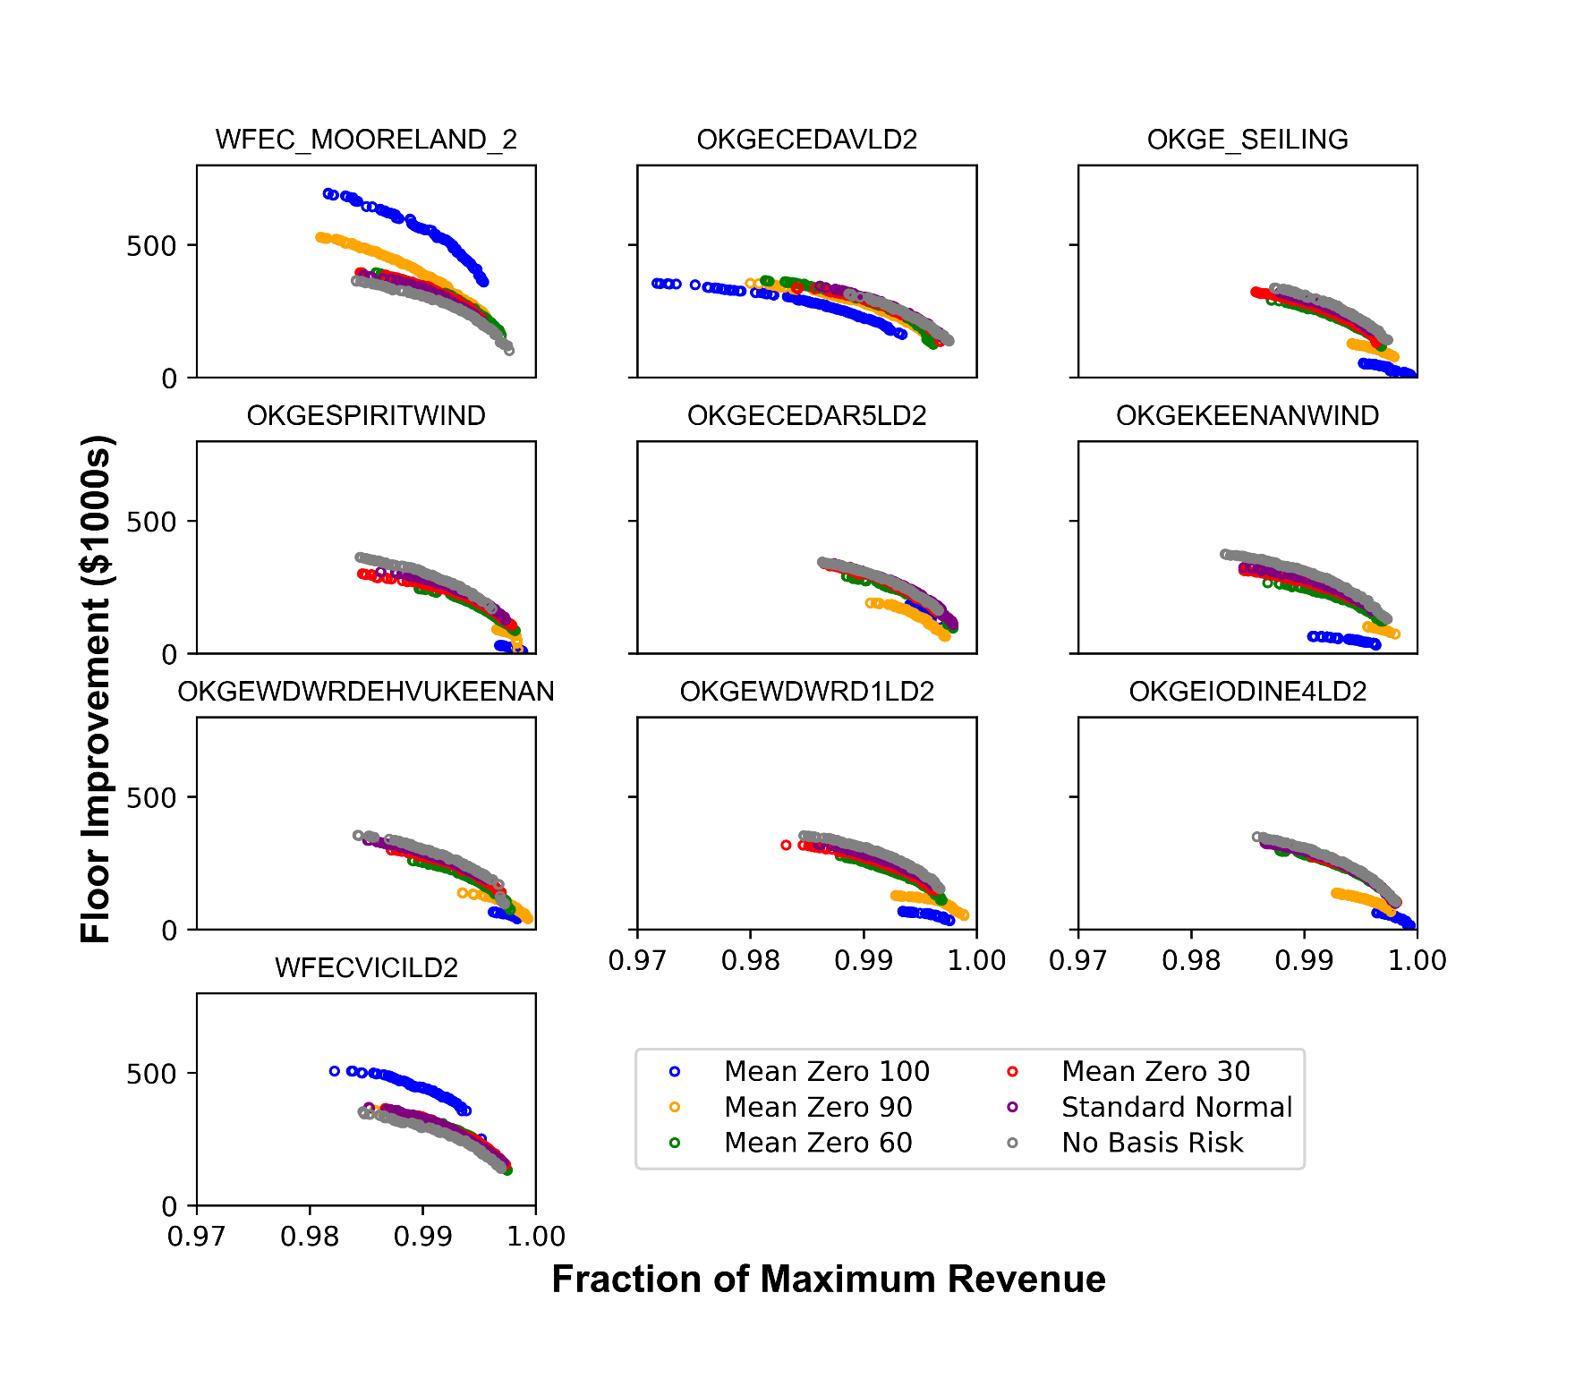
Figure A4 (Appendix)

