Slide 1

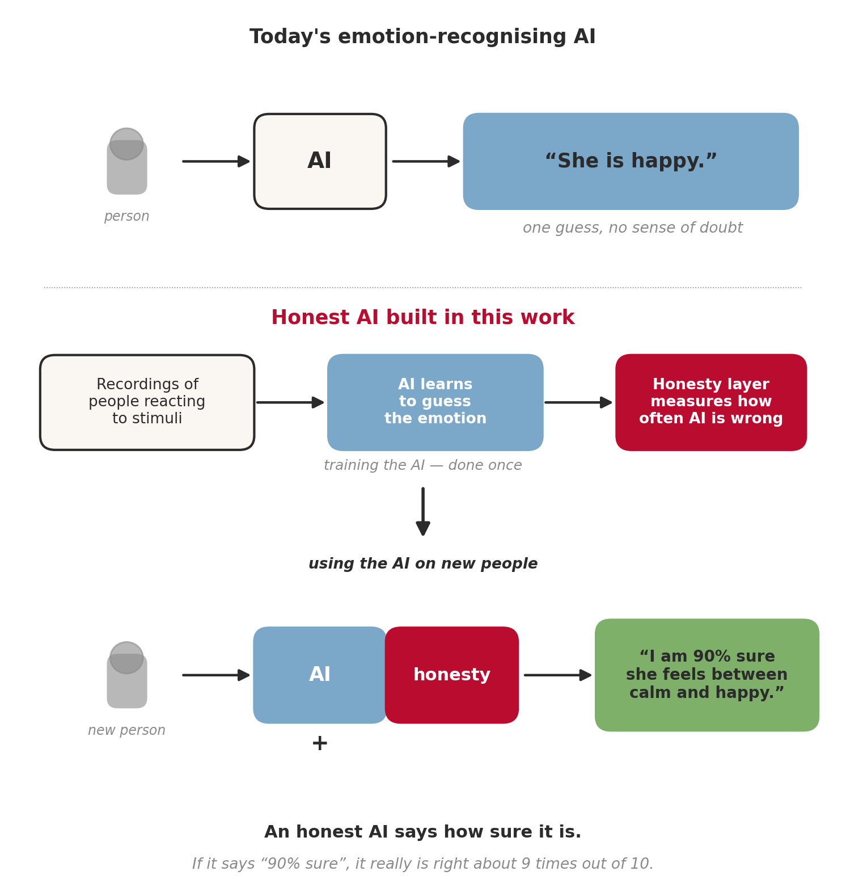
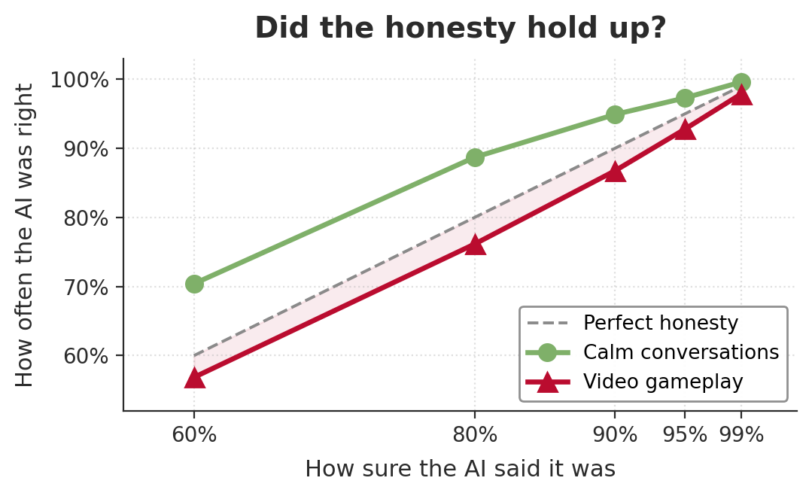
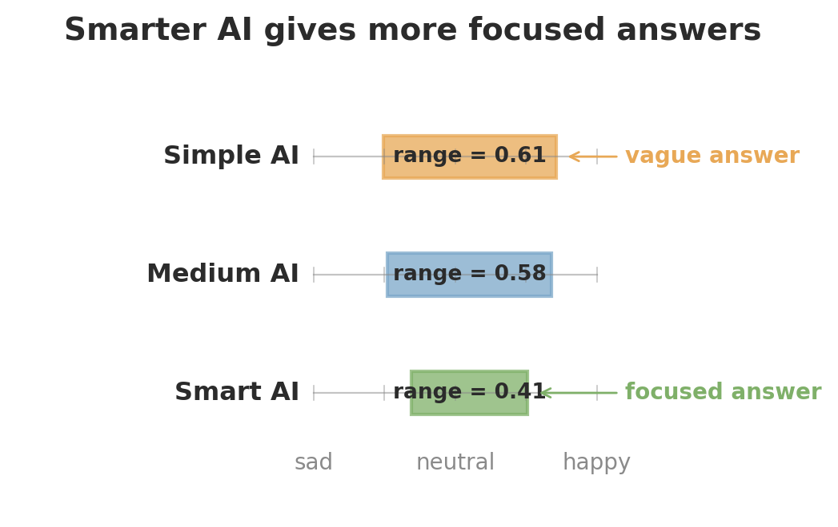
B.Sc. IT (Hons.)
Artificial Intelligence
Quantifying Uncertainty in Affect Modelling
Roman Vasilets
Supervisor: Dr Konstantinos Makantasis
May 2026
INTRODUCTION
Can a computer tell how you feel from your voice or your face? This question lies at the heart of affective computing — the field of building machines that can recognise human emotion. Emotion-aware AI promises kinder mental-health tools, more responsive video games, and more sensitive everyday technology. But there is a problem. Emotions are subjective. Even two people watching the same video often disagree about how the speaker feels. Today's AI ignores that uncertainty — it always gives a single, confident answer, even when it really should not. This makes emotion-aware AI risky to trust in the real world.
ARCHITECTURE DESIGN
AIM
Aim: build emotion-recognising AI that does not just guess, but knows when it isn't sure — and how sure it really should be. How we did it: 1. Gather real emotional data — calm conversations and lively gameplay. 2. Build three AI models, from simple to clever. 3. Add an “honesty layer” called Conformal Prediction. 4. Test whether the AI's confidence matches reality.
METHODOLOGY
1. Gather data recordings of calm conversations and lively video gameplay
2. Build the AI three models of increasing intelligence
3. Add honesty teach each AI to say how sure it is
4. Test it does “90% sure” really mean right 9 times out of 10?
RESULTS
Calm conversations The AI was honest about its confidence. Video gameplay Slightly overconfident, still useful. Smarter AI, sharper answers Cleverer models gave tighter ranges.
CONCLUSIONS AND FUTURE WORK
This project shows it is possible to build emotion-recognising AI that knows when it isn't sure — and that this honesty can be added on top of any existing AI without retraining it. The result is a system far more trustworthy in real applications, from mental-health support to game design to assistive technology. What worked: the honesty held up almost perfectly on calm laboratory recordings, and was only slightly optimistic on fast-moving gameplay. Next steps: close the gameplay gap, extend the method to facial expression alongside voice, and bring it to live, real-time settings. All the code is released openly so others can build on this work.
REFERENCES
[1] Ringeval et al., “RECOLA: a multimodal corpus of remote collaborative and affective interactions”, 2013. [2] Melhart, Liapis & Yannakakis, “The AGAIN video game annotation dataset”, IEEE Trans. Affective Computing, 2022. [3] Shafer & Vovk, “A tutorial on conformal prediction”, Journal of Machine Learning Research, 2008. [4] Boström, “Conformal prediction in Python with crepes”, Proc. Machine Learning Research, 2024.

