Slide 1

Binary Search
A Pythonic Way to Intelligently Speed Up Searching
Presented by Ross White

Slide 2
How does a normal search work?
“Adam”
“Beth”
“Chris”
“Colleen”
“Dave”
Notes:
Imagine you have a list of alphabetized names, it doesn't have to be names, but for our example we'll talk about a list of names.

Slide 3
How does a normal search work?
“Adam”
“Beth”
“Chris”
“Colleen”
“Dave”
Search returns quickly if name appears early.
What if the name you’re looking for is last?
Notes:
When searching for a name in this list, the computer will examine the first name, then the second, the third and so on.

Slide 4
How does a normal search work?
“Adam”
“Beth”
“Chris”
“Colleen”
“Dave”
Search returns quickly if name appears early.
What if the name you’re looking for is last?
Notes:
When searching for a name in this list, the computer will examine the first name, then the second, the third and so on.

Slide 5
How does a normal search work?
“Adam”
“Beth”
“Chris”
“Colleen”
“Dave”
Search returns quickly if name appears early.
What if the name you’re looking for is last?
Notes:
When searching for a name in this list, the computer will examine the first name, then the second, the third and so on.

Slide 6
How does a normal search work?
“Adam”
“Beth”
“Chris”
“Colleen”
“Dave”
Search returns quickly if name appears early.
What if the name you’re looking for is last?
Notes:
When searching for a name in this list, the computer will examine the first name, then the second, the third and so on.

Slide 7
How does a normal search work?
“Adam”
“Beth”
“Chris”
“Colleen”
“Dave”
Search returns quickly if name appears early.
What if the name you’re looking for is last?
Notes:
When searching for a name in this list, the computer will examine the first name, then the second, the third and so on.

Slide 8
How does a normal search work?
“Adam”
“Beth”
“Chris”
“Colleen”
“Dave”
Search returns quickly if name appears early.
What if the name you’re looking for is last?
System examines every name in list before it finds your value
For small lists this may be inconsequential
Notes:
The system will have to examine every name in the list before it finds your value.
For small lists this may be inconsequential to you.

Slide 9
BIG lists
What if you’re not searching a small list?
What if your list of a million or more names?
Notes:
But what if you were searching a list of a million people or more?
The larger your data set grows the longer a search like this will take.
This is something those with an understanding of Big O will understand.

Slide 10
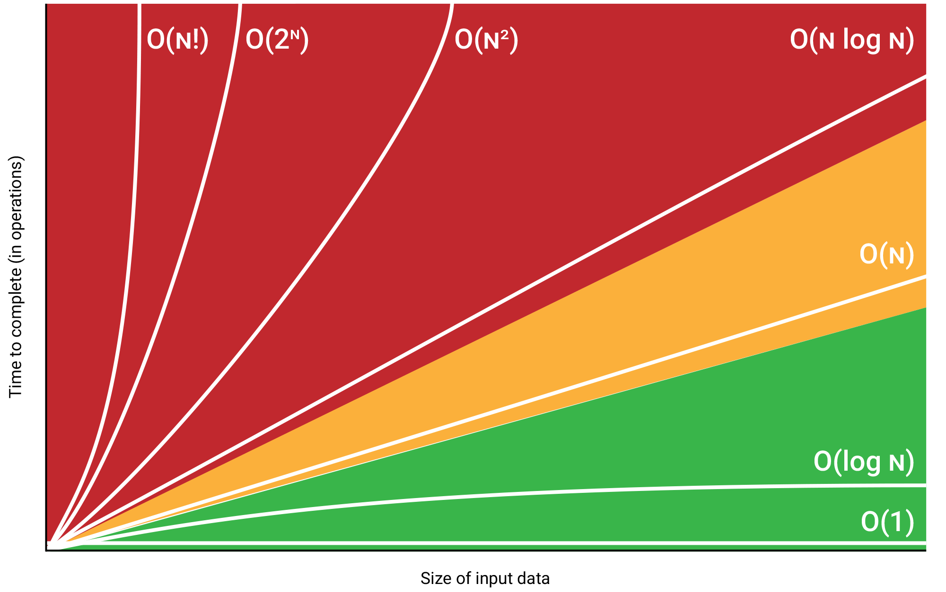
Big O
A mathematical way to express time taken for algorithm to run against increasing data sets.
A simple search = O(n)
Notes:
I won't be covering Big O in detail here but this it is a mathematical way to express the time taken for an algorithm to run against a increasing data sets.
In a simple search, where the search must examine all the elements in a list from start to end, this is a Big O value of O(n).

Slide 11
What is binary search?
Another example…
Number guessing game
Notes:
Another example of a simple search is a number guessing game.

Slide 12
What is binary search?
Another example…
1 : 100
Notes:
If your friend tells you to guess the number they've chosen between 1 and 100 and they will tell you if it is higher or lower than your guess... would you start at 1?

Slide 13
What is binary search?
Another example…
1 : 100
1
Notes:
Unless the number they chose was 1, you’d have only eliminated one number, leaving 99 more.

Slide 14
What is binary search?
Another example…
1 : 100
1
2 : 99
Notes:
Unless the number they chose was 1, you’d have only eliminated one number, leaving 99 more.

Slide 15
What is binary search?
Another example…
1 : 100
1
2 : 99
2
Notes:
If they choose the next number, the process continues.

Slide 16
What is binary search?
Another example…
1 : 100
1
2 : 99
2
3 : 99
Notes:
We’ve still only eliminated one more number.

Slide 17
What is binary search?
Another example…
1 : 100
< 50
> 50
Notes:
By using binary search we halve our possibilities with each step. If we choose 50 as the first guess, we’ll know our guess is either too high or too low and we can eliminate 50 numbers with the first step.

Slide 18
What is binary search?
Another example…
1 : 100
< 50
> 50
< 75
Notes:
By using binary search we halve our possibilities with each step. If we choose 50 as the first guess, we’ll know our guess is either too high or too low and we can eliminate 50 numbers with the first step.

Slide 19
What is binary search?
Another example…
1 : 100
< 50
> 50
< 75
> 75
Notes:
By using binary search we halve our possibilities with each step. If we choose 50 as the first guess, we’ll know our guess is either too high or too low and we can eliminate 50 numbers with the first step.
So binary search is how we eliminate half the possible options with each step. If you extrapolate this to a list of a million numbers, you can see how this would save you time.

Slide 20
Big O
A mathematical way to express time taken for algorithm to run against increasing data sets.
Binary search= O(log n)
Notes:
Returning to Big O, we can see the improvement made by using binary search. Binary search trees have a Big O value of O(log n).

Slide 21
How can you use binary search in Python?

Slide 22
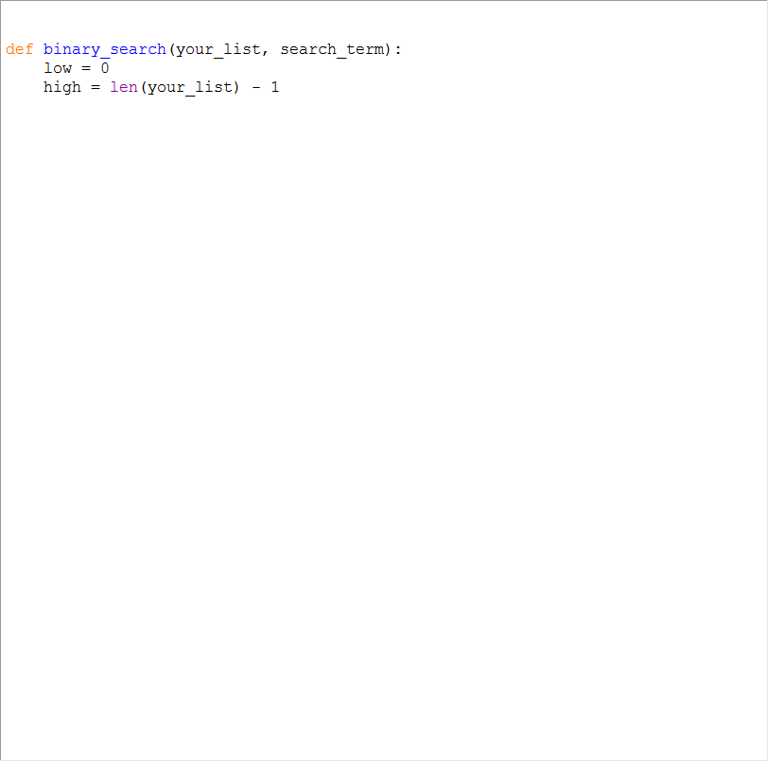
Notes:
Create a function we can pass any sorted list into, along with the item we’re searching for.
Low = 0 is our variable for keeping track of the bottom of our range
High = len(your_list) – 1 is our variable for tracking the top of our range, we’ll update these as the script runs

Slide 23
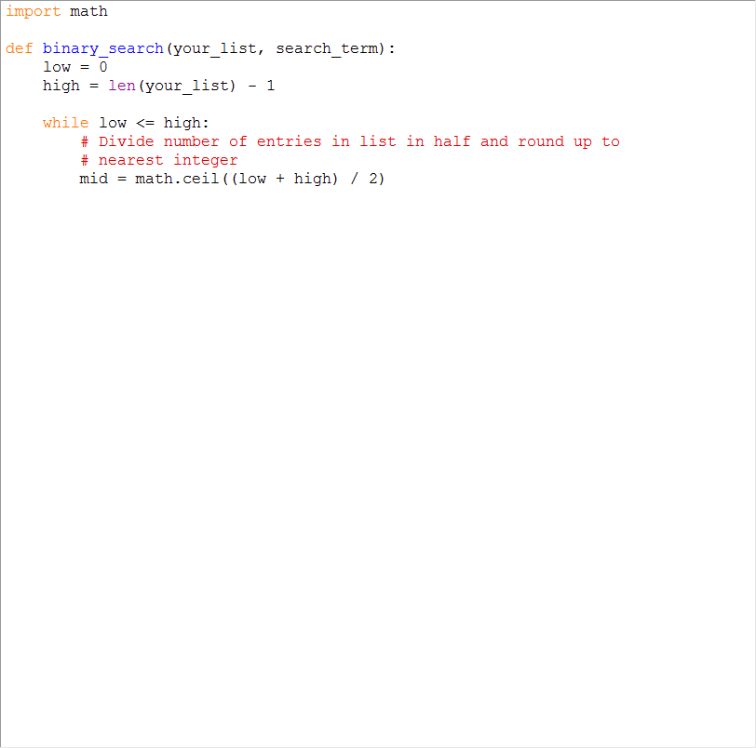
Notes:
Now I’m creating a while loop.
The first step in the while loop is to find the middle of the list. So we add the low index 0 and the index of the last item in the list and divide by 2.
Because this is Python 3 rounding isn’t automatic so I’ve imported the math module and am using math.ceil to round up for lists with odd numbers of elements.

Slide 24
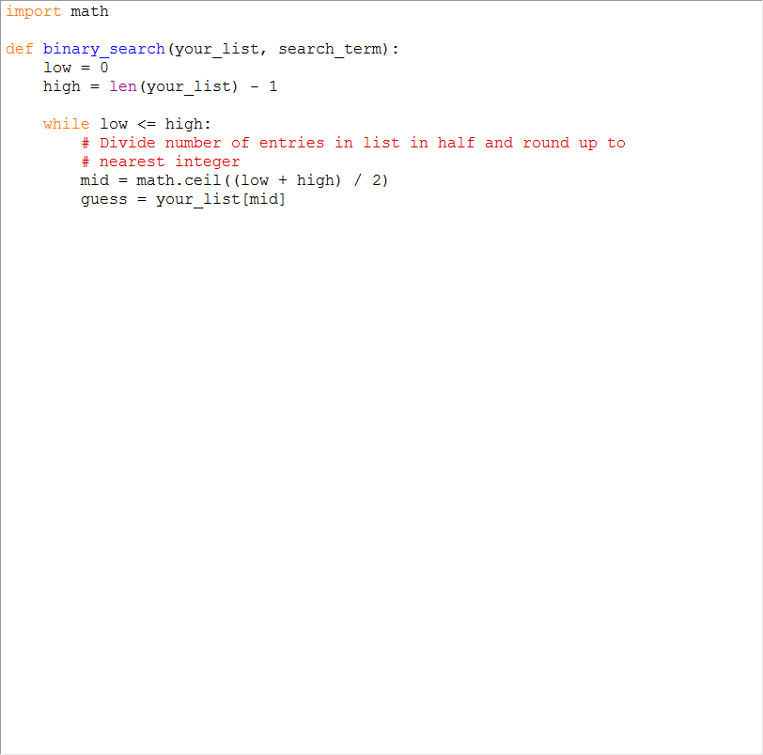
Notes:
Now I add a variable to get the value of the element at the position of our mid variable in the list.

Slide 25
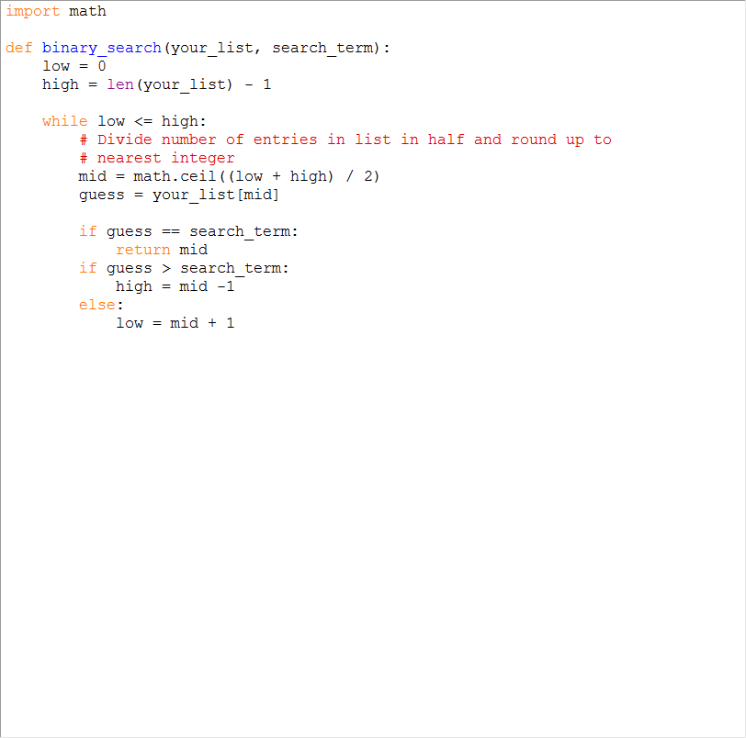
Notes:
Next we check if the guess value equals the item we’re searching for. If it does, we return that value.
If not, we update the high or low value depending on whether our guess was too low or too high.

Slide 26
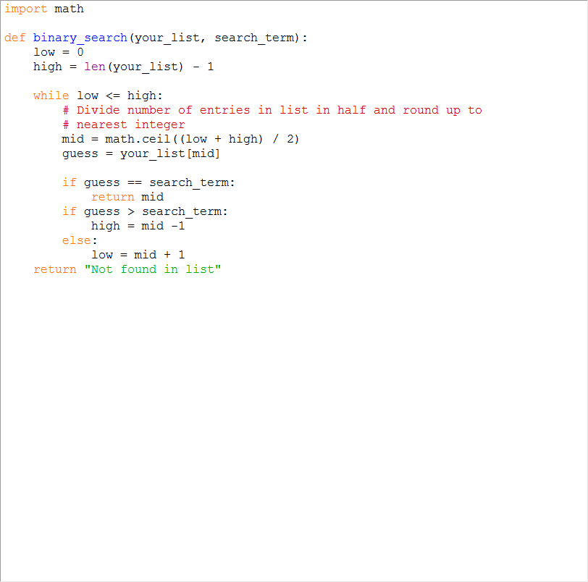
Notes:
Finally, if the value we’re looking for isn’t found, our function will return the string “Not found in list”

Slide 27
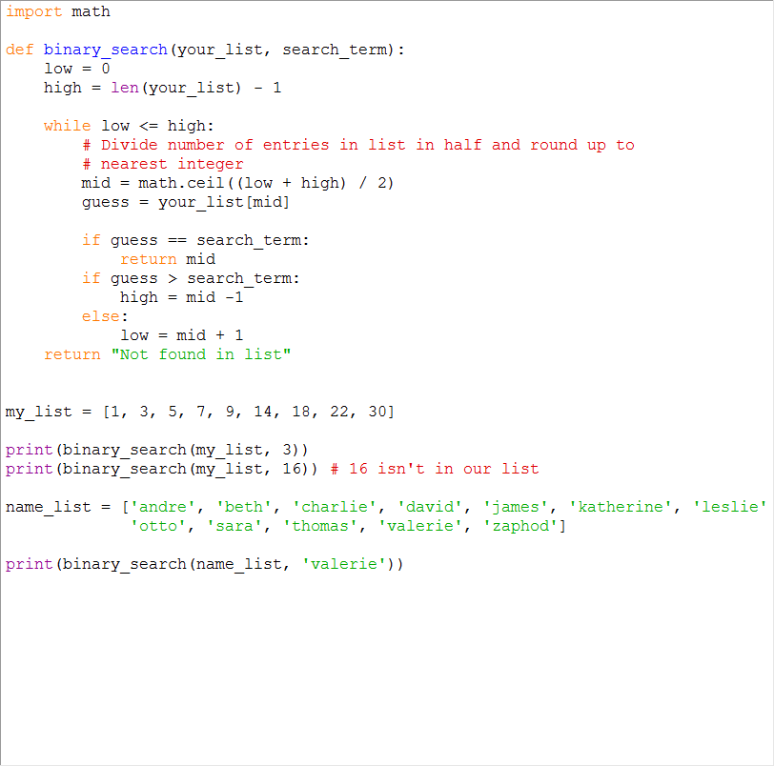
Notes:
At the bottom I’ve added a list of numbers and list of names
Then test the function by searching for a number in the list, a number not in the list, and then a name in the name list.

Slide 28
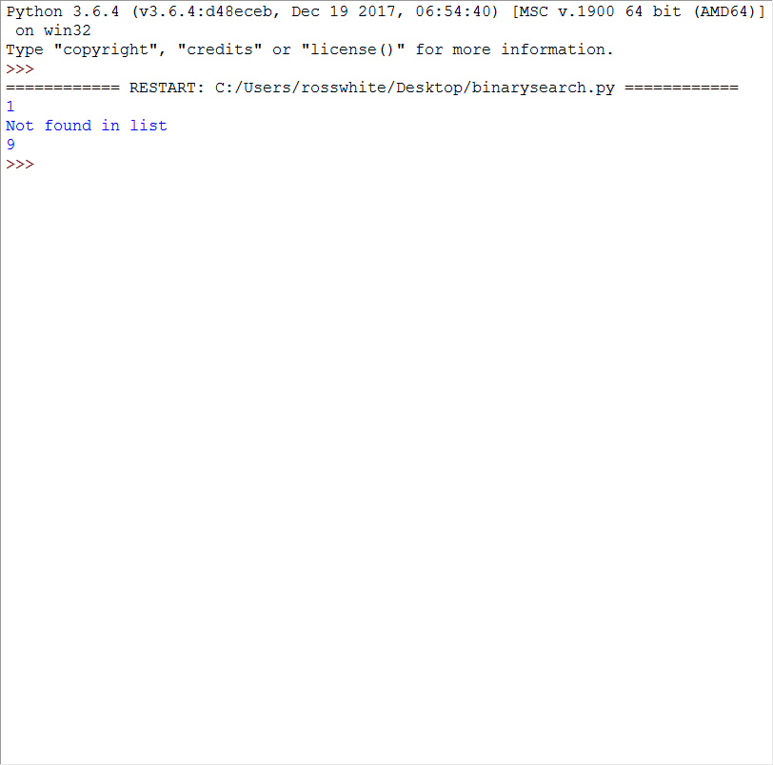
Notes:
This is what the output of the tests at the end look like.
This algorithm will return the index of the item we searched for. But once you have the index it is easy to perform operations on that index in the list.

Slide 29


Thank you
https://github.com/romwhite
@askrosswhite
Notes:
Remember that binary search only works on sorted lists. There are also algorithms which will speed up sorting large lists, which aren’t covered here.

