Slide 1

Financial Market Time Series Prediction with Recurrent Neural Networks
Name : WANDJI ROMUALD ESDRAS
ID : 21708255
esdraswandji@gmail.com

Slide 2
Overview
The task of Forecasting in financial market has always been an idyllic research topic for scholars researchers from various academic fields.
Our goal in this study is to look at an interesting approach to teach the computer to generate new stock price given a set of stock price in the past recorded sequentially.

Slide 3
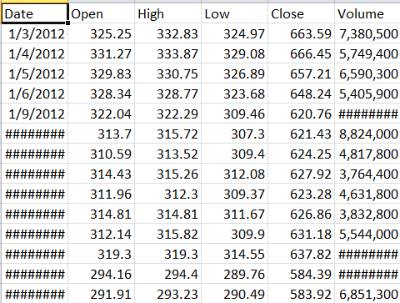
Data
Our algorithm has been trained on the entire Google Stock price of 1280 observations, each over a millisecond each

Slide 4
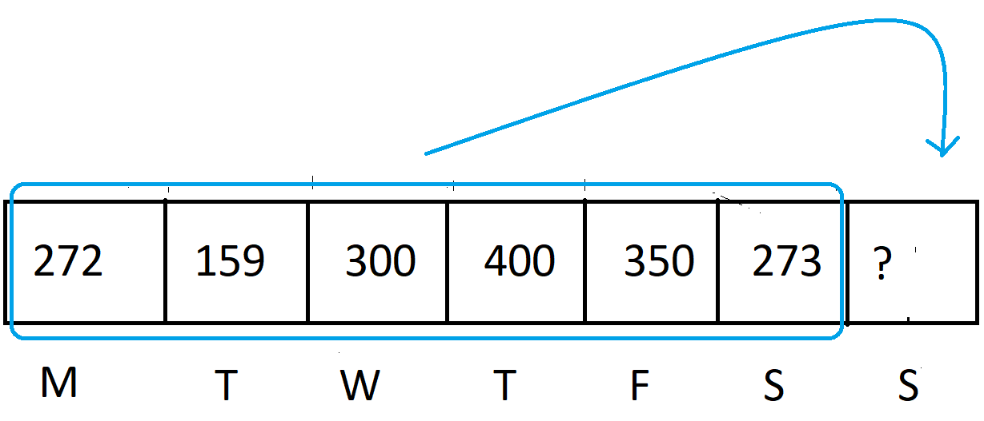
Task
The learning task here involves predicting new stock price according to a sequence of Stock price already present in the data.

Slide 5
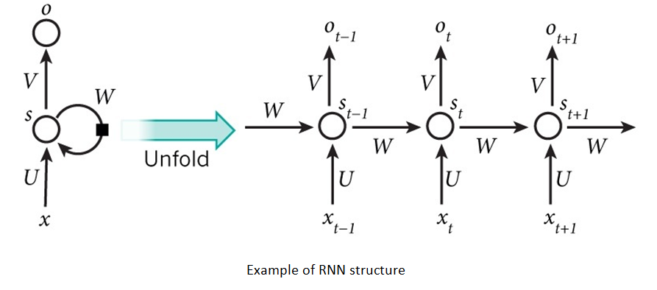
Model
Using the features described above, we implemented RNN and LSTM. These were implemented in Python using the scikit-learn and Keras packages.

Slide 6
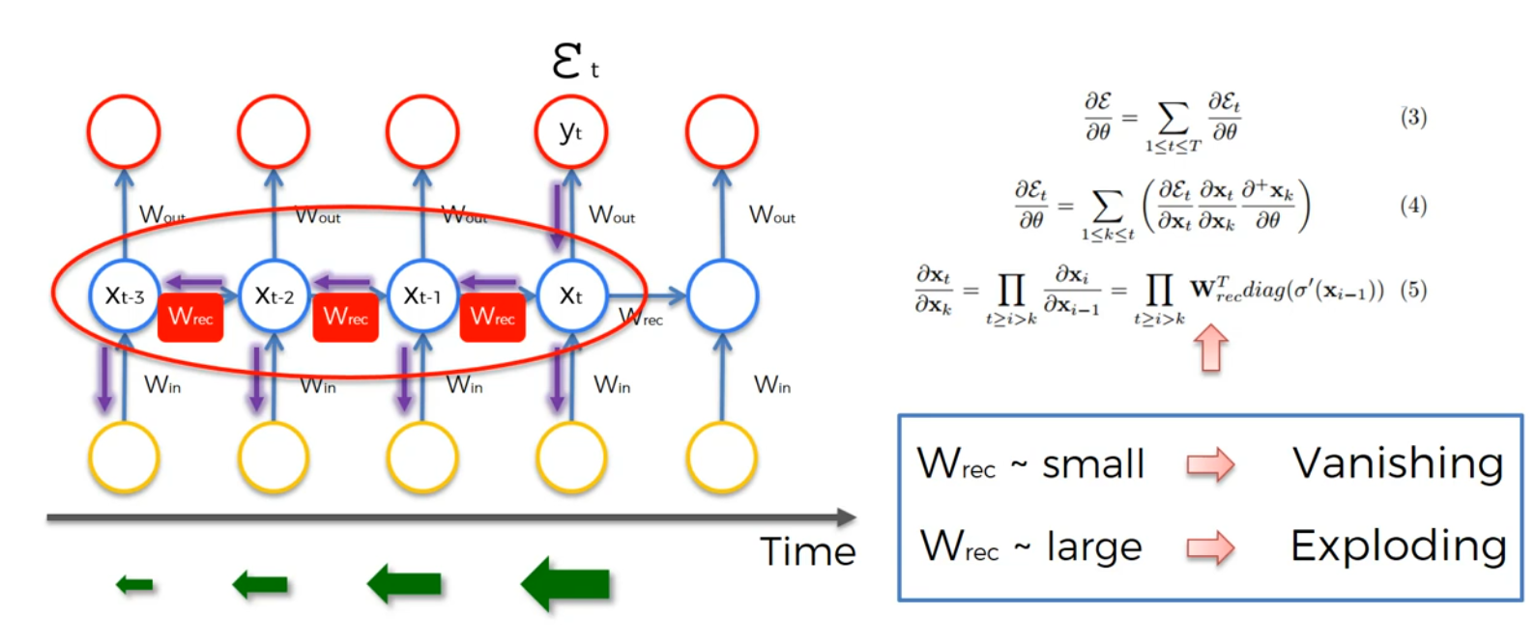
Vanishing (exploding) Gradient Descent
Using RNN can often lead to some issues during the learning process witch are the problem of vanishing of exploding gradient descent

Slide 7
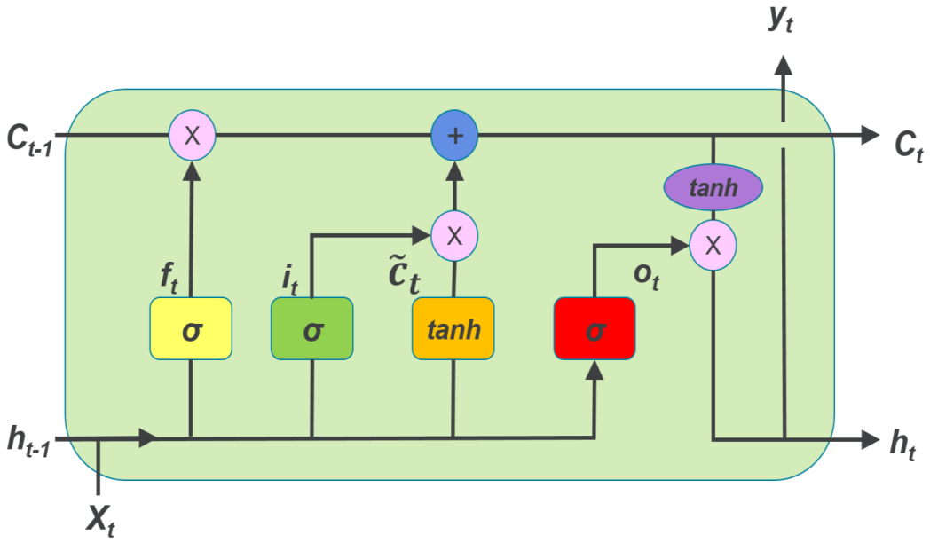
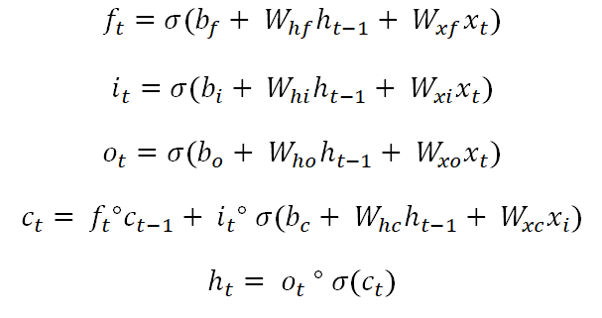
LSTM
The main purpose of LSTM is to solve the problem of vanishing gradient descent.

Slide 8
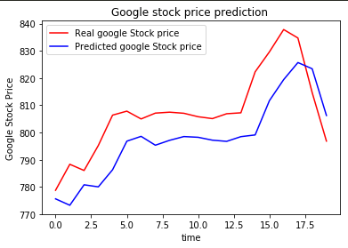
Result
For the configuration with 60 timesteps and 4 LSTM, we have the following figure :

Slide 9
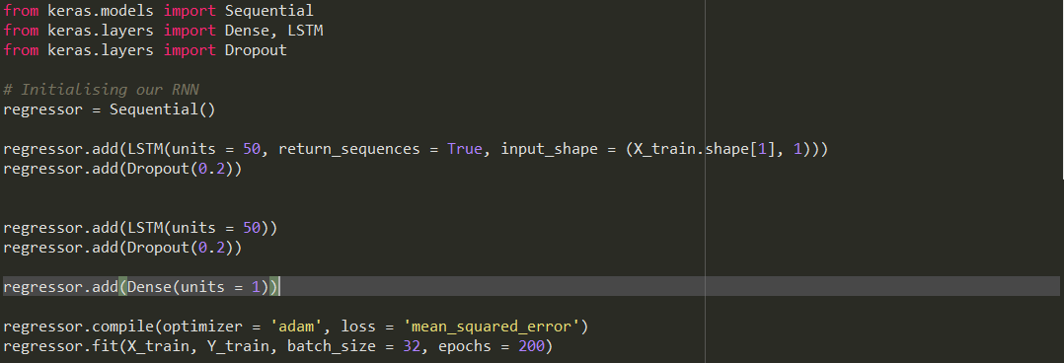
Implementation
Here is a basic implementation of LSTM using keras

Slide 10
Conclusion
In this work, we proposed forecasting stock market using LSTM, a sub-class of Recurrent Neural Network. In order to test the universality of the LSTM model.
We only test LSTM model in our thesis, other Recurrent Neural Network structures can also be applied to stock market prediction such as, Echo State Network, Neural Turing Machines and Continuous-time RNN.

Slide 11
THANK YOU !!!

