Slide 1

What’s your question?
Question word order, question intonation and question forms

Slide 2
Guess the other six most difficult questions
Where do babies come from?
Why is the sky blue?
Why can’t I stay up as late as you?
Is Santa real?
What does ‘green’ mean?
Do animals get married?
Why do we have to recycle?
What does [expletive] mean?
Based on: https://nypost.com/2020/04/22/kids-ask-the-darndest-things-the-toughest-questions-parents-hear-from-their-children/ (link obtained on 5th Nov 2021)

Slide 3
Do animals get married?
Where do babies come from?
Question word | Auxiliary verb | Subject | verb | …?
- | Do | animals
-
-
Where
Who
Why
What
When
How

Slide 4
Which intonation is correct?
Do you like chocolate?
Do you like chocolate?
Where do you come from?
Where do you come from?
For yes/no questions our voice goes UP / DOWN.
For wh- questions our voice goes UP / DOWN.

Slide 5
Rank the questions – from toughest to easiest.
Where do babies come from?
Why is the sky blue?
Why can’t I stay up as late as you?
Is Santa real?
What does ‘green’ mean?
Do animals get married?
Why do we have to recycle?
What does [expletive] mean?
2
7
8
1
5
4
3
6
Based on: https://nypost.com/2020/04/22/kids-ask-the-darndest-things-the-toughest-questions-parents-hear-from-their-children/ (link obtained on 5th Nov 2021)

Slide 6
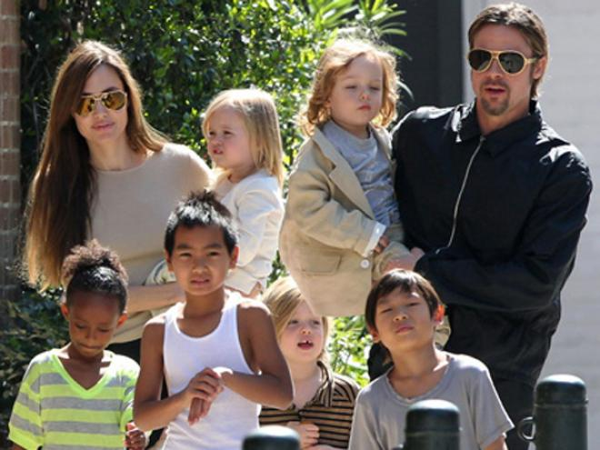
What is a rainbow family?
That’s a big family, isn’t it?
What or who inspired her to create such a family?
When did you hear about Angelina Jolie and her big family for the first time?
Isn’t it an example of a modern family?
Would you like to be a part of such a family?
Who knows any other real-life example of a rainbow family?
Could you tell me whether or not you want to have a rainbow family of your own?
Would you mind telling me when you would like to have children?
https://www.standardmedia.co.ke/entertainment/the-standard/2000130665/anjelina-jolie-and-brad-pitt-go-old-school-with-love-letters-to-keep-romance-alive (link obtained on 5th Nov 2021)

Slide 7
Match the questions with their question types
That’s a big family, isn’t it?
What or who inspired her to create such a family?
When did you hear about Angelina Jolie and her big family for the first time?
Isn’t it an example of a modern family?
Would you like to be a part of such a family?
Who knows any other real-life example of a rainbow family?
Could you tell me whether or not you want to have a rainbow family of your own?
Would you mind telling me when you would like to have children?
Hypothetical question
Direct question with a question word as the object
Indirect question with a question word
Direct question with a question word as the subject
Question tag
Either/or question
Indirect yes/no question
Negative question

Slide 8
Match the questions with their question types (answers)
That’s a big family, isn’t it?
What or who inspired her to create such a family?
When did you hear about Angelina Jolie and her big family for the first time?
Isn’t it an example of a modern family?
Would you like to be a part of such a family?
Who knows any other real-life example of a rainbow family?
Could you tell me whether or not you want to have a rainbow family of your own?
Would you mind telling me when you would like to have children?
Question tag
Either/or question
Direct question with a question word as the object (inversion!)
Negative question
Hypothetical question
Direct question with a question words as the subject (no inversion!)
Indirect yes/no question
Indirect question with a question word

Slide 9
Put the words in order
future / would / the / What / to / like / study / in / you / ?
tell / time / is / Could / what / you / me / what / it / ?
see / Aren’t / happy / me / you / to / ?
mind / Would / him / whether / not / you / like / telling / or / you / me / ?
it / the / exercise, / This / was / wasn’t / difficult / most / ?
What would you like to study in the future?
Could you tell me what time it is?
Aren’t you happy to see me?
Would you mind telling me whether or not you like him?
This wasn’t the most difficult exercise, was it?

