Slide 1
Context data
Event information
Mobile sensing
Mobile sensing
Social media
Level of density
Level of movement
Crowd activities
Motivating emotion
Ambulatory crowd
Limited movement crowd
Crowd of spectators
Participatory crowd
Crowd model
Expressive crowd
Aggressive crowd
Crowd of demonstrator
Escaping crowd
Expressive crowd
Expressive crowd
Expressive crowd
Crowd model
Crowd monitoring
Mapping method

Slide 2
Context data
Social media
Emotion analysis
Emotion Analysis
Emotional Bag-of-Words
Emotion model
Anger
Fear
Happiness
Sadness
Level of intensity
Rule repository
Mapping
Emotion - Crowd type Mapping Model
Ambulatory
Limited movement
Spectator
Rule-based reasoning
Expressive
Participatory
Aggressive
Rule-based reasoning
Crowd model
Demonstrator
Escaping
Dense
Rushing
Violent
Crowd types

Slide 3
Raw context data
High level context data
Output
Social media
Emotions
Crowd types
Emotion analysis
Crowd type classification

Slide 4
Anger
Anger
Fear
Happiness
Disgust
Happiness
Sadness
Surprise
Sadness
Fear

Slide 5
am
feeling
very
i
scared
I am feeling very scared. The crowd is too packed and aggressive
the
aggressive
crowd
is
and
too
packed

Slide 6


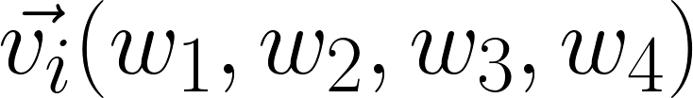

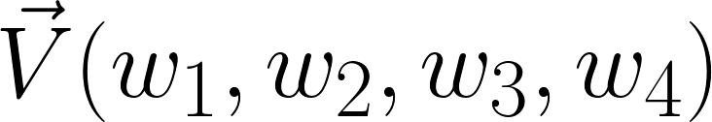

Collected dataset
Tweet
Fear
BOW
Tokenizer
Training set
Anger BOW
Association Scoring
Happiness
BOW
Sadness
BOW
Emotion in a tweet
Emotion Distribution in the crowd

Slide 7
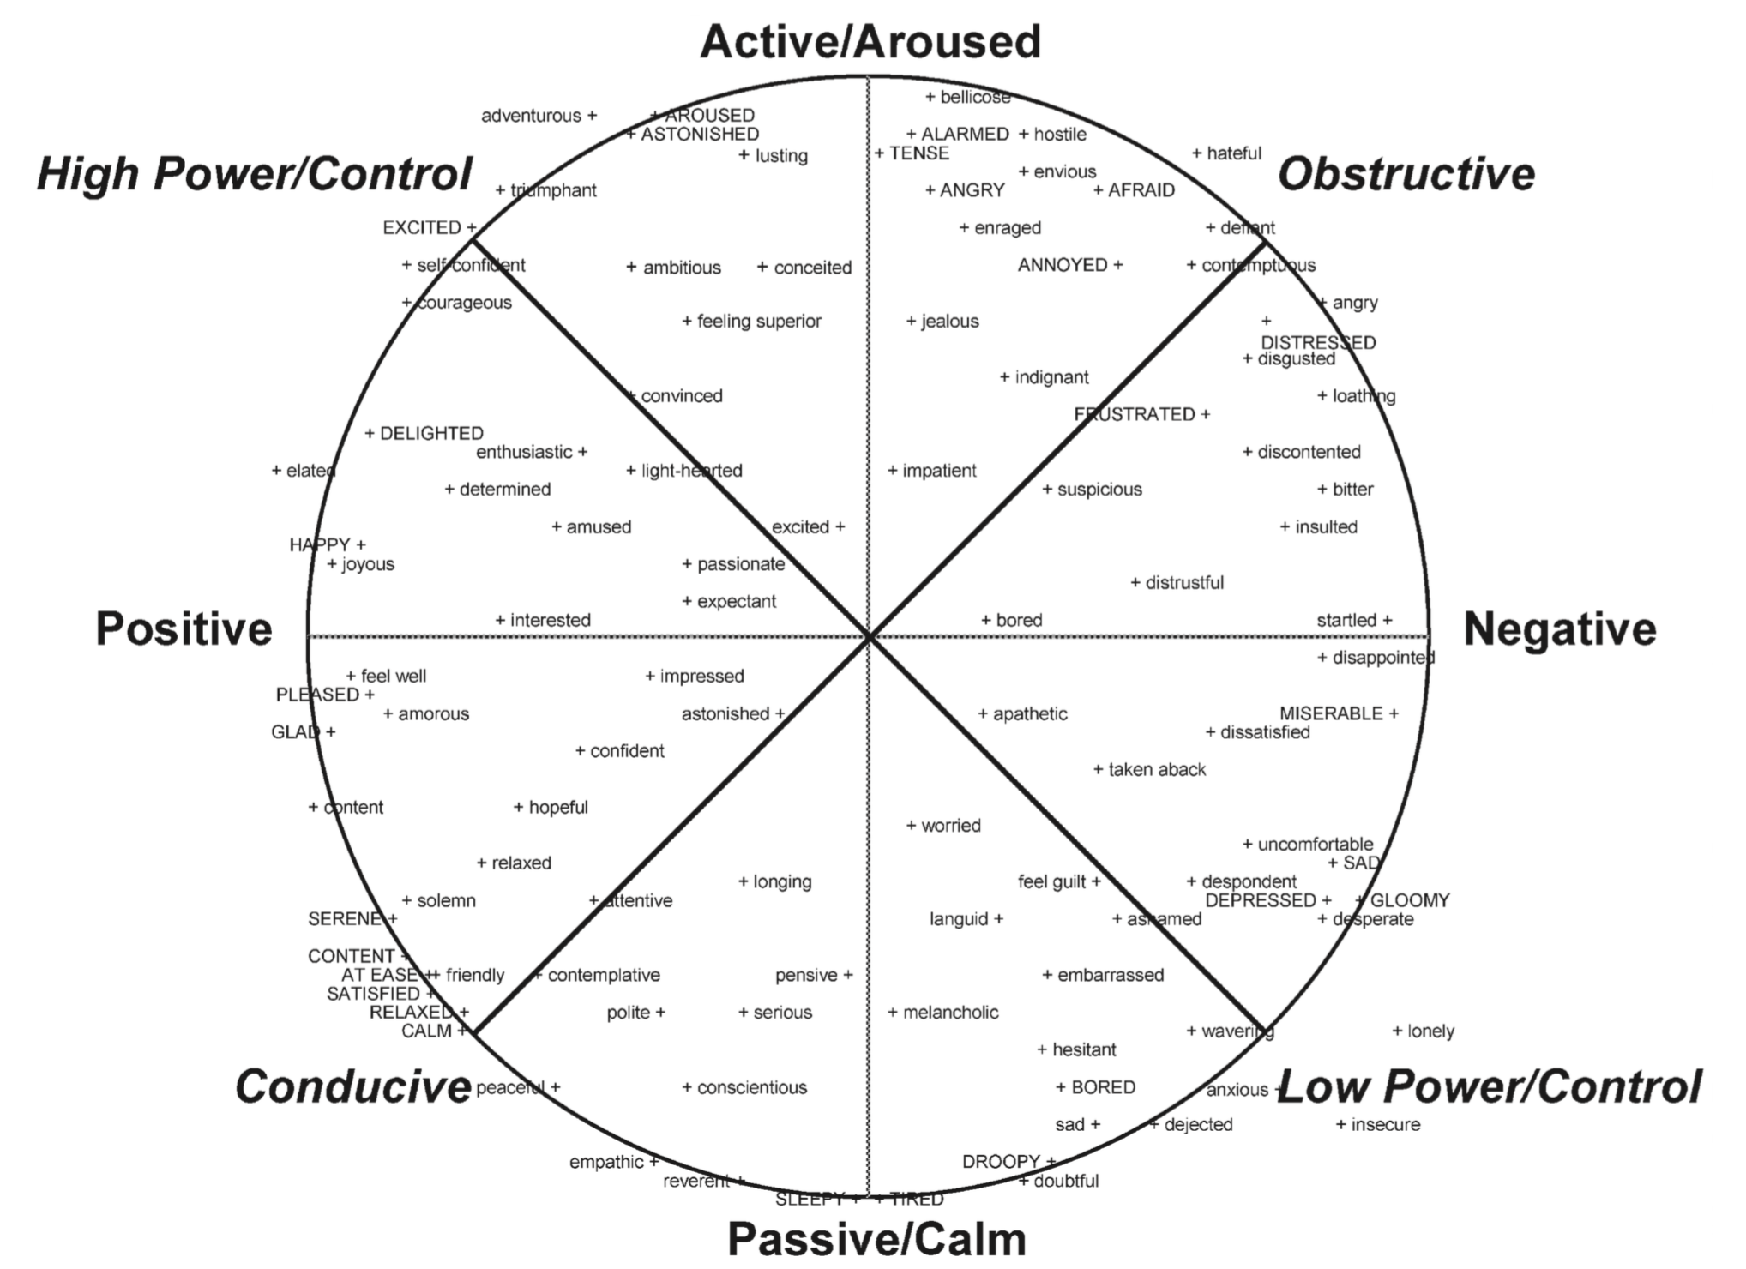

Slide 8
High
High
Threshold th
Low
Threshold t1
Medium
Threshold t2
Low

